Slide 1



Distributed Dynamic Diversity Databases for Life
1st Periodic Review 24 June 2010 Brussels
Work Package 3
Strengthening the GSD Partner Network; a Virtual Community
Thierry Bourgoin, MNHN, Paris

Slide 2



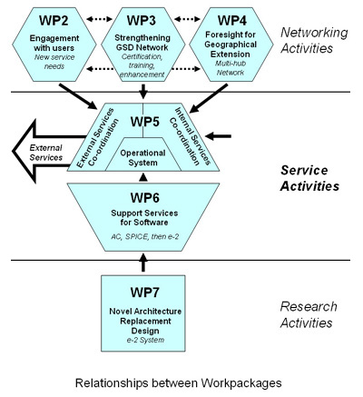

Slide 3
Strengthening the GSD Network:
A Virtual Community
OBJECTIVES:
To engage GSDs in a sustainable participation with Sp2000 CoL vision
To improve GSD compliance with CoL standards and BPs
To explore/agree on new extensions of GSD bio-data delivering
To explore/agree on new extensions for GSD internal services
To roll out service-based delivery to the new e-2 Architecture
GOALS:
Strengthening the GSD network
Legitimacy of GSDs and CoL
Facilitated CoL maintenance
Quality of CoL data and services
New CoL services to users
GSD bio-data interoperability
GSD completeness and data quality
Toward a new CoL

Slide 4
WP3 Description of work:
Task 3.1: Survey to assess, to peer review and to certificate each GSD
Task 3.2: Evaluate and report on standards, best practices, new fields, ...
Task 3.3: Consultation with each GSD choosing the pilot projects
Task 3.4: Two two-month Pilot projects per GSD database
Task 3.5: New e-2 system wrapper for few selected GSD databases

Slide 5
Task 3.1 - Survey to assess, to peer review and to certificate each GSD
Discussion with the custodians of the Global Species Databases (GSDs) started with a 1-day workshop at the Opening Project Meeting (Reading, 17 Sept. 2009) and continued in November with a survey of their databases to measure their compliance with the existing Species 2000 Data Standard (Sp2000 Standard Dataset, v3.2, as agreed Dec.2004, in the FP5 EuroCat Project).
In link with the EC programme PESI, a questionnaire was sent to assess 41 GSDs.
All but 6 have completed it.
A list of working wrappers of GSDs was set up with WP1.
Peer reviewing of new GSDs and repeat peer reviewing of original GSDs of the EuroCat project will continue throughout the 4D4Life project, but slightly delayed due to shortage of time.
Membership managed with WP1.
Results (deliverable 3.1) of all theses actions were presented and discussed at the second project meeting in Faro (16-18 Feb. 2010) and served as base of discussion for Task 3.2.
Notes:
Task 3.1 - A survey to assess, peer review and certificate each provider GSD, its wrapper & delivery, and its formal membership of the programme, including data capture for the improved metadatabase

Slide 6
Task 3.2 - Evaluate and report on standards, best practices, new fields, ...
GSD answers to the questionnaire have been tallied and amplified by statistics from the CoL 2009 Annual Checklists and 2010 beta version).
Further discussions occurred during a second dedicated 1-day workshop attached to the Second Project Meeting in Faro (16-18 Feb. 2010).
Proposal of changes to the best practices documents, data fields definition and new datafields was discussed.
A Wiki has been opened for receiving technical information from GSDs as well as continuing the discussion with custodians about extensions of the data fields and improvement of the Species 2000 Standard Dataset.
Proposal to add five additional fields to the standard data supplied to Sp2000 for CoL :
  Distribution (using TDWG standard and Ocean Areas system of WoRMS), Taxon LSIDs, Known habitat, Subgenus when appropriate, Name LSIDs.
- Rewriting of the Standard dataset document look necessary for better definition of fields, terminology and standards recommended to be used.
Notes:
Task 3.2 - Undertake prior consultation and prepare a Network Discussion Document, including proposals for i) Changes to the Data Standard for existing fields (if any), ii) Changes to the Best Practice Document (if any), iii) Possible extensions to the bio-data fields, including data supply requests (if any) from the Services Team, and iv) possible internal service supply issues (e.g. name-alerts, comments from users, taxa from regional hubs, cross- checks with other lists, and unassigned name batches).

Slide 7
Task 3.3 - Consultation with each GSD choosing the pilot projects
Following the assessment of each GSD, the consultations started at the second Project Meeting in Faro. All custodians were meet individually and in small groups to agree on planning the pilot projects. Priorities for these was completeness and data quality of the GSD data in compliance with regards to the CoL standards for: 1) synonymy, 2) distribution, 3) references, 4) common names and 5) latest taxonomic scrutiny.
A working wrapper was asked to all GSD in sus.
Not all of the custodians were able to attend, so several small meetings were organised in Reading (2nd june) and Paris (25th June).

Slide 8
Task 3.4 - Two two-month Pilot projects per GSD database
- Work with pilot projects should start on the 1st of July and reported at the third Project Meeting in Prague in March 2011
Task 3.5 - New e-2 system wrapper for few selected GSD databases
- Will start in September 2011

