Slide 1



Distributed Dynamic Diversity Databases for Life
Work Package 2
Engagement with scientific users and partners
Sara Oldfield, Botanical Gardens Conservation International

Slide 2



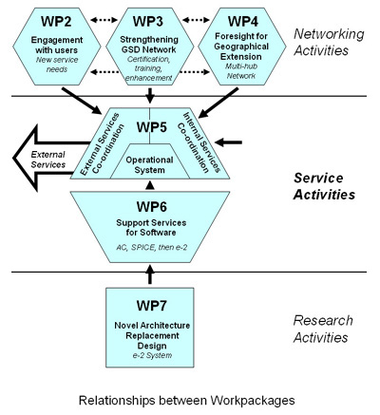

Slide 3
WP2 Objectives
To establish a communication and promotional program
Locate and characterise the main classes of external and internal users
To work with each class of user to specify a list of new or altered services
Work with the Services Team to select a subset of priority services
To work with the Services Team to test and launch the new services

Slide 4
WP2 Outcomes for Year 1
Three main areas of progress in WP2:
- Drawing up an outreach strategy
- User groups and user priority analysis
- Provisional list of new services

Slide 5
Catalogue of Life outreach strategy
Areas of outreach: A User Survey with 244 responses provided insight into users of CoL and differences between user groups
Definitions of CoL: Providing clear definitions for general communication and publicity material
CoL website: The website homepage is currently very deficient. Develop better introductory web pages
4D4Life website: regular news items, promotion of e-bulletin, featured events

Slide 6
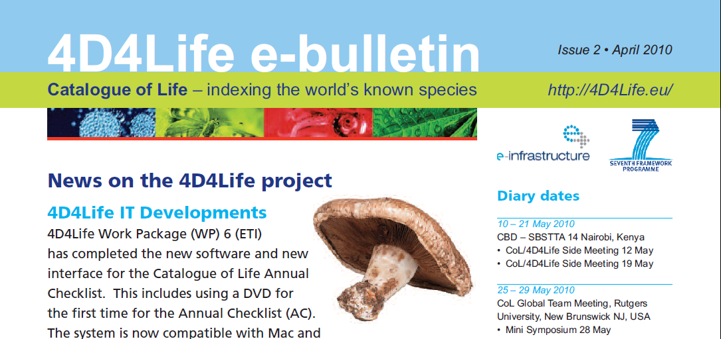
Outreach achievements
Dedicated website www.4D4Life.eu
Regular e-bulletin (Task 2.1) - Target 1000

Slide 7

Outreach achievements
New leaflet widely distributed, e.g. SBSTTA and 4th Global Botanic Gardens Congress

Slide 8
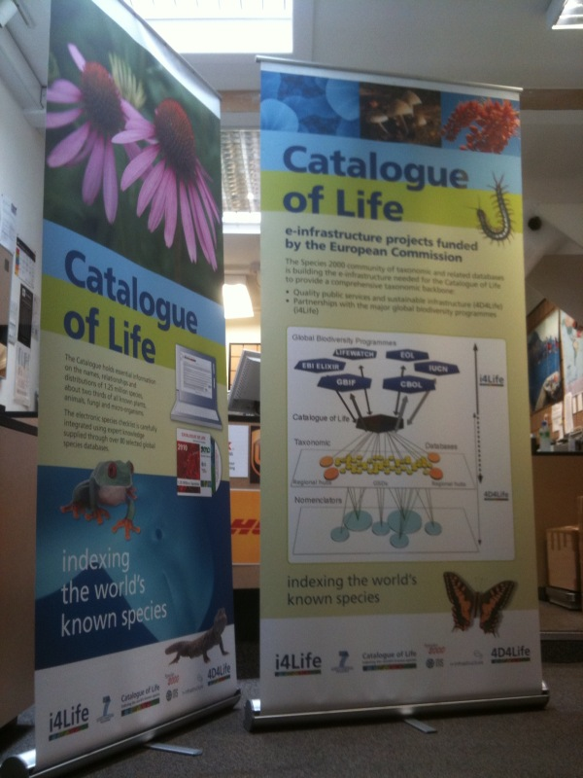
Portable display panels developed

Slide 9
Users and User Priorities Task 2.2
BGCI developed an online survey to identify user needs. There were 244 respondents
Majority of responses came from the USA and UK
Academic and government sectors were the two with the highest responses, the commercial sector was the lowest
Sectors were analysed by user classification
A follow up survey of 153 of original respondents was done

Slide 10
Interviews with biodiversity portals
Date | Institute
25 November 2009 | GBIF
30 November 2009 | IUCN/Birdlife International
30 November 2009 | Barcode of Life
1 December 2009 | National Centre for Biotechnology Information (NCBI)
2 December 2009 | WWF US
3 December 2009 | EOL
7 December 2009 | IUCN
29 March 2010 | UNEP WCMC

Slide 11
Interviews with commercial organisations
Date | Institute | Sector | Interviewees
16 March 2010 | Taylor & Francis Group | Publishing | John Buckingham
16 March 2010 | BHP Billiton | Extractive | Jamison Suter
17 March 2010 | AngloGold Ashanti | Extractive | Andrew Parsons
22 March 2010 | Thomson Reuters | Publishing | Nigel Robinson
23 March 2010 | The Garden Centre Group | Retail | Tim Clapp
25 March 2010 | Wiley | Publishing | David Nicolson
25 March 2010 | Neal’s Yard Remedies | Retail | Louise Green

Slide 12
User Classes
User class | Description
Biodiversity Analyst | Answer biodiversity questions, such as the total number of species found in a given country or region
Checker | Check name details, for example the correct spelling, its accepted name, synonyms and common names
Documenter | Use it as the standard taxonomic reference, for example in a statutory context such as when health regulators attempt to control the use of herbal remedies
Linker | Link user’s taxonomic classification or species checklist to the Catalogue for a more complete taxonomic representation
Researcher | Find additional information about a species, such as pictures, description, conservation status, and literature, from various sources
Standardiser and Integrator | Incorporate the entire catalogue or sections of it, such as family or genus, into user’s own information system
Taxonomist | View a single, peer-reviewed taxonomic hierarchy in relation to alternative classifications and treatments with the latest taxonomic opinion

Slide 13
Potential new services Task 2.3
A total of 126 new services were identified
They were classified into 7 groups of services;
1. Enhanced user interface 5. Improved internal services
2. Enhanced CoL functionality 6. Publicity and promotion
3. Expanded CoL content 7. Miscellaneous
4. Improved external linkages
Taking into account all the information; the top three services identified by each user class were recorded

Slide 14
Engagement with the Services
Team Task 2.3
A triage meeting held in March 2010 at the University of Reading with all work package leaders
A refined list of potential new services was produced
The Services team will now work with the Design team to begin implementing these new services
BGCI will be holding further 1 to 1 interviews to identify further potential needs of the commercial sector

Slide 15
Ongoing work in Year 2
Assist in testing and public launches of two batches of new services (Task 2.5)
Produce a final outreach strategy document
Implement the priorities outlined in the outreach strategy for publicity and communication working with the Secretariat at the University of Reading

