Slide 2
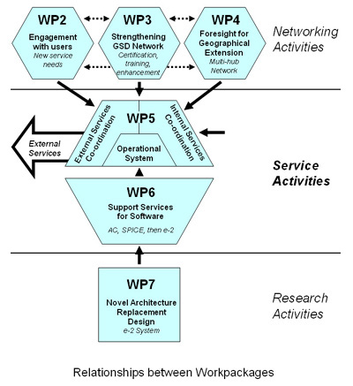
Role and guiding principles
Role: To coordinate design, development and deployment
between work packages and (with ST) to triage new
service proposals
Without interrupting established cycle of checklist production, change the way we do things - to increase reliability of service and improve efficiency of process
Design for sustainability of a reliable “production-quality” service, reliable software and GSD interfaces
Cleanly separate operation of public service from software maintenance from development of new architecture

Slide 3
What have we determined / steered?
Development infrastructure
Base Schema
  Common understanding of how information is stored in various data structures necessary to deliver the Catalogue
Unification of workflows for compiling AC and DC
  Consideration and planning
Improvements to current software, including:
  Hardening of core SPICE software
  Improvement of Management and User interfaces
  Wrapper Development Kit and documentation
Design proposals for Quality Assurance Workbench (QAW)
Agreement on requirements the new ‘e2’ architecture has to support

Slide 4
What’s next?
Completion of the services triage process in consultation with ST
Finalising process description for unification of workflows
Multi-hub network design
Sub-system design and technology decisions for the e-2 architecture

