Slide 1



Distributed Dynamic Diversity Databases for Life
1st Periodic Review 24 June 2010 Brussels
Work Package 7
New Service-based Architecture
Richard White, Andrew Jones, Alex Hardisty, Jonathan Giddy,
Cardiff University School of Computer Science and Informatics

Slide 2
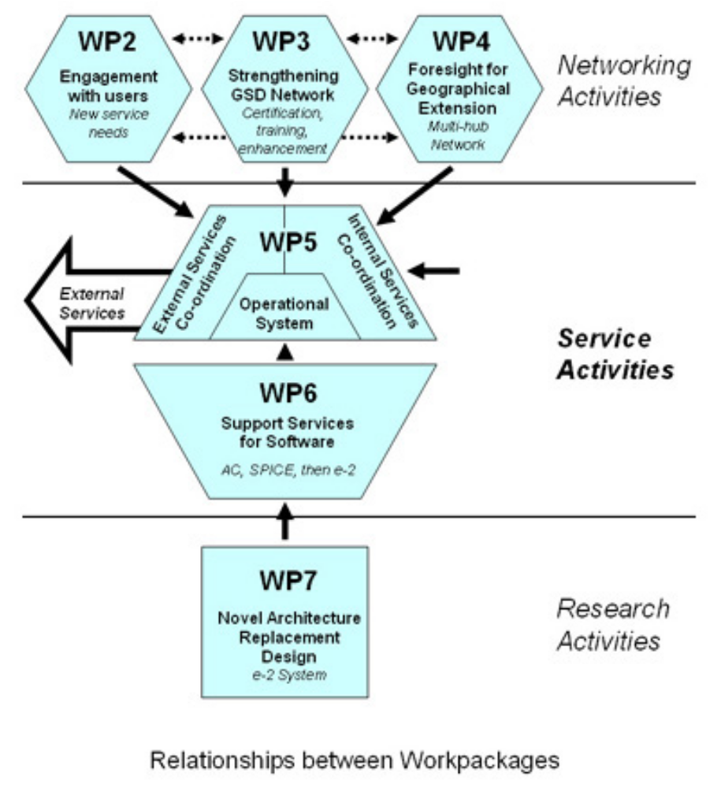

Slide 3
Objective
To build a state-of-the-art “e-infrastructure” for the Catalogue of Life, which will
form the basis for a sustainable Catalogue of Life
be ready to replace the current system, as maintained and improved in WP6, at the end of the 4D4Life project

Slide 4
WP7 task activity during year 1
7.1: Requirements gathering and specification
7.2: System architecture design
7.3: Data formats and protocols
7.4: Proof of concept demo
7.5: Test implementation
7.6: Enhanced prototype
7.7: Monitoring and assisting deployment

Slide 5
Task 7.1: Requirements gathering and specification
Requirements gathered from other WPs and Catalogue of Life partners
Continuing activities:
  Monitor current developments in TDWG , GBIF, etc.
  Keep requirements under review during prototyping

Slide 6
Task 7.2: System architecture design
e-2 Design principles
e-2 Subsystems
  Harvesting
  Assembly
  Publishing
  Users, linking, control, etc.
Subsystem component interfaces
Deliverable 7.1A & B (months 12 & 18)

Slide 7
e-2 Design principles
Service-oriented architecture
  Re-usable, compatible, distributed components
Open platform approach
  Retain control of core components
  Publish interfaces for development of value-added services
Standards
  Compliant with community standards (W3C, TDWG, GBIF, etc.)
  Facilitate new initiatives in semantic interoperability, content negotiation, Linked Data, etc.
Business logic technology
  Providing a unified and integrated platform for rules, workflow and event processing

Slide 8
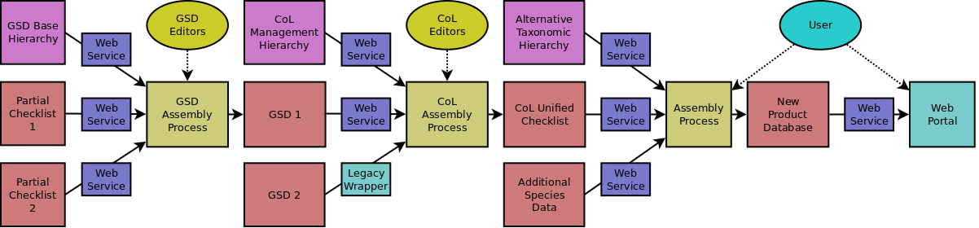
Re-usable components
The same subsystems and components can be used
  for CoL assembly
  by data providers to assemble their data
  by users of CoL data and other data

Slide 9
e-2 Subsystems
Harvesting – collects data from GSDs and other sources
Assembly – supports process of assembling Catalogue content from multiple sources
Publishing – publishes content via multiple routes e.g., dynamically via Web, annual snapshots
User – services and interfaces to end users of content
Annotation - user annotation of content and feedback
Linking – to regional hubs and other partners
Control – system control and management

Slide 10
Task 7.3: Data formats and protocols
Subsystems and components require interfaces
  for data flow and for event messages (including alerts, status and control information)
  Some private to ensure CoL system integrity and some public for community development
Options for data harvesting and publishing
  Independent of the chosen architecture
  Data content, format, protocols
  Services for data transfer, retrieval and querying, linking, synchronisation, etc.
For system configuration and execution:
  Business logic rules, events and workflows

Slide 11
Task 7.4: Proof-of-concept demo
To demonstrate the feasibility of the proposed new e-2 architecture
  may be subject to experimentation and revision
HDM (Hierarchical Data Manager) component
  Functionality currently not available
  Experiment with development technologies
  Key component of proof-of-concept

Slide 12
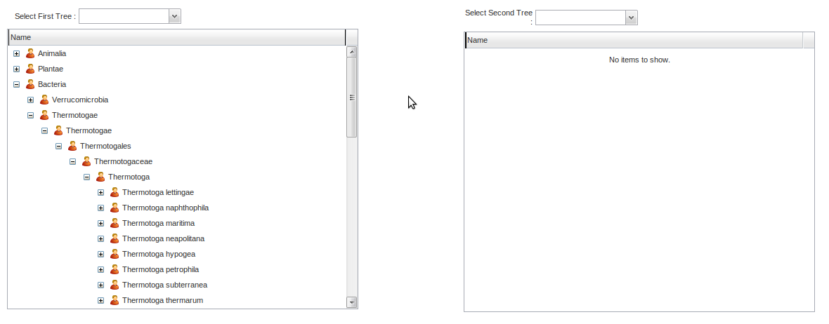
HDM (Hierarchical Data Manager)
Web-based application using Google Web Toolkit (GWT)
Rich set of tree manipulation functions
Respond to and generate events
Twin views permit attachment of one sub-tree to another

Slide 13
Significant results
Comprehensive requirements analysis for the CoL programme including all existing and planned activities
Preliminary specification for e-2 design
  presented to CoL at Liaison meeting 26-27 May 2010
  awaiting endorsement by Design Team meeting 19 July 2010

Slide 14
Delayed appointments
WP7 employees did not start work until January and February 2010, due to
  late signing of the 4D4Life contract
  lengthy Cardiff University appointment process
We have adjusted the timing of our remaining tasks in order to get back on track during year 2

Slide 15
Delayed activities
Effects on tasks:
  7.2, 7.3 and 7.4: delayed start, now under way
  7.4, 7.5 and 7.6: will partially overlap to make up lost time
  7.6 and 7.7: more effort will be available to support the transfer of the new infrastructure to WP6 for deployment
Effects on deliverables:
  D7.1 to be submitted in two parts
    D7.1A submitted on time, 30 April 2010
    D7.1B to be submitted by 31 August 2010
  D7.2 (proof of concept) delayed to month 18

Slide 16
Work during year 2
7.1: Requirements gathering and specification [maintenance to respond to feedback and clearer WP4 requirements]
7.2: System architecture design [lower levels with more detail]
7.3: Data formats and protocols [initial selection of harvesting mechanisms]
7.4: Proof of concept demo [continue to implement]
7.5: Test implementation [to start in month 15, August 2010]
7.6: Enhanced prototype [to start in month 18, November 2010]
7.7: Monitoring and assisting deployment [to start in month 22, March 2011]

Slide 17
Task 7.5: Test implementation
Developed from the proof-of-concept demonstration system into a Prototype System
Incorporate some working components
Carry out some of the functions expected by users
Tested by users

Slide 18
Task 7.6: Enhanced prototype
More components and functionality
Transfer to WP6 (ETI) [Milestone 7.1 in month 22]
Enhancement by ETI in collaboration with WP7 (Task 7.7) during year 3
  a new Production System to replace the improved current system
  the basis for a sustainable Catalogue of Life

