Slide 1




Other roles for Regional Hubs – as Regional Centres
Data collecting
Networking
Fund rising
Data dissemination
Publicity & Education
4D4Life Opening Meeting, 15-17 September 2009, Reading, UK

Slide 2
Other roles for Regional Hubs – as Regional Centres
B. Networking
Regional meetings
Regional newsletters
4D4Life Opening Meeting, 15-17 September 2009, Reading, UK

Slide 3
Other roles for Regional Hubs – as Regional Centres
C. Fund rising
National funds
International support of cooperation
4D4Life Opening Meeting, 15-17 September 2009, Reading, UK

Slide 4
Other roles for Regional Hubs – as Regional Centres
D. Data dissemination
Website in national language(s)
CoL website and products mirror
AC & DC interfaces in national language(s)
CD production in site and its distribution
Inquiry service
[National Taxonomic Service]
4D4Life Opening Meeting, 15-17 September 2009, Reading, UK

Slide 5
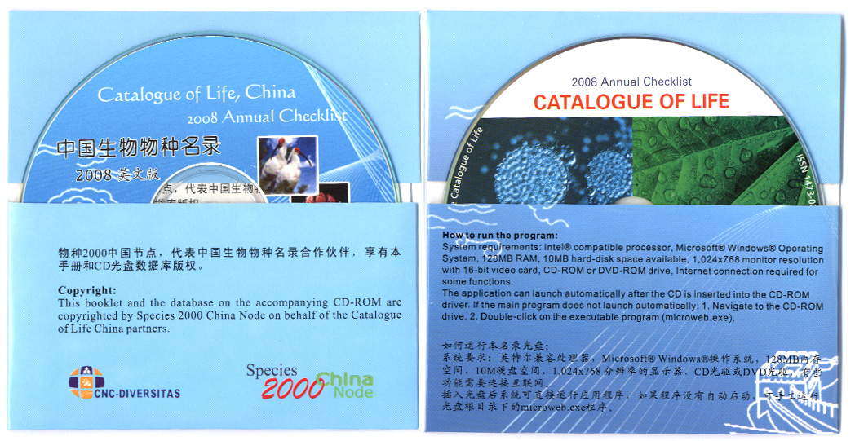
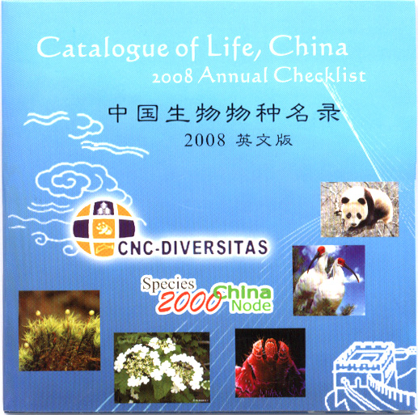
4D4Life Opening Meeting, 15-17 September 2009, Reading, UK

Slide 6
Other roles for Regional Hubs – as Regional Centres
E. Publicity & Education
PR campaigns in mass media
Publications (checklists and papers)
Presentations and lectures
Scholarships
4D4Life Opening Meeting, 15-17 September 2009, Reading, UK

