Slide 1
China Hub
Liqiang Ji
Chinese Academy of Sciences

Slide 2
Species diversity in China
Number of species be described: animal and plant
Taxon name | Number of species
Vertebrate | 6300
Invertebrate | 25000-30000
Insect | 60000-70000
Seed plant | 30000
bryophyte | 2600
Fern | 2300
Lichen | 2000
Algae in fresh water | 9000

Slide 3
Species 2000 China Node
The Species 2000 China Node is the China regional hub of the 4D4Life project.
It follows the standard system of the Standard Dataset of the Species 2000, and compiles the Catalogue of Life China for all users in the world.

Slide 4
Species 2000 Standard Dataset
Accepted Scientific Name linked to References
Synonym(s) linked to Reference(s)
Common Name(s) linked to Reference(s)
Latest taxonomic scrutiny
Source Database
Family name
Classification above family, and highest taxon
Distribution by province
Reference(s)
Additional data
Expert information(name, institution, post address, email)

Slide 5
Goal of China Hub
To provide a validated checklist of all species distributed in China to all users in the world
To provide webservice about the checklist to 4D4Life regional hubs and selected users/applications

Slide 6
Data sharing for dynamic list
A data sharing system based on the Internet will be established for dynamic information service in Species 2000 China Node.
The data sharing system consists of a gateway website, local database and 3 distributed databases located in the Institute of Zoology, Institute of Botany and Institute of Microbiology, respectively.

Slide 7
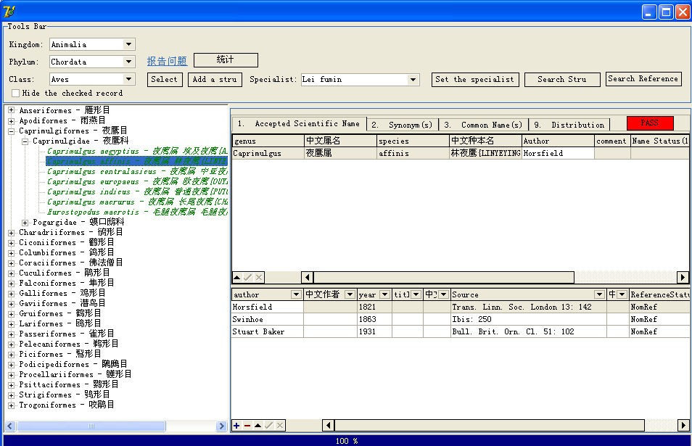
Software for data collect and check

Slide 8
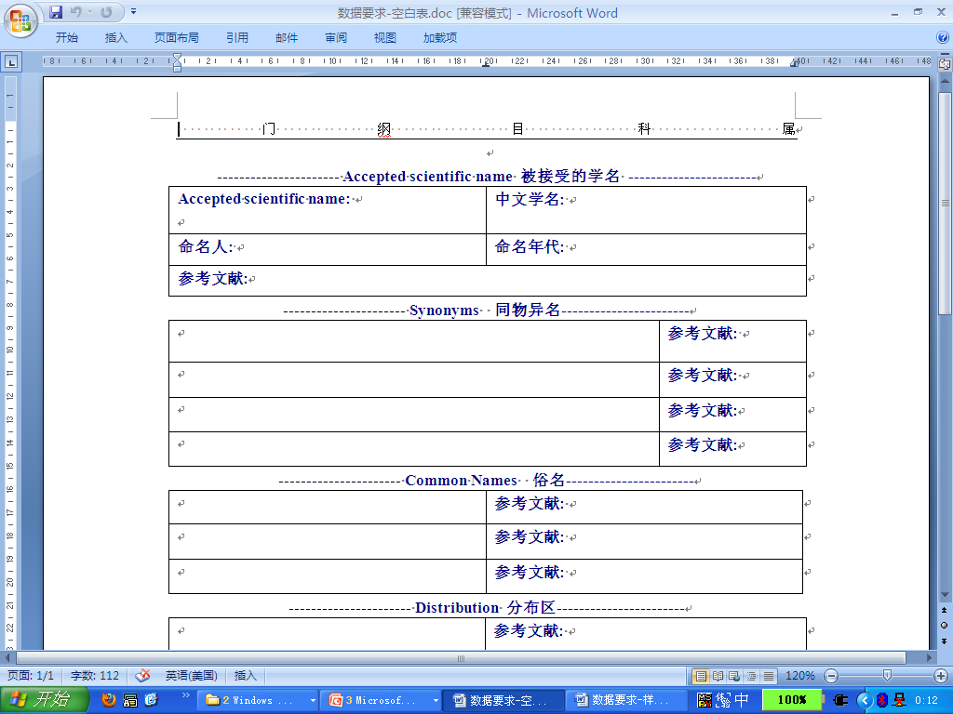
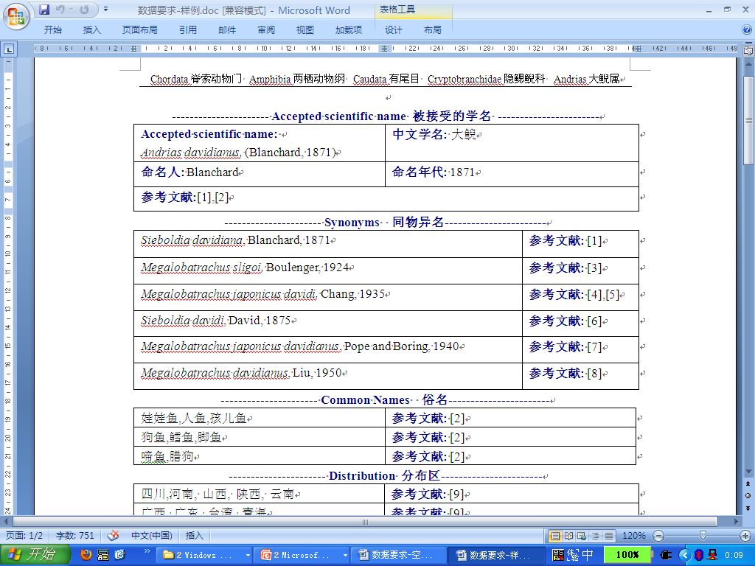
Collect data with a word file

Slide 9
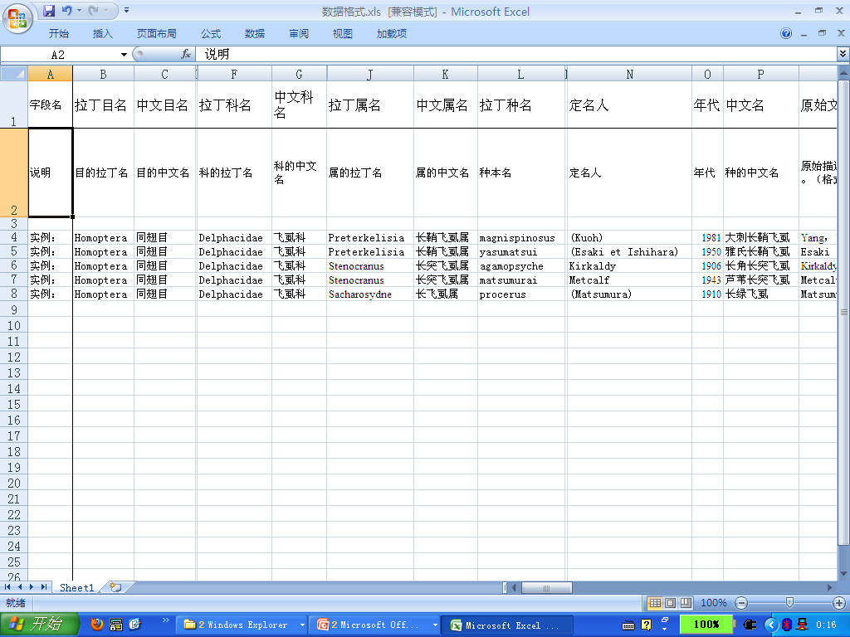
Collect data with an excel file

Slide 10

2009版年度动物名录数据统计
2009 Animal checklist of China
 | class | order | family | genus | Sp. | Sub. Sp. | Syn. | Com.
Fish | 2 | 44 | 296 | 1188 | 3233 | 18 | 4836 | 4640
Amphibian | 1 | 3 | 12 | 57 | 347 | 0 | 1753 | 115
reptile | 1 | 3 | 25 | 125 | 403 | 19 | 1734 | 117
Bird | 1 | 21 | 83 | 401 | 1269 | 0 | 2374 | 3385
Mammal | 1 | 14 | 53 | 236 | 564 | 3 | 689 | 1471
Insect | 1 | 1 | 1 | 129 | 405 | 0 | 80 | 0
Spider | 1 | 1 | 66 | 618 | 3300 | 0 | 3425 | 1981
Subtotal | 8 | 87 | 536 | 2754 | 9521 | 40 | 14891 | 11709

Slide 11
2009版年度动物名录数据统计
2009 Plant checklist of China
 | Class | Order | Family | Genus | Sp. | Sub. Sp. | Syn. | Com.
Seed plant | 8 | 75 | 256 | 3200 | 30061 | 4865 | 54443 | 19485
bryophyte | 4 | 21 | 116 | 520 | 2653 | 178 | 3958 | 88
Fern | 6 | 11 | 63 | 221 | 2270 | 166 | 6491 | 390
Subtotal | 18 | 107 | 435 | 3941 | 34984 | 5209 | 64892 | 19963

Slide 12
What can we do with CoL China?
Know species number of each taxa in China
Find scientific name from Chinese common name
Know distribution area of each species in China
Find taxonomist studying a taxa in China

Slide 13
Taxa we are working on
Taxa we are working on:
Class Insecta: Family Geometridae, Superfamily Empidoidea, Superfamily Staphylinoidea, Order Hemiptera, Superfamily Aphidoidea, Superfamily Chalcidoidea
Kingdom Animalia: Phylum Cnidaria, Phylum Ctenophora, Class Myxosporea, Class Trematoda, Class Polychaeta, Phylum Bryozoa, Order Acariformes
Kingdom Protozoa: Phylum Ciliophora, Phylum Radiozoa, Class Foraminifera
Kingdom Chromista: Phylum Bacillariophyta, Phylum Chrysophyta, Phylum Haptophyta, Phylum Phaeophyta
Taxonomists: more than 100 taxonomists involved CoL China project from 2008.

Slide 14
Need (1)
Collect species data from literature more efficiently – recognize the Latin name from an image file
Check species data more efficiently
Harvest data from source databases to form the CoL China
Compare species checklists from different sources rapidly
Compare species concept from different sources rapidly

Slide 15
Need (2)
Get the check list of a taxa from other regional hub dynamicly
Get the full data set of a species from other regional hub
Find if a Latin name appears in other regional hub as accepted name or synonym

Slide 16
Service provided by China Hub
Besides the website and CD of CoL China, the China Hub will provide the webservices as follow:
Webservice for a full data set of a species
Webservice for taxa names belonged to an taxon
Webservice for the taxon name that a taxon belong to
Download the checklist of a family (scientific names)

