Slide 1

http://www.nzor.org.nz
Jerry Cooper
Project Leader

Slide 2
What is NZOR?
“A national information infrastructure project to efficiently mobilise, integrate, and share authoritative taxonomic information critical to maintaining New Zealand’s Conservation and Biosecurity decision support systems and processes”...

Slide 3
The Vision for NZOR
A digital catalogue of taxonomic data associated with around 100,000 organisms relevant to New Zealand, and made available on the web:
  with content dynamically and automatically derived from registered, authoritative data providers within New Zealand and globally (and attributed appropriately)
  with taxonomic opinion on the preferred scientific name and synonyms according to a cited taxonomic authority
  with an accepted taxonomic hierarchy indicating the placement of a species in the ‘tree of life’
  with alternate vernacular and Maori species names where they are available
  with a statement on the presence or absence of the organism within a geographical region (New Zealand) according to cited evidence.

Slide 4
The Vision for NZOR
NZOR will provide:
  web interfaces to NZOR data content.
  web-services to allow end-users to dynamically integrate NZOR content into local databases (to free them from the burden of maintaining the integrity of these data locally)
  web-services to facilitate the checking of species lists for errors and inconsistencies
  secure feedback facilities allowing registered end users to direct queries to individual data providers
  Globally Unique Identifiers (GUIDs) to serve as permanent, unambiguous and resolvable links to NZOR data content

Slide 5
Key NZOR Players in Year 1
TFBIS
funding Year 1, with possibility of 2 & 3 depending on year 1 outcomes
Landcare Research
the nominated contractor developing NZOR in Year 1
Landcare Research, NIWA & Te Papa
the nominated consortium of data providers during Year 1
BNZ + another
the nominated end user partners during Year 1
NZOR Governance Structure
Executive Secretary, Steering Group, Advisory Group, Technical Groups
Representing: NIWA, Te Papa, DOC, BNZ, MFish, ERMA and MORST

Slide 6
Key NZOR Deliverables in Year 1
Establish Governance Structure
User needs analysis
Data provision and data use agreements
Initial cache of NZOR data from nominated providers
Demonstrate utility with nominated end users
Develop technical infrastructure
Convince TFBIS Committee to carry on funding us!

Slide 7
NZOR Limits & Expectations
Is about mobilising existing public data in compatible systems
Does not have funding to digitise or develop new data content
Does not have a mandate to impose NZOR on data providers or consumers
Will expose gaps:
1) where data exists but needs digitising
2) where data content does not exist and needs developing
Inform prioritization of developing NZOR content, for consumers, providers and funders

Slide 8
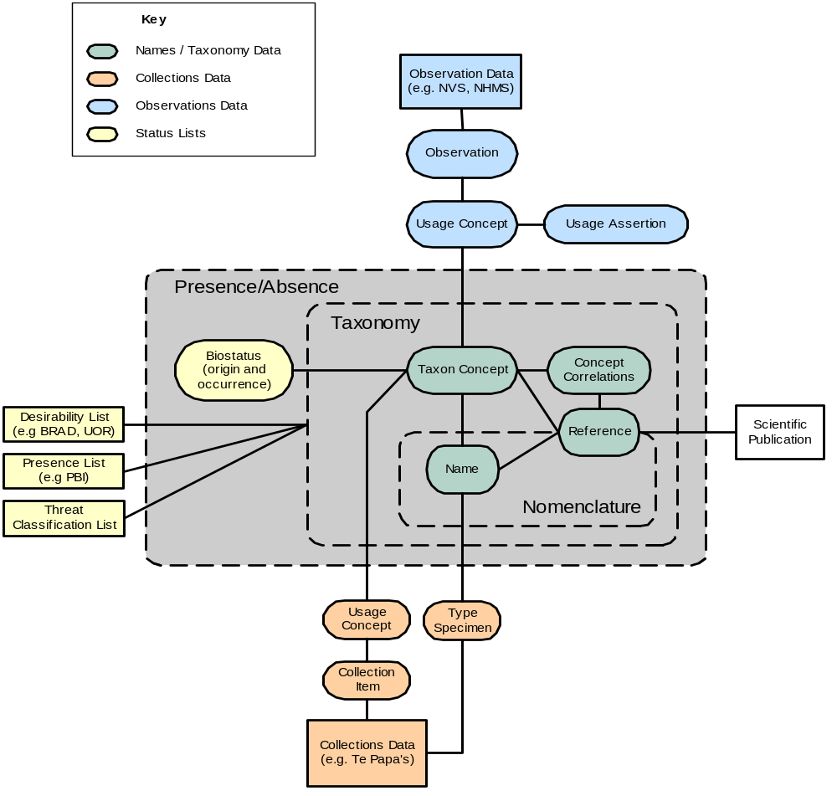
Boundary of NZOR

Slide 9
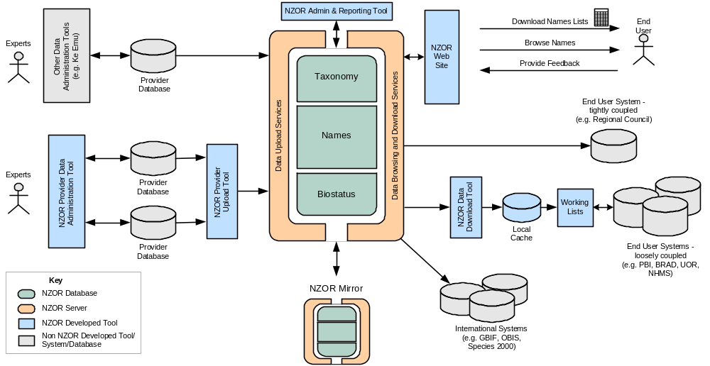
NZOR – System Overview

Slide 10
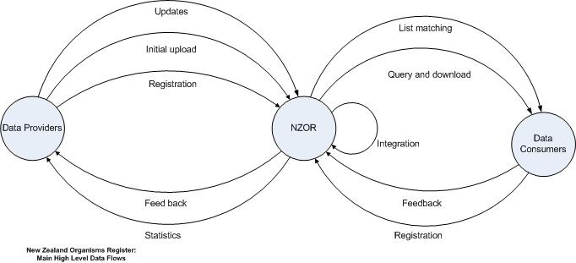
NZOR Data Flow

Slide 11
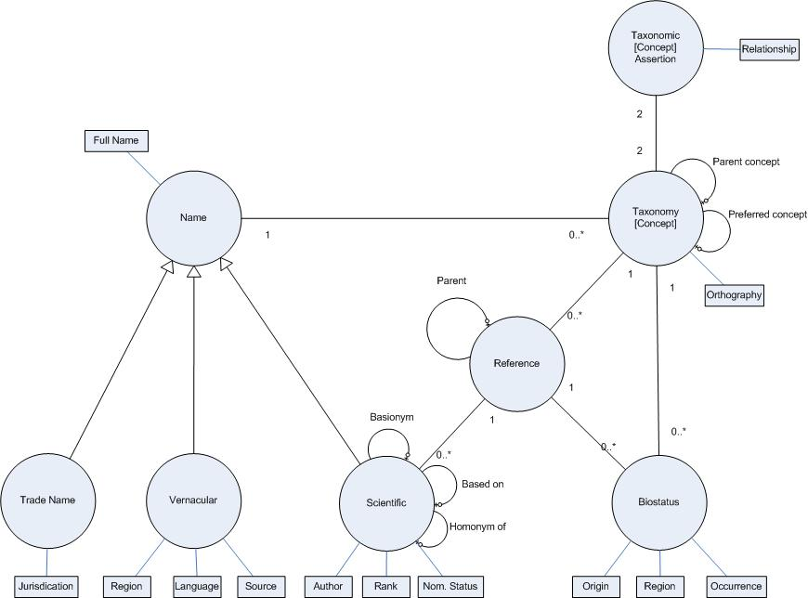
NZOR Conceptual Model

Slide 12
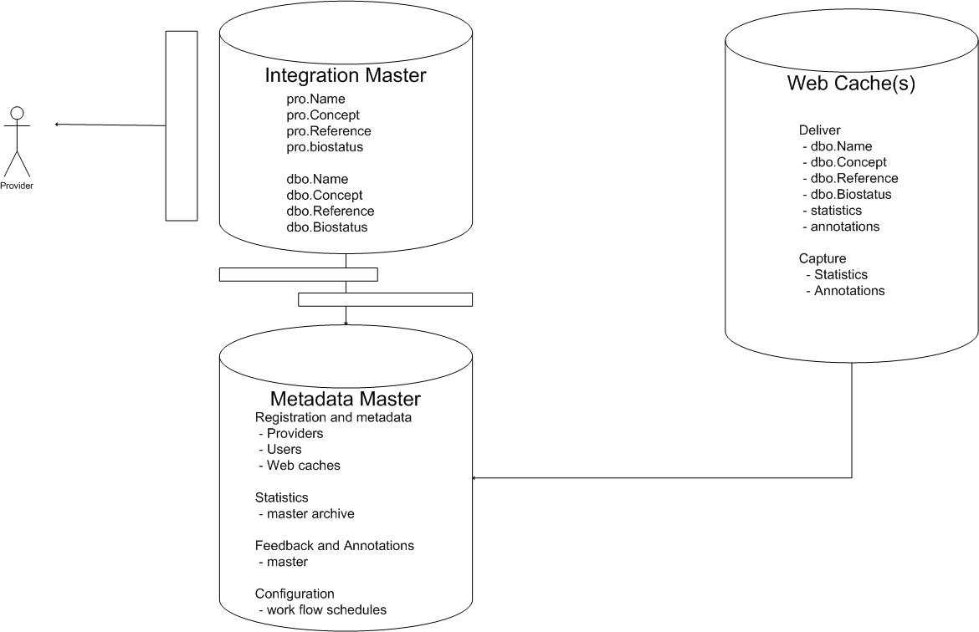
NZOR Cache Model

Slide 13
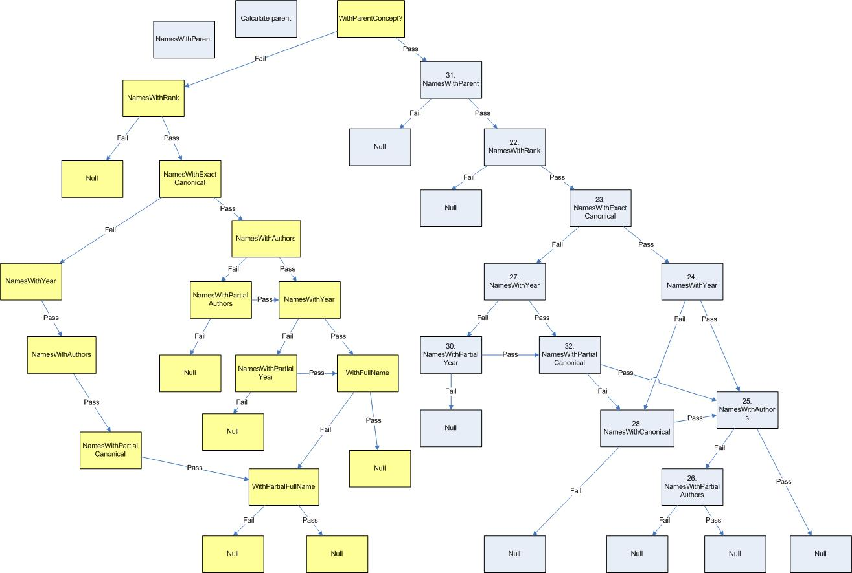
Compositae Checklist Name/Concept Integration

