Slide 1
Work In Progress
Live outage map · Chișinău
Know before the
tap runs dry.
1 in 3
We offer a live outage map for people in Chișinău who find out about water, power and gas cuts too late, and we solve it by combining every provider's official announcements with reports confirmed by neighbours.
people find out about an outage only when they are already hit by it.
13% learn from official announcements
CHALLENGE
Open Challenge · DeepTech GigaHack 2026
TEAM
Work In Progress · [Name 1], [Name 2], [Name 3], [Name 4], [Name 5]
Official
Confirmed
Partial
Notes:
TITLE + HOOK · 0:15. This slide stays up while you say the hook. Don't open with "Hello, we are Work In Progress".
Hook: "We asked people in Chișinău how they find out about water, power and gas cuts. One in three said: only when I run into the problem."
1 in 3 and 13%: our survey of Chișinău residents.

Slide 2
THE PROBLEM
WHO WANTS IT
The information exists.
It doesn't reach people.
720K
people in Chișinău
WHO HAS THIS PROBLEM?
Every household in Chișinău hit by a water, power or gas cut, especially families with small children, older people and anyone working from home.
91%
want every outage in one place
WHAT HAPPENS TODAY?
Cuts are announced on 4 separate provider websites, as tables of street names. Nobody checks them, so people rely on Facebook groups, or find out when the tap runs dry.
83%
would use it
WHY DOES IT MATTER TO THE CITY?
People can't prepare, hotlines get flooded, and nobody gets an early signal about breakdowns that were never announced.
720K: 2024 census · 91% and 83%: our survey
Work In Progress · Chișinău 02
Notes:
PROBLEM · 0:45
"Official announcements do exist, on four separate websites: Apă-Canal, Premier Energy, Energocom and Chișinău-Gaz. They're tables of street names, and nothing tells you whether your address is affected. Only 13% of people get their information from them. So one in three find out when the tap runs dry."
Circles: "There are 720,000 people in Chișinău. 91% of the people we asked want every outage in one place, and 83% would use it." (720K = 2024 census, statistica.gov.md; 91% and 83% = our survey.)
If you have one real person's story (e.g. a teammate's family), tell it here in one sentence: who, which cut, what it cost them.

Slide 3
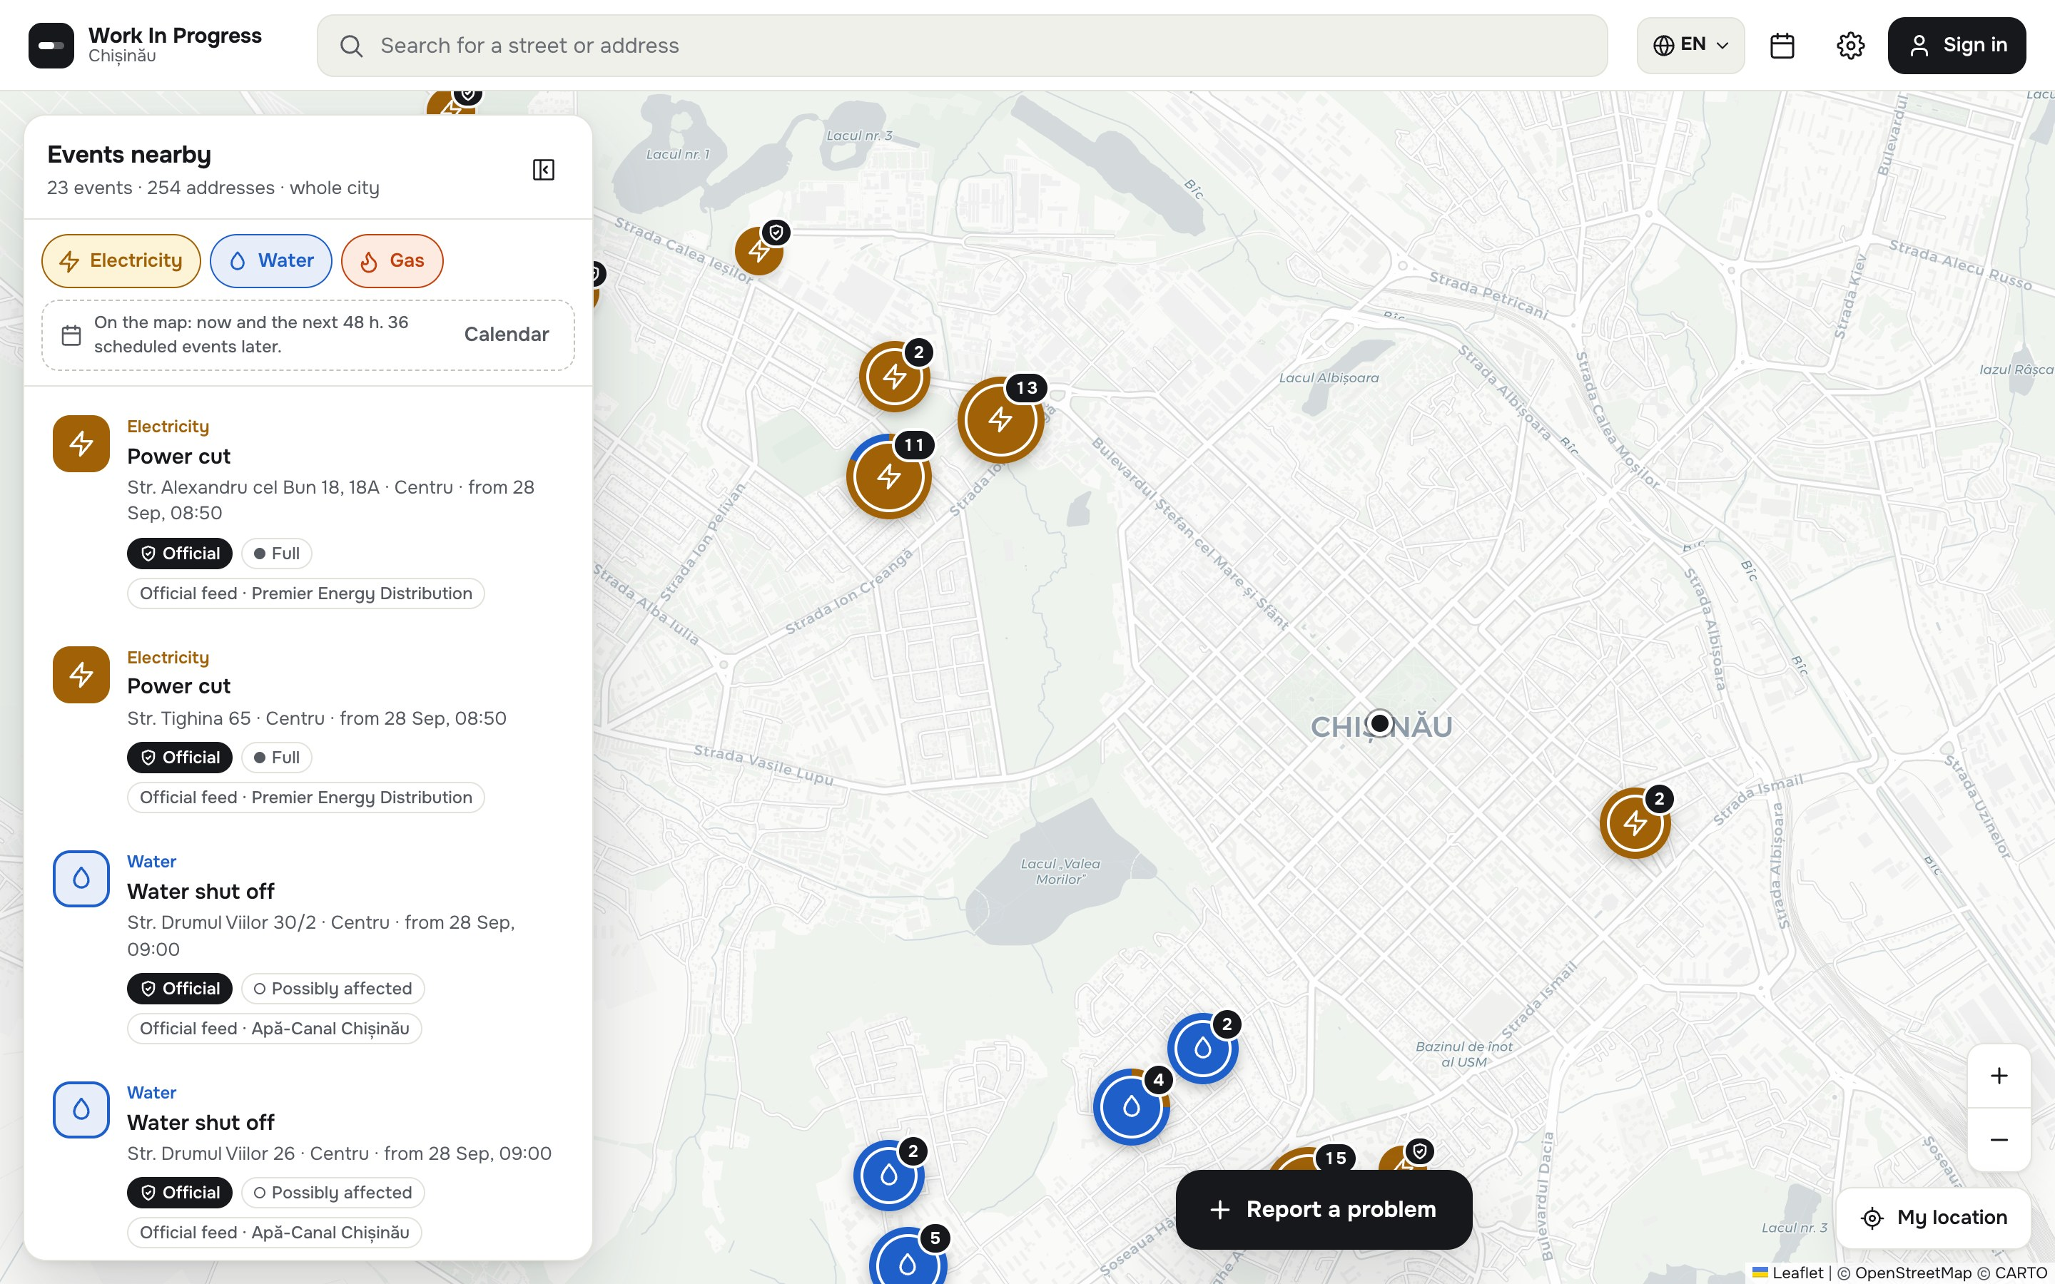
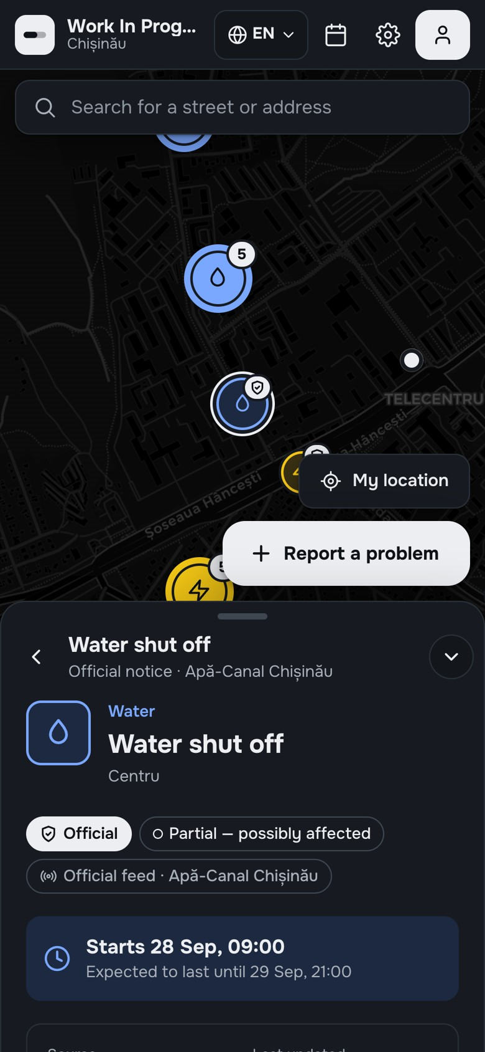
OUR SOLUTION
One live map.
Real data.
Every water, power and gas outage in Chișinău on one map: official announcements imported automatically, plus problems confirmed by neighbours.
1
Every official outage, on one map
4 providers imported every hour, placed on the real streets
2
Am I affected, and when?
Saved addresses (home, work, family) and a calendar of planned cuts
23
254
56
4
3
Neighbours confirm what's happening
Report on the web or in Telegram; 3 × "Me too" nearby makes it Confirmed
events on the map now
affected addresses
planned cuts ahead
official feeds
Live snapshot, 26 Sep 2026
Work In Progress · Chișinău 03
Notes:
SOLUTION · ~20 s of the 2:00, then go straight to the demo.
"We built one live map of every water, power and gas outage in Chișinău. Official announcements come in automatically from four providers, every hour. You see whether your saved addresses are affected and what's planned for the coming days. And neighbours confirm problems that nobody announced."
Bridge to the demo: "Social media is fast but unverified. Official sources are verified but nobody sees them. We combine the two. It's live, with real data."
Update the four numbers on the morning of the pitch.

Slide 4
DEMO
One user, one flow, start to finish
Ana checks her street
1
Opens the map
it starts on her location, with every outage nearby
2
Taps the water cut on her street
source, official start and end, addresses
3
Checks her saved addresses
is home, or her parents' flat, affected?
4
Opens the calendar
what's planned for the coming days
5
A neighbour taps "Me too"
3 answers nearby → Confirmed, live for everyone
Backup: the demo video shows the same flow. Insert → Video over this screenshot.
Work In Progress · Chișinău 04
Notes:
DEMO · ~1:40, the biggest part of the pitch. Switch to the live app (log in beforehand; skip login screens and menus). Zoom in so the back row can read it.
1 "Ana opens the app. The map starts on her location: these are the real outages in Chișinău right now. Blue is water, yellow is power, orange is gas."
2 "She taps the water cut on her street: source Apă-Canal, official start and end, the affected addresses. It came in automatically. Nobody typed it."
3 "Her home and her parents' flat are saved, so she sees right away if they're affected."
4 "The calendar shows what's planned for the coming days, so she can prepare."
5 On the second phone near a report: "Do you have this problem too?" → Me too. "Third answer: it's Confirmed, live, for everyone."
If anything freezes, switch to the demo video and keep talking.

Slide 5
HOW IT WORKS · 1 OF 2
Official data: from 4 providers to one map
INPUT
OUR ENGINE
OUTPUT
4 official provider websites
Apă-Canal Chișinău (water) · Premier Energy (power) · Energocom and Chișinău-Gaz (gas)
Importers every hour (gas every 2 h)
Read addresses and times, place them on the real streets (OpenStreetMap)
Removed from the source → marked resolved
On the map and in the calendar
What's off, where, until when, and whether your saved addresses are affected
Official
Partial
● WHAT'S REAL
● NOT BUILT YET
All 4 official feeds, live and updating on their own
Real streets, planned cuts in the calendar, saved addresses
Deployed web app for mobile and desktop. No mock data.
Direct feeds from providers: today we read their public websites
Push / email alerts for saved addresses (the setting is saved, nothing is sent yet)
Work In Progress · Chișinău 05
Notes:
HOW IT WORKS · OFFICIAL DATA · ~0:25
"First, the official side. Four providers publish their cuts on their own websites. Every hour our importers read them, place every address on the real streets and put it on the map: blue when it's a full cut, yellow when only some buildings or low pressure. When a notice disappears from the provider's site, we mark it resolved."
"All four feeds are live, nothing is mocked. Next: a direct feed from the providers instead of reading their websites, and alerts for saved addresses."

Slide 6
HOW IT WORKS · 2 OF 2
Resident reports: verified by neighbours
INPUT
OUR ENGINE
OUTPUT
A resident reports a problem
From the web app or the Telegram bot: type, location, now or later
Neighbours verify it
Same problem within 300 m? Confirm that one instead
Signed-in users within 50 m are asked "Do you have this problem too?" Anyone can answer on the event page: one per device, within 1 km
3 × "Me too" → Confirmed
More "Mine works" (at least 3) → Disputed, taken off the map. No answers in 6 h → expires
Unconfirmed
Confirmed
● WHAT'S REAL
● NOT BUILT YET
Reporting on the web, with sign-in (email / Google)
Telegram bot prototype: link your account, report a problem
Confirmations update the map in real time
The daily outage forecast in Telegram
Alerts when a problem is confirmed near your saved addresses
Work In Progress · Chișinău 06
Notes:
HOW IT WORKS · RESIDENT REPORTS · ~0:25
"Second, what residents report, from the web app or from Telegram. A new report shows up grey and dotted: unconfirmed. Signed-in users who walk within 50 metres are asked: do you have this problem too? Anyone can also answer on the event page. Three 'yes' answers make it Confirmed, green. If at least three people say 'mine works' and they're the majority, it's Disputed and comes off the map. So false alarms correct themselves, without moderators."

Slide 7
IMPACT
Know before, not after.
4 → 1
≤ 1 h
720K
websites to check become one map
from a provider's announcement to the map
residents of Chișinău covered
WHAT THIS MEANS FOR THE CITY
Residents learn about cuts before they happen, instead of 1 in 3 finding out when they're hit. Providers and City Hall get a live, verified picture of breakdowns, and fewer calls.
How we estimated: 4 = the official sources we import · 1 h = our import schedule · 720K = 2024 census, Chișinău municipality · demand: 91% of the people we surveyed want this in one place, 83% would use it.
Work In Progress · Chișinău 07
Notes:
IMPACT · 0:25
"Four websites become one map. An announcement is on the map within an hour. And it covers all 720,000 people in Chișinău. 91% of the people we surveyed want this in one place, and 83% would use it. For the city, residents can prepare, and providers and City Hall get a live, verified picture of breakdowns."

Slide 8
NEXT STEPS
What happens on Monday
1
2
3
WHAT WE NEED
An intro to Chișinău City Hall and the utility providers, and access to their outage data
NEXT WEEK
NEXT MONTH
IN 3 MONTHS
Test with real residents in one sector, and turn on alerts for saved addresses
Pilot with City Hall and Apă-Canal: their outage data as a direct feed
Public launch for Chișinău, plus the free Telegram daily forecast
Two ways to market, same engine: B2G, the city's official outage map · B2C, a freemium Telegram bot with a daily outage forecast
Work In Progress · Chișinău 08
Notes:
NEXT STEPS · 0:20
"Next week we test with real residents in one sector and switch on alerts for saved addresses. Next month, a pilot with City Hall and Apă-Canal, so their outage data comes in as a direct feed. In three months, a public launch, plus a free Telegram daily forecast. What we need is an intro to City Hall and the utility providers."
Go-to-market details are in the backup slides.

Slide 9
TEAM
Five people, one weekend.
Built from scratch at GigaHack. [Names] stay on after the weekend.
[photo]
[photo]
[photo]
[photo]
[photo]
[Name]
[Name]
[Name]
[Name]
[Name]
[Role]
[Role]
[Role]
[Role]
[Role]
[One line: why you]
[One line: why you]
[One line: why you]
[One line: why you]
[One line: why you]
Work In Progress · Chișinău 09
Notes:
TEAM · 0:15
Names and roles, one line each. Why this team can finish the job, and who stays on after the weekend.

Slide 10

Work In Progress
Chișinău
It's live. Test it now
We offer a live outage map for people in Chișinău who find out about water, power and gas cuts too late, and we solve it by combining every provider's official announcements with reports confirmed by neighbours.
Thank you!
wip-deploy-test.vercel.app
Work In Progress · [email] · wip-deploy-test.vercel.app
Jury, scan it on your phone. No account needed: open the map, tap an outage, check your street.
Notes:
CLOSE · 0:15
End on the result: repeat the one sentence, then "Thank you!" and the team name.
"We offer a live outage map for people in Chișinău who find out about cuts too late, and we solve it by combining every provider's official announcements with reports confirmed by neighbours. It's live: scan the code and try it. We're Work In Progress. Thank you!"
Leave this slide up during Q&A. Decide now who answers tech questions and who answers business questions.

Slide 11
Backup slides
Not part of the 5 minutes. Show them only if the jury asks.
Work In Progress · Chișinău B
Notes:
Backup: Q&A answers, go-to-market, data flow and trust rules, architecture, survey, real screens.

Slide 12
BACKUP · DETAILS FOR Q&A
Questions the jury may ask
How is this different from what already exists?
Provider websites are separate tables with no map; Facebook groups are fast but unverified. We put all official data on one map and let neighbours verify the rest.
What's real, and what's mocked?
Nothing is mocked: 4 live official feeds, real streets, real-time confirmations. Telegram reporting works as a prototype. Not built yet: alerts for saved addresses, the Telegram forecast, direct provider feeds.
Does it work with real data?
Yes. Everything on the map today comes from Apă-Canal, Premier Energy, Energocom and Chișinău-Gaz, updated every 1–2 hours.
What would you need to go live?
A direct outage feed from the providers (instead of reading their websites), a pilot with City Hall, and hosting for city-wide traffic.
What if a provider's website changes?
Each importer runs on its own and fails safely: one broken source doesn't stop the others. The long-term fix is a direct feed.
How do you stop fake reports?
A report needs an account, 3 "Me too" answers from people within 1 km, one answer per device, a Disputed status, and automatic expiry.
Work In Progress · Chișinău B1
Notes:
In Q&A: pause, answer in 2–3 sentences. If you don't know: "We haven't tested that yet; here's how we would." Never argue with the jury.

Slide 13
BACKUP · GO-TO-MARKET
Two ways to reach Chișinău
Same engine, same data: official feeds + neighbour confirmations.
B2G · Municipality
B2C · Freemium Telegram bot
WIP Outages
bot
The city's official outage map
Your daily outage forecast
Good morning!
Today at Home: no outages.
One place for everyone
City Hall offers the all-in-one map to its 720K residents, under its own brand
Free
Every morning: what's off today at your address
Next week's planned cuts, so there are no surprises
Data straight from the source
Municipal providers such as Apă-Canal publish directly, with no scraping
Next week
Water off · Tue 30 Sep
09:00–21:00
Str. Drumul Viilor 28
A live picture for the city
Confirmed breakdowns across Chișinău in real time, for dispatch and planning
Premium
Several addresses: home, parents, office
Instant alert when a breakdown is confirmed nearby
Fewer hotline calls
Residents check the map instead of calling the provider
Remind me the day before
Forecast: concept
Work In Progress · Chișinău B2
Notes:
GO-TO-MARKET · fold into Impact & next step (keep it to ~20 s) or use it in Q&A.
"We see two ways to market, on the same engine. B2G: Chișinău City Hall offers this as the city's official outage map, with municipal providers like Apă-Canal publishing straight into it, and a live picture of breakdowns for the city. B2C: a freemium Telegram bot. Free, it sends you a daily forecast for your address and next week's planned cuts, so there are no surprises. Premium adds several addresses and instant alerts when a breakdown is confirmed nearby."
The Telegram bot is a concept; it isn't built yet. Premium features are a proposal.

Slide 14
BACKUP · DATA FLOW & TRUST RULES
Official data + neighbour verification
Apă-Canal Chișinău
Automatic importers
every hour · gas every 2 h
placed on real streets (OpenStreetMap)
Real-time database
Firebase
events · votes · users
Live map
web · mobile-first
RO / RU / EN
Premier Energy
Energocom
Chișinău-Gaz
Reports: web + Telegram
"Me too" / "Mine works" · one per device
Official
Confirmed
Partial
Unconfirmed
Disputed
Blue
Green
Yellow
Dotted
Yes < No
announced by the provider; on the map right away, source named
3 × "Me too" from people within 1 km. The app asks signed-in users within 50 m
only some buildings, or low pressure: you may be affected
a new report, visible so neighbours can check it; expires after 6 h
more "Mine works" than "Me too" (at least 3) → taken off the map
Work In Progress · Chișinău B3
Notes:
HOW IT WORKS · 0:45
"Two sources, one set of rules. Official data comes in automatically from four providers, every hour, placed on the real streets. A citizen report appears right away with a dotted outline, marked Unconfirmed, so neighbours can check it. Signed-in users who walk within 50 metres are asked: do you have this problem too? Anyone can also answer on the event page. Three 'yes' answers from people within a kilometre make it Confirmed. If at least three people answer 'no, mine works' and they outnumber the 'yes' answers, the report is Disputed and comes off the map. So false alarms and pranks correct themselves, without moderators. Old reports expire on their own."
Example if asked: 1 'yes' and 3 'no' → disputed, removed. 4 'yes' and 3 'no' → stays confirmed.

Slide 15
BACKUP · NEW WAY TO REPORT
Report a problem from Telegram
Work In Progress bot
bot · replies in Romanian
No app to open: residents report straight from the chat they already use. Reports land on the same map, with the same rules.
/raporteaza
What problem do you want to report?
/login
Link Telegram to your account once, with a one-time link that expires in 10 minutes
Water
Gas
Electricity
1
Water
2
/raporteaza
Choose the problem: water, gas or electricity
Is it happening now, or starting later?
Happening now
Upcoming
3
Now or later
"Happening now", or pick the start date from a calendar
Send the location of the problem.
Send location
4
Send location
One tap. The report appears on the map as Unconfirmed until 3 neighbours confirm it
Report sent. Neighbours nearby confirm it.
Working prototype on the same database as the web app. Messages translated from Romanian.
Work In Progress · Chișinău B4
Notes:
Only if asked about other ways to report: "Residents can also report from Telegram, the app they already use. /login links the account once; /raporteaza asks the type, now or later, and the location. The report lands on the same map, under the same confirmation rules."
Status: working prototype, not yet deployed as a public bot.

Slide 16
BACKUP · ARCHITECTURE
Architecture
Official data
Python importers · GitHub Actions (cron)
Read 4 provider websites, parse addresses and times, stable IDs, auto-resolve when removed, clean up after 24 h
Geocoding
OpenStreetMap · Nominatim / Photon + cache
Turn "street + building numbers" into points and affected zones on real streets
Backend
Firebase · Firestore + Auth + security rules
Real-time events, votes and users · email / Google sign-in · votes limited to +1 in the database
Front-end
React · TypeScript · Leaflet · CARTO / OSM
Live map, list, calendar, reporting, proximity confirmation, saved addresses, RO/RU/EN, light / dark
Operations
GitHub Actions CI · Vercel
Every push to main is type-checked, built and deployed
New provider = one new importer
New category or city = configuration
API-ready = service layer over structured data
Work In Progress · Chișinău B5

Slide 17
BACKUP · TRUST RULES
Trust rules
Rule | Value | Why
New citizen report | Visible at once as "Unconfirmed" (dotted) | Neighbours need to see it to confirm it
Confirmed | 3 × "Me too" | One person can't make it official; a few neighbours are quick enough
Who can answer | Within 1 km (GPS), one answer per device | Only people who can see the problem; no account needed
"Do you have this too?" prompt | Signed-in users within 50 m of a report | Asks the right people, with an account behind each prompt
Disputed | ≥ 3 × "Mine works" and more than "Me too" | False alarms and pranks leave the map, no moderator needed
Who can report | Signed-in users (email / Google) | Accountability for new reports
Duplicate check | Similar reports within 300 m | One problem → one report with more confirmations
Expiry | 6 h unconfirmed · 24 h with no activity | The map shows the present, not old news
Affected address | Saved address within 250 m | Personal "you're affected" signal
Work In Progress · Chișinău B6

Slide 18
BACKUP · OUR SURVEY
133 residents of Chișinău
How do you usually find out about disruptions in the city?
46%
are dissatisfied with the information they find
91%
would find it useful to see all outages in one place, verified by the community
83%
would use such a service
Online survey, September 2026. 132–133 answers per question.
Work In Progress · Chișinău B7

Slide 19
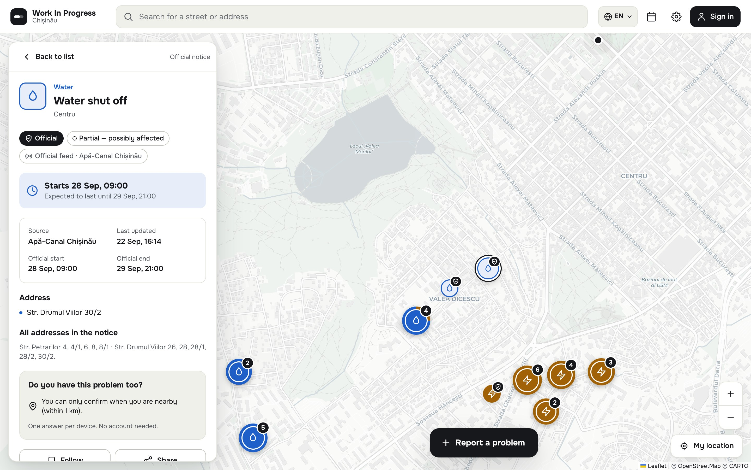
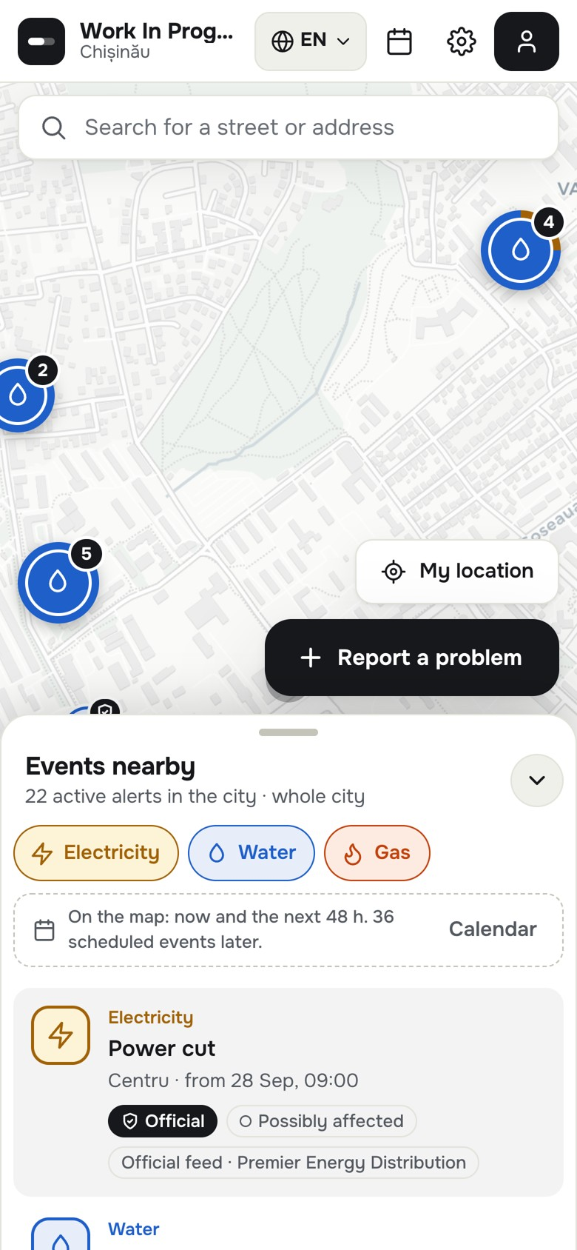
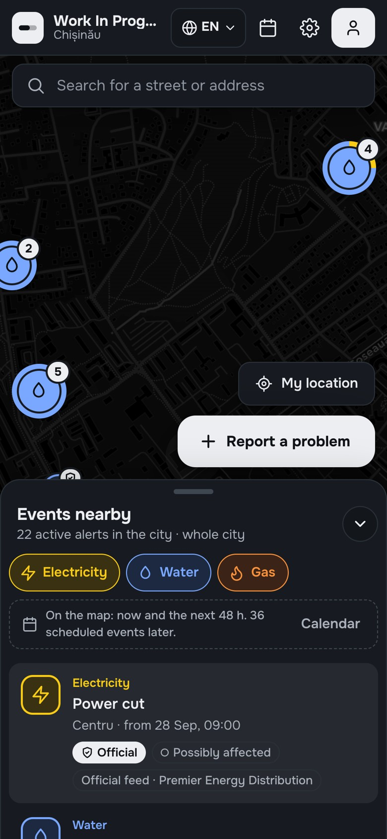
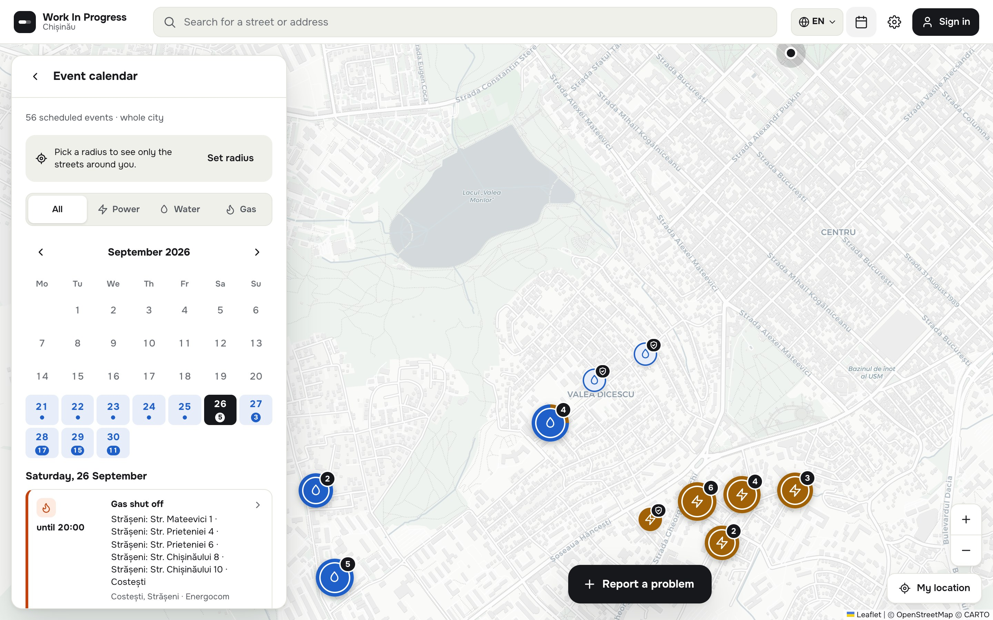
BACKUP · REAL SCREENS
Backup
If the network fails on stage, walk through these screens or play the demo video.
Official event: source, official start and end, addresses
Calendar of planned cuts, by day
Mobile · light
Mobile · dark
Work In Progress · Chișinău B8

