Slide 1


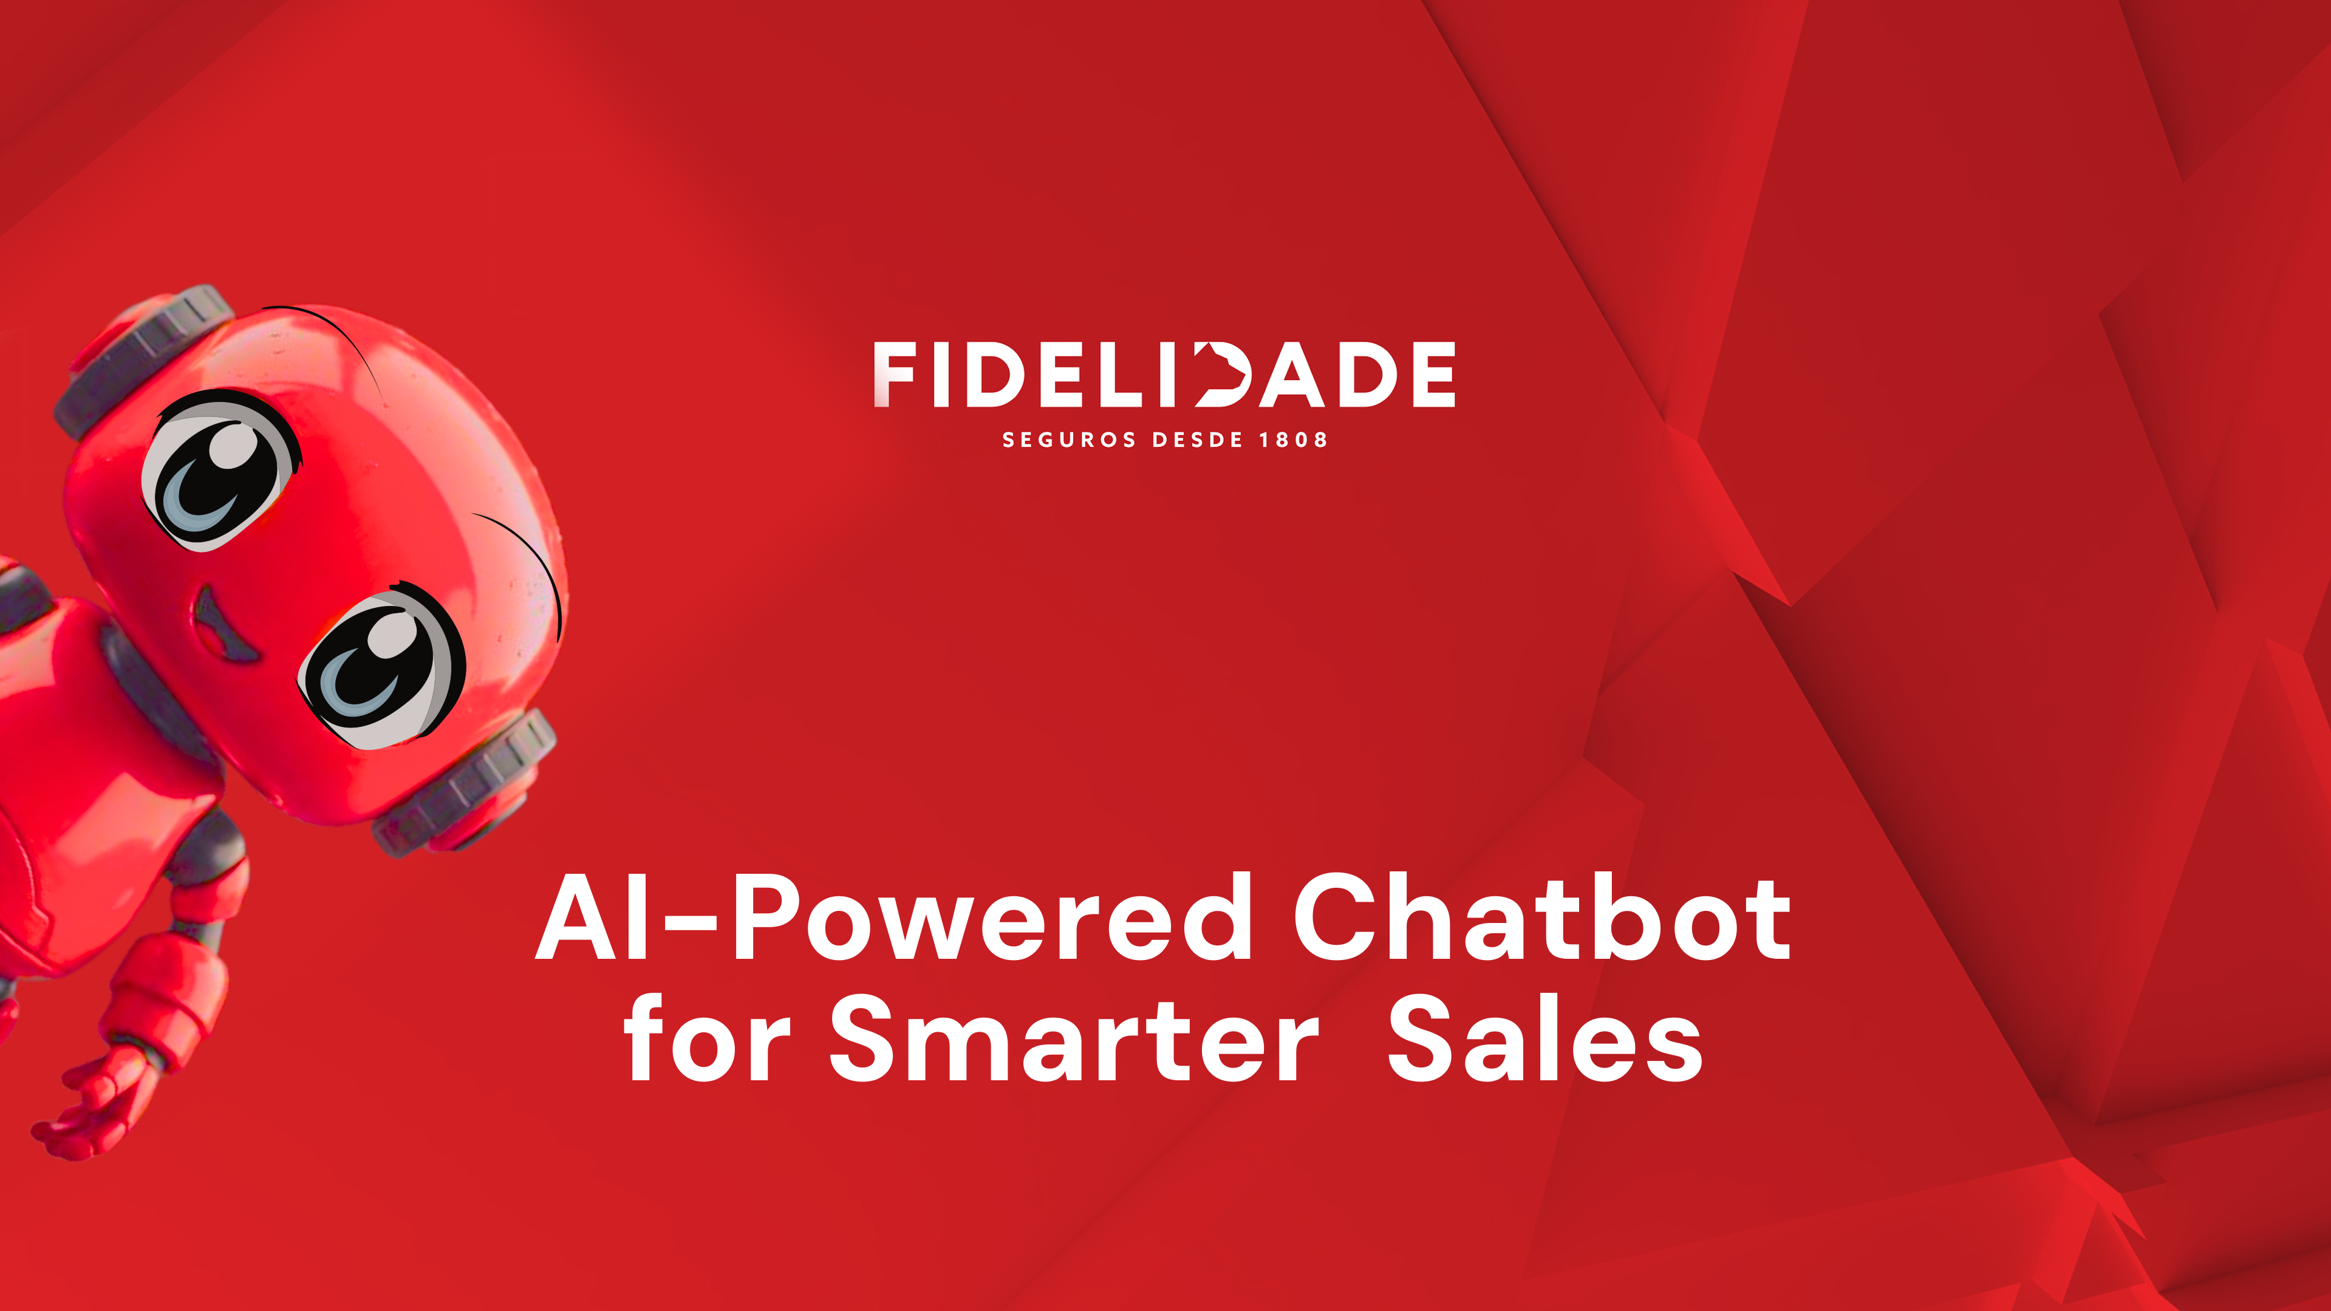

Group P

Slide 2

€
01
01234
01
2
3
4
5
6
0
1
2
3
4
5
6
7
012345
0123
4
5
0
1
2
3
4
5
6
7
8
01
2
3
4
Sales personnel spend 70% of their time on non-selling tasks

Slide 3
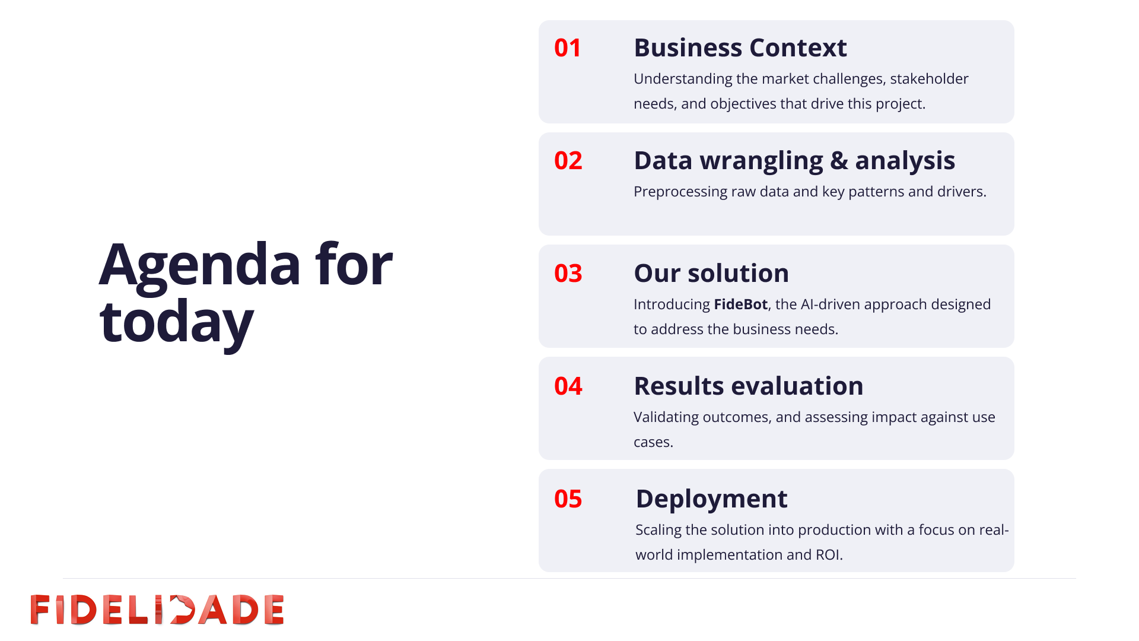

Slide 4

Business Context
External factors can become market opportunities if Fidelidade’s salesforce is well informed
1.
2.
3.
Aging Population & Shrinking Workforce
Financial Illiteracy of
Portuguese population
Inflation
Are opportunities as they increase the importance of investing, exploring financial instruments and build up personal savings
Is a barrier to the need for proactive financial planning
With a well-informed salesforce, Fidelidade, leveraging its network of sales locations throughout Portugal with nearly
4 000 agents, has the means to face these challenges.

Slide 5





Data wrangling & analysis
Fidelidade offers 5 saving and investment products, about which the salesforce needs to be well informed, but it doesn’t stop here
1.
2.
3.
Fidelidade’s Products
Competitors’ Information
Financial Concepts
Seguro Option
Q&A about basic investment principles;
Q&A about digital investment methods aimed at investors;
Tips for investing;
Investment methods;
Saving and investing;
Investor profile;
Product risks;
Term deposits;
Savings plans; Stocks;
Investment funds;
Complex financial products;
Glossary.
Proteção Ações Option
Over 60 documents containing detailed information about other products in the market, directly competing with either PPR Evoluir or the options in My Savings portfolio.
ESG Ações Option
Dinâmico Ações Option
PPR Evoluir
Proteção + Ativo

Slide 6
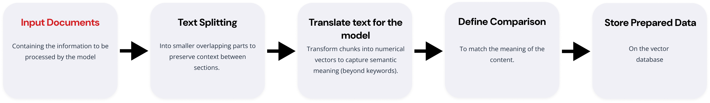
Data wrangling & analysis
The data used as input to the chatbot consisted of 83 reviewed and corrected documents

Slide 7
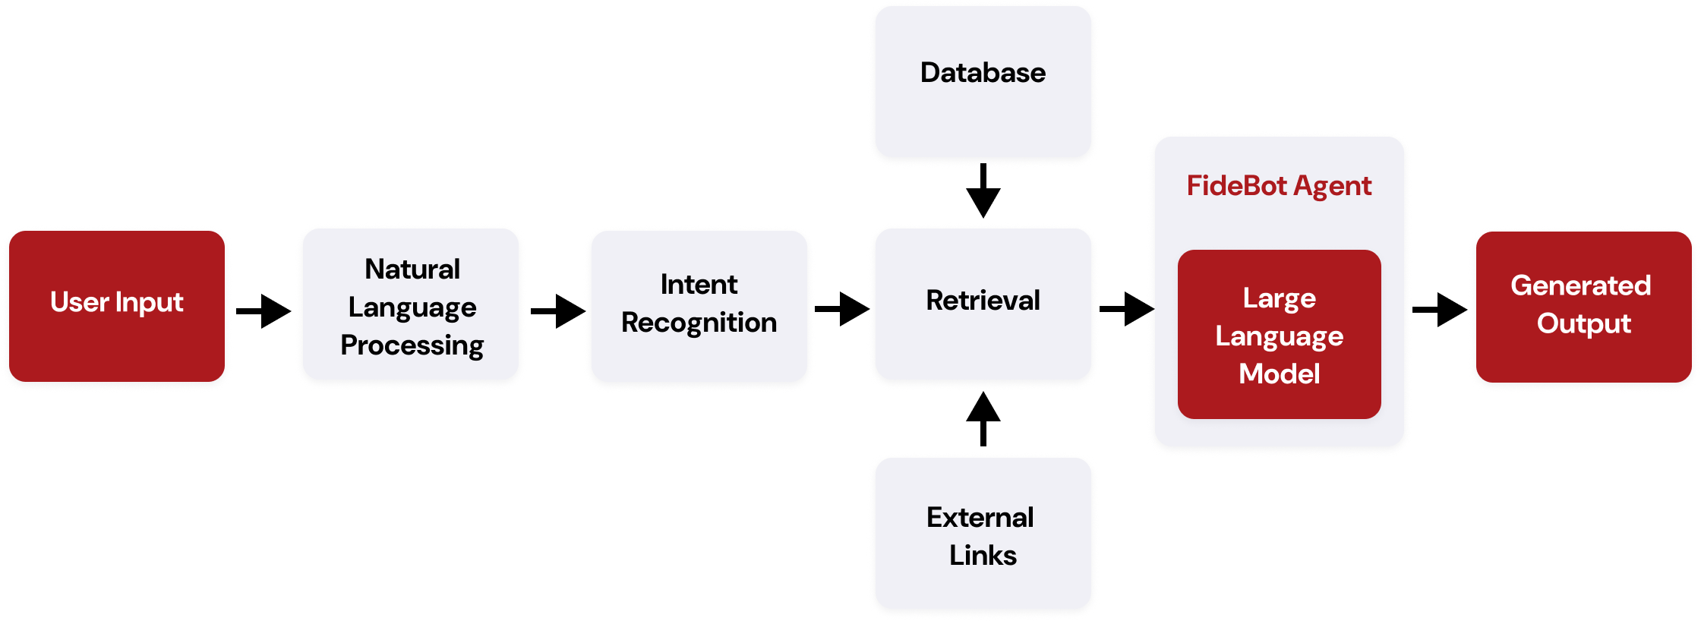
Our solution
The solution analyzes each question, retrieves trusted content, and responds with clear financial guidance in the user’s language

Slide 8
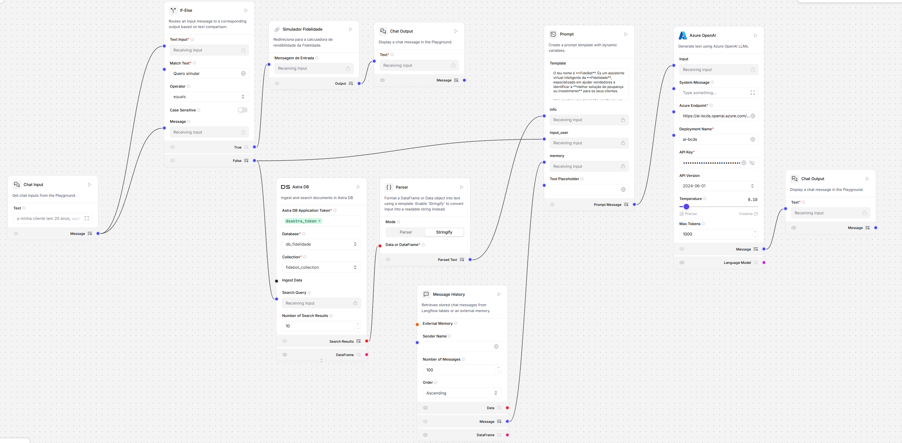

Slide 9

Our solution
FideBot is an AI-powered vendor-driven financial chatbot trained on 83 documents, delivering instant smart assistance
Bridges financial literacy gaps with clear, supportive communication.
Guides sellers with a
step-by-step reasoning to ensure customized
advice.

Slide 10
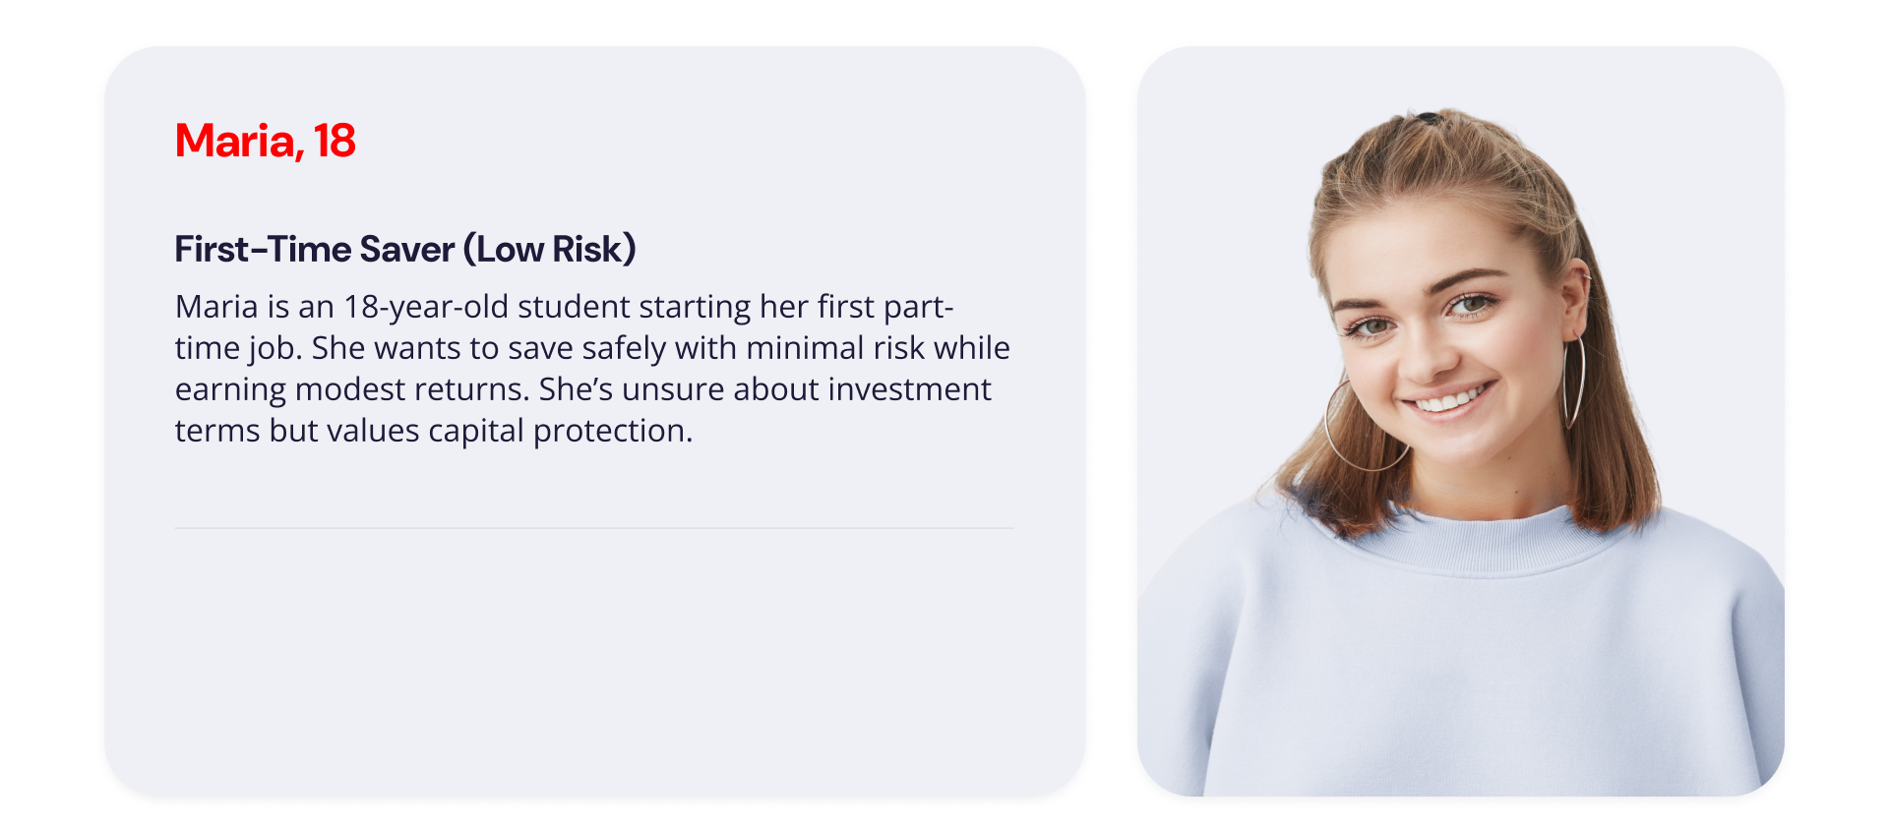

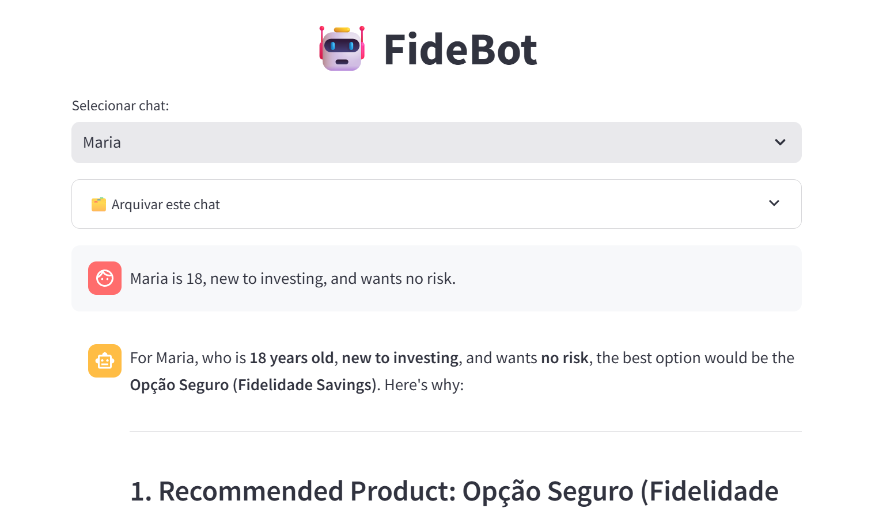
Results evaluation
Maria is 18, new to investing, and wants no risk.

Slide 11
Results evaluation
Maria is 18, new to investing, and wants no risk.

Slide 12
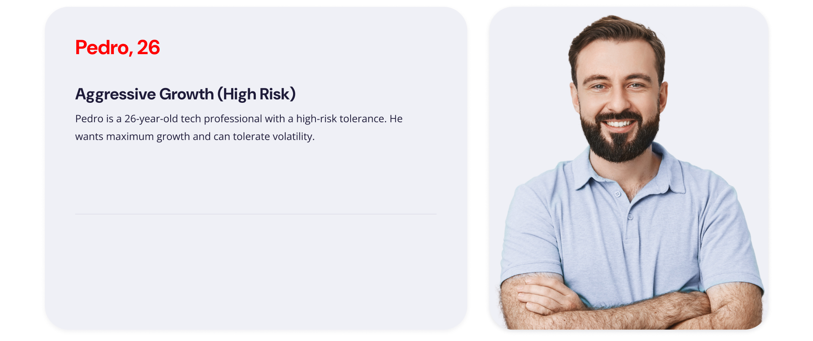
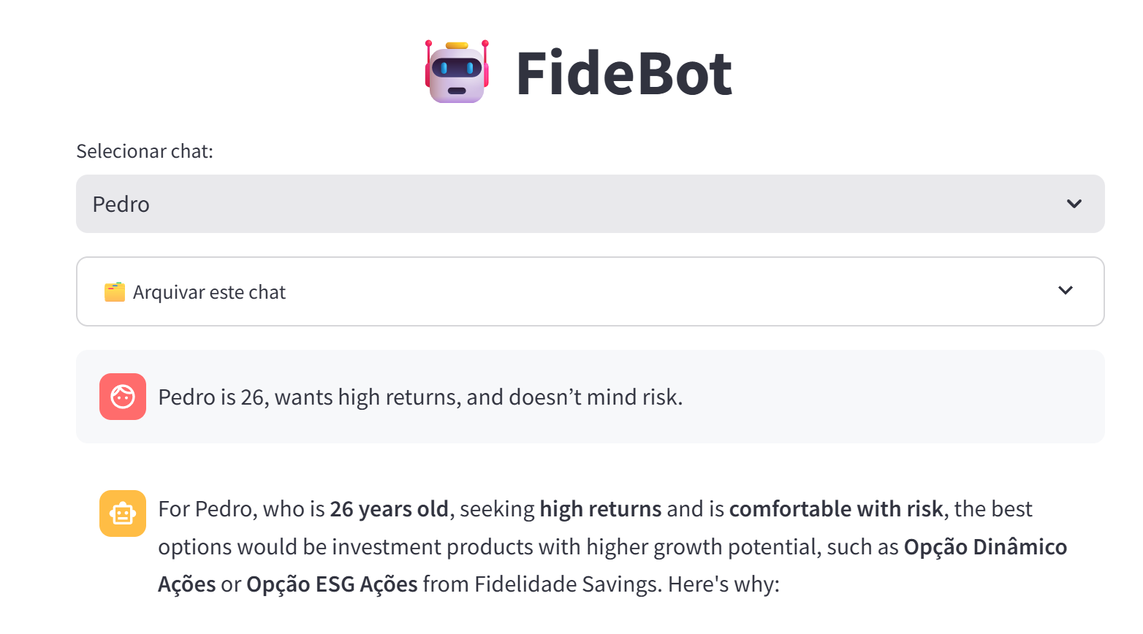
Results evaluation
Pedro is 26, wants high returns, and doesn’t mind risk.

Slide 13
Results evaluation
Pedro is 26, wants high returns, and doesn’t mind risk.

Slide 14
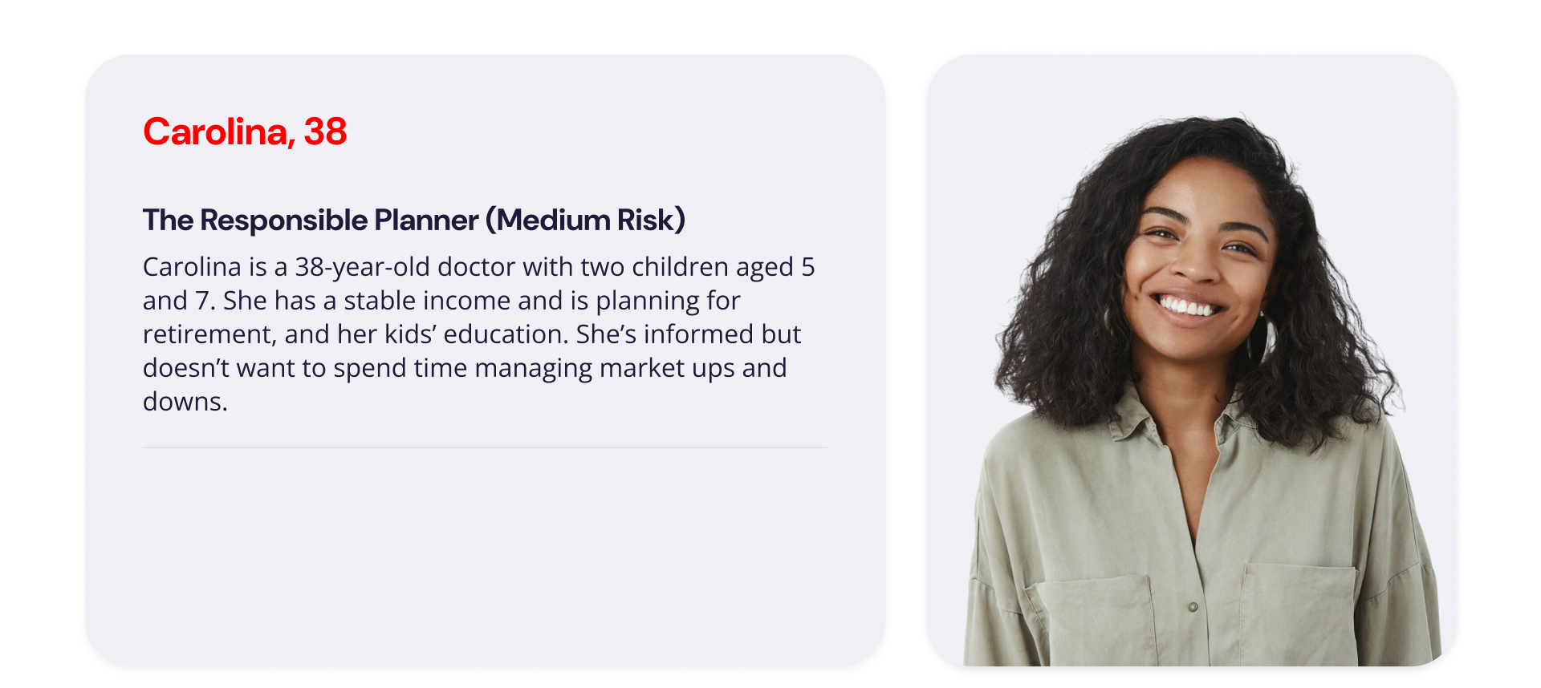
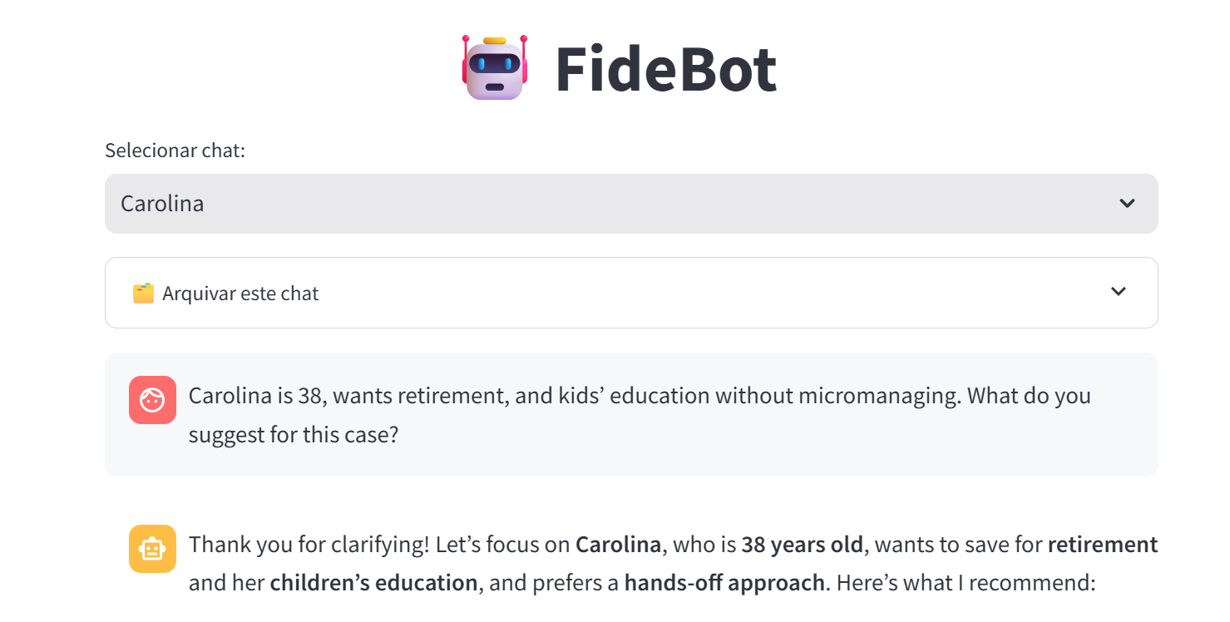
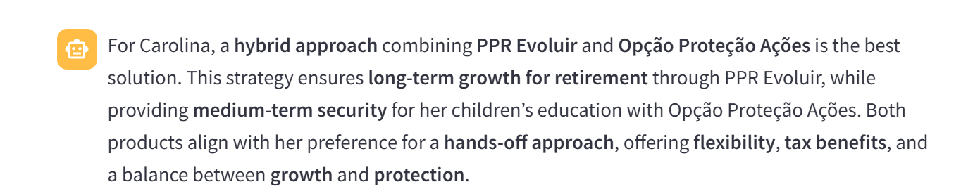
Results evaluation
Carolina is 38, wants retirement, and kids’ education without micromanaging.

Slide 15
Results evaluation
Carolina is 38, wants retirement, and kids’ education without micromanaging.

Slide 16
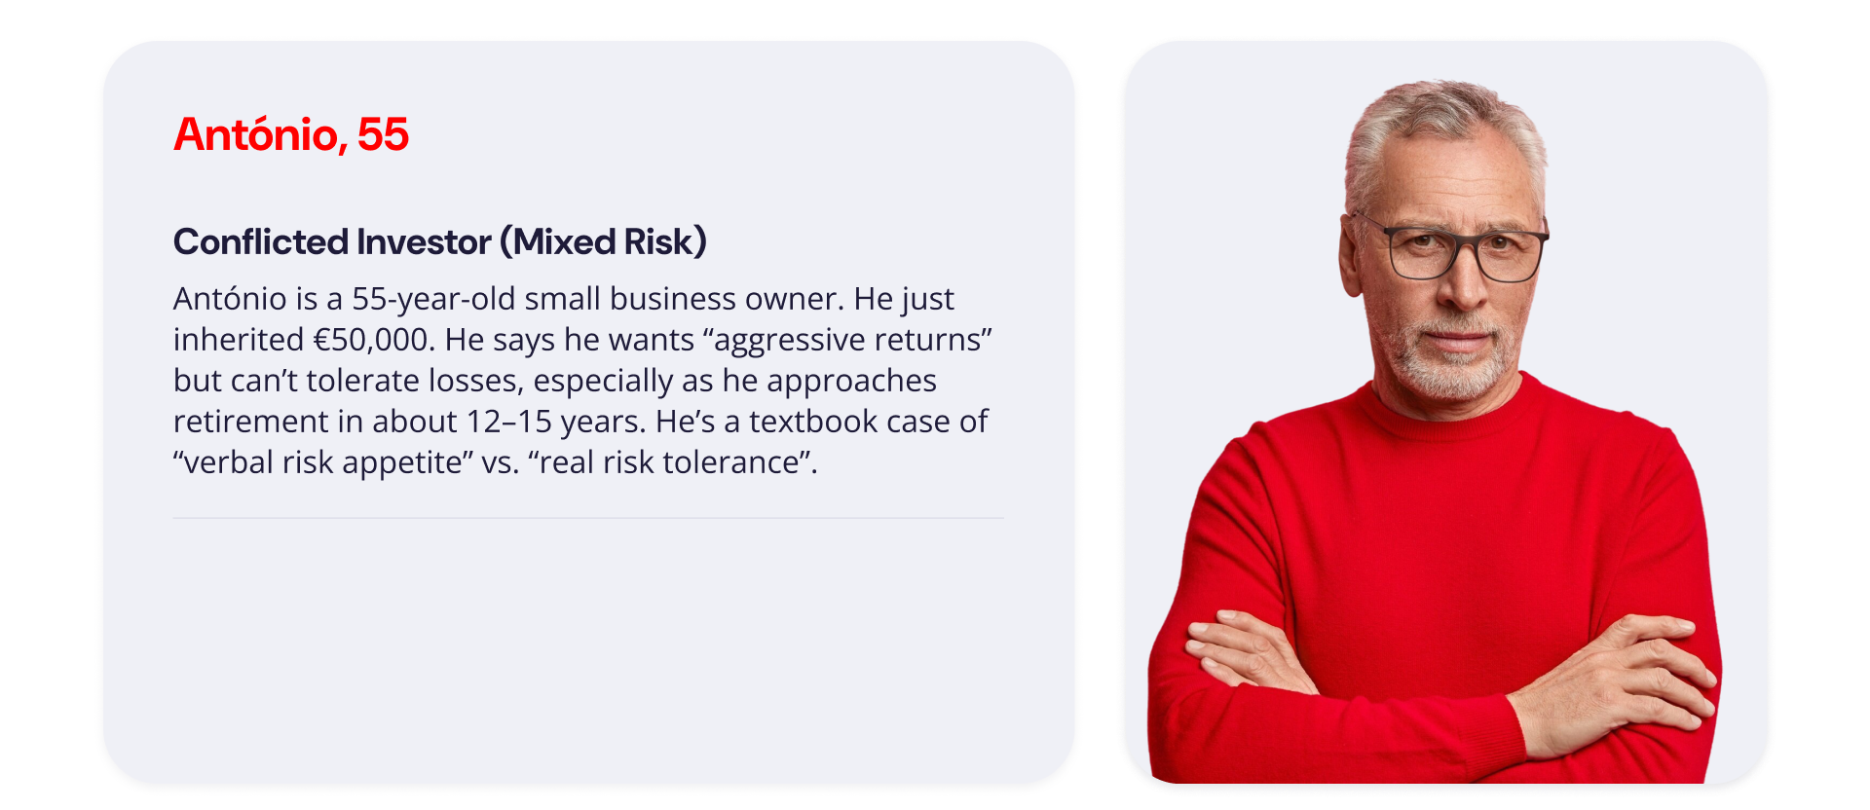
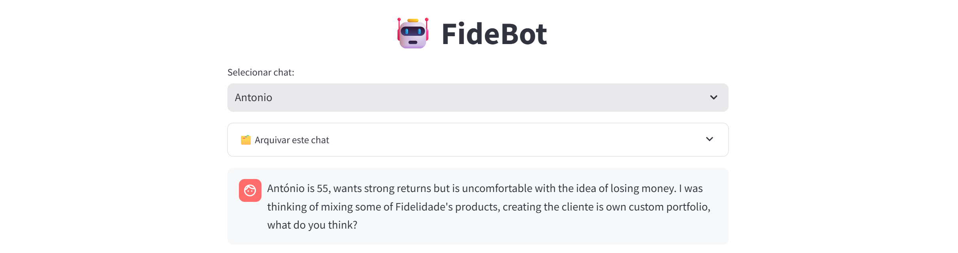
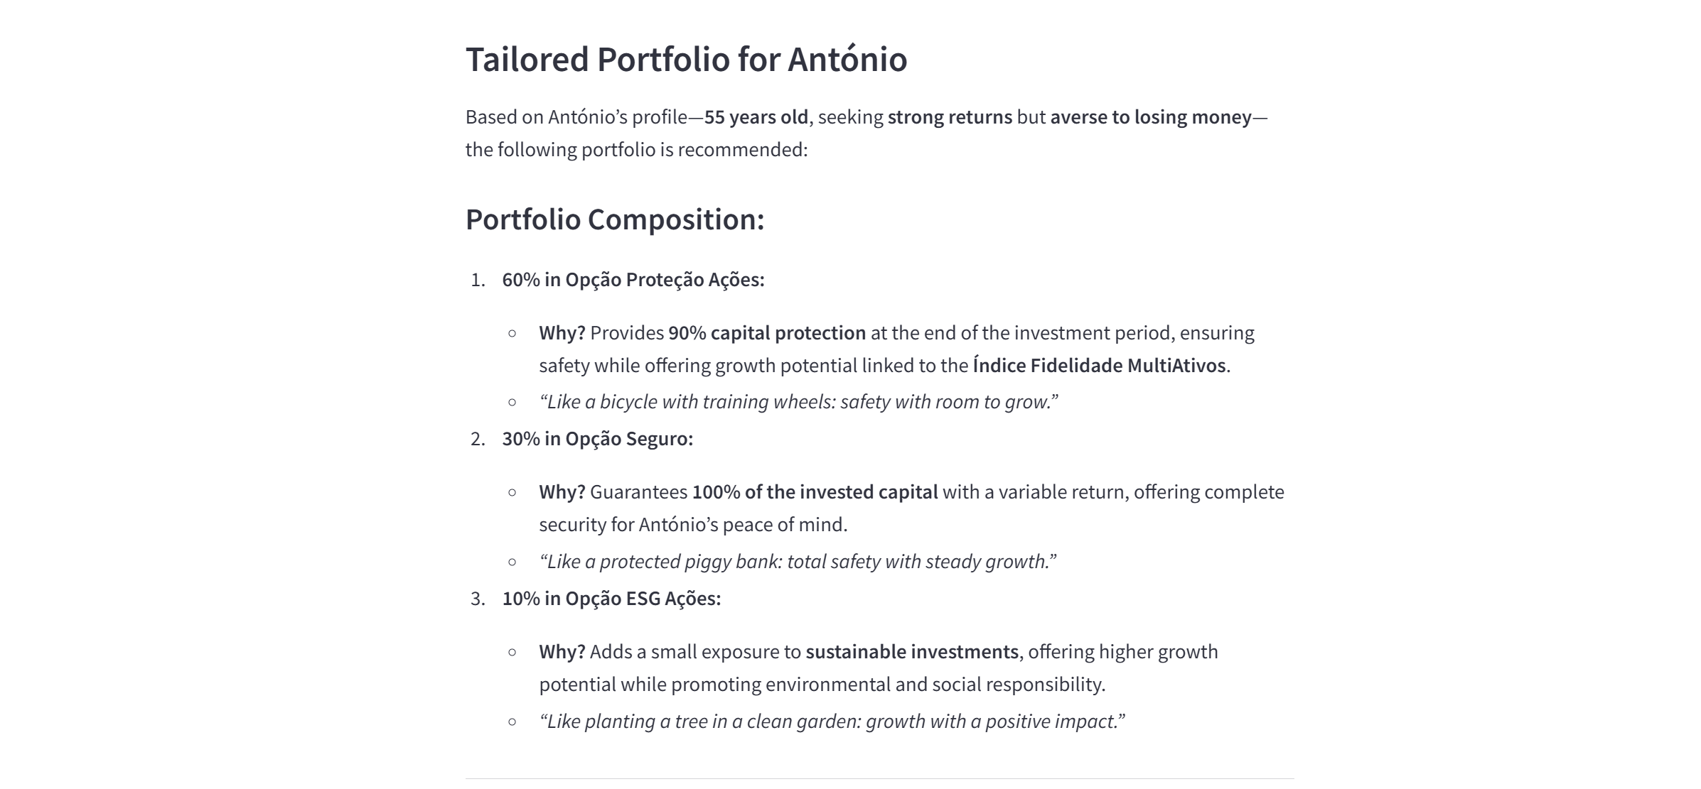

Results evaluation
António is 55, wants strong returns, but is uncomfortable with the idea of losing money.

Slide 17
Results evaluation
António is 55, wants strong returns, but is uncomfortable with the idea of losing money.

Slide 18
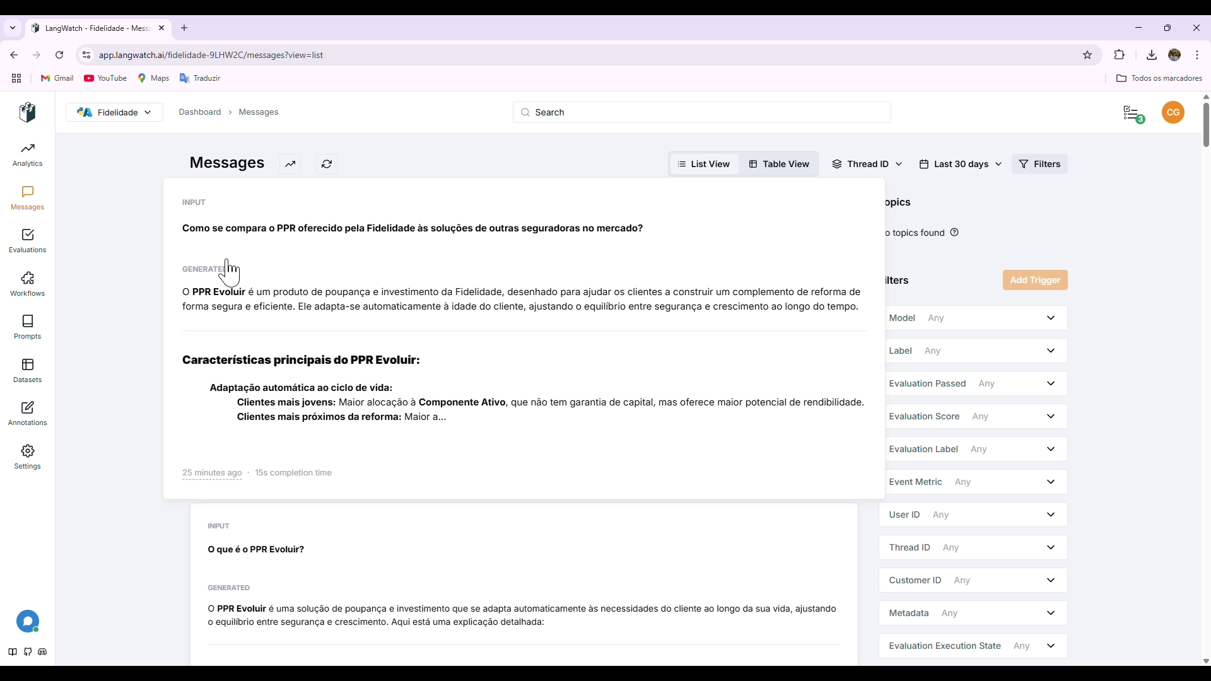
Results evaluation
Lanwatch was used to automatically test Fidebot’s accuracy, safety and cost
Evaluation Metrics
LLM Match - Semantic accuracy 100% pass
Rubric Score - Human-like quality 4.33/5
Moderation - Toxicity/safety check
100% pass
PII Detection - Privacy Compliance
100% pass
Valid Format
100% pass
Mean Cost per Message: 0.003€

Slide 19
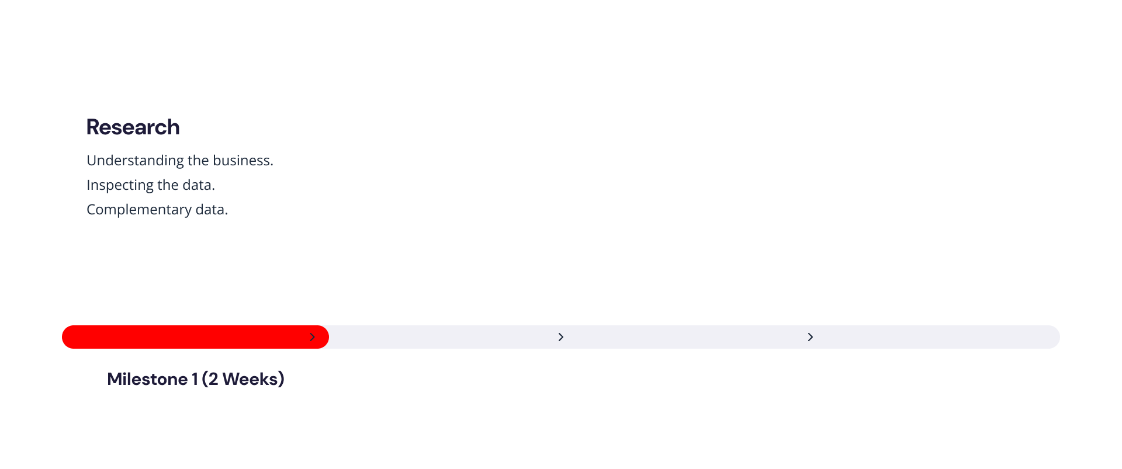
Deployment
The first milestone was heavily characterized by data and business understanding, followed by the development of an MVP

Slide 20
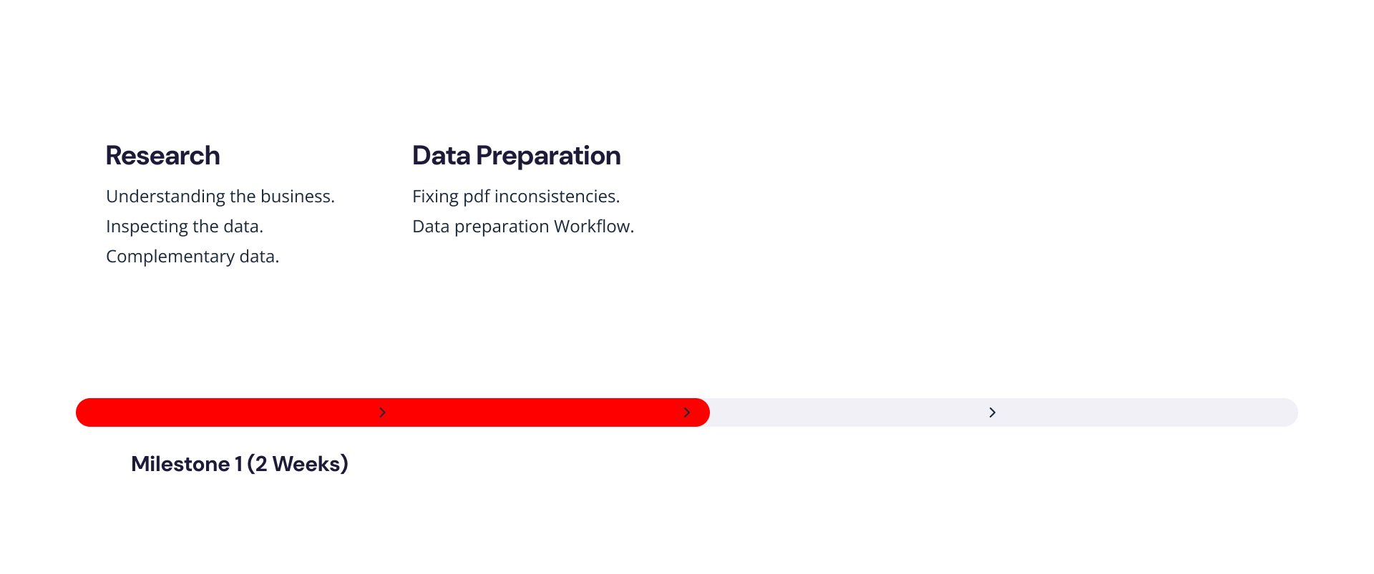
Deployment
The first milestone was heavily characterized by data and business understanding, followed by the development of an MVP

Slide 21
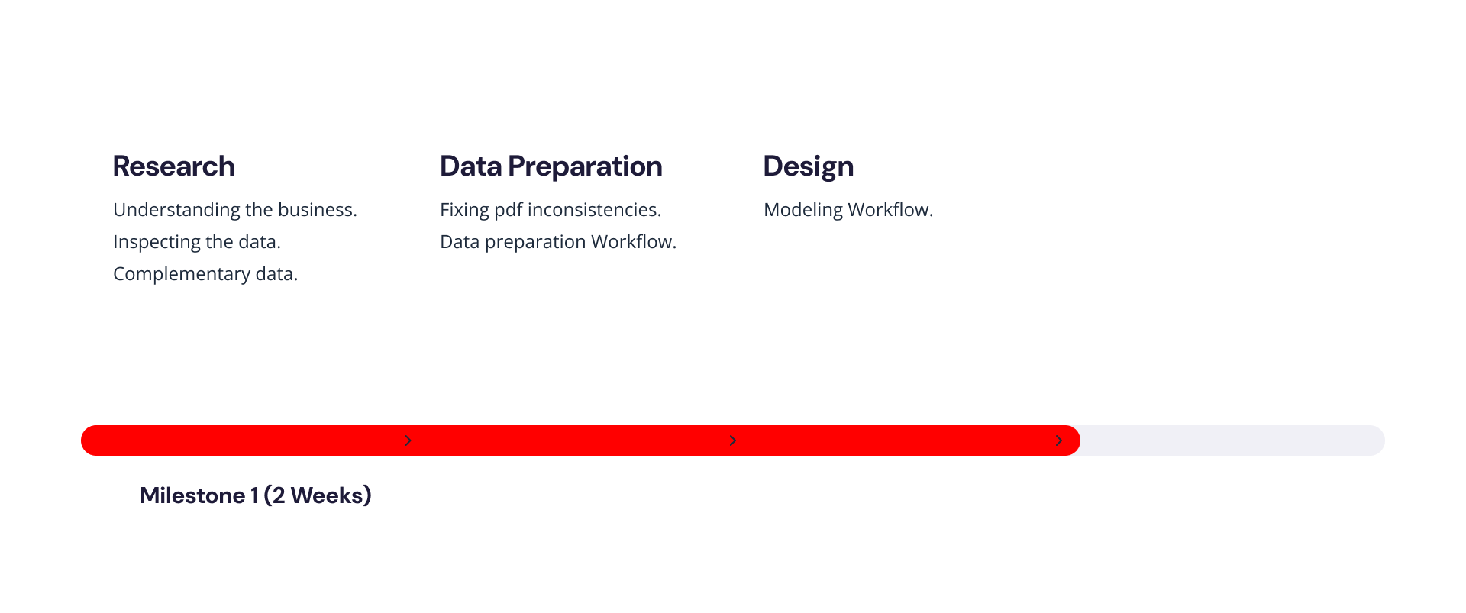
Deployment
The first milestone was heavily characterized by data and business understanding, followed by the development of an MVP

Slide 22
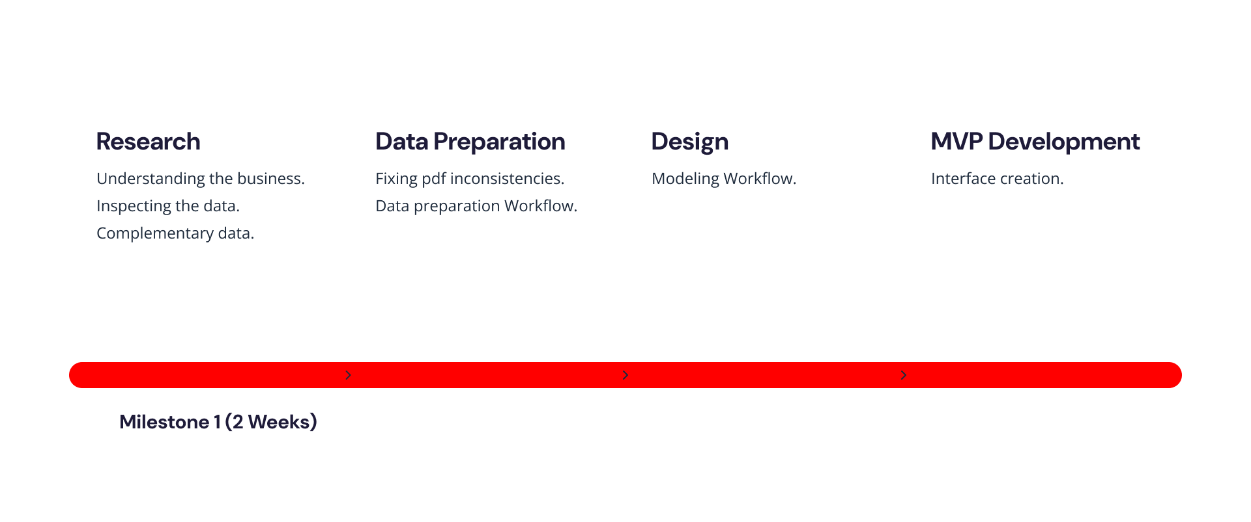
Deployment
The first milestone was heavily characterized by data and business understanding, followed by the development of an MVP

Slide 23
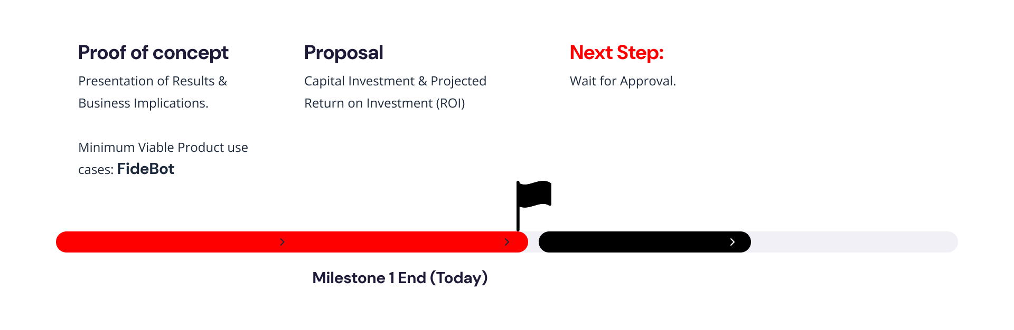
Deployment
Today we finalize the first milestone by presenting our results and proposal, wanting to meet soon to discuss next steps

Slide 24
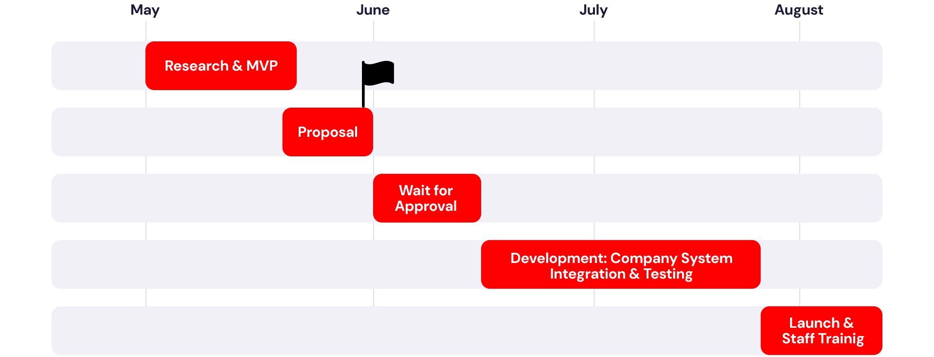
Deployment
After approval, we expect to have a fully integrated product ready to launch in August

Slide 25
Deployment
Our solution will save your salesforce about 1.6M hours a year on non-selling tasks
h
01
01
2
3
4
5
6
0
1
2
3
4
0
0
0
0
(considering 4k employees)
🛠️Operational Costs
~ 108k € /year
🚀 Project Costs
20k €
+ 5k € of implementation costs
💶 Net Savings
~ 14M €/year

Slide 26
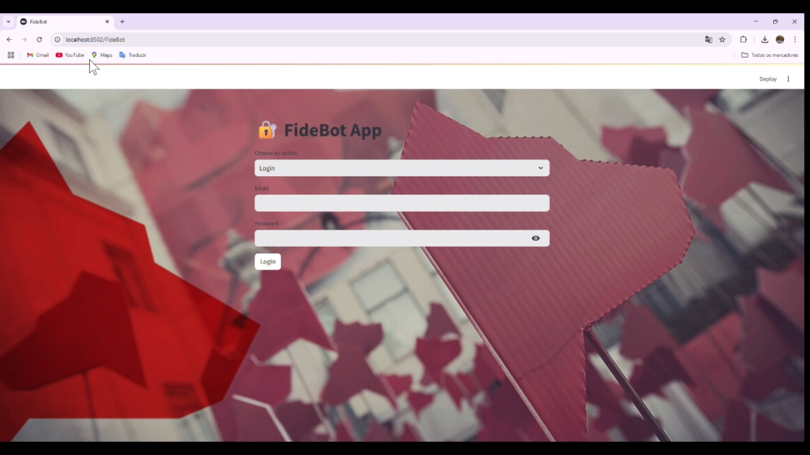
Our solution is optimized and well equipped with both quality information and tools to ensure continuous improvement
Why our solution?
1. Completeness through Fidelidade’s data and external sources (benchmark data).
2. Continuously updated via real-time vector database.
3. Integrated Real-Time Evaluation.
4. Secure Multi-Funtion MVP prepared for testing.

