Slide 1
Final project Presentation
Advanced network management 2020

Slide 2

OUr team
2020280596 - Henry Zheng - 郑嘉恒
2020280401 - Sahand Sabour - 山姆
2020280261 - Samuel Pegg - 茄子

Slide 3
Our method
ESB business indicator (ESB) anomaly detection
Trace data faulty service detection
Host KPIs data root cause localization

Slide 4
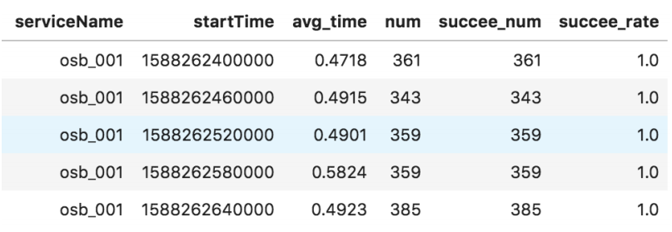
ESB anomaly detection
For a normal instance of ESB data:
The avg_time is around 0.5
The success_rate is approximately 1.0
We use Birch for detecting anomalies in these attributes.

Slide 5
Birch [1]
BIRCH is a hierarchical clustering algorithm:
It works well large data-sets; it clusters data after a single scan.
It can dynamically cluster incoming data
It creates a Clustering Feature Tree (CFT); the important parameters are:
Number of clusters: set to 2 (normal and anomaly)
Threshold: defines the radius for mergeable sub-clusters (set to 0.5 for avg_time and 0.1 for success_rate)
Problem: we must start our program at a time when there is no anomaly to get the desired results. (not practical)
Solution: Pre-train the model on all the available dataset (13 days).
After an anomaly is detected:
Stop analyzing new incoming ESB data.
Call the module for trace faulty service detection.
[1] A. Gulenko, F. Schmidt, A. Acker, M. Wallschlager, O. Kao, ¨and F. Liu, “Detecting anomalous behavior of black-box services modeled with distance-based online clustering”, in 2018 IEEE 11th International Conference on Cloud Computing(CLOUD), 2018, pp. 912–915

Slide 6
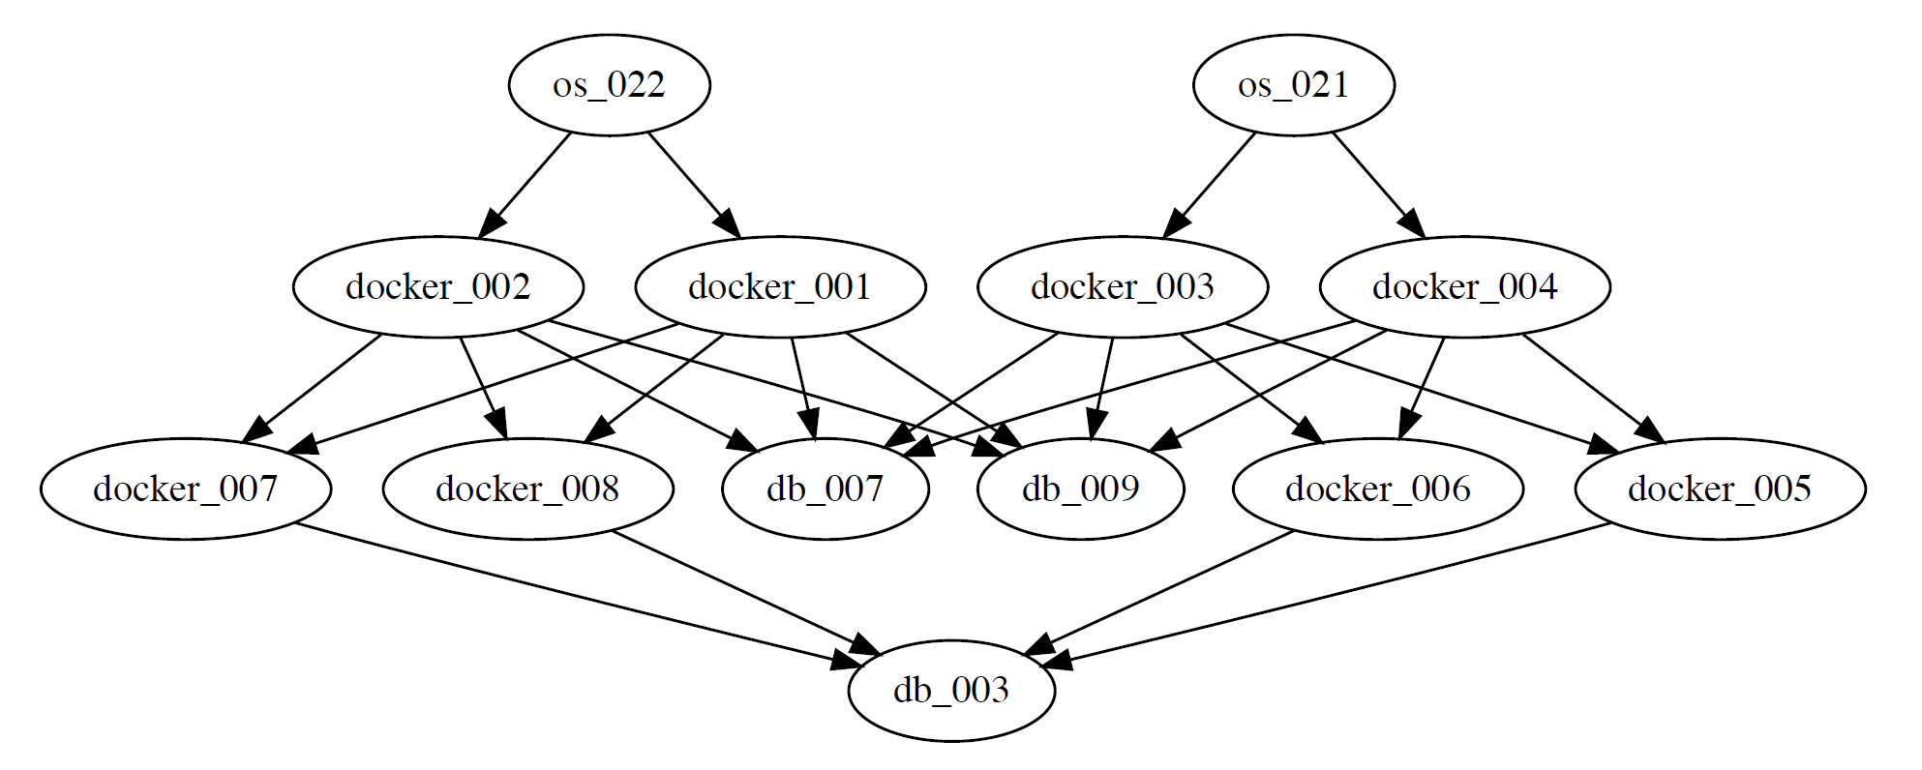
Trace Data
The graph shows the topology of the trace data
We replaced the service name with the host of the child/DS name and removed fly remote functions
Edges represent calls from one host to another

Slide 7
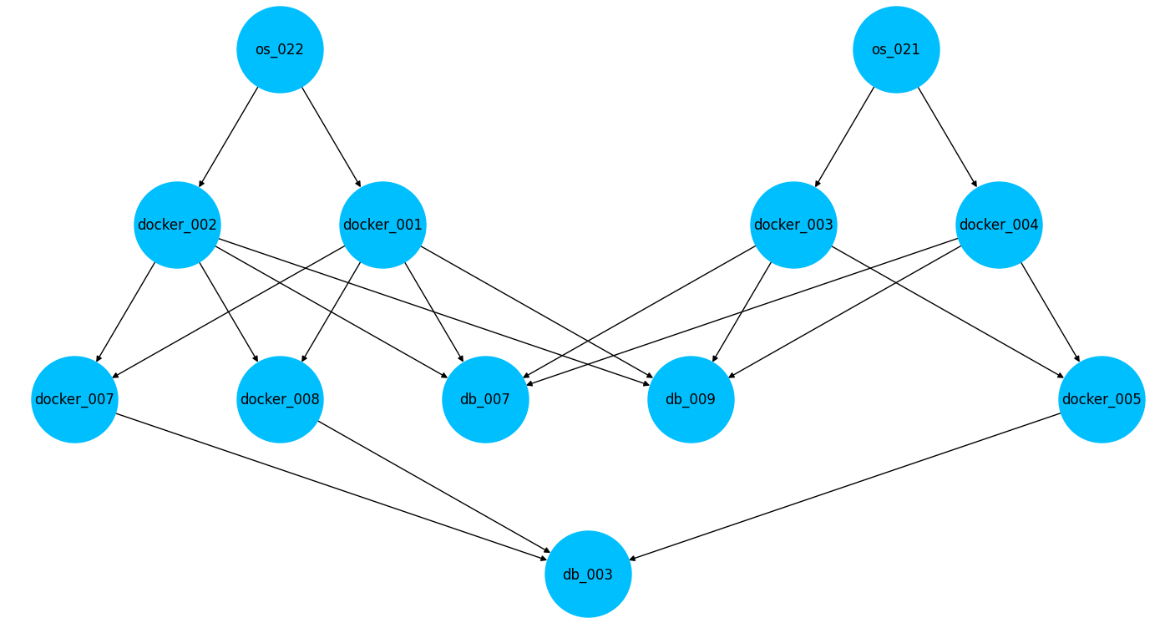
Problem: missing Host

Slide 8
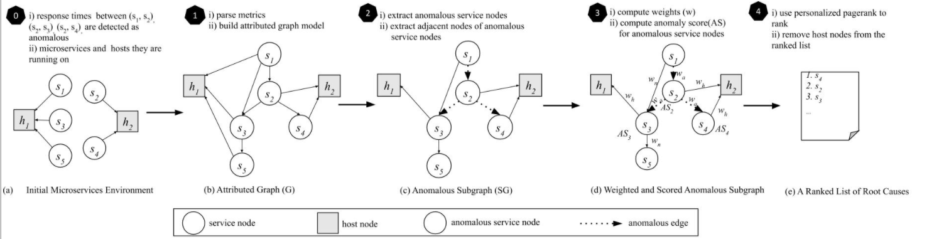
Approaches tried
Birch clustering algorithm + PageRank
Problem: All results ended up on db_003 as all paths in the topology lead to it. Adjusting edge weights/teleporting probability didn’t solve.
MicroRCA
Problem: Requires distinct definitions of services and hosts – DBs can be either. Requires a lot of heavy preprocessing
Trace Anomaly
Problem: Takes too much time to construct Feature Vector and Inference
MicroRCA Overview

Slide 9
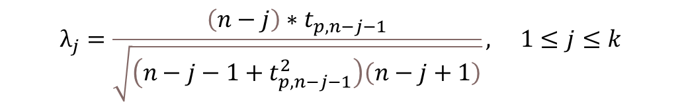

Our Approach
ESD
Requires minimal pre-processing and very fast​
$$R_{j}=\frac{\left|X_{j}−X_{median}\right|}{MAD} 1≤j≤k$$
$$MAD=median\left(\left|X_{i}−median\left(X\right)\right|\right)$$
$$λ_{j}=\frac{\left(n−j\right)∗t_{p,n−j−1}}{\sqrt{\left(n−j−1+t_{p,n−j−1}^{2}\right)\left(n−j+1\right)}}, 1≤j≤k$$

Slide 10
Baseline
ESB Data
Trace Data
Hybrid ESD
Node Localization
Birch
Detect irregularities in both average time and success rate
Find the host most likely causing the delay
Hybrid ESD
Root Cause
Find the specific KPI causing the irregular response time of the host

Slide 11
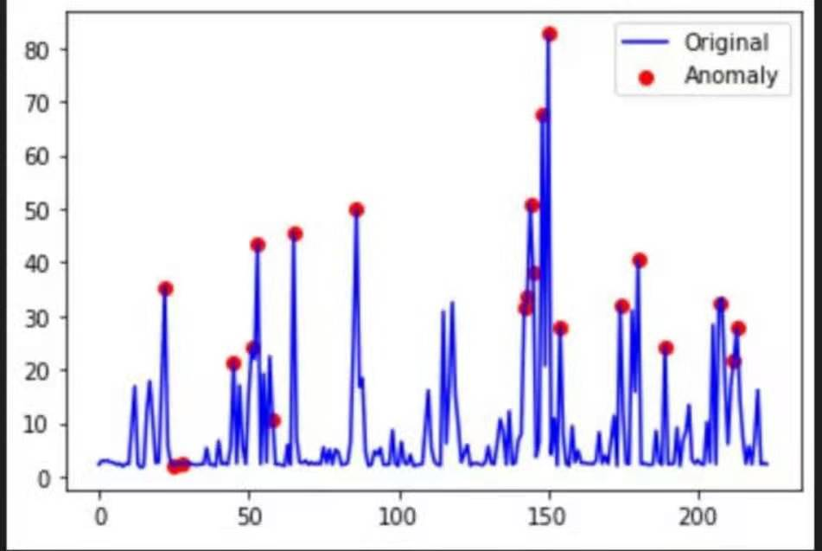

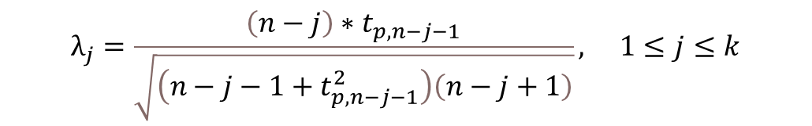

Trace Data
Pre-Processing
Extreme Studentized Deviate (ESD) Anomaly Detection
Compute for anomaly score
$$R_{j}=\frac{\left|X_{j}−X_{median}\right|}{MAD} 1≤j≤k$$
$$MAD=median\left(\left|X_{i}−median\left(X\right)\right|\right)$$
$$λ_{j}=\frac{\left(n−j\right)∗t_{p,n−j−1}}{\sqrt{\left(n−j−1+t_{p,n−j−1}^{2}\right)\left(n−j+1\right)}}, 1≤j≤k$$
$$Anomaly Score= Mean\left(\frac{X_{anomalous}−X_{median}}{X_{median}}\right)$$

Slide 12
Trace data
Construct Score Table
Find for the most anomalous service
Restart detection if no anomalous entries in the table

Slide 13
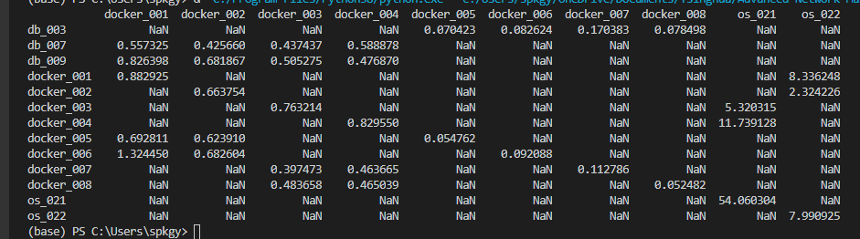
Example Anomaly score table
Send os_021 to host KPI detection

Slide 14
Host
cmdb_id of anomalous host
Filter KPI data by Host
KPI Data for Host
H-ESD
Output a score for each KPI
Return KPI(s) with highest score(s)

Slide 15
Lessons learned
Importance of data processing
Working with time series
Detect anomalies using clustering
Don't overcomplicate the problem
5. Remember to uncomment important code​

Slide 16
Thank You any questions?

