Slide 1
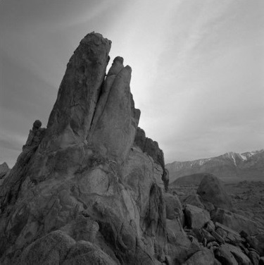
Catch These signs
A memoir on:
CNN
MLP
&
KNN

Slide 2
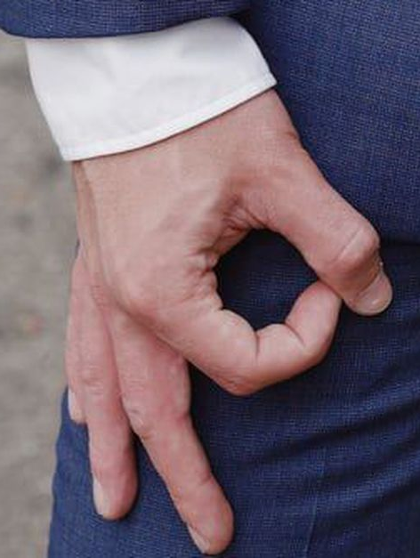
The Problem – What is this hand trying to tell me?
Classifying The American Manual Alphabet Using Machine Learning
Sign language is one of the most popular minority languages used in the United States and is experiencing an increase in demand for tech to assist the deaf.
GOAL: Identify different hand signs to help foster communication between sign users and a non sign users.

Slide 3
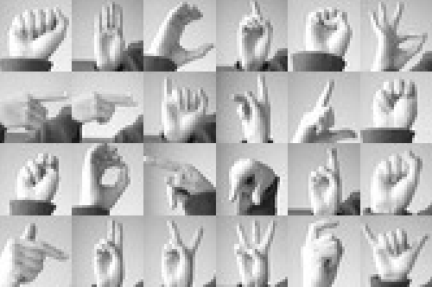
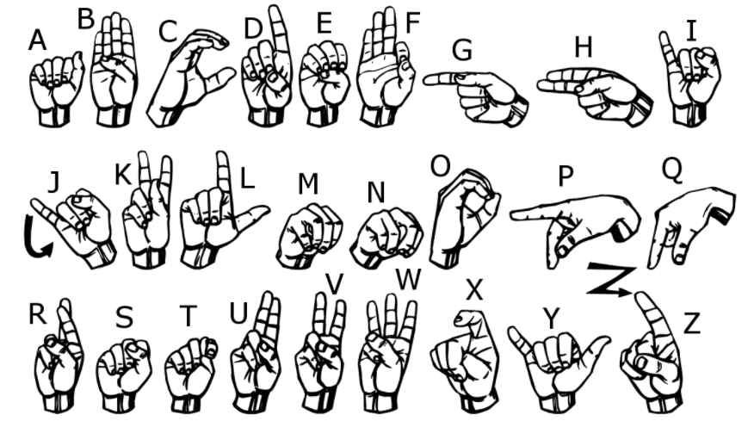
The data
The American Sign Language letter database of hand gestures represent a multi-class problem with 24 classes of letters (excluding J and Z which require motion).

Slide 4
The algorithms
Convolutional Neural Network
Multilayer Perceptron
K Nearest Neighbor

Slide 5
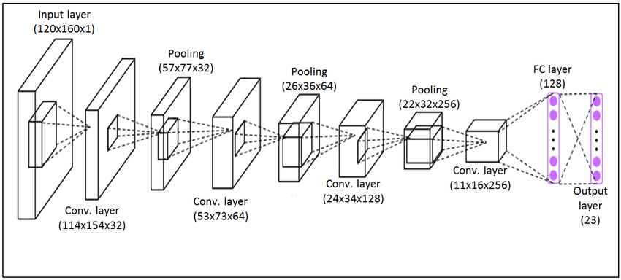
Convolutional neural network
CNN is a good choice for image recognition because the weights of the convolutional layer being used for feature extraction as well as the fully connected layer being used for classification are determined during the training process. In traditional models for pattern recognition, feature extractors are hand designed.

Slide 6
CNN – How it works
- CNN compares images piece by piece
- The pieces that it looks for are called features.
- Find rough feature matches, in roughly the same position.
- Create a map to put the value of the filter
Sliding the filter throughout the image
Get an output of values in a matrix
- ReLU layer (Rectified Linear Unit) a transform function that removes negative values from the matrix.
- Pooling layer – shrinks the image into a smaller size
- Stack the layers
Adding additional layers of Convolution, ReLU, and Pooling will reduce the output matrix further.
- Fully Connected layer
This is the final layer where the actual classification happens.
Here we take our filtered and shrunken images and put them in a single list

Slide 7
CNn – the hold out method
Hold-out is when you split up your dataset into a ‘train’ and ‘test’ set. The training set is what the model is trained on, and the test set is used to see how well that model performs on unseen data. A common split when using the hold-out method is using 80% of data for training and the remaining 20% of the data for testing.
For this project a %50 split was used.
The hold-out method is good to use when you have a very large dataset, you’re on a time crunch, or you are starting to build an initial model in your data science project.
Loss function: Catagorical Cross Entropy Optimizer: Adam Activation Function: Relu (Rectified linear unit) Layers Used: 10 Learning Rate: 0.001 Epochs: 2000

Slide 8
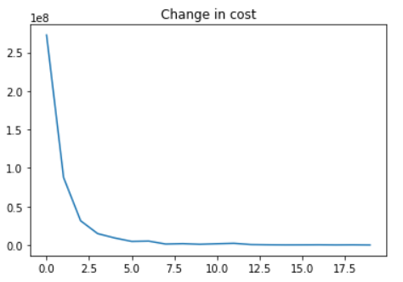
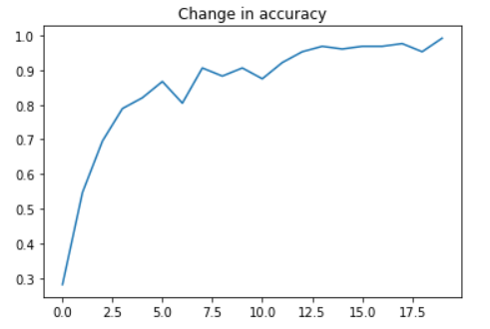
CNN – Splitting dataset into training and holdout(test set)
Accuracy on Training Data: 97.83%
Accuracy on Test Data: 97.83%

Slide 9
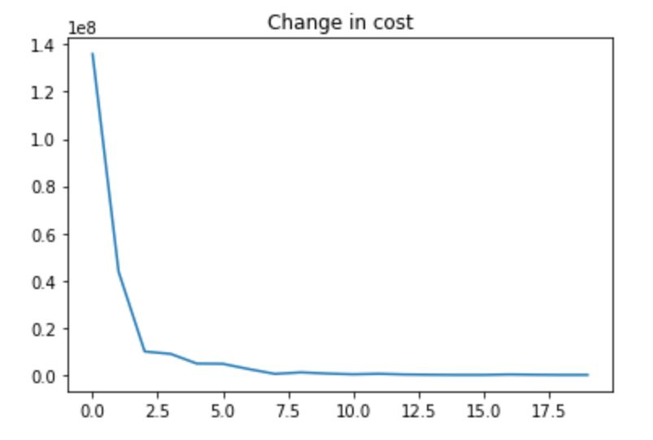
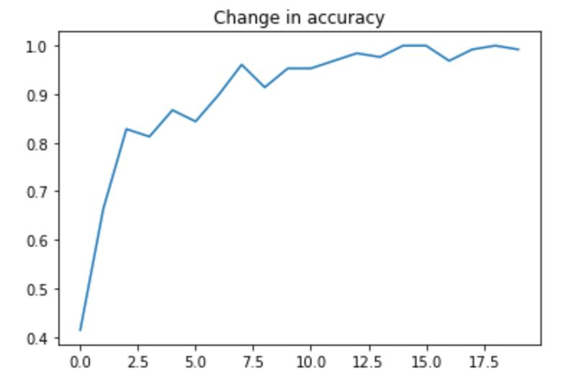
CNN – Accuracy after training on Whole dataset
Accuracy after training on whole dataset: 99.05%

Slide 10
Multilayer perceptron
MLP is the predecessor to Convolutional Neural Networks. It was once used as image classification due to the use of hidden layers in the neural network. It's good for image classification because it can distinguish data that is not linearly separable.

Slide 11
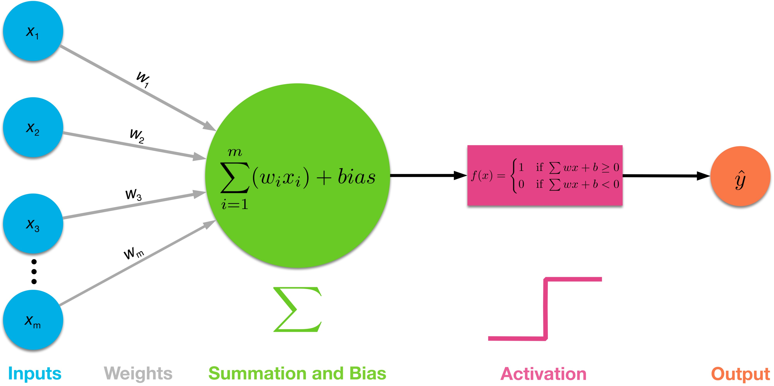
MLP – How it works
Contains many perceptrons that are organized into layers
A class of feedforward artificial neural network
Consists of at least three layers of nodes:
an input layer, a hidden layer and an output layer.
- Each node is a neuron that uses an activation function - Linear algebra reduces all layers to a two-layer input-output model - Utilizes backpropagation for training

Slide 12
MLp – How did we train this Neural Network?
Learning occurs in the perceptron by changing connection weights after each piece of data is processed, based on the amount of error in the output compared to the expected result
Example -- layer1 = tf.nn.relu(tf.add(tf.matmul(x, weights['w1']), biases['b1'])) layer2 = tf.nn.relu(tf.add(tf.matmul(layer1, weights['w2']), biases['b2'])) layer3 = tf.nn.relu(tf.add(tf.matmul(layer2, weights['w3']), biases['b3'])) layer4 = tf.nn.relu(tf.add(tf.matmul(layer3, weights['w4']), biases['b4'])) layer5 = tf.nn.relu(tf.add(tf.matmul(layer4, weights['w5']), biases['b5'])) layer_out = tf.matmul(layer5, weights['_w']) + biases['_b’]
Loss function: Cross Entropy Optimizer: Adam Activation Function: Relu (Rectified linear unit) Layers Used: 10 Learning Rate: 0.002 Epochs: 5000

Slide 13
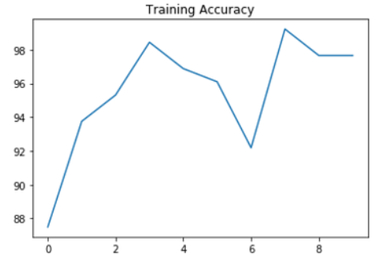
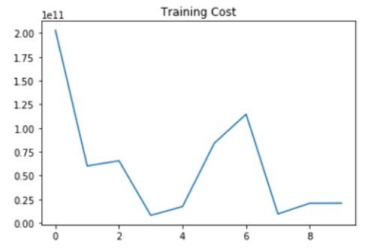
Mlp – TRAINING DATA
Average Training Accuracy: 96.35%

Slide 14
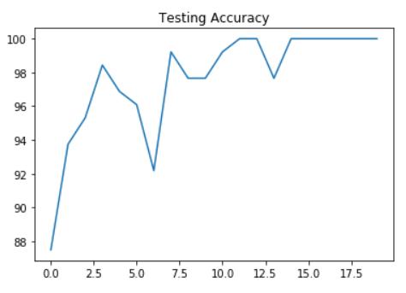
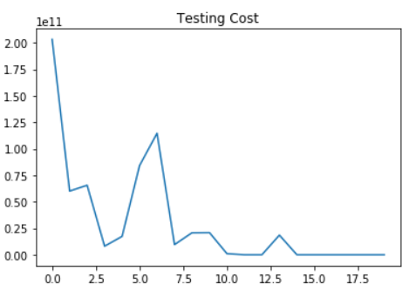
Mlp – TESTING DATA
Average Testing Accuracy: 99.14%

Slide 15
K Nearest neighbor
In KNN (K is the # of nearest neighbors) is a non- parametric, lazy algo. It finds the nearest neighbor and uses that neighbor’s label to help predict the classification of K.
KNN’s are great for image classification because the training phase is much faster compared to other classification algorithms (instance - based), and they’re incredibly simple to understand and use.

Slide 16
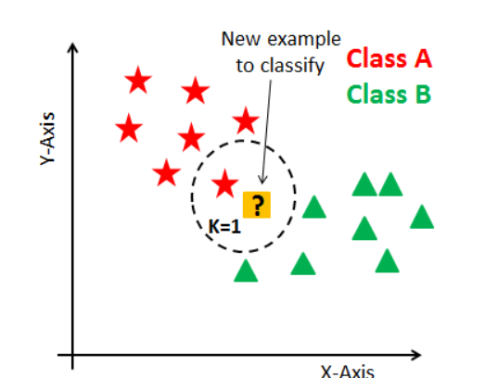
KNN – The simple Classifier
To run a KNN you basically need two things:
The number of nearest neighbors you want the algo to find
The Distance formula you want to use
Notes:
That it
Does not reply on epocs
Iterations
No cost fuction worries
Or
Optimizations or layers
Its basically one line of code and youre good
There isn’t any learning with knns because they shove the entire data set into memory to use for predictions
which makes it easy to use
but terrible for larger data sets

Slide 17
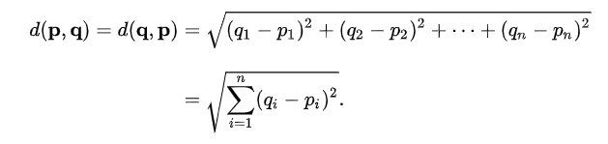
KNN – Euclidean Distance
Basically the distance formula we all know and love.
Notes:
What I used for the algoritm
There are others but the Euclidean distance is popular for image classification

Slide 18
KNN – data
Neighbors = 5
Distance = Euclidean
Training Accuracy = 99.22%
Testing Accuracy = 98.83%
Notes:
What I used for the algoritm
There are others but the Euclidean distance is popular for image classification

Slide 19
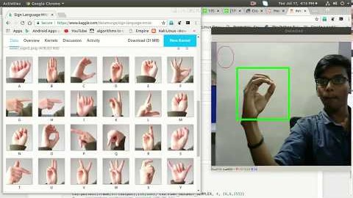
DEMO

Slide 20
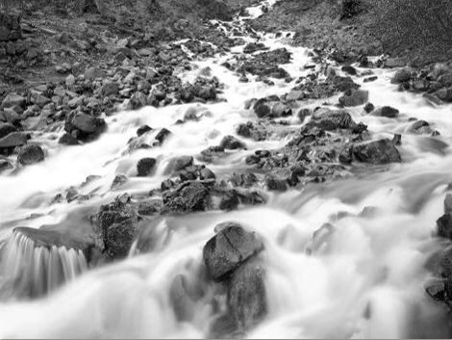
FIN

