Slide 1
CATCH Q8 Review Meeting - Leeds
Overview of progress to date
Innovations in spatial microsimulation
Innovations in spatial modelling
Next steps

Slide 2
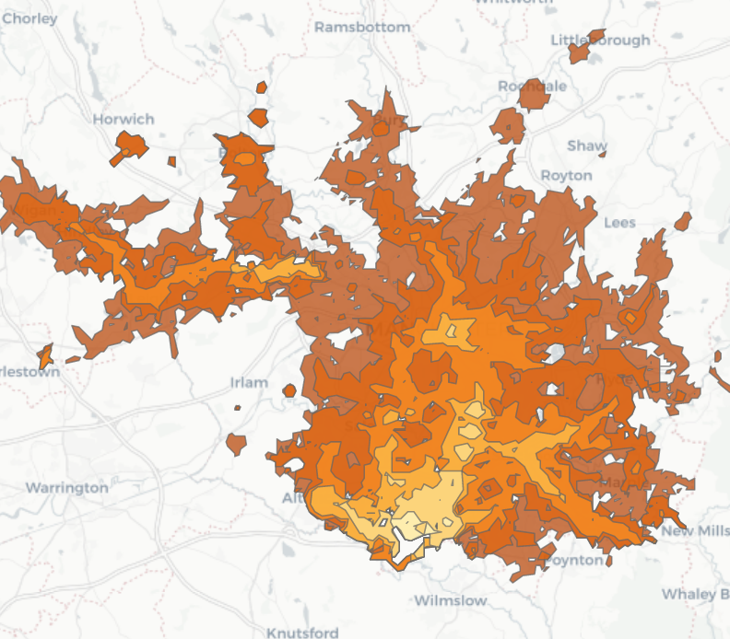
Modelling of synthetic population – source: http://rpubs.com/RobinLovelace/331026
Method: OpenTripPlanner running on Linux using open data for travel times to Manchester Airport
Data: synthetic but could be GPS from CATCH
Map generated by Robin Lovelace building on work by Marcus Young: https://github.com/marcusyoung/otp-tutorial
And Andrew Byrd for software
Open transport services
Direction of future travel?

Slide 3
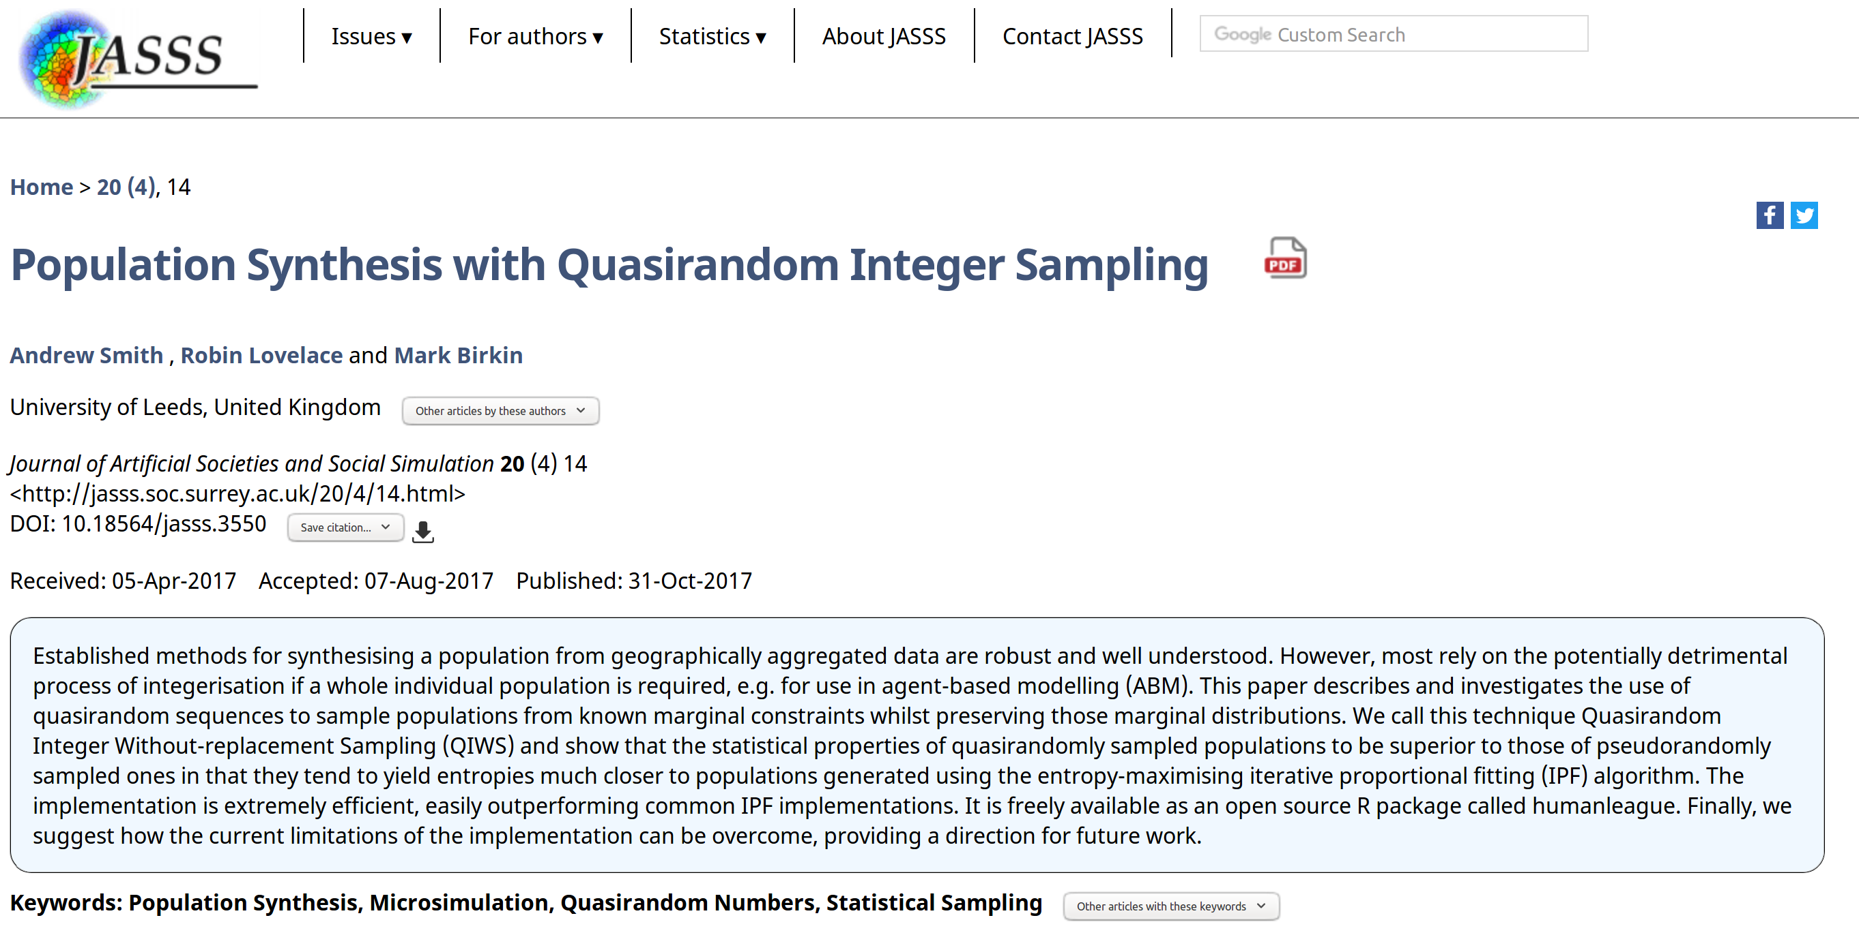
Barriers and solution
Add image from the Hackathon in Leeds

Slide 4
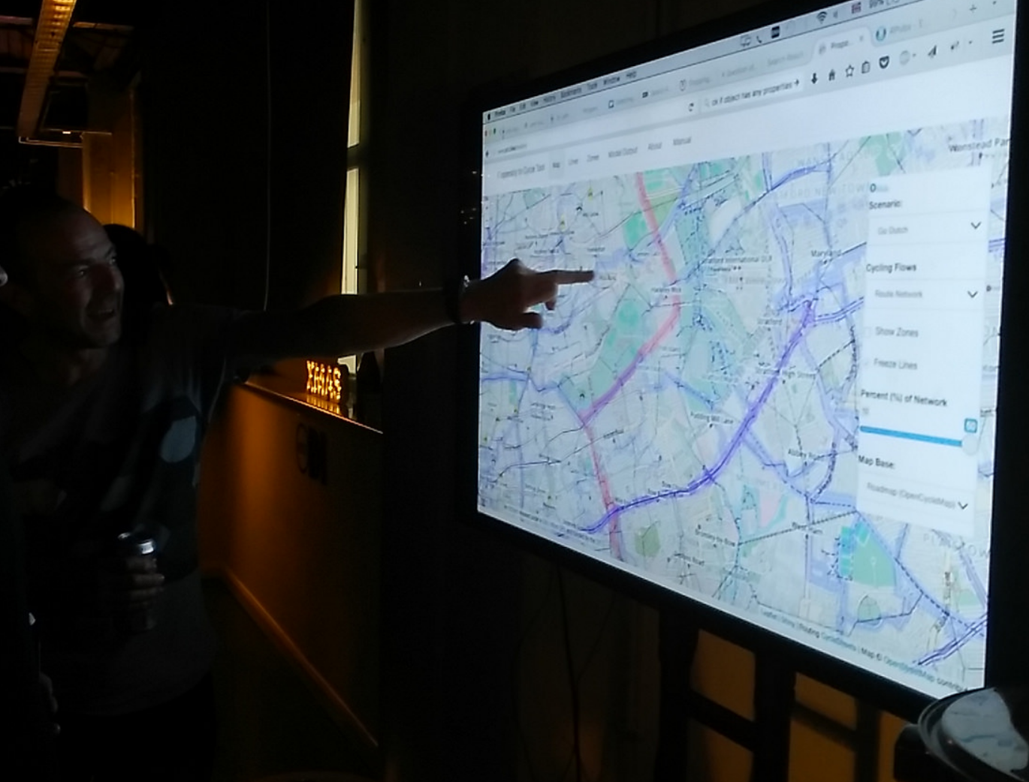
Recent progress from Leeds
Two journal papers submitted:
One paper titled Identification of dynamical systems from multiple temporal sequences of probability densities
The other paper titled reconstructing stochastic dynamical systems based on stationary densities
Organised a hackathon in Leeds (September 2016)

Slide 5
1. New unsupervised learning approach to modelling population flow based on temporal probability distributions
Data observation for different travel modes
Probability distributions describe the ratio of population using different travel modes
Iterated map constructed to characterise the evolution of probability distributions

Slide 6
2. New unsupervised learning approach to modelling non-autonomous dynamical systems
Data observation for different travel modes and different weather conditions
……
Different weather conditions
……
Resulting population intensity for different travel modes
Iterated map describing evolution of population intensity

Slide 7
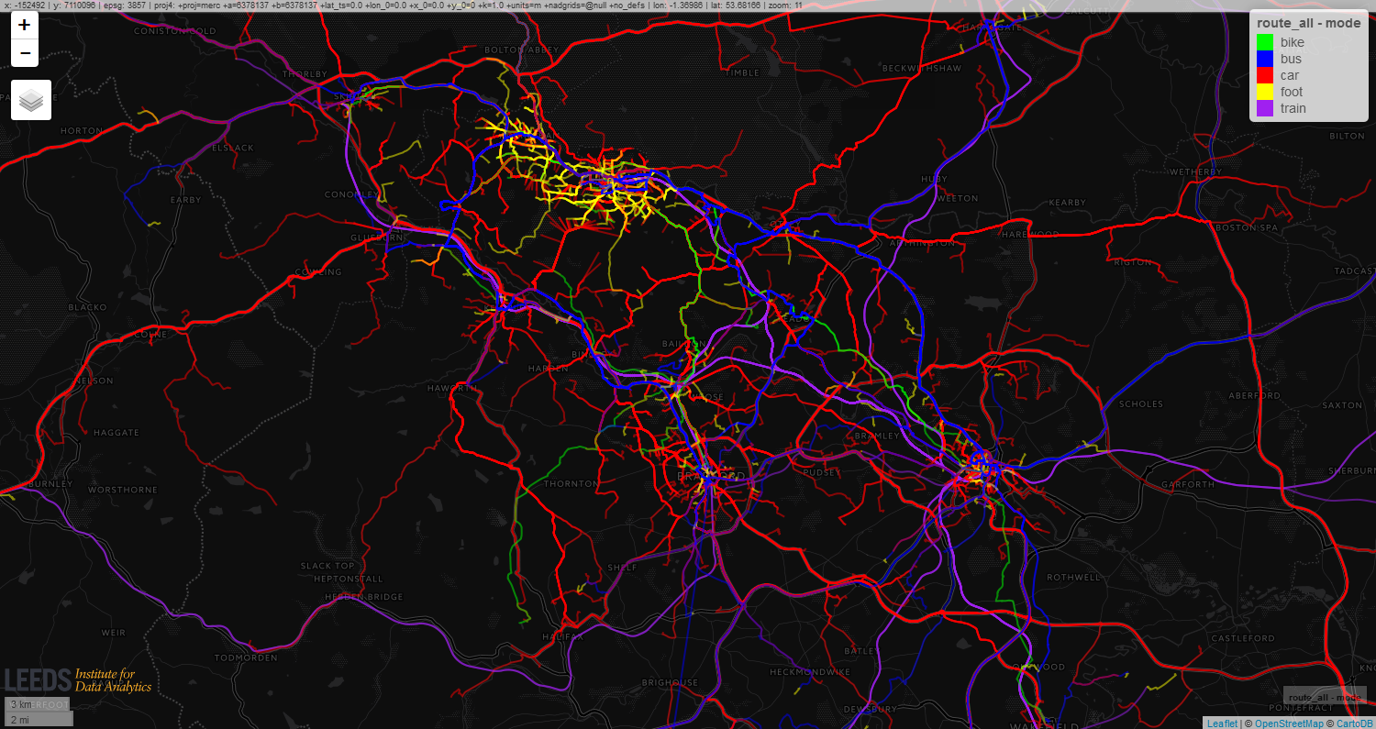
APIs based commuting routes of population
Population flow can be observed at some point of interest.
Probability distributions can be estimated from the massive data with varying travel modes.
Model to characterise the population movement dynamcis

Slide 8
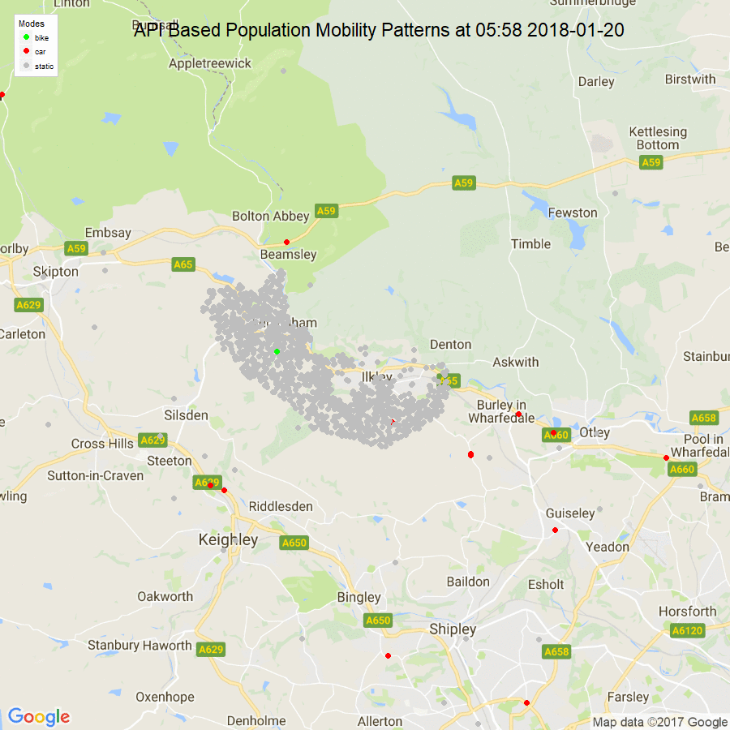
Simulation of population dynamical movement on commuting routes
Commuting routes for a town-level urban area generated by APIs
Agents using different travel modes marked with different colours
Based on national travel survey, travel peak for non-walking agents occurs at 7am-8am, while for walking agents peak time is 8am-9am.

Slide 9
Next steps
Link the theoretical framework back to real-world data
Complete write-ups and responses to reviewers of papers
Improve ability to retrieve historic conditions (i.e. weather)

