Slide 1
Multi-modal Sensor Fusion
汇报人：罗宏宇

Slide 2
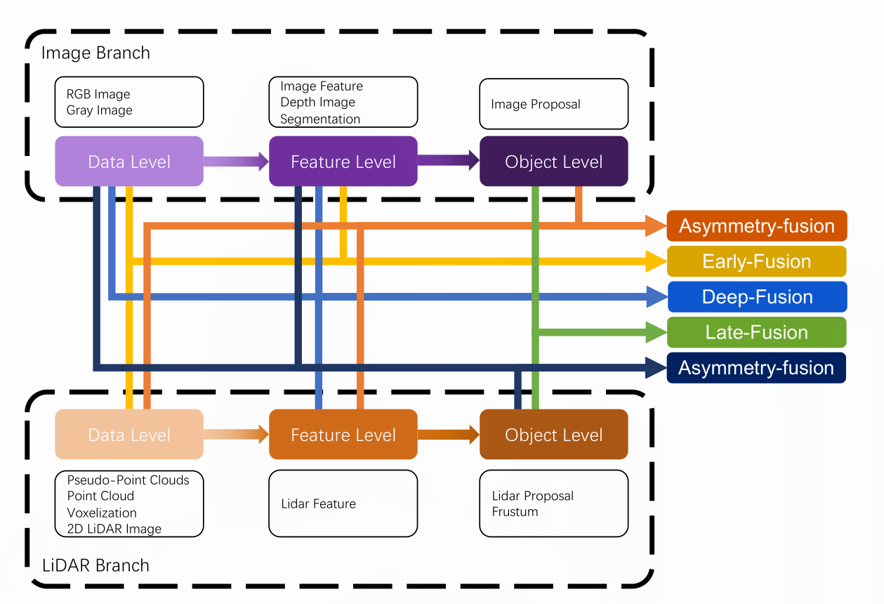
Taxononmy
Fusion is divided into four cateories, as early-fusion, deep fusion, late fusion and asymmetry fusion

Slide 3
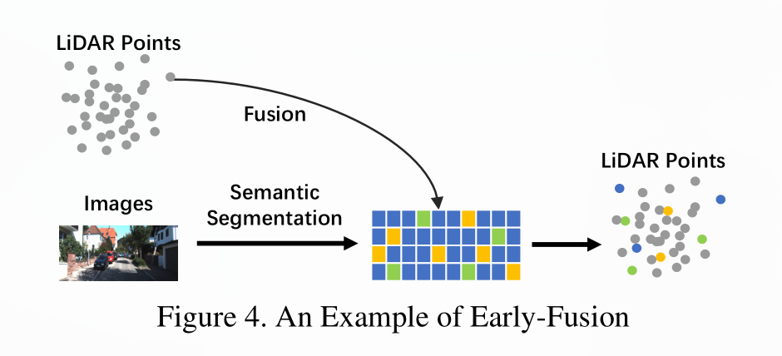
Early-fusion
Early-fusion fuses LiDAR data at data-level and camera data at data-level or feature-level

Slide 4
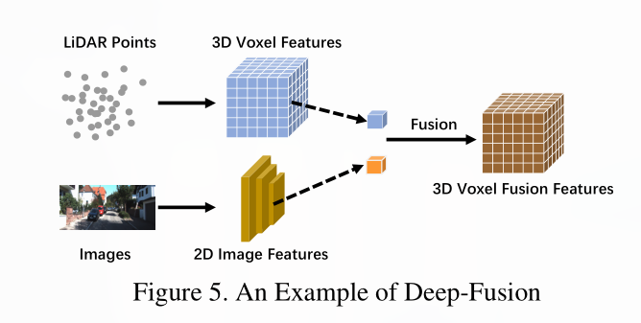
Deep-Fusion
Deep-fusion methods fuse cross-modal data at the feature level for the LiDAR branch but data-level and
feature-level for the LiDAR branch but data-level and feature-level for the image branch.

Slide 5
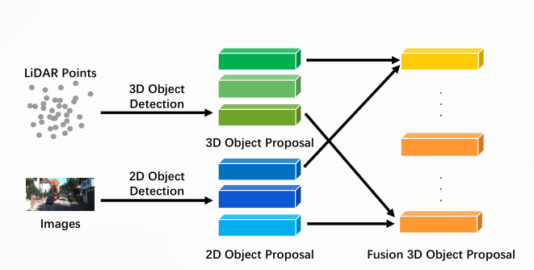
Late-fusion
Late-fusion, also known as object-level fusion, denotes the methods that fuse the result of pipelines in each modality

Slide 6
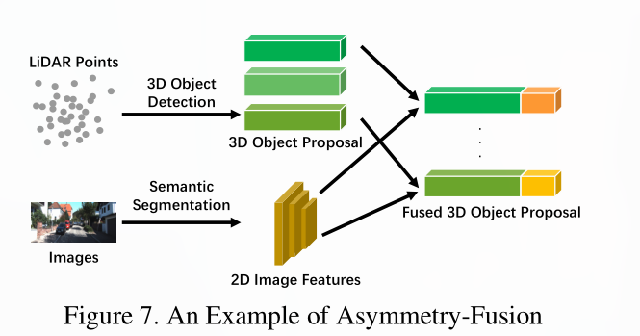
Asymmetry-Fusion
Asymmetry-fusion fuses object-level information from one branch while data-level or feature-level from other
branches.

Slide 7
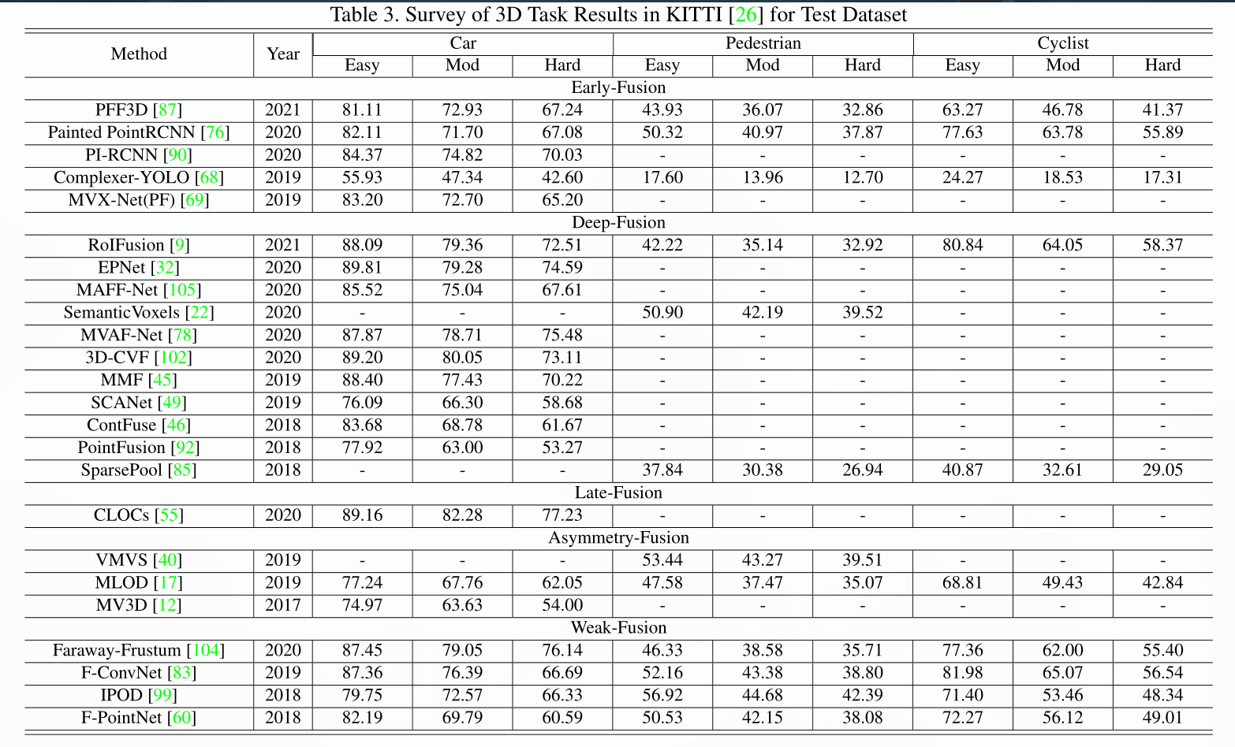
3d detection task on KITTI

Slide 8
This Week
Paper Sharing (周六)——multi-modal fusion in self-driving perception
representations for different modal
fusion taxonomy and methods
performance comparison
trend

