Slide 1
Microsoft Movie Studio
Data-Driven Decision
Catherine Gakii

Slide 2
Content
Introduction
Business context
Data
Process Steps
Results & business application(recommendation)
Evaluation and future improvement ideas
Contact information

Slide 3
Introduction
Our client- Microsoft seeks to start a new business
The goal: Explore the type of movies that can fetch the most revenue and make the business success
The variable of interest are:
Top movie rating
Domestic gross revenue
Top movie studios

Slide 4
Data Source
The data used for analysis in this project were:
1. im.db.zip specially movie _basics and movie_ratings link
2. bom.movie_gross.csv.gz

Slide 5
Process Steps
Imported the relevant libraries in the python
Imported and read the datasets
Explored the data to check the outlies, duplicates, and missing values and fixed them
Analyzed the specific variable of interest and visualized the outcomes

Slide 6
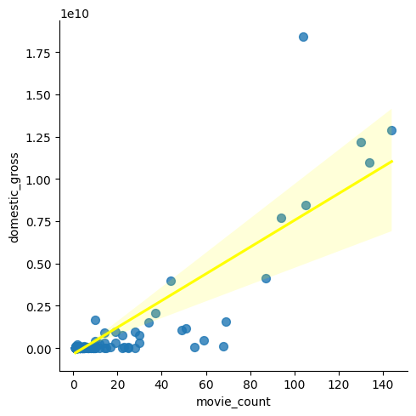
Results Conclusion
Positive correlation between the domestic revenue and movie production

Slide 7
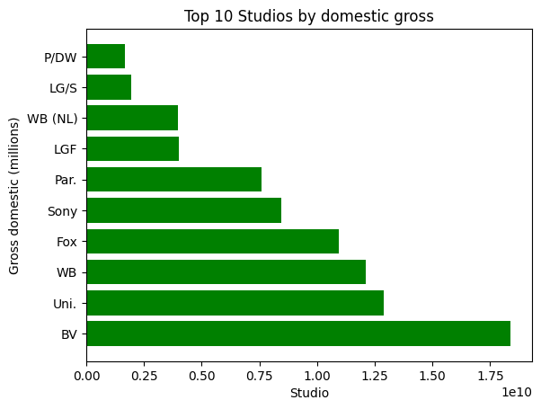
Results Conclusion
Top Studios with the highest domestic revenue

Slide 8
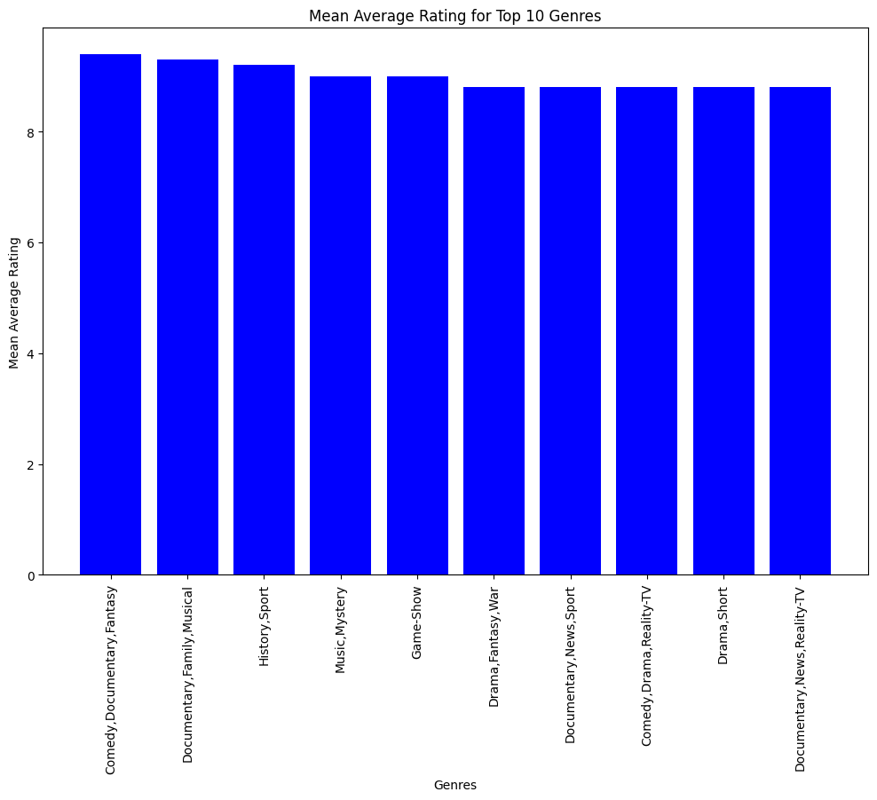
Results Conclusion
Top genres with highest rating

Slide 9
Conclusion
Based on the analysis, it can be concluded that the top studios producing the most successful movies in terms of gross revenue is DV with the highest revenue.
The data also suggests that there is a positive correlation between a studio's movie production and its gross revenue.
Based on the analysis, we can see that the genres Comedy,Documentary,Fantasy have the highest mean average rating of 9.4.This suggests that movies in these genres tend to be more highly rated by viewers compared to movies in other genres.

Slide 10
Recommendation
Microsoft should consider genres as an important factor to consider when producing movies, as it can have a significant impact on the viewer's perception of the movie.
Microsoft company may want to consider partnering with one of the top studios or emulating their successful strategies.
Microsoft can focus on producing a larger quantity of movies in order to increase the chances of generating higher gross revenue.

Slide 11

Contacts
Catherine Gakii

