Slide 1
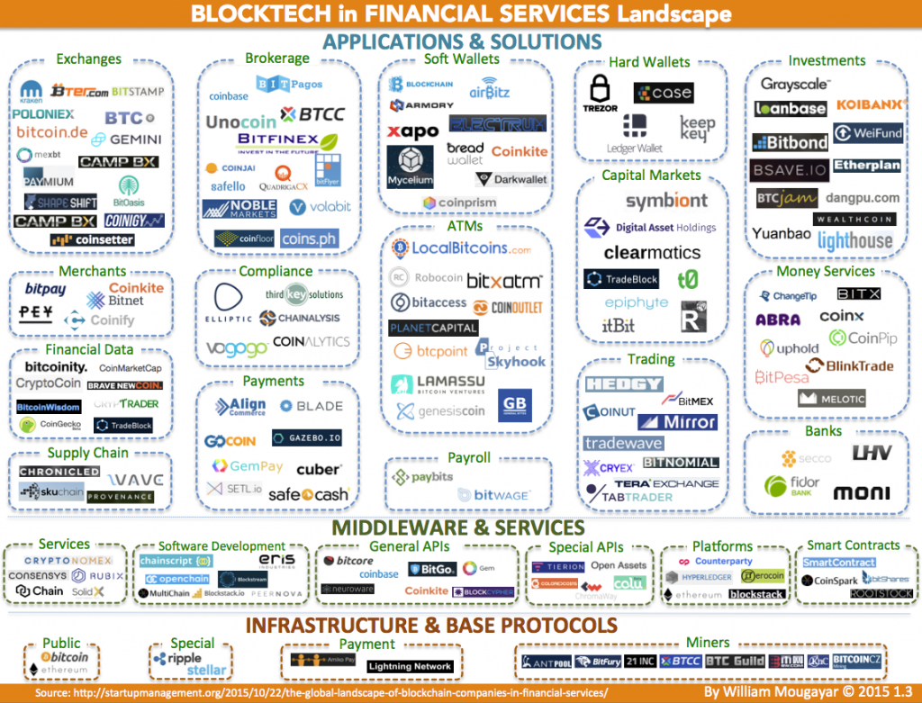

Slide 2
Exchanges
Brokerage
Wallets
Investments
Banks
Compliance
Merchants
Payroll
ATMs
Financial
Data
Capital
Markets
Trading
Supply
Chain
Money
Services
Payments
Services
Software
Dev
General
APIs
Special
APIs
Platforms
Smart
Contracts
Public
Special
Payment
Miners

