Slide 1
RiskMetrics Group Overview
Presentation to ABC Client
Date
Presenter
email@address.com

Slide 2

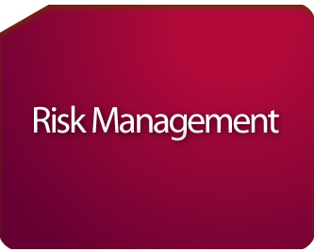


RiskMetrics Group: One Company/Multiple Capabilities
We help investors better understand and manage risk across a broad spectrum
  RiskMetrics Group offers industry-leading products and services in the disciplines of risk management, corporate governance and financial research & analysis
  RiskMetrics – a leading provider of quantitative risk management and portfolio analytics
  ISS Governance Services – a leading provider of corporate governance and proxy voting services
  Financial Research & Analysis – a leading provider of forensic accounting, legal, M&A, environmental and social research

Slide 3
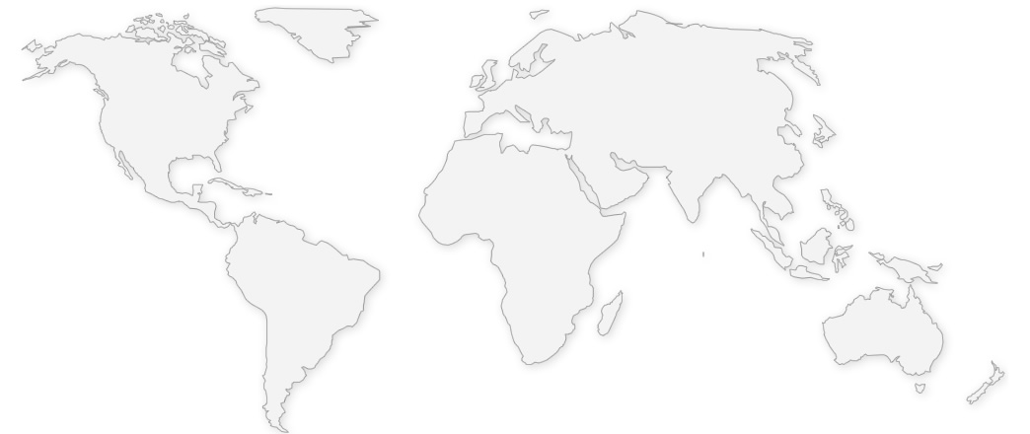
RiskMetrics Group
  3 Leading Businesses
  Over 2000 Institutional Clients
  1200 Corporate Clients
  1000+ Employees
  19 Offices - New York Headquarters
  Global Data Procurement Network
  Research Depth and Industry Innovation

Slide 4
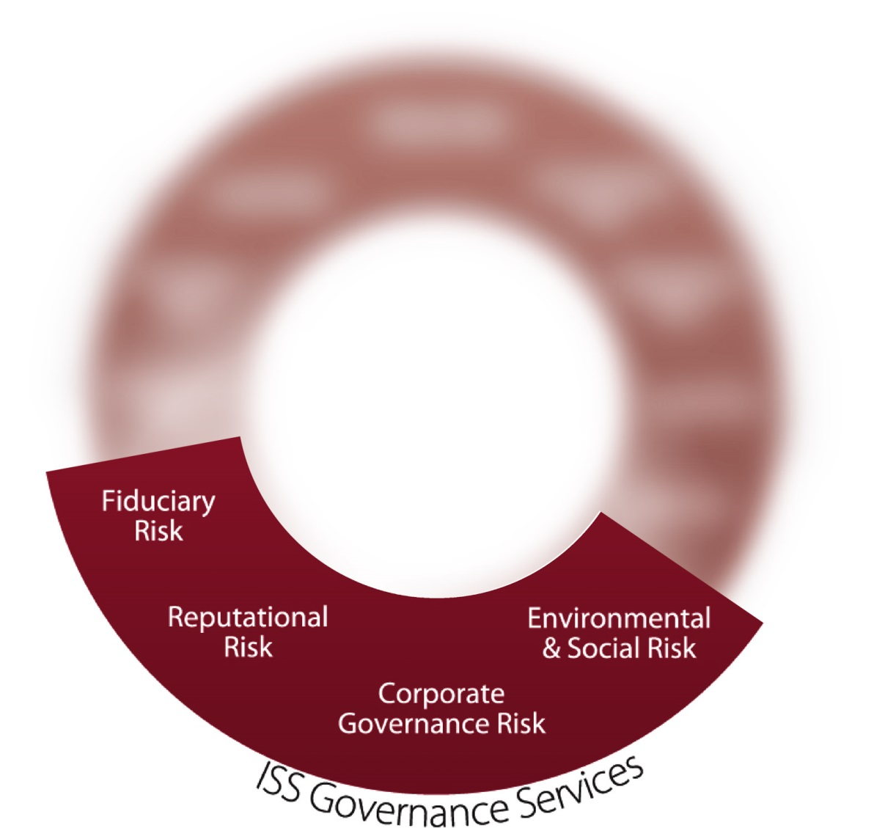
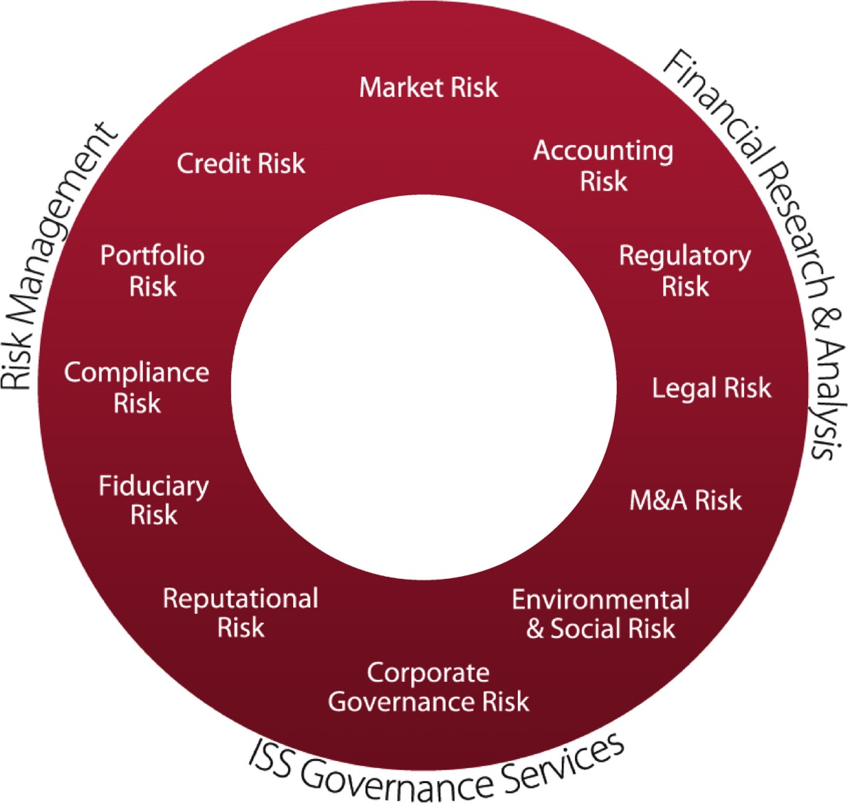
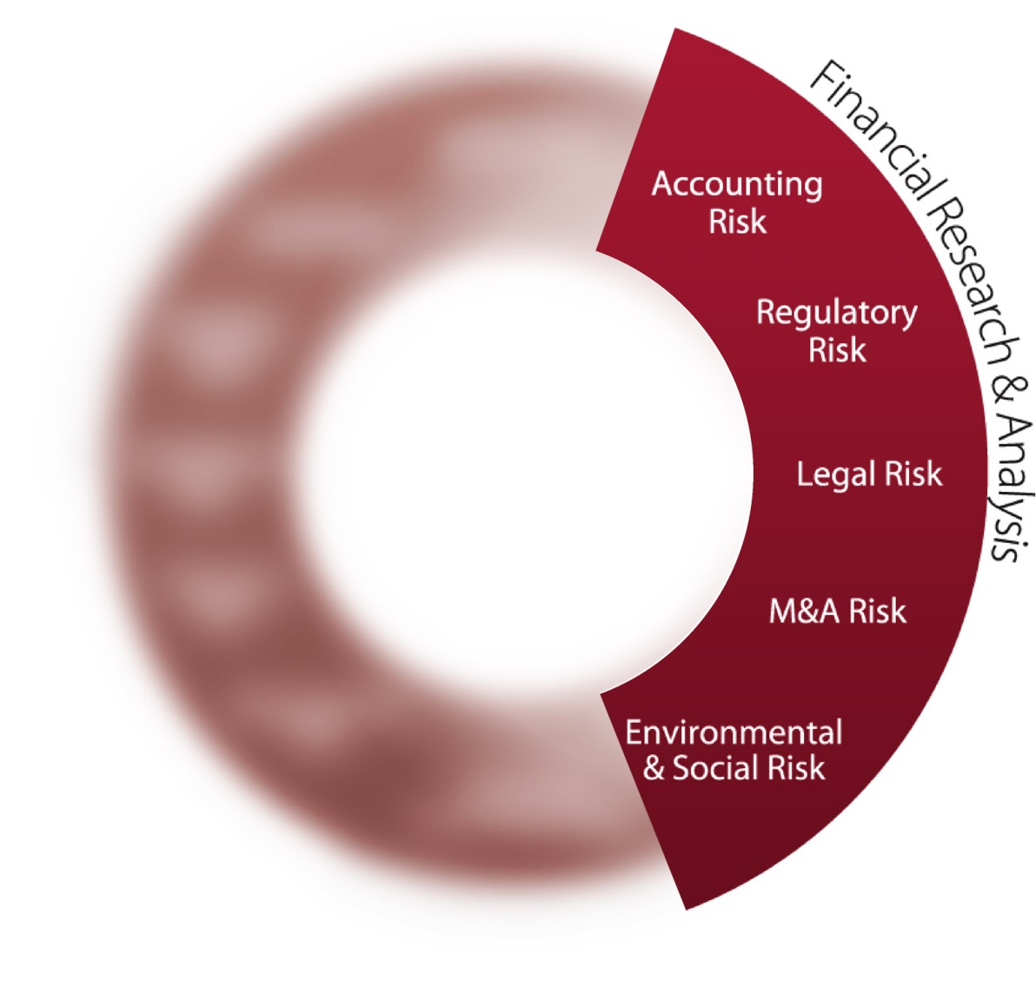
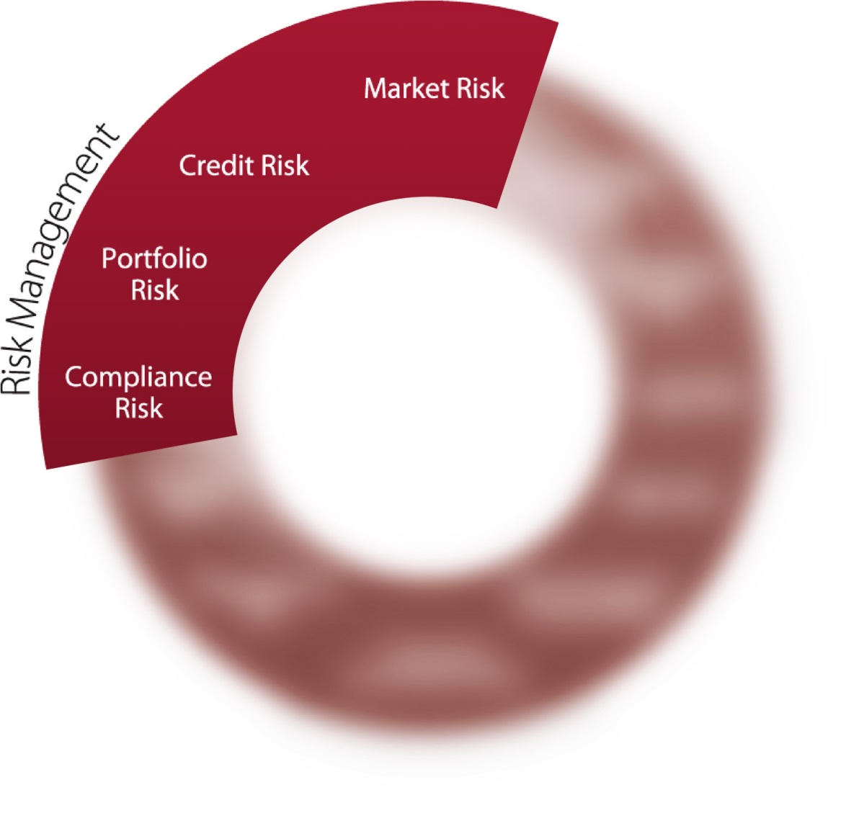

Addressing a Broad Spectrum of Risk
RiskMetrics Group views risk through a wide lens, enabling clients to make more informed decisions based upon multiple points of risk insight and a more complete risk management solution.
    Proxy Analysis
    Proxy Voting
    RREV
    Global Proxy Distribution
    Securities Class
    Action Services
    RiskManager
    CreditManager
    Risk Measurement
    Data Services
    Portfolio Reporting
    Accounting Research
    Legal Research
    M&A Research
    ES&G Research
    Data & Analytics
RiskMetrics Group

Slide 5



Scope of Services
  RiskManager
  CreditManager
  Risk Measurement
  Data Services
  Portfolio Reporting
  Proxy Analysis
  Proxy Voting
  RREV
  Global Proxy
  Distribution
  Securities Class
  Action Services
  Accounting Research
  Legal Research
  M&A Research
  ES&G Research
  Data & Analytics

Slide 6
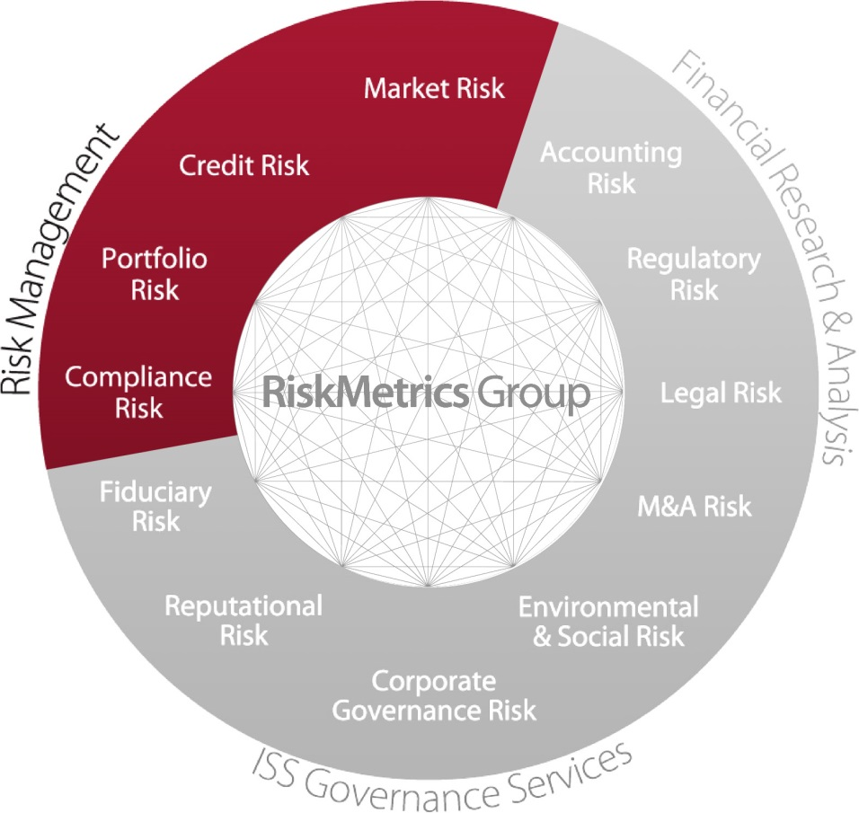
Risk Management
RiskMetrics provides leading risk and wealth management solutions to the global financial community.
  Providing Risk Management solutions to over 600 clients in 50 countries
  Broadly accepted by risk practitioners and regulators as the standard for over 10 years
  Continuously evolving, time-tested methodology
  Coverage on over 70 Global Exchanges, 90 currencies and over 30,000 Global Indices
  Flexible solutions customized to suit client needs

Slide 7
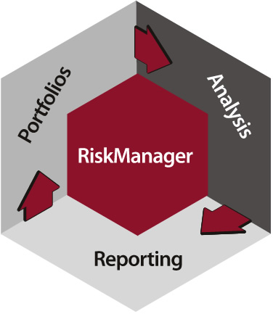
RiskManager
Identify, Measure, and Manage Risk
RiskMetrics’ entire suite of analytics, market data and security master data in a fully-
integrated risk solution.

Slide 8
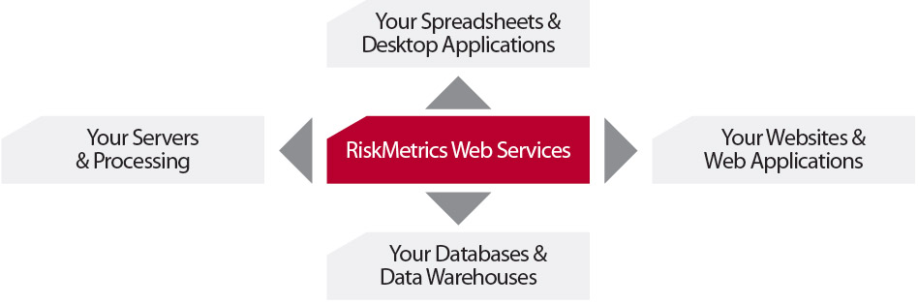
Web Services
Provides secure, accurate and timely measures of risk, accessed on-demand from across the globe
Seamlessly integrate RiskMetrics Group's hosted best-of-breed data and risk analysis
directly into your own applications, data warehouses, spreadsheets, databases and workflows.

Slide 9
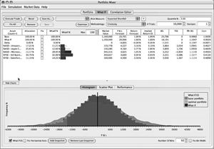
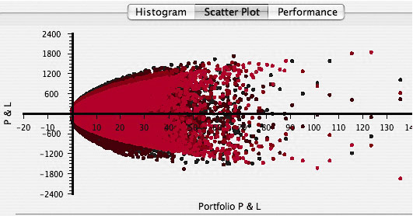
Portfolio Pilot
Portfolio managers can interactively explore new dimensions of performance
and return
Test & Graph a Variety of Statistics
  Efficient frontier
  Return/ Risk Omega
  Compare simulated and portfolio P&L
  Test correlation assumption
Portfolio Pilot provides real-time feedback as users manipulate the composition of their
portfolios, toggle between simulation methodologies, adjust capital market parameters,
and explore portfolio risk optimizations.

Slide 10
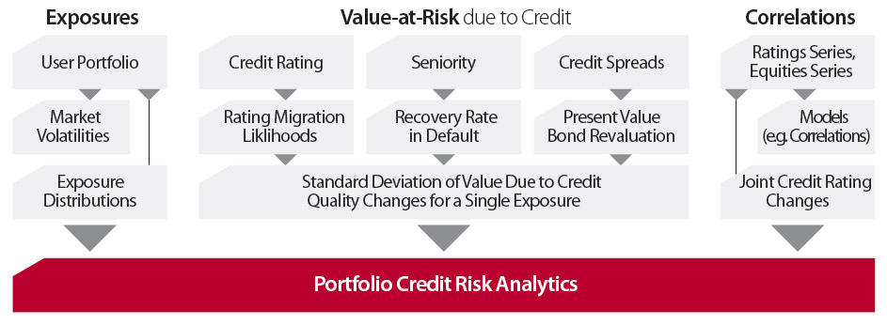
CreditManager
Helps institutions measure, analyze and manage portfolio risk due to credit events
Credit Manager quantifies overall credit risk by capturing market exposures, rating changes and default risks within a Value-at-Risk and expected shortfall framework.

Slide 11
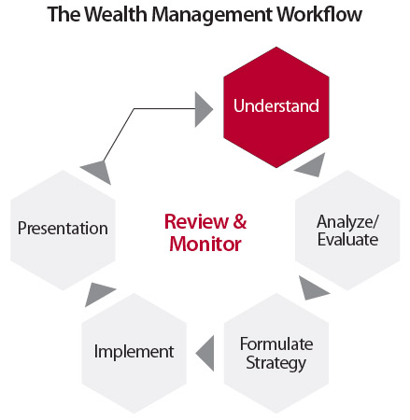
WealthBench
Enabling advisors to deliver fully-informed, tailored investment planning proposals reflecting each clients’ needs, goals and constraints while remaining consistent with house investment- and risk-based policies
WealthBench offers wealth management professionals superior financial planning and client relationships building tools.

Slide 12
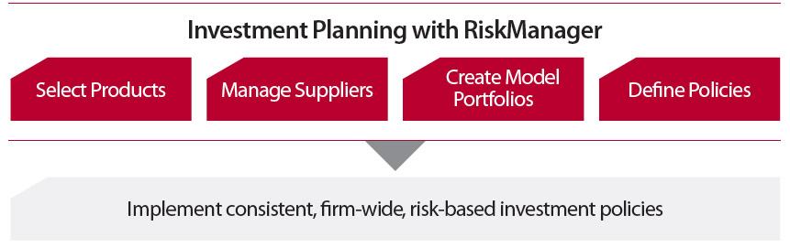
Investment Planning with RiskManager
Consistent cross-asset class and cross-product risk analysis
Users can:
  Select products
  Manage suppliers
  Create model portfolios
  Define risk-based investment policies for implementation firm-wide
RiskMetrics Group's Investment Planning services allow investment management professional to meet all their firm's risk management requirements.

Slide 13


ISS Governance Services
Our solutions help our clients manage their corporate governance and fiduciary risks through proxy research and recommendations, an end-to-end proxy voting platform and compliance support services.
  Proxy Advisory Services
  Custom Proxy Advisory Services
  Taft-Hartley Advisory Services
  Social Advisory Services
  RREV Research Services
  Proxy Voting Services
  Vote Disclosure Services
  Voting Analytics
  Global Proxy Distribution
  Securities Class Action Services
ISS Governance Services is a trusted partner in addressing our clients’ full spectrum of proxy research and voting needs.

Slide 14
ISS Governance Services – Our research approach
No other proxy advisory firm offers our combination of deep domain expertise, global scope, and range of research perspectives
  More than 200 highly credentialed research professionals, many with advanced degrees, fluent in more than 25 languages
  20 years experience in corporate governance
  Research team structured to address key governance issues of audit, board structure, compensation, M&A and capital issuance
  Transparent proxy voting policies, formulated through an open process
  More than 38,000 meetings covered across 100 markets
Domain Expertise
Audit
Board
Compensation
M&A
Corporate
Responsibility
100 global markets
Benchmark U.S. &
International
Custom Policies
Social and
Environmental
Research Perspectives
Taft-Hartley
Faith-Based
Public Fund
ISS Governance Services offers a broad range of policy options, including custom policy development, supported by the industry's largest and most experienced research team.

Slide 15
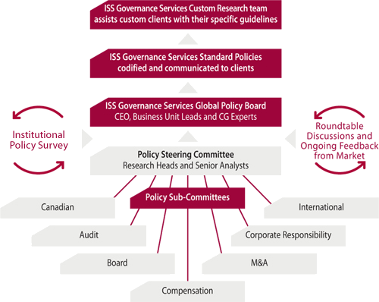
U.S. and International
Proxy Advisory Services – Policy Formulation
Proxy voting policies developed through a collaborative process with the investment community and industry constituents
  Our policies, and the process by which they are formulated, are transparent and open
  Ongoing market feedback, including surveys, roundtables and an open industry comment period, is a critical input into the policy formulation process
  Policies and market feedback are all available via our Policy Gateway at www.riskmetrics.com/issgovernance/policy

Slide 16
Custom Proxy Advisory Services
Helping investors vote their proxies according to their unique corporate governance philosophies
  Custom policy experts and clients collaborate to develop policy guidelines that drive research and recommendations for every security in a clients’ portfolio
  Custom consulting for a wide range of labor-driven and corporate social responsibility issues, including climate change risk, global labor standards, fair employment, forced labor and more
  Turnkey Proxy Voting Services ensure that votes are executed reliably, with clients maintaining control of the voting decision
  Ongoing monitoring by our governance experts helps clients evaluate emerging policy issues and new types of shareholder proposals
Client Governance
Views
Custom Policy
Guidelines
Custom Research and
Recommendations
Custom Vote Execution
ISS Governance Services
Policy Expertise
More than 300 institutions worldwide rely on our custom proxy advisory services to develop and apply voting policies that reflect their unique corporate governance philosophies or those of their underlying clients.

Slide 17
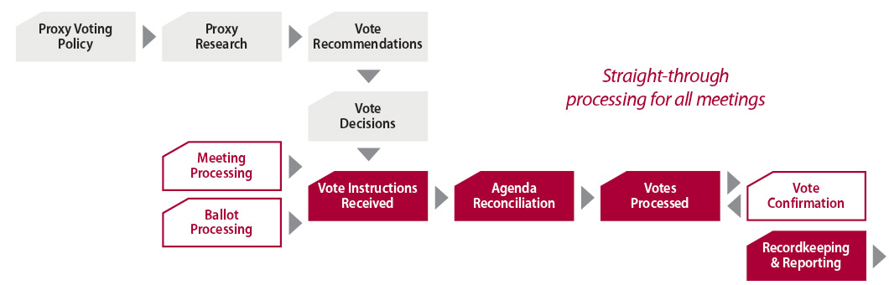
Proxy Voting Services
No other solution offers the depth of data, reliability and ease of use of ISS Governance Services’ end-to-end proxy voting solution
  Continuous quality control measures to ensure system reliability
  Daily audits, detailed vote reconciliation and automated, end-of-day production checks ensure all votes are executed accurately
  Key Performance Indicators (KPI) for monitoring critical voting processes, including meeting notification, research delivery timeliness and proxy season production work flows
  Straight-through-processing for all meetings
  Dedicated account management
  Comprehensive client training programs
  Ongoing oversight of key voting processes
  SAS 70 Type I and II certifications and ongoing SAS 70 audits
End-to-End Proxy Voting Services

Slide 18
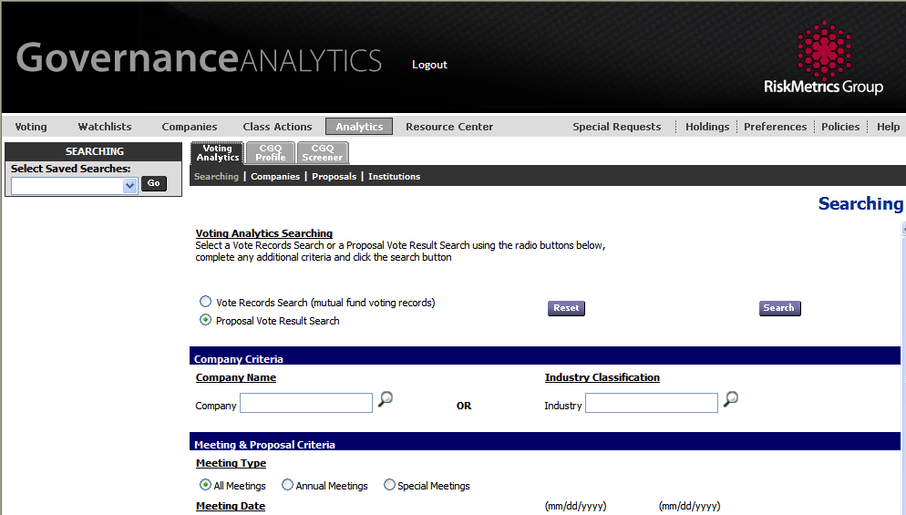
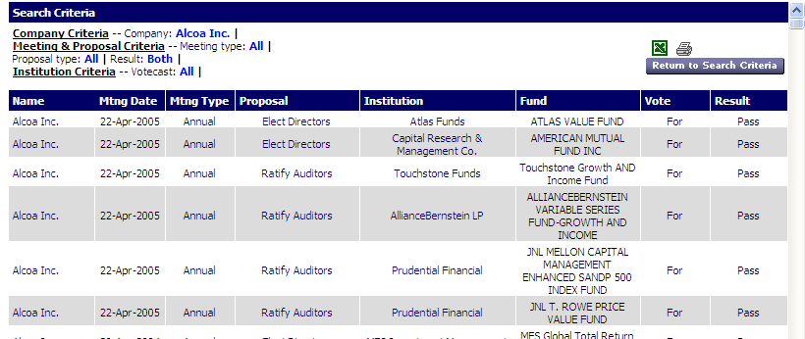
Voting Analytics®
Detailed information on proxy vote records and results to help you be an informed fiduciary
Client Benefits:
  Benchmark proposal frequency, success and failure rates as well as analyze for-and-against statistics
  Identify voting patterns and trends through analysis of vote records and vote results
  Aggregate voting statistics by proposal, by fund, or meeting by meeting
  Compare voting policies and guidelines
  Access 10-Q filings and N-PX results
  Access the proxy voting policies and records of the largest institutional investors in the U.S.
  Three years of vote records for top mutual fund complexes, plus eight years of vote results for Russell 3000™ company meetings

Slide 19
Global Proxy DistributionSM Services
Global Proxy Distribution offers custody banks a single, turnkey solution to the complex process of proxy distribution
  Proactive procurement from a network of global and local sources
  Accurate coding of shareholder meeting agenda items
  Daily client holdings updates, including shares-on-loan data, for quicker and more accurate meeting notification
  Consolidated client-specific ballots for all account positions
  Online and e-mail alerting for over 200 specific shareholder meeting issues
  Accurate, timely proxy set up, including powers of attorney
  Comprehensive reporting exceeding compliance requirements
  Quality control and auditing, including SAS-70 Type I and II audits
Meeting
Processing
Meeting
Information
Procured from
Local Market
Client Holdings Data
From Custodian
Vote
Instructions
Executed
Vote
Confirmation
Recordkeeping &
Reporting
Ballot
Processing

Slide 20
Global Proxy DistributionSM
ISS Governance Services’ expertise across all stages of the complex proxy distribution and voting process ensures accuracy and quality in proxy distribution
Material ID &
Materials Procurement
Voting Entitlements
Best Practice
Governance
Integrated, Web-Based
Solution
Full Service Support
  38,000 shareholder meetings annually in 100 markets
  Dedicated staff in 7 global service centers for proactive, timely identification of meetings and procurement of shareholder meeting materials
  25 languages translated “in-house”
  Proactive monitoring of meeting activity in all markets covered
  Limited reliance on subcustody network for meeting notification
  Local market voting expertise
  Verification of voting securities and voting entitlements
  Prompt notification of share position, meeting detail changes and related corporate actions
  Reconciliation of client holdings positions
  Leverage governance expertise to apply to the coding and distribution of proxy ballots
  200+ regionally-based analysts worldwide
  Best practice governance policy developed over 20+ years
  Integration of customized, client-based policies onto voting platform
  Governance Analytics & Votex platforms set new standards in web-based proxy voting solutions
  Best-practice data security and user account & password control
  Full user customization
  Intra-day updates for best timeliness
  Research & governance content fully integrated with voting functions
  Flexible and comprehensive reporting
  Compatible with ISS Governance Services’ compliance solutions
  Local service support and account management
  Outsourcing of vote administration work available through Voting Agent Service
  Research and processing support available from a single provider

Slide 21
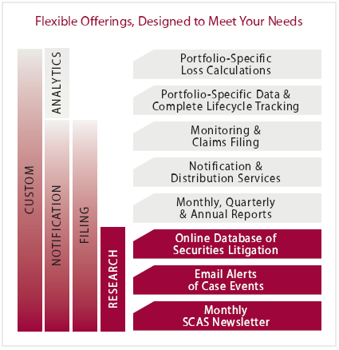
Securities Class Action Services
Providing investors with a comprehensive solution for securities class action claims research, notification, filing and analytics
  Provides complete research and analysis on all federal, state and SEC settlements
  Notification and tracking of settlements across their life cycle
  Outsourced claims filing services for asset recovery
  Loss calculation analytic services with three standard calculation formulas available
  Notification and Distribution Services (SCAS NS) notify retail nondiscretionary accountholders of eligibility and provide filing materials and documentation

Slide 22
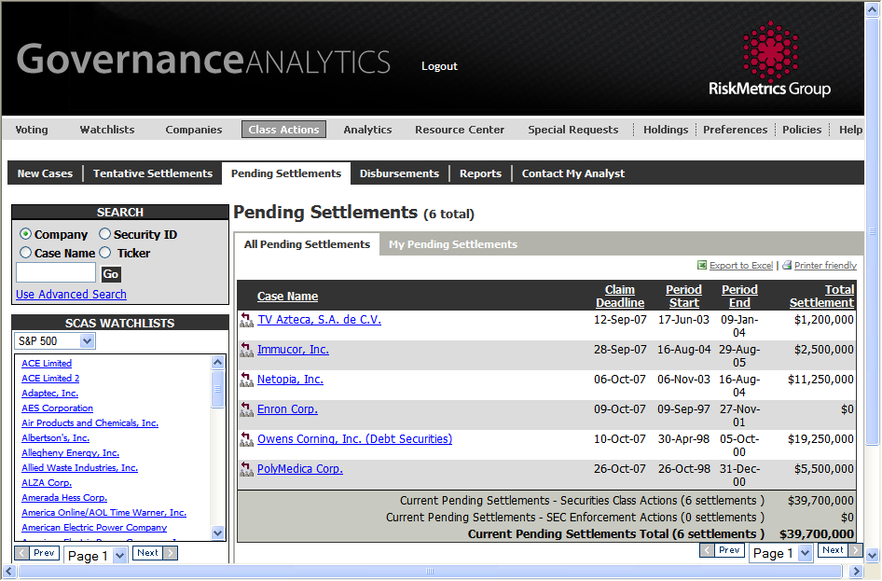
Securities Class Action Services
Delivered via the integrated Governance Analytics platform
  Provides portfolio-specific views of cases and settlements
  Management reports available on a monthly, quarterly, and annual basis
  E-mail alerts to monitor securities class action lifecycle
  SCAS Alert monthly newsletter and Securities Litigation Watch blog keep you abreast of securities litigation developments
Securities Class Action Services helps investors recover every settlement dollar they are entitled to.

Slide 23
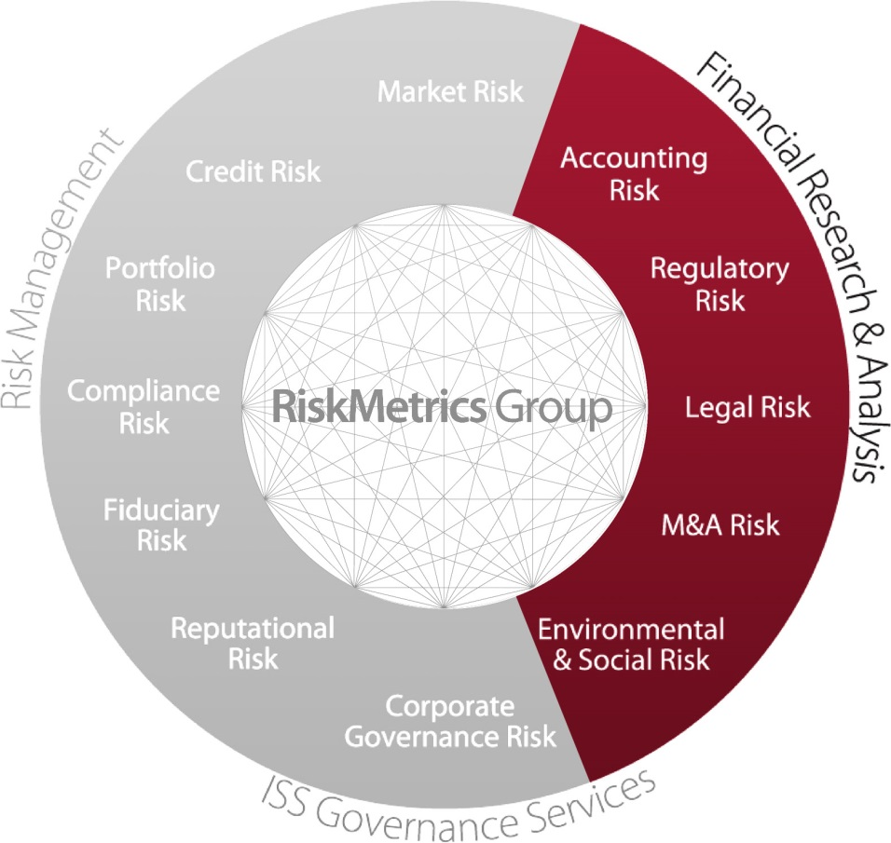
Financial Research & Analysis
Solutions designed to help clients make more informed decisions across a broad spectrum of risk within Accounting, Legal, M&A and ESG
  Identify companies with underappreciated market risk
  Understand the strategic rationale for M&A
  Gain insight into regulatory events and major litigation
  See the environmental and social perspective through the lens of a shareholder
  Recognize strengths, deficiencies, and quality of corporate governance practices

Slide 24

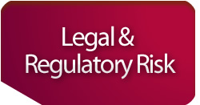


Financial Research & Analysis
A trusted resource for risk management, portfolio monitoring, continuing education, due diligence, and special project work
  CFRA Accounting Lens
  CFRA Due Diligence
  M&A Edge
  CFRA Academy
  CFRA Legal Edge
  Sustainability Research
  Data Feeds
  Screening Solutions
  Corporate Governance Quotient (CGQ)
  Resource Center
  Compensation Modeling
  Custom Analytics
We are a proven resource for idea generation, risk management, due-diligence, increased analytical capacity.

Slide 25
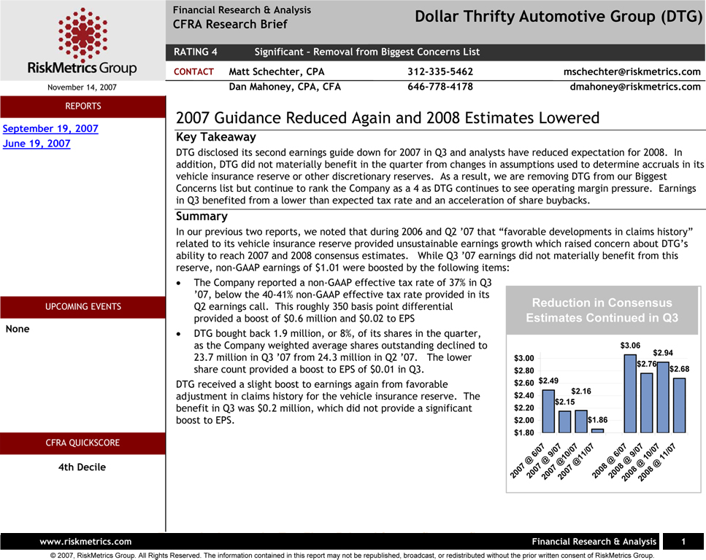
CFRA Accounting Lens
Fundamental, proprietary research that forewarns clients of a company’s operational deterioration, pre-announcements, restatements, and securities claims
COMPANY REPORTS
Detailing quality of earnings, cash
flow, operations, and corporate
governance
EDUCATIONAL REPORTS
Insight into accounting issues and the implications for industries and “at risk” companies
QUICKSCORES
Fully back-tested methodology provides decile ranking of 11,000+ companies’ accrual risk
CONFERENCE CALLS
Analyst calls on accounting - company, educational or industry specific
BIGGEST CONCERNS LIST
Companies flagged with underappreciated risk relative to market value
INDUSTRY REPORTS
Broad-based evaluations of risk within six major industries
RESEARCH BRIEFS
“Actionable” published insights based on recent company information
RESEARCH NOTEBOOK
Raw notes, findings & observations from filings and press releases

Slide 26

CFRA Accounting Lens
Our exception-based research process has identified nearly every significant accounting fraud – and effectively and consistently forewarned our clients of business deterioration
• Proprietary quantitative and qualitative screening
• Universe of 10,000+ companies
• Sourced on key metrics, trends and policies
Screening
And
Triage
• In-depth review of financial statements, footnotes, transcripts, filings and conversations with management
• Intense peer review process –
“The Sounding Board”
Analyze
And
Prioritize
Ideas chosen for in-depth research publication are noteworthy for
insight, actionability and uniqueness
Publish

Slide 27
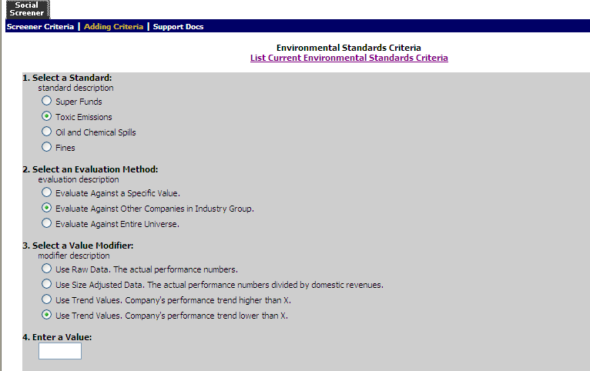
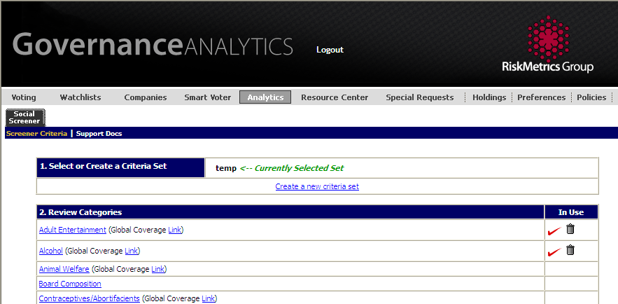
Screening Solutions
Tools for managing portfolios with social and environmental investment criteria
  Screening combines index-based coverage with an exhaustive, issues-based approach to provide coverage beyond the index
  Screening standards based on verifiable, objective research
  Custom portfolio screens available to match your firm’s unique investment philosophy and client guidelines
  Multiple security types are screened, including bonds and options, to help ensure compliance
  Screening data is also available as a data feed to integrate into your trading and compliance systems

