Slide 1

Symbology Progress Update
Yanlai Wu
Advisor: Dr. Tang

Slide 2
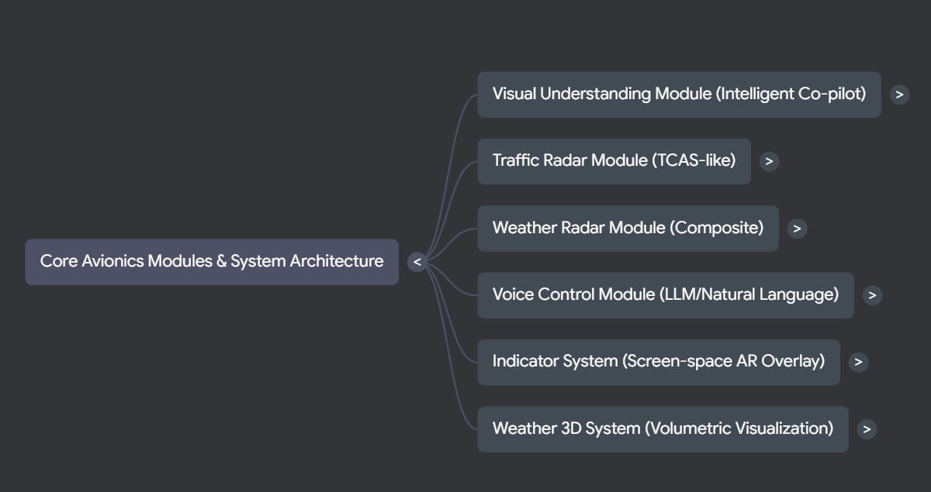

Slide 3
Visual Understanding Module

Slide 4
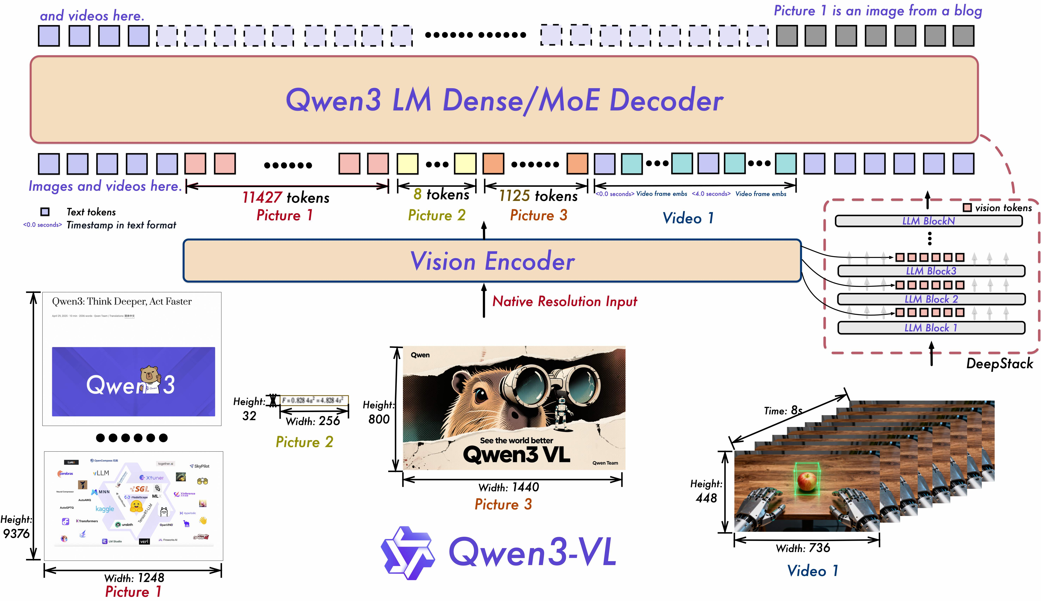
Visual Understanding Module with Multi-Modal LLM
Core Function: The Visual Understanding module serves as an intelligent co-pilot, converting raw cockpit visual data (including charts, radar, and instruments) into concise semantic briefings.
LLM Integration: The VisionLLMClient interfaces with OpenAI-compatible APIs, supporting custom hosted models like Qwen/Qwen3-VL-32B-Instruct-FP8.
Real-time Feedback: Server-Sent Events (SSE) are handled to provide real-time feedback during long analysis generations.
Specialized Analysis: Implementations include the SectionalChartAnalyzer (identifying airspace frequencies and obstacle heights) and the WeatherRadarAnalyzer (mapping visual colors to meteorological severity, such as Light, Moderate, or Extreme Precipitation).
Qwen3-VL Model Pipeline

Slide 5
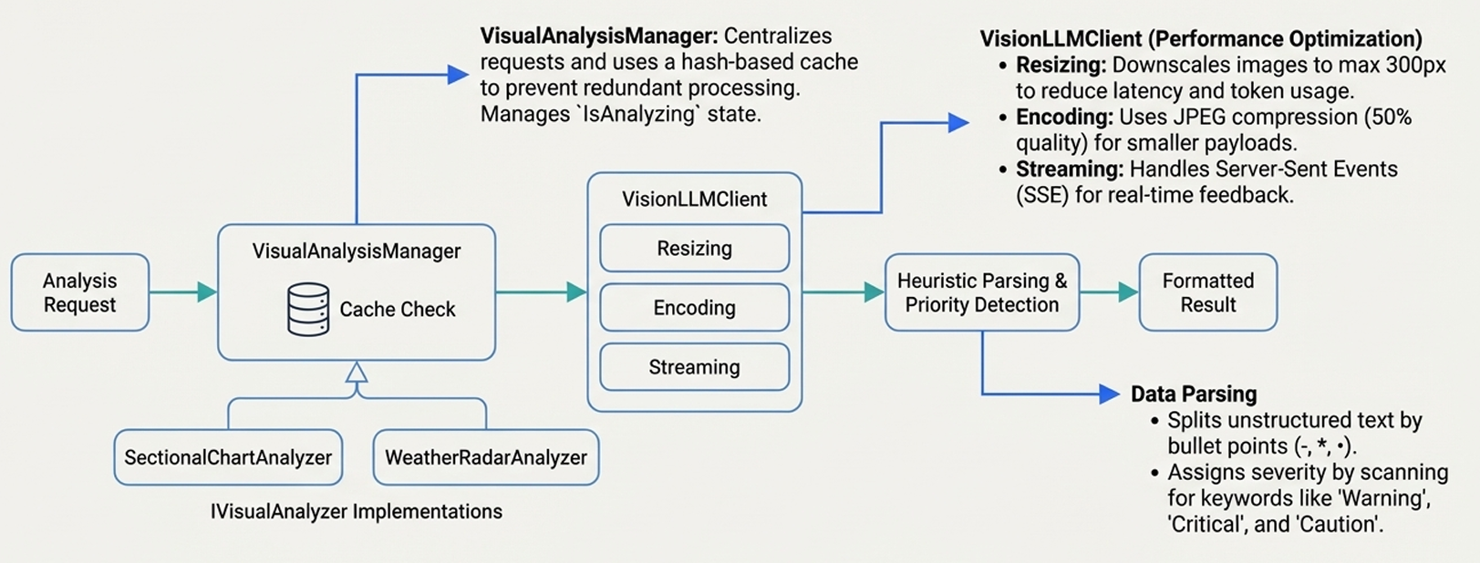
Visual Understanding Module with Multi-Modal LLM

Slide 6
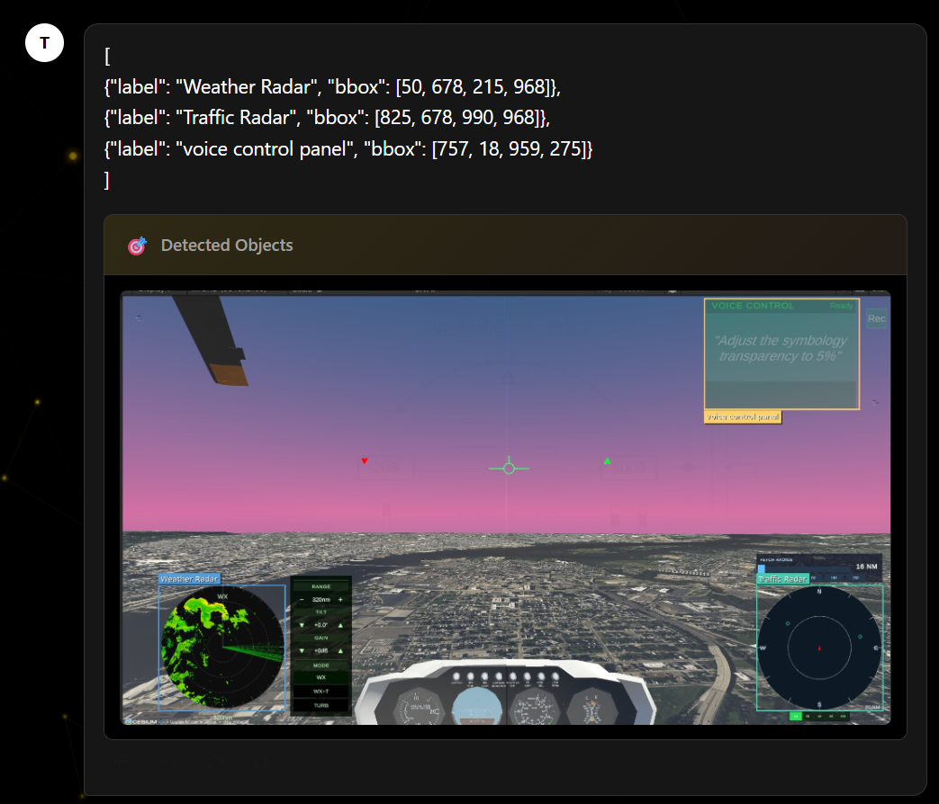
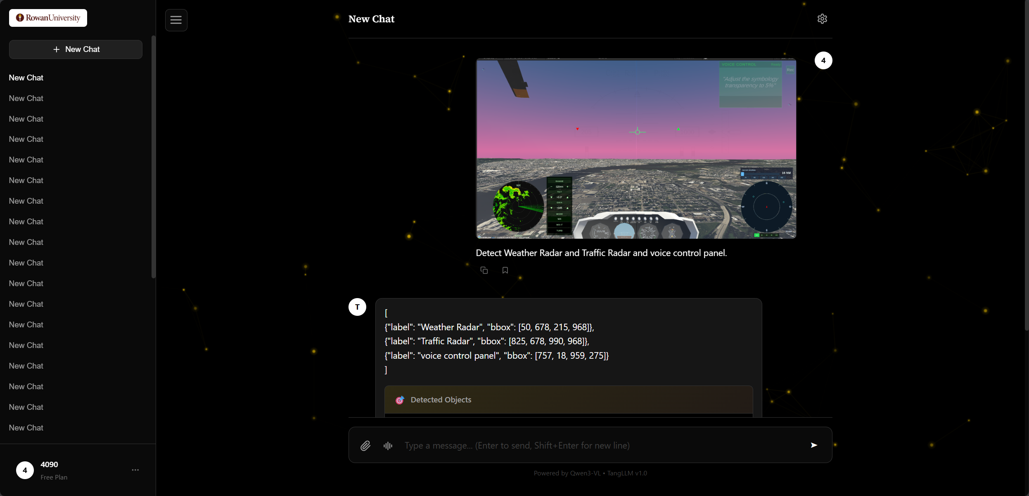
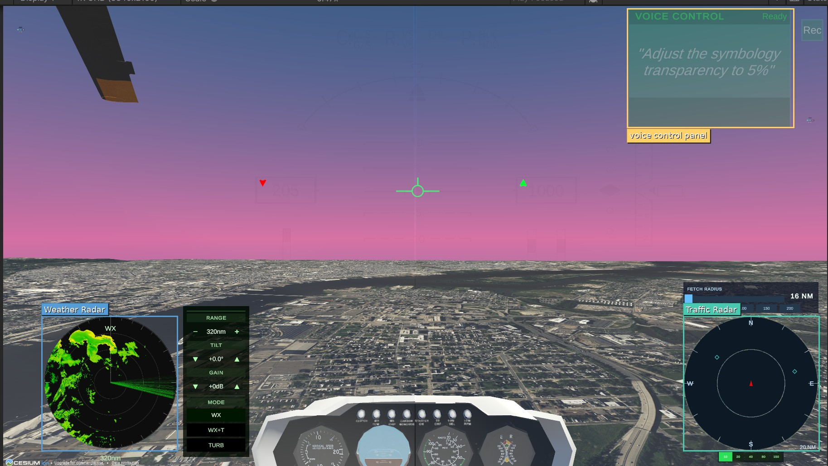
Multi-Modal LLM visual capabilities
Accurately identifies and localizes HUD instruments in complex, dynamic scenes
Demonstrates pixel-level understanding and robust spatial reasoning

Slide 7
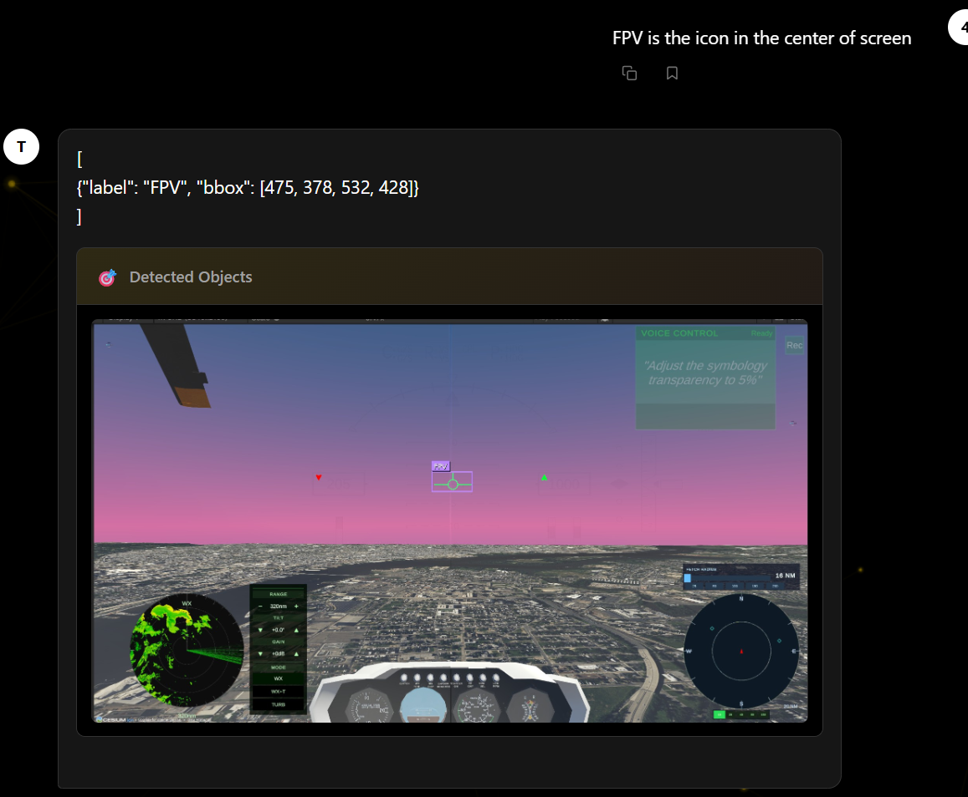
Multi-Modal LLM visual capabilities

Slide 8
Message Communication

Slide 9
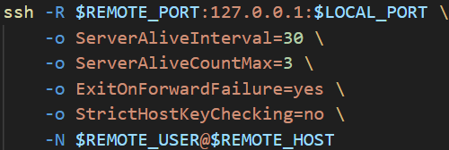
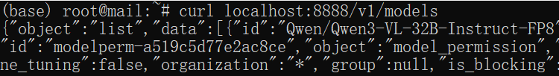


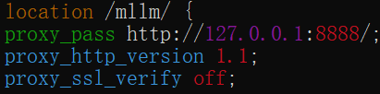



Message Communication
SSH reverse tunnel
Local Machine (w/o public IP)
Executed on local machine running LLM or other stuff (w/o public IP)
Remote Machine (with public IP)
LLM on local machine
https://game.agaii.org/mllm
Nginx Proxy Pass
Local Devices

Slide 10
Traffic Radar Module

Slide 11
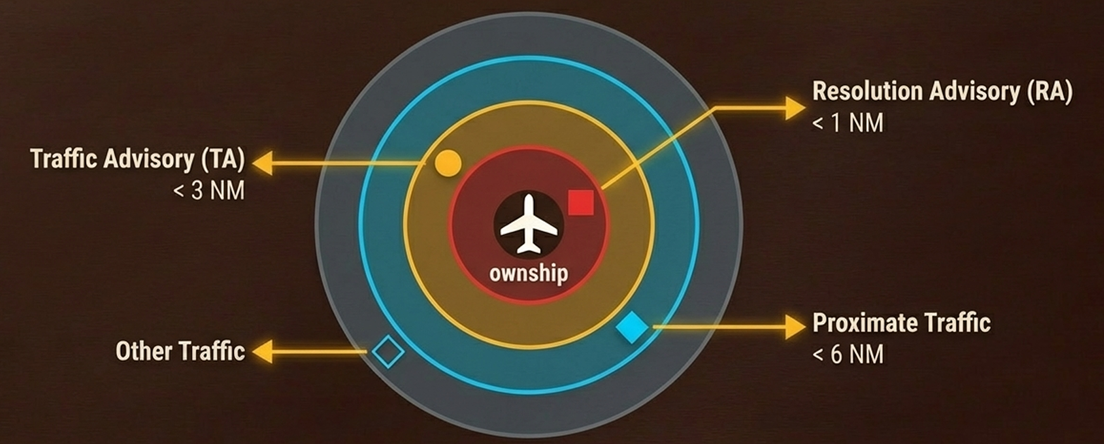
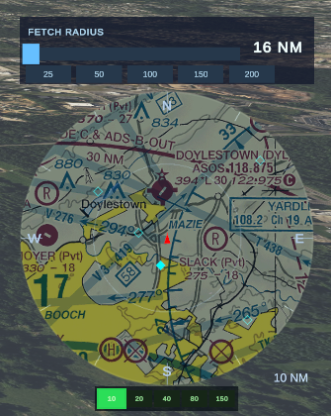
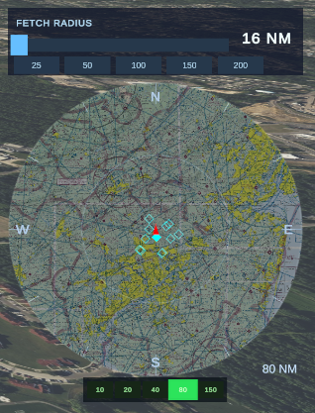
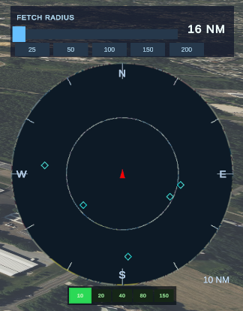
Traffic Radar Module
Overview and Purpose
• Function: A complete TCAS-like (Traffic Collision Avoidance System) display powered by live ADS-B data.
• Data Handling: The TrafficRadarDataManager implements a rigorous caching strategy, requesting data from the Airplanes.live API only when the aircraft moves significantly or a time threshold expires.
• Priority Sorting: Targets are sorted so the most dangerous ones are processed and displayed first if system limits are hit.
Display Features
• Rendering: Uses a mask component to clip the display to a circle.
• Visualization Modes: Supports Track-Up Mode, which rotates the display and compass rose based on the aircraft heading.
• Underlays: Integrates with a provider to render Sectional Chart map tiles beneath the radar targets, maintaining correct rotation and scale.
• User Experience: Employs Micro-Animations to smoothly interpolate range changes (e.g., zooming from 10nm to 20nm) to prevent jarring visual jumps.

Slide 12
Weather 2D/3D Module

Slide 13
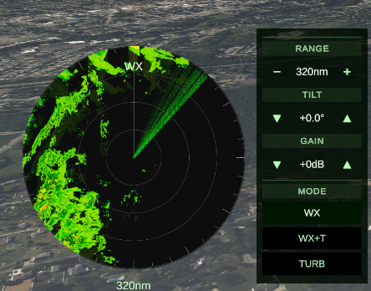
Weather 2D Module
• Composite Radar System: Fetches, stitches, and processes real-world weather data.
• Tile Architecture: The NOAAWeatherProvider acts as a mapping engine, dynamically selecting API zoom levels (1-10) based on the radar's generic range setting (NM).
• Compositing Strategy: Downloads a grid of 256px tiles (e.g., 3x3 or 5x5) and blits them into a single large Texture2D composite.
• Virtual Camera: The final "Radar Texture" uses a virtual camera that pans and rotates over the static composite to match the aircraft heading, preventing data re-download when the plane turns.

Slide 14
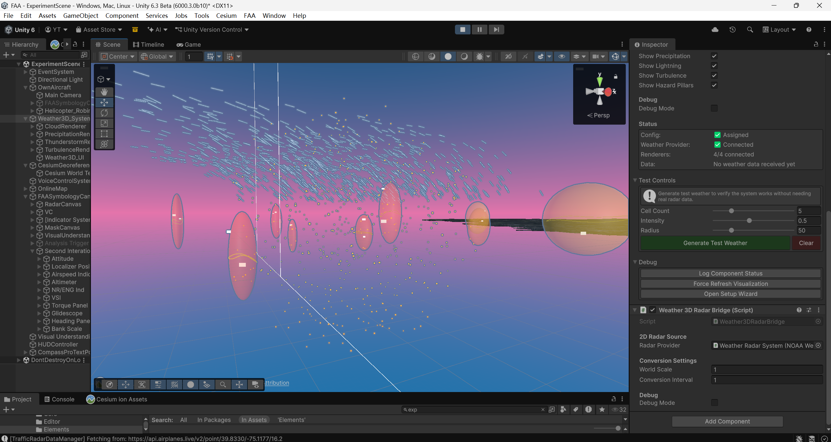
Weather 3D Module- under experimenting

Slide 15
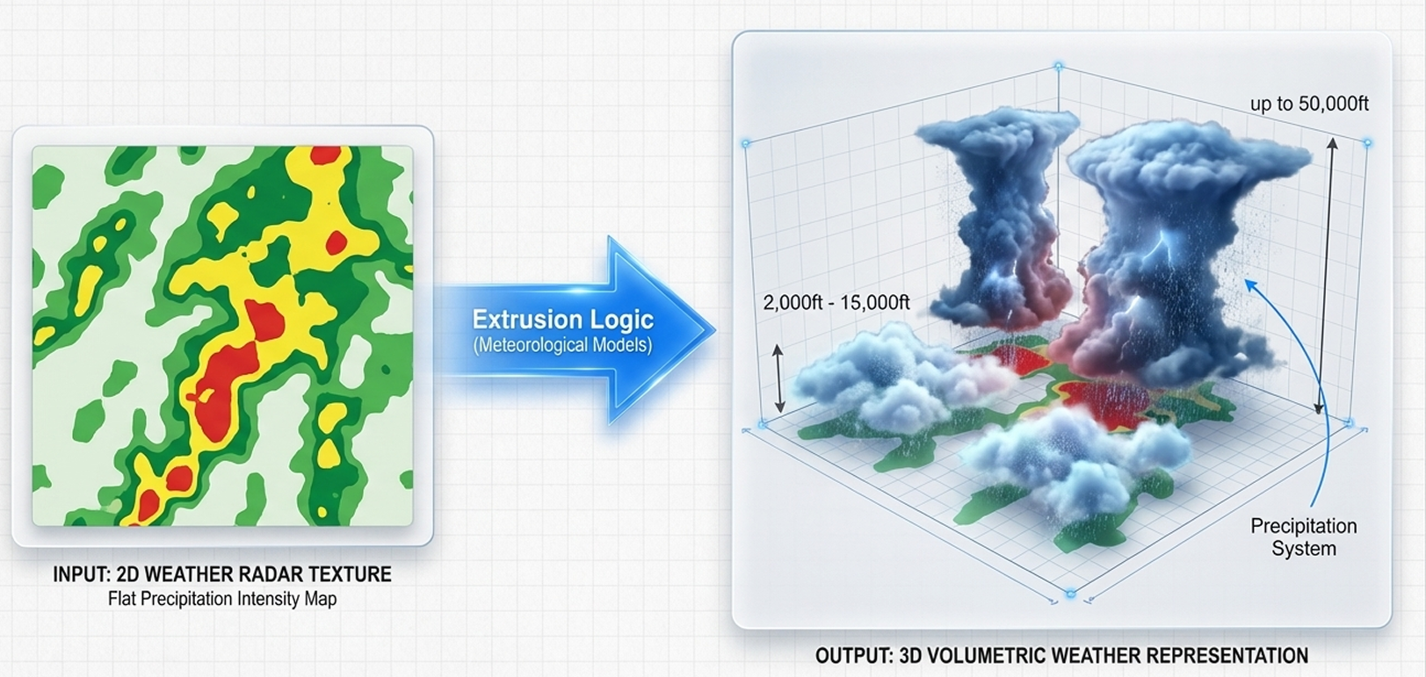
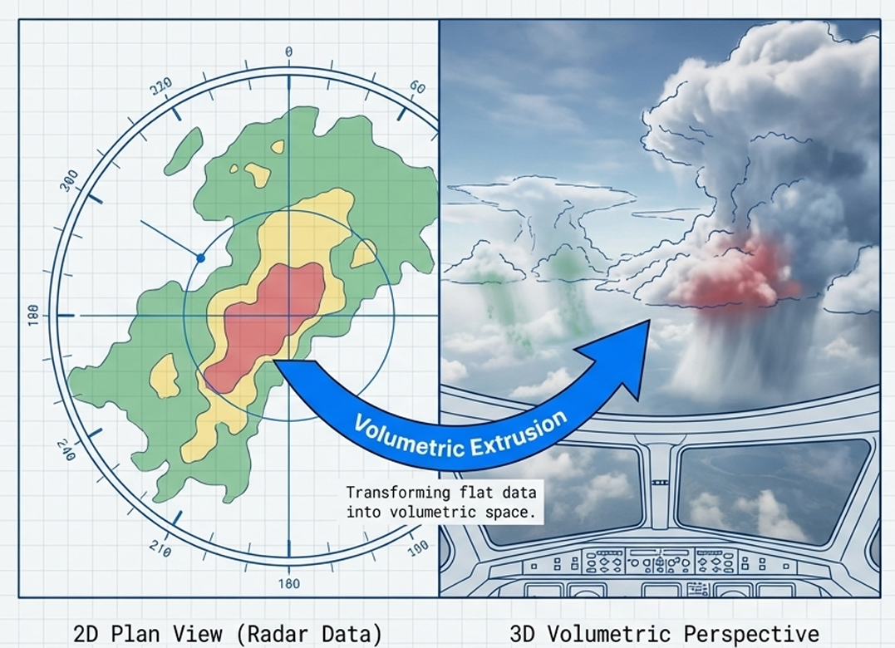
Future visualization plan for 3D weather

Slide 16
Voice Control System

Slide 17
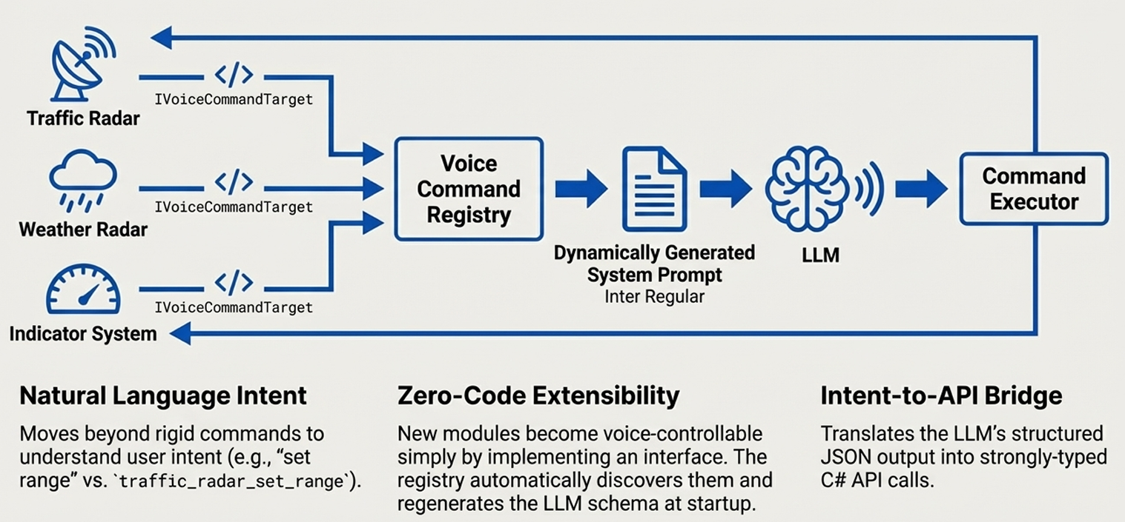
Voice Control

Slide 18
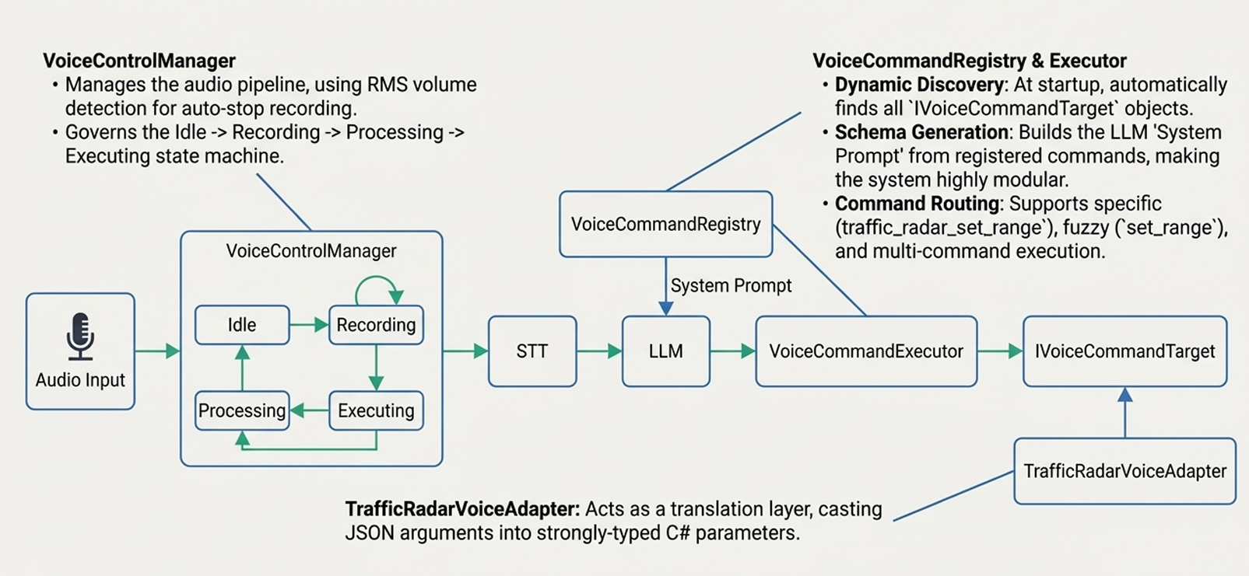
Voice Control Logic

Slide 19
Indicator System Update

Slide 20

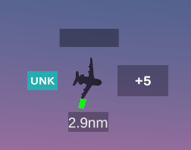

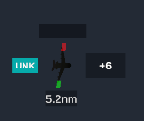
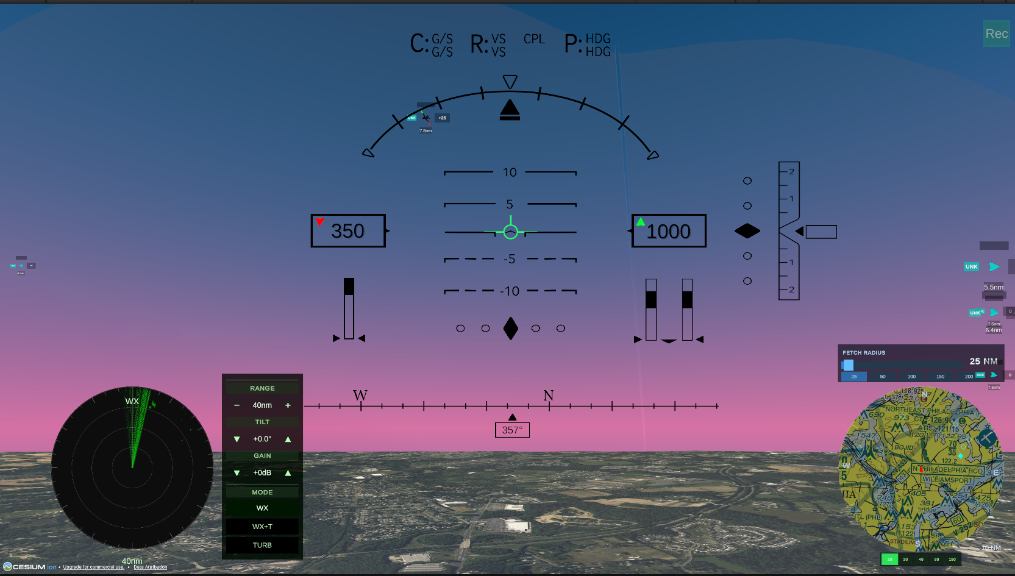
Indicator Module
Core Function & Architecture
• System Purpose: Functions as a screen-space Augmented Reality (AR) overlay system. It visualizes targets, including Traffic, Waypoints, and Hazards, even when these objects are outside the camera view.
• Proximity Logic: The system implements dynamic opacity rules, allowing it to fade out distant targets or make high-priority threats pulse.
Advanced Rendering Features
• Dual Visualization: The IndicatorElement switches between displaying a "Symbol" when the target is on-screen and an "Arrow" when the target is off-screen.
• Pseudo-3D Effect: It creates a "pseudo-3D" effect by rotating the 2D UI symbol to match the target's pitch and bank.
• Navigation Lights: The module procedurally generates navigation lights—Port (Red), Starboard (Green), and Tail (White)—for traffic targets based on the viewer's relative position.

Slide 21
DEMO

