Slide 1

Symbology Development Update
Yanlai Wu
Advisor: Dr. Tang

Slide 2
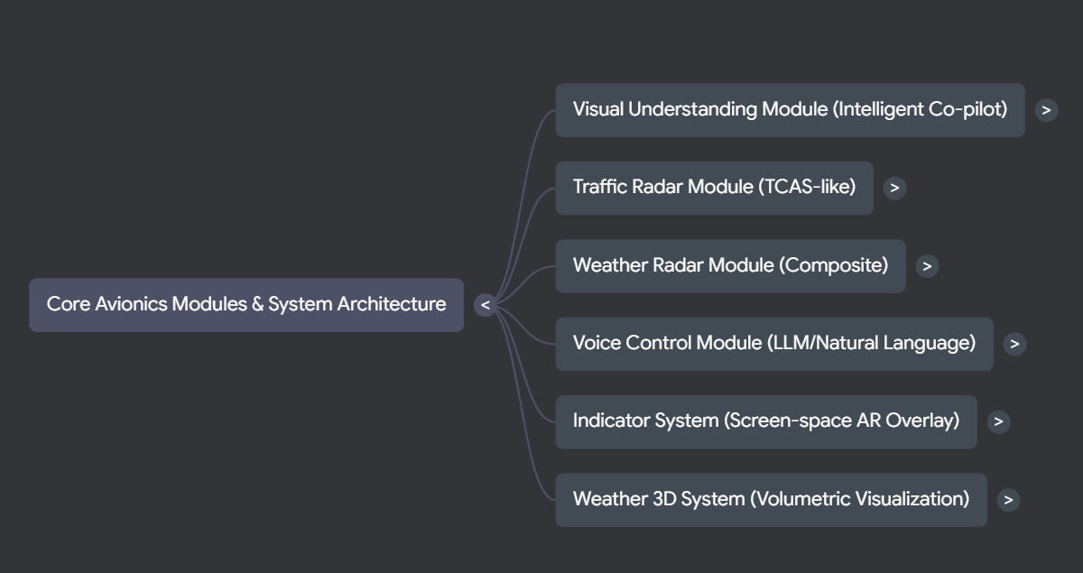

Slide 3
Works Completed This Month

Slide 4
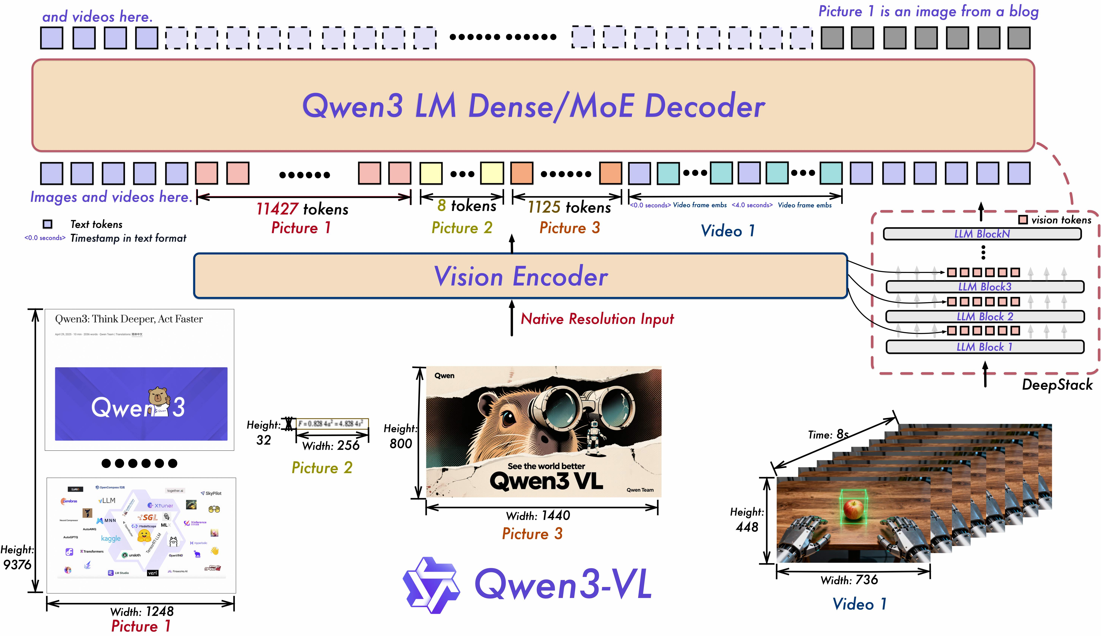
Aircraft Control System
Architecture: Modular flight dynamics system with IFlightDynamics interface supporting multiple aircraft types through clean abstraction.
FixedWingDynamics: Realistic airplane physics with pitch/roll/yaw control surfaces, airspeed management (60-350 knots), coordinated turns, and auto-leveling behavior.
HelicopterDynamics: Rotary-wing simulation with collective/cyclic pitch control, main rotor RPM management (320-400 RPM), tail rotor anti-torque, ground effect, and translating tendency.
AircraftState: Centralized state management for position, attitude, airspeed, and flight parameters with event-driven updates.
Aircraft Control Architecture

Slide 5
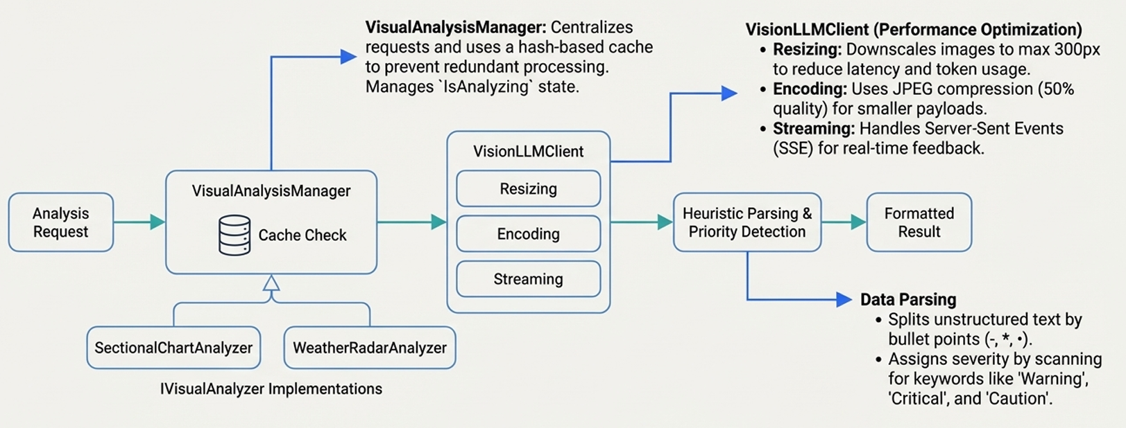
3D Weather Visualization System

Slide 6
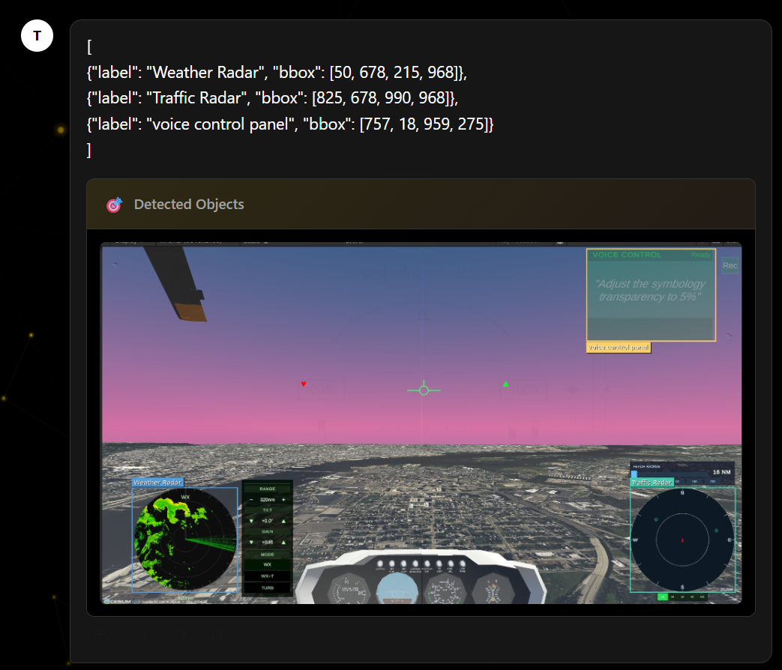
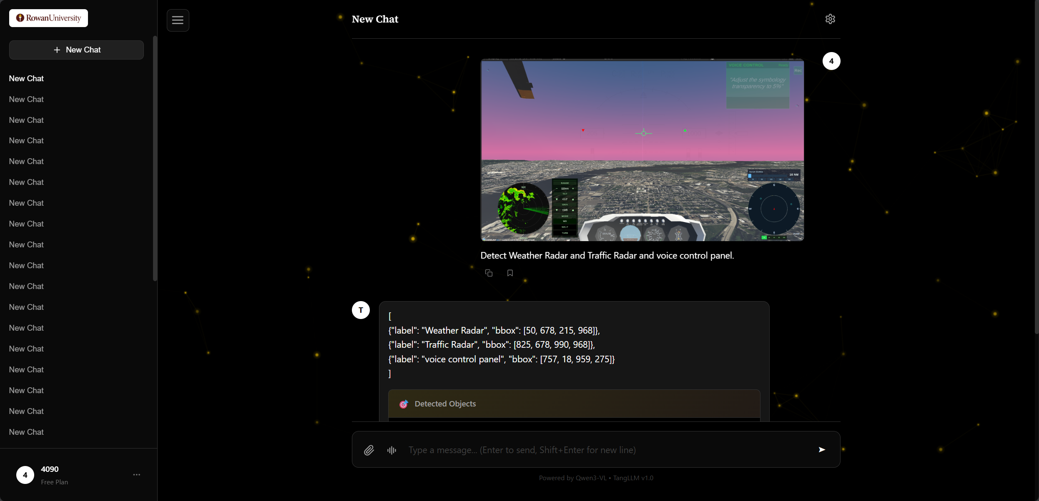
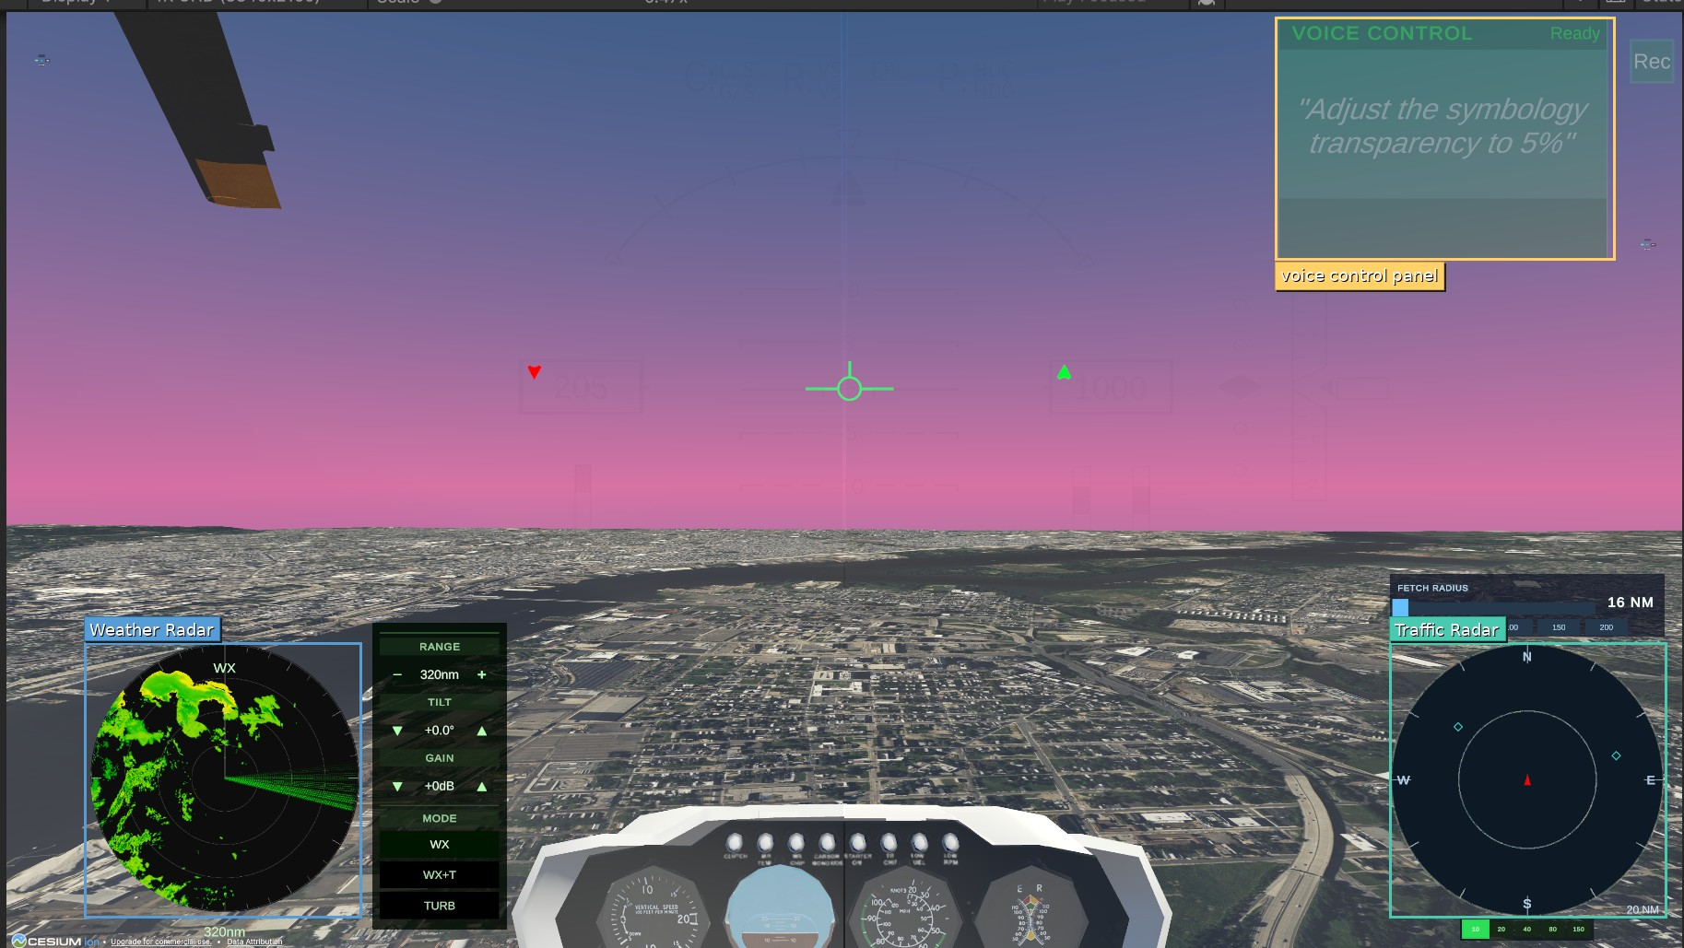
Volumetric Weather System
VolumetricWeatherManager: Main orchestrator managing data sources, renderers, and visualization pipeline
WeatherVolumeData: 3D grid-based weather data structure with intensity, precipitation type, lightning probability
Multiple view modes: Perspective3D, TopDown, CrossSection
Layer visibility control: for intensity pillars, lightning effects, precipitation

Slide 7
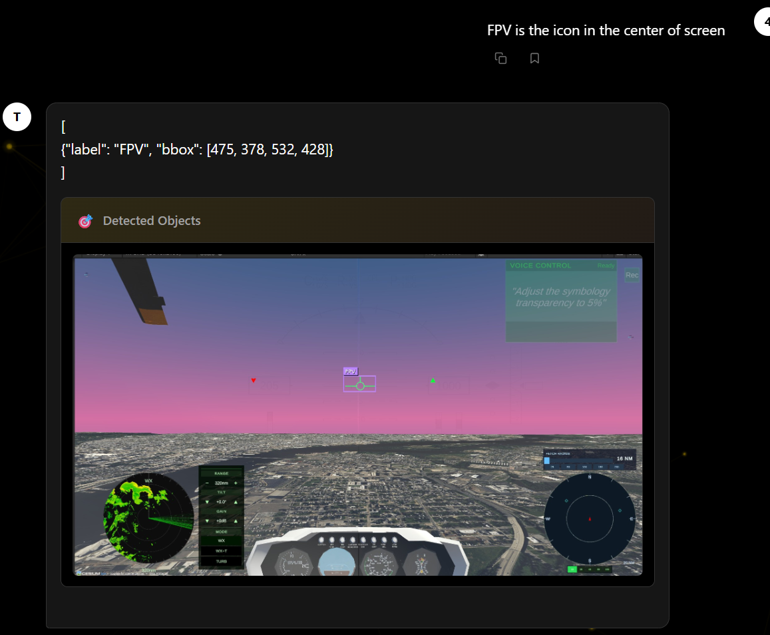
Weather Visualization Editor Tools
VolumetricWeatherSetupWizard: Unity Editor window for quick system setup
WeatherPrefabFactory: Automated prefab creation with proper component configuration
WeatherMaterialSetup: Shader and material configuration for visual effects
Menu integration: Tools/Weather Visualization/ menu path

Slide 8
Voice Control System

Slide 9
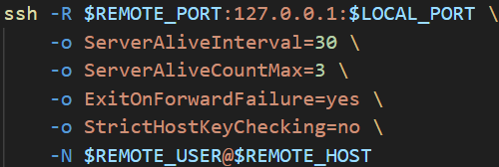
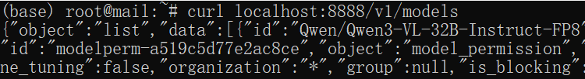


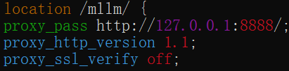



Radial Wheel Menu Interface
SSH reverse tunnel
UIToolkitRadialMenuAdvanced: Hierarchical radial menu with UI Toolkit
Sub-menu support: Nested navigation for command categories
Gesture support: Mouse wheel and gesture-based interaction
Visual effects: Ripple effects, pulse animations, gradient backgrounds
Transparency control: Adjustable menu, ring, and segment opacity
Audio feedback: Open, close, select, and execute sounds
Local Machine (w/o public IP)
Executed on local machine running LLM or other stuff (w/o public IP)
Remote Machine (with public IP)
LLM on local machine
https://game.agaii.org/mllm
Nginx Proxy Pass
Local Devices

Slide 10
Symbology and Visual Systems

Slide 11
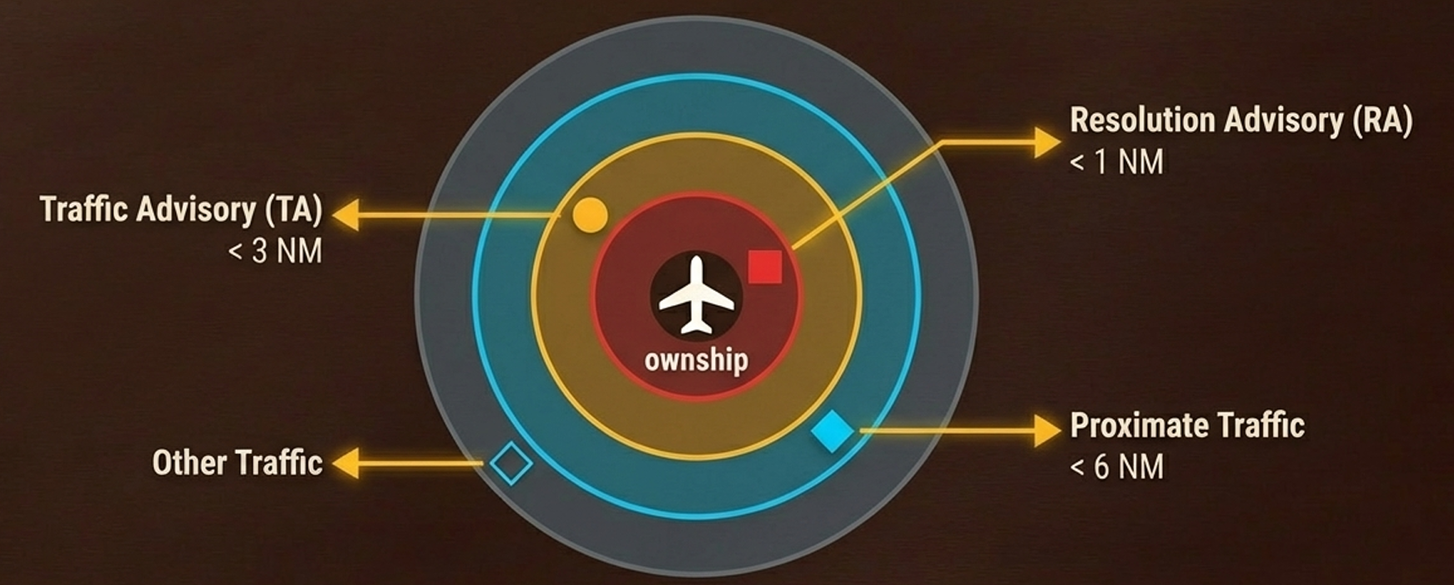
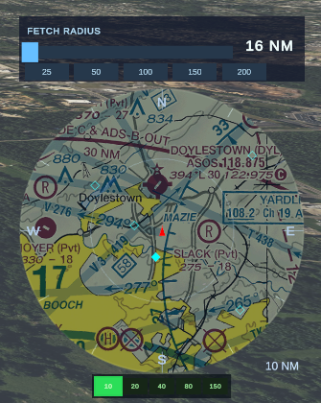
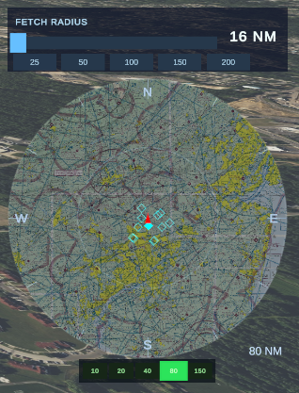
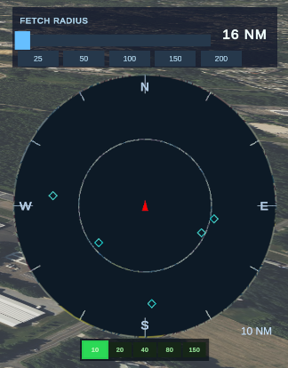
CompassBar System and SymbologyColorManager
CompassBar System
• CompassBarSystem: Screen-space compass with track-up mode
• Data Handling: The TrafficRadarDataManager implements a rigorous caching strategy, requesting data from the Airplanes.live API only when the aircraft moves significantly or a time threshold expires.
• Priority Sorting: Targets are sorted so the most dangerous ones are processed and displayed first if system limits are hit.
SymbologyColorManager
• SymbologyColorManager: Centralized color management for all HUD elements
• Track-Up Mode: Display rotates based on aircraft heading
• Color Adjustments: Black to white asset conversion for better visibility the radar targets, maintaining correct rotation and scale.
• Opacity/Transparency: Voice-controlled color and transparency adjustments

Slide 12
Summary and Next Steps
Completed Work
Aircraft Control Dynamics (FixedWing + Helicopter)
3D Weather Visualization System with volumetric rendering
Voice Control UI with Radial Menu
Weather Editor Tools for rapid prototyping
Symbology Color Management improvements
Next Steps
Integration testing with Cesium physics
Performance optimization for weather rendering
Voice command expansion

Slide 13
DEMO

