Slide 1
Delay Modeling in VHDL

Slide 2
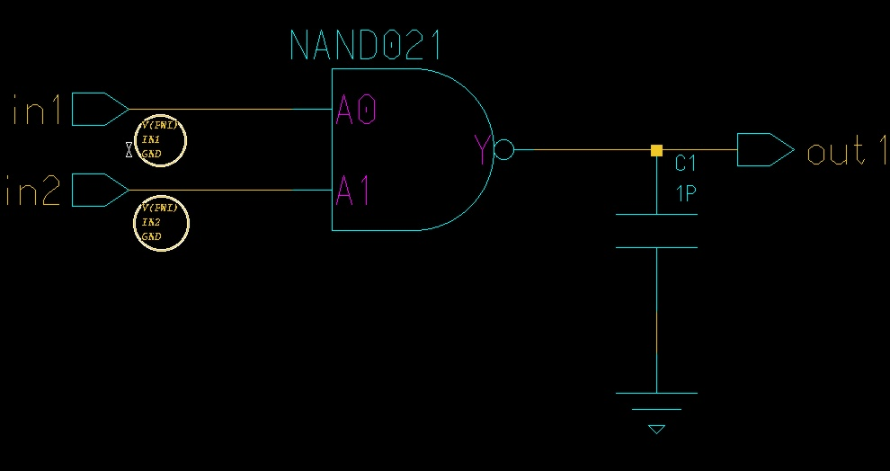
Everything is Analog…
All digital devices display analog behavior at the physical level – they are implemented with analog devices
  Ex: consider a 2-input NAND gate driving a capacitive load typical of a PCB trace

Slide 3
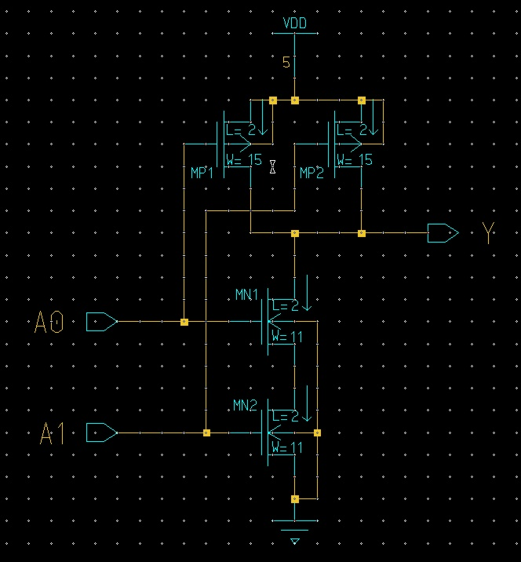
2-Input NAND Implementation

Slide 4
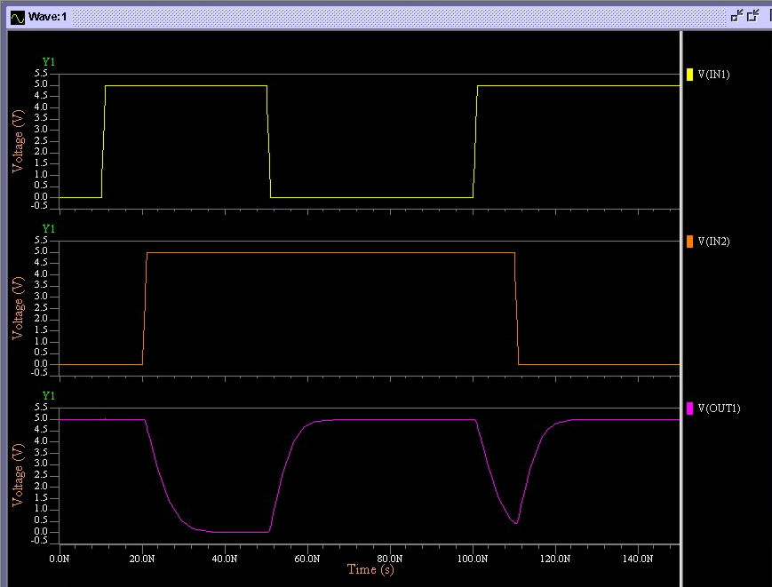
Simulation of an Input Hazard

Slide 5
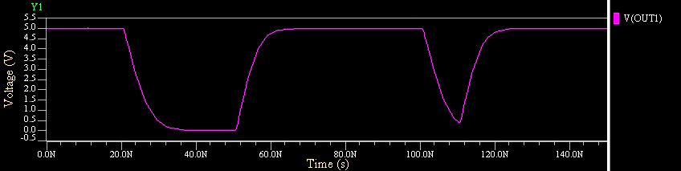
Modeling Delays and Hazards
The basic question is, how do we model this behavior at the logic level (with VHDL)?
OR
OUT1
OUT1
23ns
52ns
105ns
114ns
23ns
52ns

Slide 6
Measuring Propagation Delay
Propagation delay is measured from the 50% point on the inputs to the 50% point on the outputs
Rise and fall times are measured from the 10% to 90% points
V
in
50%
t
t
pHL
t
pLH
V
out
90%
50%
10%
t
t
f
t
r

Slide 7
Propagation delay for NAND example
8 ns
5 ns

Slide 8
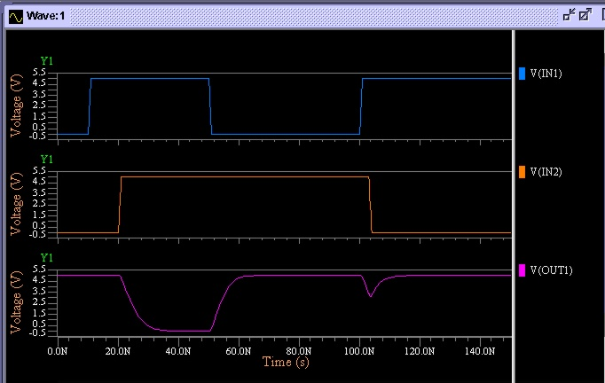
Behavior for short pulses
If pulses on the outputs are short enough, the output might not even cross the switching threshold – as if the output has not changed at all.

Slide 9
VHDL Inertial Delay
library ieee;
use ieee.std_logic_1164.all;
entity nand_std_logic is
generic(TpHL : time := 8 ns;
TpLH : time := 5 ns);
port(in1 : in std_ulogic;
in2 : in std_ulogic;
out1 : out std_ulogic);
end nand_std_logic;
architecture inertial_behavior of nand_std_logic is
begin
process(in1, in2)
begin
if(in1 = '1' and in2 = '1') then
out1 <= '0' after TpHL;
elsif(in1 = '0' or in2 = '0') then
out1 <= '1' after TpLH;
else
out1 <= 'X'; -- handle all other input values
end if;
end process;
end inertial_behavior;
out1 <= '0' after TpHL;
equivalent
out1 <= inertial '0' after TpHL;
example16a

Slide 10
Recall: Signal Events vs Transactions
When a waveform causes a value on the target signal to change, it’s said that an event has occurred on the target signal.
When a value is scheduled to be assigned to a target signal after a given time, a transaction is said to have been place on the driver of the target signal.
A transaction that doesn’t change the value of a signal is still a transaction, but it doesn’t cause an event on the signal.

Slide 11
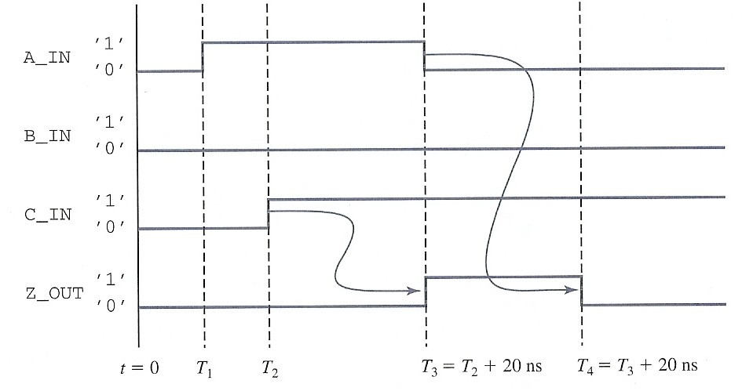
Recall: Transaction vs. Event
T₅ = T₁+20 ns
Z_OUT transactions
(‘0’, T₁ + 20 ns) (‘1’, T₂ + 20 ns) (‘0’, T₃ + 20 ns)
Z_OUT events
(‘1’, T₂ + 20 ns) (‘0’, T₃ + 20 ns)

Slide 12
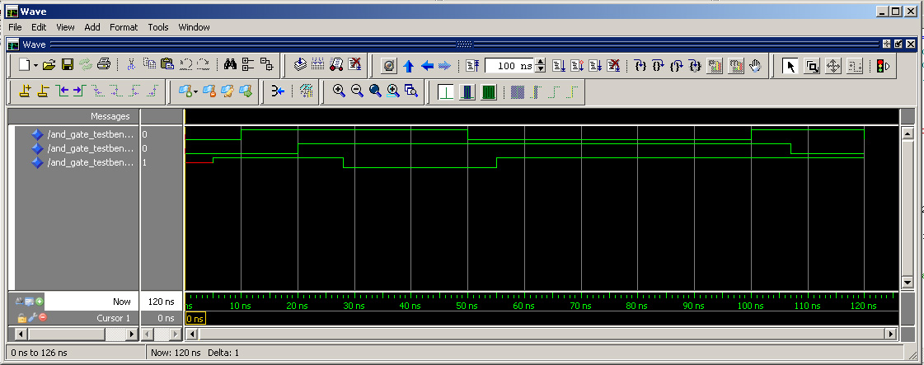
Inertial Delay Simulation Results
events transactions
time in1 in2 out1
100 ns ‘1’ ‘1’ ‘0’ at 108 ns
107 ns ‘1’ ‘0’ ‘1’ at 112 ns
Transaction at 107 ns overwrites previous transaction that has not taken place

Slide 13
VHDL Transport Delay
All transactions resulting from events on the inputs are scheduled (i.e., “transported”) on the outputs in sequence
library ieee;
use ieee.std_logic_1164.all;
architecture transport_behavior of nand_std_logic is
begin
process(in1, in2)
begin
if(in1 = '1' and in2 = '1') then
out1 <= transport '0' after TpHL;
elsif(in1 = '0' or in2 = '0') then
out1 <= transport '1' after TpLH;
else
out1 <= 'X'; -- handle all other input values
end if;
end process;
end transport_behavior;
example16b

Slide 14
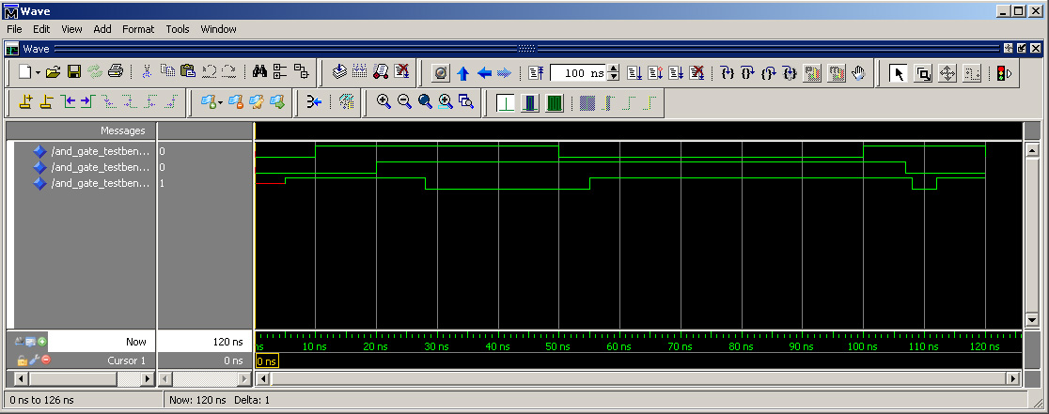
Transport Delay Simulation Results

Slide 15
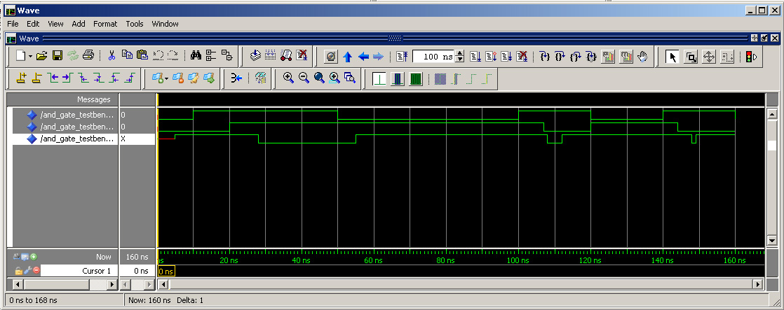
Problems with Default Delay Models
Transport - all transactions on the output will occur regardless of how short they are
Inertial – all transactions on the output that are shorter than the propagation delay are filtered out
This may be too pessimistic – we may desire that some transactions that are less than the propagation delay be scheduled on the output but that others that are less than some threshold are filtered out

Slide 16
Reject Clause
Reject clause allows the specification of a minimum width under which transactions are erased from the output
All others are copied to the output with the specified propagation delay
library ieee;
use ieee.std_logic_1164.all;
architecture reject_behavior of nand_std_logic is
begin
process(in1, in2)
begin
if(in1 = '1' and in2 = '1') then
out1 <= reject 2 ns inertial '0' after TpHL;
elsif(in1 = '0' or in2 = '0') then
out1 <= reject 2 ns inertial '1' after TpLH;
else
out1 <= 'X'; -- handle all other input values
end if;
end process;
end reject_behavior;
example16c

Slide 17
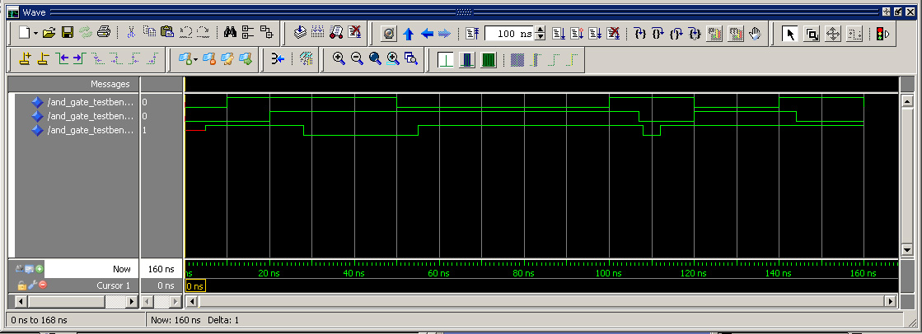
Reject Clause Simulation Results

