Slide 1

Does a production company drive how profitable a movie is?
Caitie Schrotberger
DSC 530-T303 Fall 2024

Slide 2
Hypothesis: Movies produced by the top 10 production companies are more likely to make a profit
As an avid movie watcher and past video store manager, popular movies are typically driven by large studios that have the budget to advertise and create a fan base.
This research will see if this is true based on data analysis of a file from www.themoviedb.org from Kaggle. It has over 4,800 movies from 1916 through 2017.

Slide 3
Data set variables
Included in the exploration were the following fields:
id/movie_id - the primary key for the data set
originial_title - the title of the movie
production_companies - the production company names associated with the title
budget - the budget amount to create the movie
revenue - the amount of revenue received from ticket sales of the movie
vote_average - the average based on user input, values of 1-10 with 10 being the highest
vote_count - the number of users who voted on the title
release_date - the date the movie was released in theaters
ProfitRate – field calculated as revenue divided by budget
Data Cleansing was done as follows:
Removing NULL values
Converting fields from lists
Correcting missing data
Creating columns as necessary for filtering and segmenting for analysis
Only evaluating records with a revenue amount

Slide 4
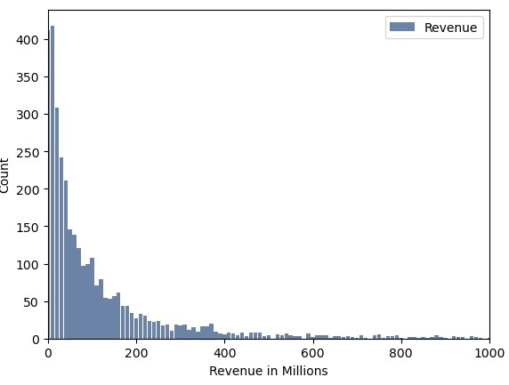
Revenue
To create the revenue histogram, the values were rounded and presented in millions.
Variable Summary:
Min, Max, Median, and Mean were 0, 2800, 100, 112.5 accordingly.
The standard deviation was 188.4 and variance was 35494.
This distribution was left sided as the majority of films made under 5 million dollars
Even though rows with no revenue were removed, after rounding those under 5 million became 0 million

Slide 5
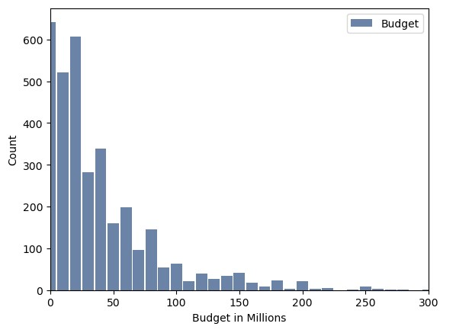
budget
To create the budget histogram, the values were rounded and presented in millions.
Variable Summary:
Min, Max, Median, and Mean were 0, 380, 20, 38.8 accordingly.
The standard deviation was 44.4 and variance was 1975.
This distribution was left sided as the majority of films made under 5 million dollars
Even though rows with no revenue were removed, after rounding those under 5 million became 0 million

Slide 6
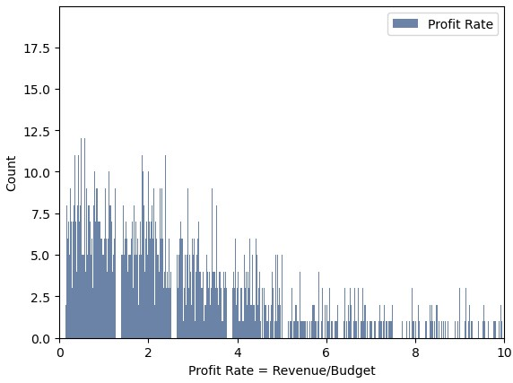
Profit rate
To create the Profit Rate histogram, revenue was divided by budget.
A value over 1 would indicate that the movie made money.
A value of 4 would indicate a movie made 4 times as much as its budget.
This variable was created to compare movies on the same scale.
Variable Summary:
Min, Max, Median, and Mean were 0, inf, 2.45, inf accordingly.
The standard deviation and variance were not able to be calculated.
This distribution was left sided, but not as significant as budget and revenue. This is expected because the two variables used to create it are left sided.

Slide 7
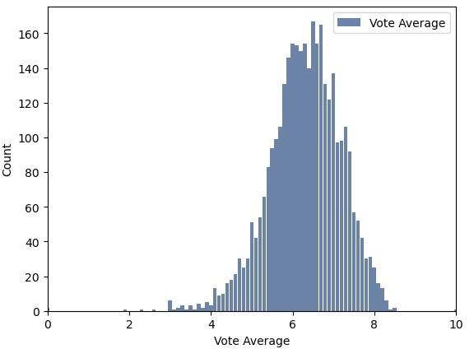
Vote average
This histogram represents the distribution of the average rating a movie received.
Variable Summary:
Min, Max, Median, and Mean were 0, 10, 6.3, 6.3 accordingly.
The standard deviation was 0.88 and variance was 0.77.
This distribution was close to a traditional bell curve, but centered around 6.3 rather than the middle score of 5.

Slide 8
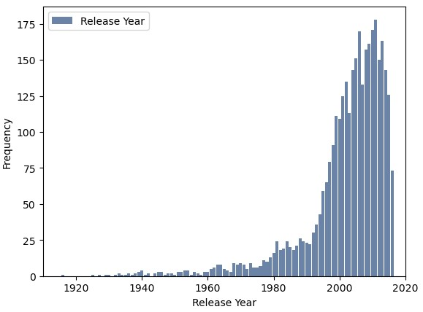
Release year
This histogram represents the year the movie was released to the public.
Variable Summary:
Min, Max, Median, and Mean were 1916, 2016, 2005, 2001 accordingly.
The standard deviation was 13 and variance was 172.
This distribution is right sided. One can assume that as technology has advanced more and more movies are made each year.

Slide 9
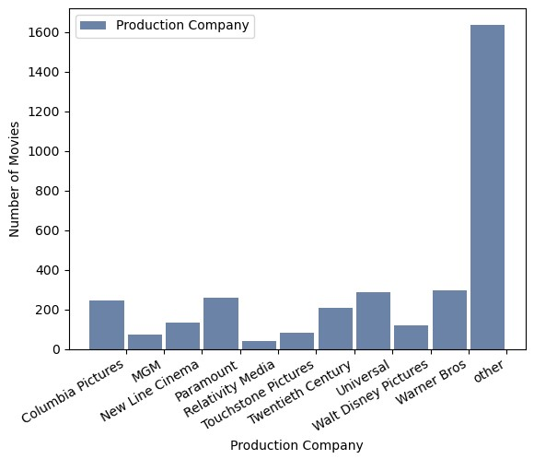
Production company
This histogram represents the number of movies produced by the top 10 production companies. All other movies were classified as other.
Variable Summary:
Calculations cannot be done on a categorical variable.
The production companies with higher volumes than others are Warner Bros, Universal, Paramount, and Columbia Pictures.

Slide 10
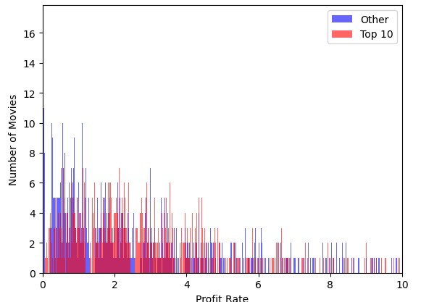
Probability mass function
The Probability Mass Function (PMF) maps the probability or distribution of the data set, rather than the values.
This helps to be able to compare two different data sets with different sample sizes.
The graph on the left is the profit rate of the data set, split between the Top 10 production companies and the Others.
Though there appears to be a pattern, because the sample sizes are different you need to convert to a probability to be able to compare them in a normalized matter.

Slide 11
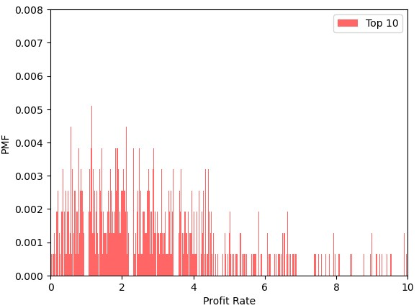
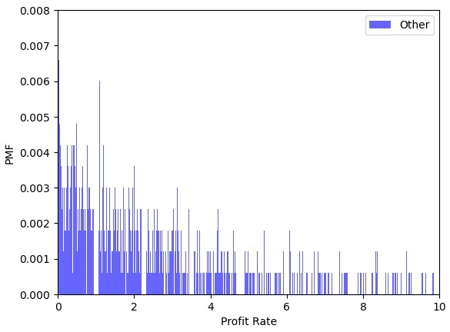
PMF by Production Company Split
The below histograms are now normalized through the PMF function and are comparable. The Y axis has been set at the same values for easy comparison.
Based on this, the normalized distribution shows that moves produced by the top 10 production companies have more that are profitable than the others.

Slide 12
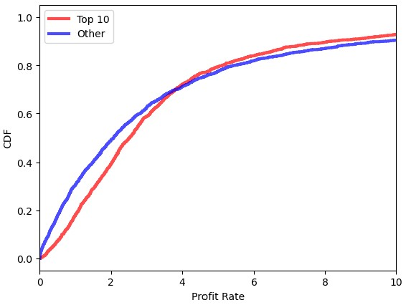
Cumulative Distribution Function (CDF)
To the left is the CDF of the two groups of movies. A CDF provides the cumulative probabilities of the data set. The CDF is a value between 0-1, representing what percent of the data has obtained the variable.
In this case, about 30% of the movies produced by the top 10 production companies have revenue of two times their budget.
Compared to that, almost 50% of the other movies have revenue of two times their budget.
This means that movies produced by one of the top 10 companies make more profit as their curve is not as steep initially.

Slide 13
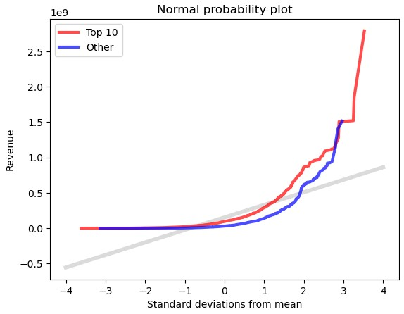
Normal Probability Plot
The normal probability plot shows how normal the distribution is of your data. I used the actual revenue of the two groups compared to the model.
The distribution is not normal as the lines are not nearly straight. The tails are both above the model. This value in the data set alone would not be good to build a model.

Slide 14
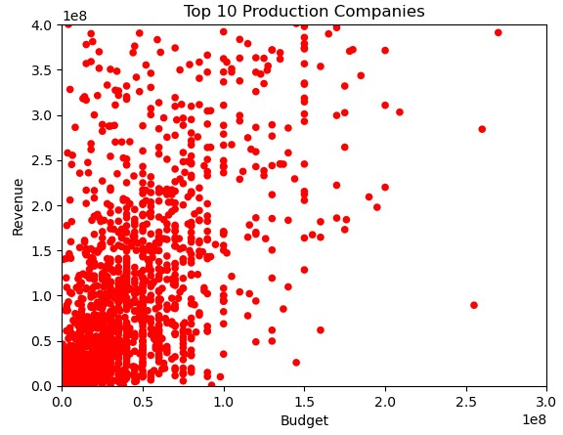
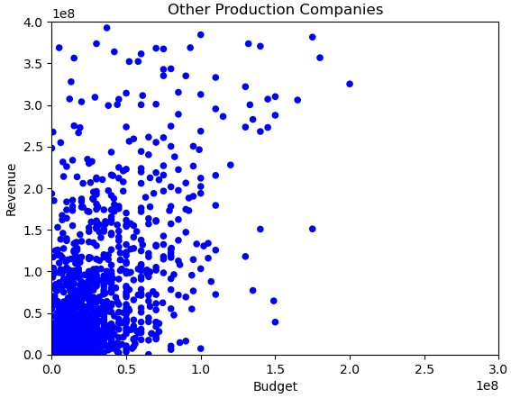
Variable Relationships: Revenue vs Budget
To the right are the scatter plots of budget as compared to revenue for the two groups: Top 10 and Other Production Companies. You can see that the other group is more tightly grouped in the bottom left corner than the Top 10 and slightly linear.
Covariance:
Top 10: 7,057,449,799,192,811.0
Other: 368,403,812,970,2118.0
Pearsons Correlation:
Top 10: 0.6663449166360617
Other: 0.730214523458628
Spearman Correlation:
Top 10: 0.626489532978286
Other: 0.6339632782734186
Based on these, the outliers are probably influencing the relationship between the variables.

Slide 15
Hypothesis Testing
I ran permutation tests, difference in standard deviation, and tested correlation on budget and revenue between the Top 10 and other groups and all of them came out a 0.0.
All of these mean that there is a strong relationship and statistical significance that the amount spent on budget for a movie will predict the revenue, regardless of production company

Slide 16
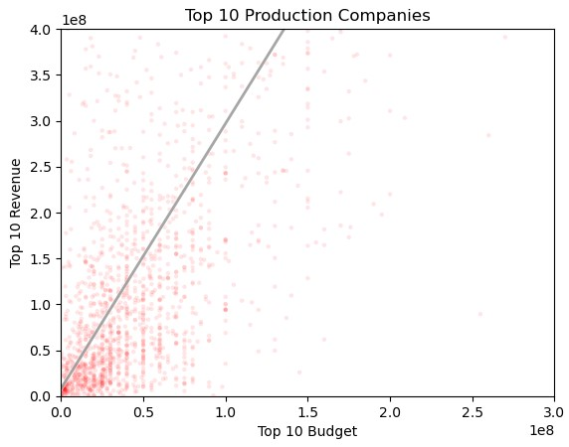
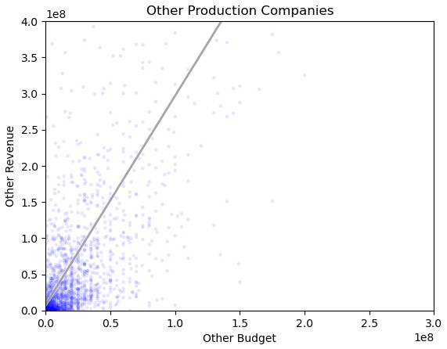
Linear Regression Analysis
Least squares fit or a linear regression model was done on budget and revenue, split between the top 10 and other production companies.
For the top 10, the intercept was
8,182,184 and the slope was 2.89.
For the others, the intercept was
-4,170,562 and the slope was 3.03.
The intercept is the amount of revenue that would be made if the budget was 0. The slope indicates the return based on each additional dollar spent.
For these two groups, while the return (slope) is smaller for the top 10, they start out with a $12 million dollar advantage. The other production companies are at a disadvantage and start out with a loss.

