Slide 1

BarterNearMe
Cathal Donohoe
Nathan Garrihy
Supervisor:
Dr. Martin Kenirons

Slide 2
Context & Objectives
People often buy items that they only intend to use once, and just throw it in the corner for eternity. Even aside from the one-off purchases, many of people's belongings are barely used by them and are left idle for most of the time. This website is a solution to this problem in the form of a 21st century barter system.
Objectives:
Users can register and browse items
Users can select to borrow items from other users
Users can view the owners of items and contact them
Users can add items to a Wishlist

Slide 3
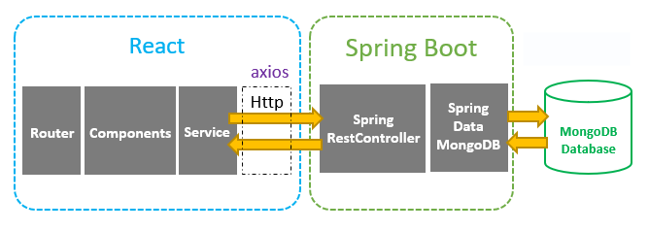


Technologies & System Architecture
The Technology we’re using is a React app with a Spring boot backend.
We selected React as it utilizes parts of the application on both client side and server side which boosts our development significantly.
We selected spring boot for its autoconfiguration. The ability to change configuration based on dependencies can avoid convoluting the backend. We wanted to build an API built on dependency injection.

Slide 4
Development & Deployment
List any objectives that have already been implemented.
Backend user signup and login
Frontend home, Sign up and login page

Slide 5

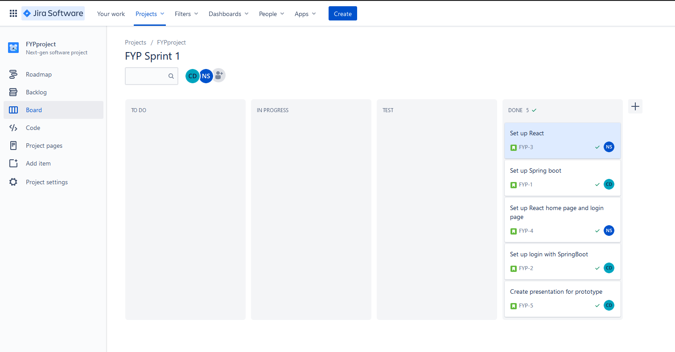
Work Plan
Current work done

Slide 6
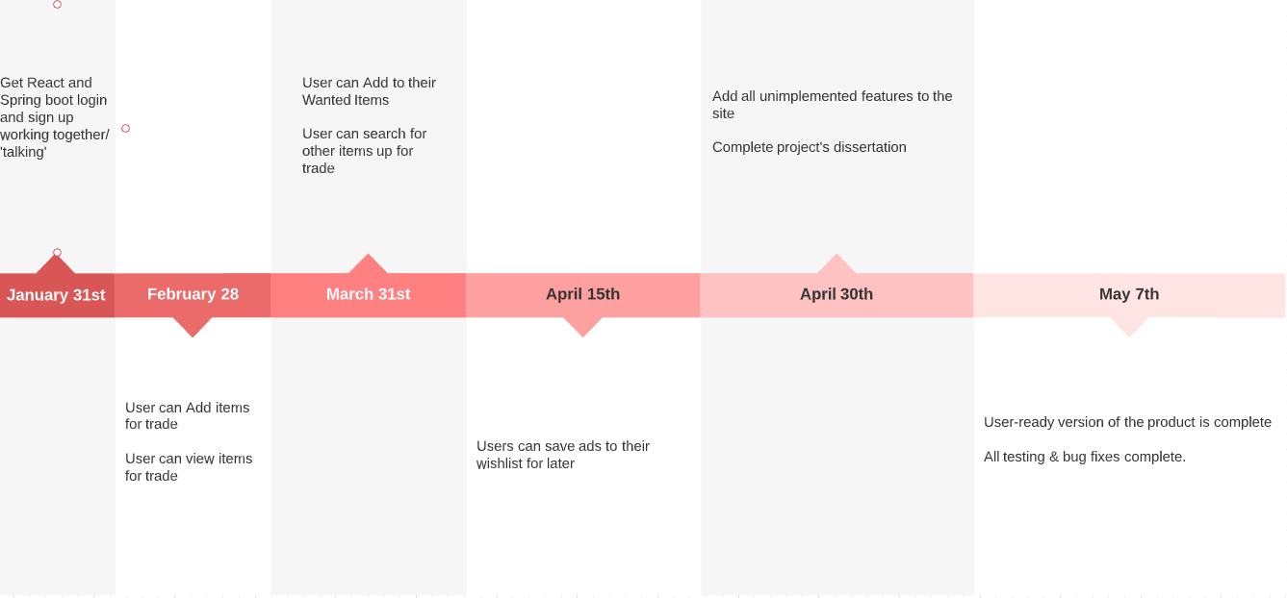
Work to be done

