Slide 1
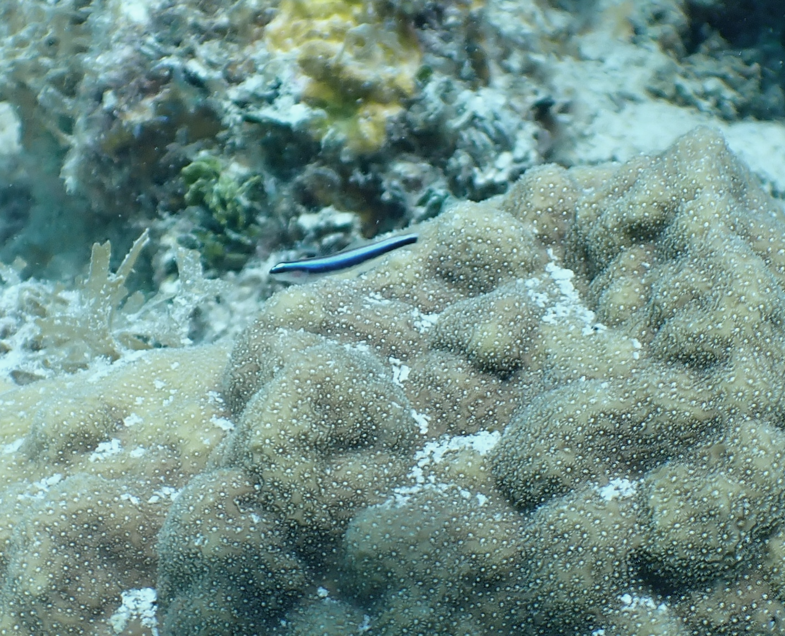
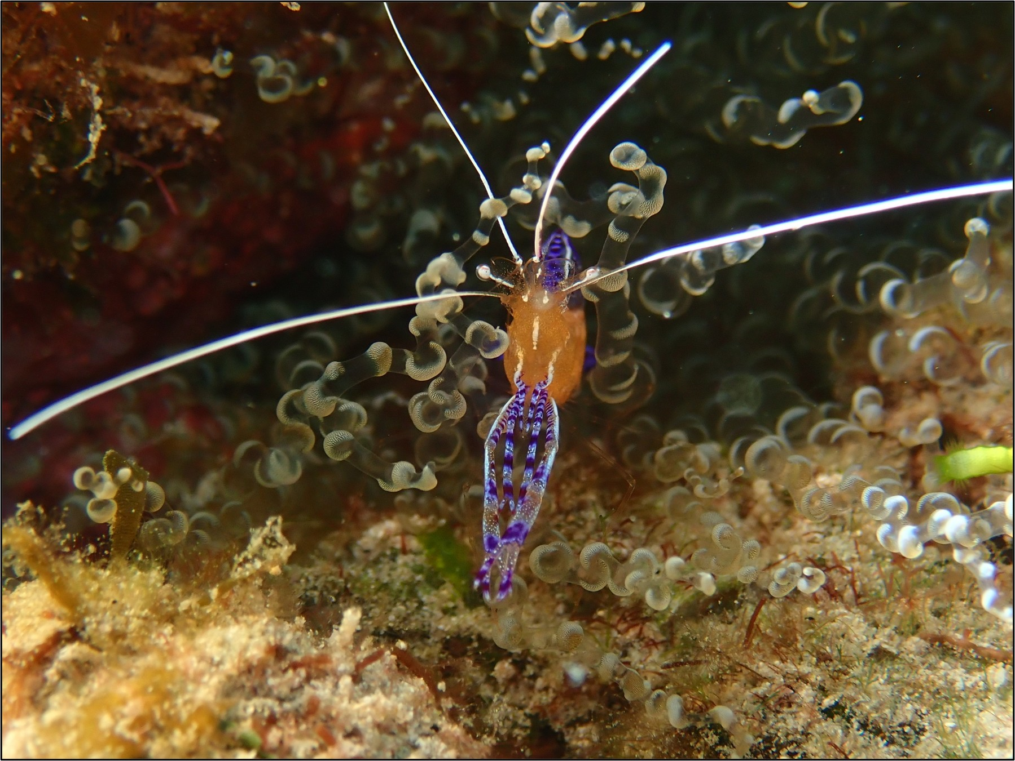
Cleaner goby on live coral:
Cleaner shrimp on anemone:

