Slide 1
LEGAL-EASE: A Legal Text Summarizer Mini Project presentation
Team Members:
-Anna Rose Joshy -TLY23CS028
-Cathereen Sebastian -TLY23CS040
-Fasna T P -TLY23CS043
-Fathima Juhana K -TLY23CS046
Guide In Charge: Rinsha T M

Slide 2
Introduction
Terms & Conditions and Privacy Policies are long and complex.
Users often skip reading them.
Important clauses are hidden in legal jargon.
Need for a tool that simplifies and highlights key risks.

Slide 3
Problem Statement
“Users often accept legal documents without understanding hidden risk clauses due to complex language and lengthy content. This lack of clarity can lead to uninformed decisions and potential privacy or financial risks.”

Slide 4
Existing Solutions
Legal documents are complex (e.g., app T&C) → no simplification.
Some tools give summaries but no risk analysis (e.g., TermsWeUse).
Tools like TermsCheck and John Snow Labs NLP exist → no Risk Meter.
Users still miss key clauses (e.g., auto‑renewal, liability) → manual effort needed

Slide 5
Proposed Solution
Web‑based platform using Python and NLP.
Users paste or upload Terms & Conditions or Privacy Policy content.
System breaks text into clauses using NLP techniques.
Risk‑prone clauses highlighted and grouped into categories.
Results displayed with a Risk Meter in user‑friendly format.

Slide 6
Objectives
.
To simplify legal documents into plain language.
To detect and highlight risky clauses (data sharing, auto‑renewal, liability waivers).
To provide a quick Risk Meter for trust assessment.
To design a user‑friendly dashboard for non‑lawyers.
To promote awareness and informed consent among users,

Slide 7
Motivation
Most users accept legal documents blindly without reading
Hidden clauses can cause privacy loss, financial risks, or restricted rights
Existing tools are too technical or incomplete for everyday users
Need for a simple, awareness‑focused solution that empowers non‑lawyers

Slide 8
Literature Review
1] E. A. Kadhim, M.-R. Feizi-Derakhshi, and H. S. Aghdasi,"Advanced Text Summarization Model Incorporating NLP Techniques and Feature-Based Scoring,"IEEE Access, vol. 13, pp. 19302-19308, Jan. 2025, doi: 10.1109/ACCESS.2025.3528830.
2] N. J. Paulraj, "Natural Language Processing on Clinical Notes: Advanced Techniques for Risk Prediction and Summarization,"Journal of Computer Science and Technology Studies, vol. 7, no. 3, pp. 494-502, May 2025, doi: 10.32996/jcsts.2025.7.3.56.
3] N. Jain, N. Sharma, R. Yadav, and N. Kumar,"TEXT SUMMARIZATION USING NLP,"Journal of Science, Computing and Engineering Research (JSCER), vol. 8, no. 5, pp. 1-6, May 2025,doi: https://doi.org/10.46379/jscer.2025.080503.
4] M. H. Kazemi and A. Alvanchi,"Application of NLP-Based Models in Automated Detection of Risky Contract Statements Written in Complex Script System,"Expert Systems with Applications, vol. 259, 125296, Jan. 2025,doi: 10.1016/j.eswa.2024.125296.

Slide 9
Literature Review
5] S. Barrett, V. Ramasamy, G. Dorai, and B. Boswell, “Navigating Privacy Policies with NLP and Graph Mining: Advancements in User-Centric Legal Document Analysis,” SoutheastCon 2025, 2025, doi:10.1109/SOUTHEASTCON56624.2025.10971616.
6] R. Vasanthi, Haritheesathan, H. R. DK, D. Kumar, and H. Kumar, “Automated Terms and Condition Analyser Using Natural Language Processing,” ICETITE 2024, 2024, doi: 10.1109/IC-ETITE58242.2024.10493329.
7] P. A. Poornima, N. K. V. Nagaraja, and M. Venugopalan, “Legal Contract Analysis and Risk Assessment using Pre-Trained Legal-T5 and Law-GPT,” Proc. Int. Conf. on Integrated Circuits and Communication Systems (ICICACS), Mar. 2025
8] N. K. Mulunguzia, B. Halubanza, S. Halubanza, M. Namuchile, M. B. Mulungushi, Z. Kaluba, and E. Nyirenda,“AI-Powered System for Simplifying and Analyzing Terms and Conditions,” Proc. Seventh Int. Conf. on Information and Communication Technologies (ICT), Lusaka, Zambia, Oct. 2025.

Slide 10
Literature Review-Comp Table
Title & Year | Core Idea | Limitations | Future Scope
AI-Powered System for Simplifying and Analyzing Terms and Conditions | A mobile app that uses AI (GPT) to summarize Terms & Conditions and flag risky clauses from documents, URLs, or installed apps, helping users understand legal agreements quickly. | Works only in English, can be slow with large files, and needs more user feedback for accuracy. | Add multilingual support, crowdsourced feedback, and offline optimization.
Privacy Policy Knowledge Graph Construction using NLP | The work employs NLP techniques such as entity extraction and relationship identification to convert privacy policy text into structured knowledge graphs, enabling systematic analysis of data collection and sharing practices. | The quality of the knowledge graph depends on the accuracy of NLP-based entity and relationship extraction, which may not capture all implicit legal interpretations. | The framework can be applied to a broader set of privacy policies and refined to improve extraction accuracy and graph quality.
Advanced Text Summarization Model Incorporating NLP Techniques and Feature-Based Scoring (2025) | Uses features like NER and sentence scoring to make better summaries | Needs more computing power, not easy to use in all areas | Add deep learning, support more languages, use in real apps
Application of NLP-based models in automated detection of risky contract statements written in complex script system | The paper proposes NLP-based machine learning and deep learning models to automatically detect risky clauses in legal contracts | Does not explain decisions clearly,Limited generalization across different languages, domains, or contract types. | This can be added to apps or websites,Explains why a clause is risky.

Slide 11
Literature Review-Comp Table
Title & Year | Core Idea | Limitations | Future Scope
Text Summarization Using NLP(2025) | web-based text summarization application using N L P techniques that uses a model (BART-large-CNN) to generate abstractive summaries that capture the core meaning of the original text | may not give accurate summaries for very long or domain-specific documents (like medical or legal texts). | improved by adding support for multiple languagescan be expanded by combining extractive and abstractive summarization
Natural Language Processing on Clinical Notes (2025) | Uses NLP to analyze clinical notes for risk prediction and automatic summarization | Privacy issues, high computation cost, limited explainability | Multimodal AI, explainable NLP, real-time clinical decision support
Legal Contract Analysis and Risk Assessment Using Legal-T5 and Law-GPT | This paper uses Legal-T5 to summarize contracts and Law-GPT to identify risks. Similar clauses are grouped to make contract analysis faster and more organized. | Needs high computing power, Risk results require human checking, Not designed for country-specific laws | Reduce system complexity, Add jurisdiction-based legal analysis, Improve risk classification accuracy
Automated Terms and Condition Analyser using Natural Language Processing(2024) | Uses web scraping + NLP to extract and analyze website Terms & Conditions.Applies TextRank summarization and keyword extraction to simplify long legal text.Categorizes clauses into high, medium, and low risk for user awareness. | Depends mainly on keyword-based risk categorization, which may reduce accuracy.Limited handling of contextual or semantic interpretation of complex legal clauses. | Integrate deep learning / contextual NLP models for better semantic understanding.Provide real-time browser integration and multilingual policy analysis.

Slide 12
Software Requirement Specifications(SRS)
Functional Requirements
Input: Paste/upload legal text
Processing: NLP + keyword detection.
Output: Risk clauses + Risk Meter
Non‑Functional Requirements
Usability: Simple web interface
Performance: Quick clause analysis
Portability: Runs on any browser
Scalability: Extendable to more risk categories

Slide 13
Software Requirements
Front End: HTML, CSS, JavaScript
NLP libraries (spaCy, NLTK)
Back End: Python (Flask)
Database: SQLite
OS: Windows/Linux
IDE : Visual Studio Code
Web Browser : Google Chrome / Firefox

Slide 14
Hardware Requirements
Processor: Intel i3 or above
RAM: 4 GB
Device: PC/Laptop with internet

Slide 15
SYSTEM DESIGN DOCUMENT

Slide 16
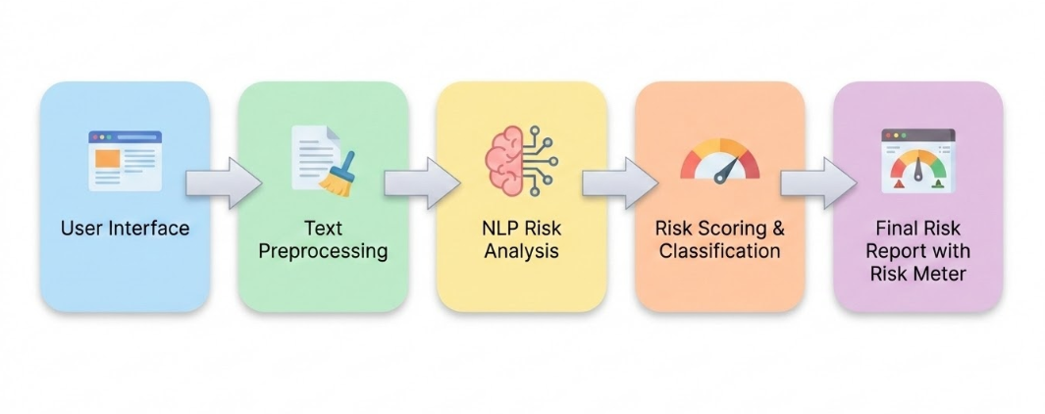
System Architecture

Slide 17
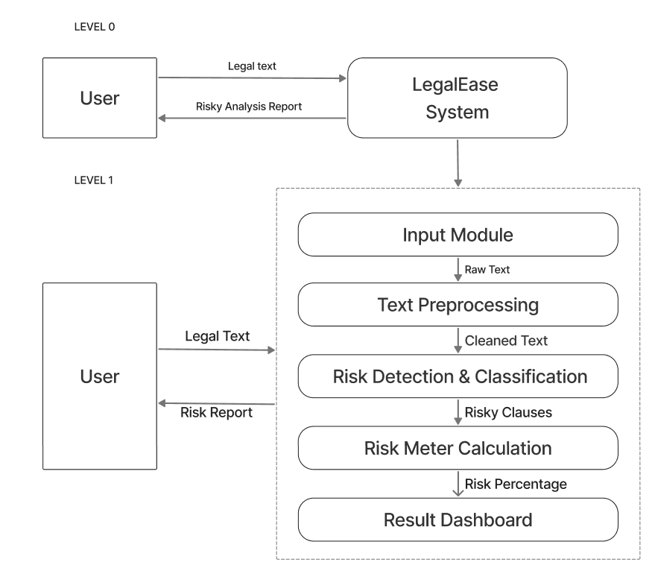
Data Flow Diagram

Slide 18
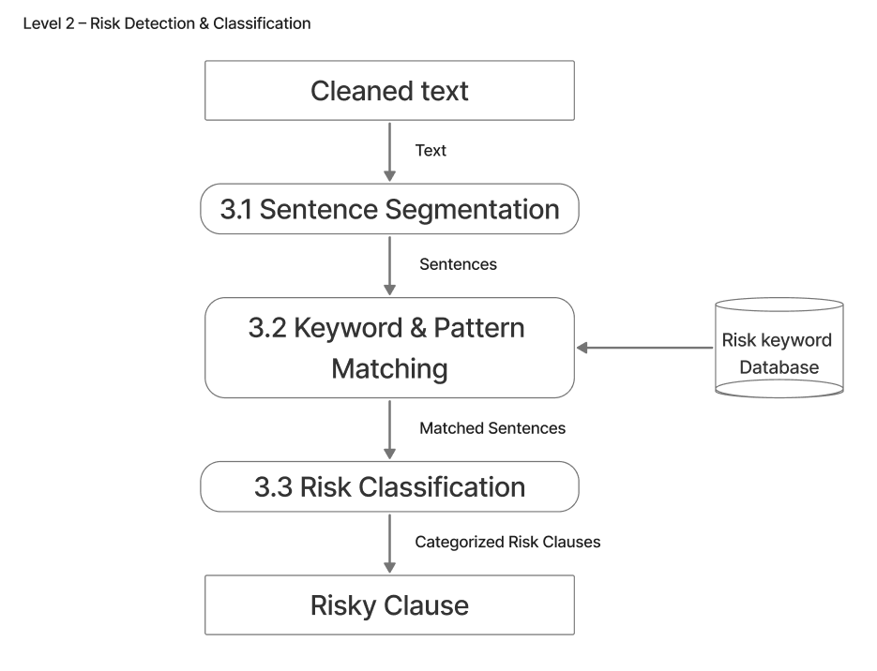

Slide 19
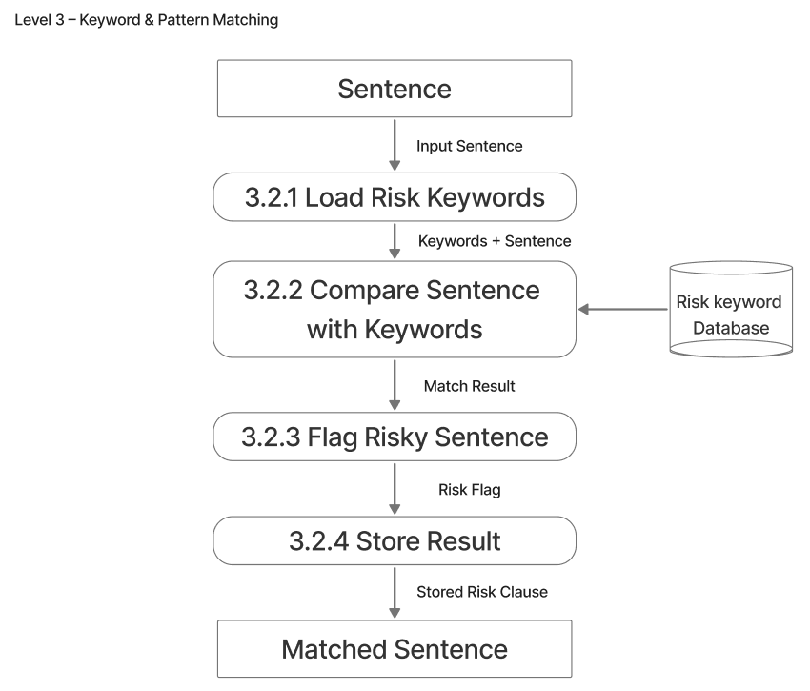

Slide 20
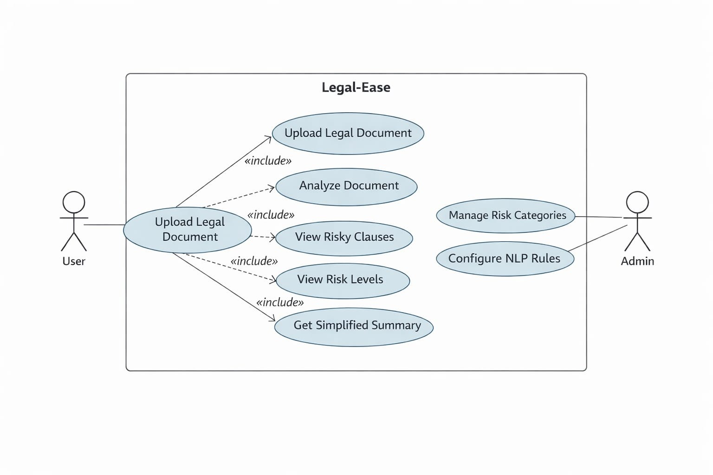
Use Case Diagram

Slide 21
Database Design
1.Risk_level
FIELD | DATA TYPE | DESCRIPTION | CONSTRAINTS
level_id | INTEGER | Risk level ID | Primary Key
level_name | TEXT | Risk level name | NOT NULL
min_score | INTEGER | Minimum risk score | NOT NULL
max_score | INTEGER | Maximum risk score | NOT NULL
description | TEXT | Meaning of risk | NOT NULL

Slide 22
2. Risk_clause
FIELD | DATA TYPE | DESCRIPTION | CONSTRAINTS
clause_id | INTEGER | Unique clause ID | Primary Key
clause_text | TEXT | Extracted legal clause | NOT NULL
risk_keywords | TEXT | Keywords triggering risk detection | NOT NULL
simplified_text | TEXT | Simplified explanation | NOT NULL
risk_score | INTEGER | Risk score (0–100) | NOT NULL
level_id | INTEGER | Assigned risk level | Foreign Key

Slide 23
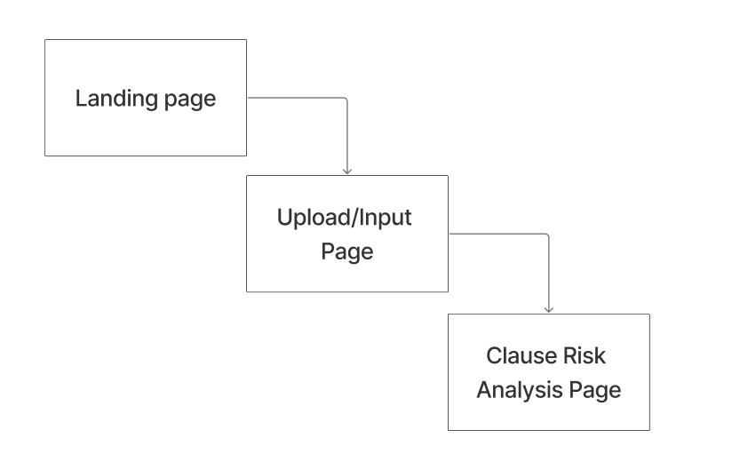
Page Design

Slide 24
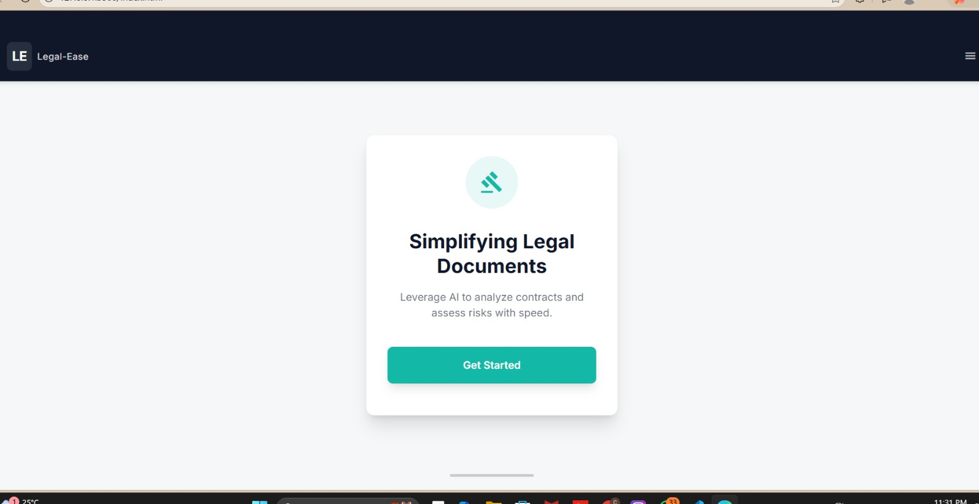
GUI

Slide 25
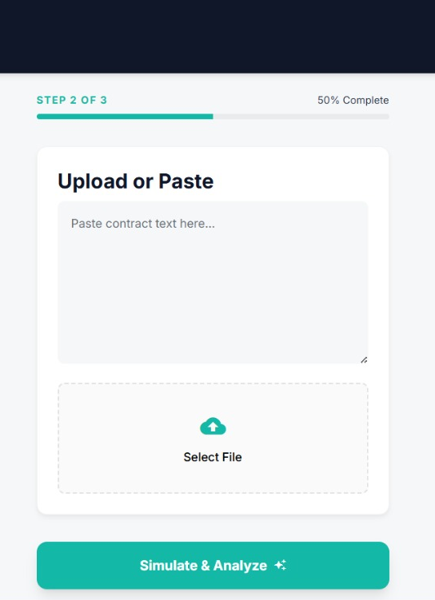
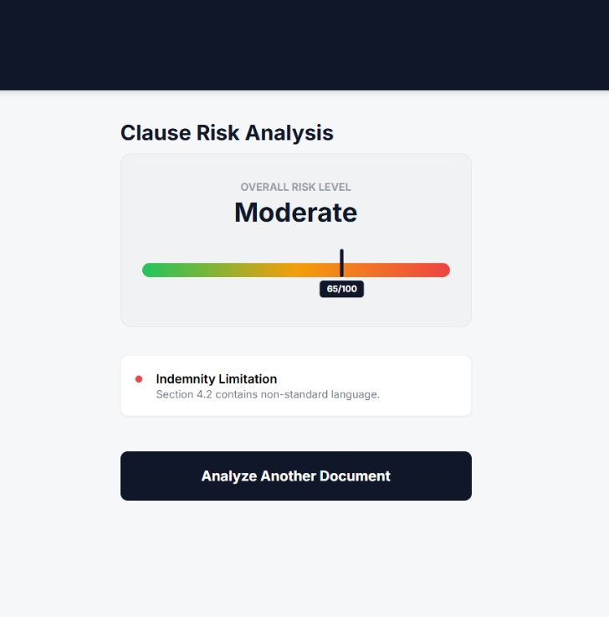

Slide 26
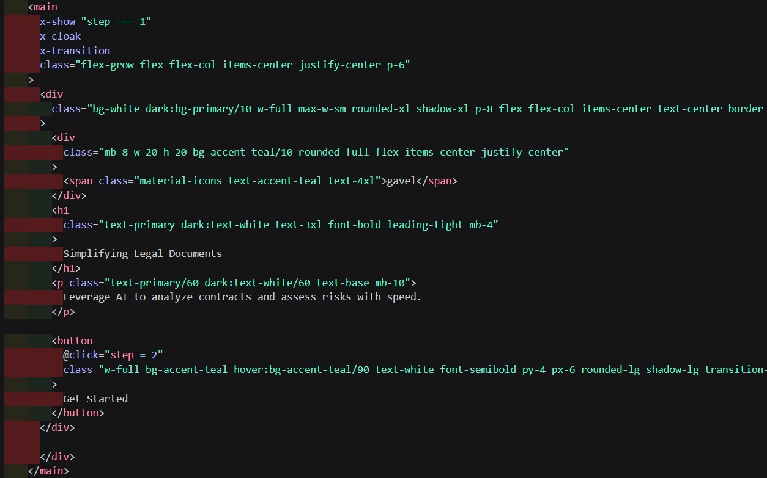
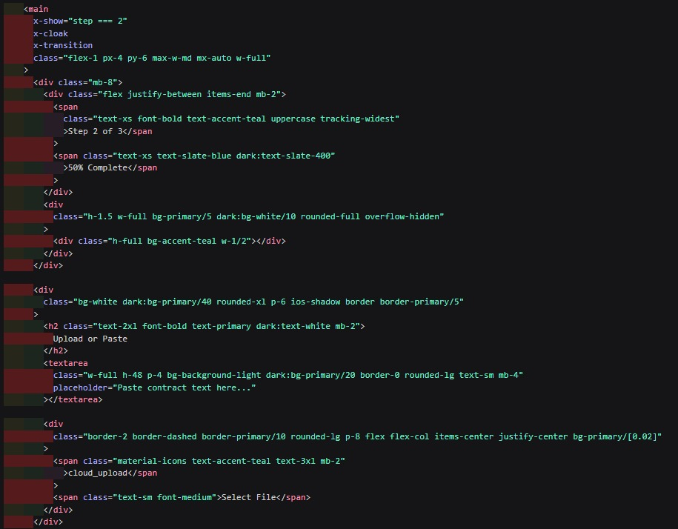
25% Completed Project
Landing page Upload & Input Page

Slide 27
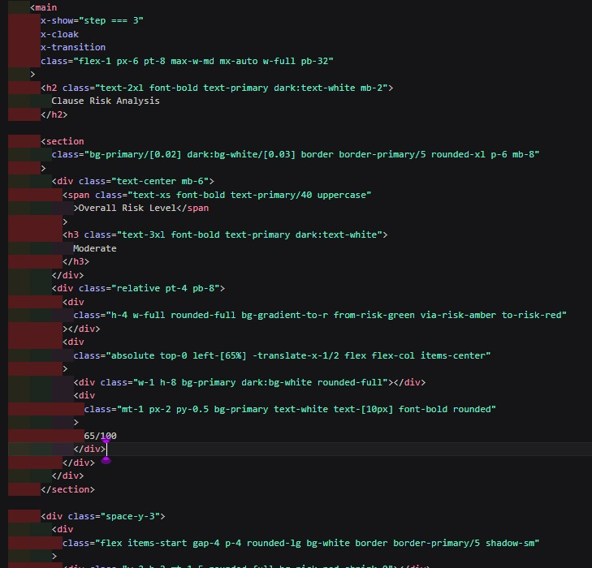
Clause Risk Analysis Page

Slide 28
Demo Video

Slide 29
Conclusion
Legal‑Ease simplifies complex legal documents.
Highlights risky clauses clearly.
Adds a Risk Meter for awareness.
Promotes informed decision‑making.

Slide 30
THANK YOU! ANY QUESTIONS?

