Slide 1
Secure Data Hiding in Image Using Steganography
CAPSTONE PROJECT
Presented By:
Student Name : CATHERIN RANI L
College Name & Department : ETHIRAJ COLLEGE FOR WOMEN &MCA

Slide 2
OUTLINE
Problem Statement
Technology used
Wow factor
End users
Result
Conclusion
Git-hub Link
Future scope

Slide 3
Problem Statement
Data Concealment: Develop a method to securely hide sensitive data within an image, ensuring it remains imperceptible to the human eye.
Security: Protect the hidden data from unauthorized detection or extraction, using robust encryption or algorithms.
Image Quality: Ensure the quality of the cover image is preserved, with minimal distortion or alteration from the hidden data.
Robustness: Design the system to withstand common image processing attacks, such as compression or tampering, while ensuring reliable data retrieval.

Slide 4
Technology used
1. PLATFORM: Python 3
2. LIBRARIES:
OpenCV (cv2): Used for image processing and manipulation, such as loading, saving, and modifying images.
NumPy: For handling array-based operations, which is essential for image pixel manipulation.
Matplotlib: For displaying and visualizing images during the process.
Pillow: For advanced image editing tasks and image format conversions.

Slide 5
Wow factors
Advanced Security: Utilizes robust encryption algorithms to ensure the hidden data remains secure and inaccessible without the secret key.
High Image Quality: Focuses on maintaining the original image quality, ensuring that the hidden data is imperceptible to the human eye.
Enhanced Robustness: The system is designed to withstand common image attacks like compression, cropping, and noise insertion while retaining the hidden data.
Efficient Data Hiding: Employs optimized techniques for efficient and seamless embedding of large amounts of data into images with minimal distortion.

Slide 6
End users
Digital Communication Professionals: Those involved in secure communications, such as military, law enforcement, and intelligence agencies, who need to transmit confidential information covertly.
Data Privacy Advocates: Individuals or organizations focused on safeguarding personal data, protecting against unauthorized access or interception.
Software Developers & Engineers: Developers working on secure applications or tools involving image processing, encryption, or secure data transmission.
Educational Institutions & Researchers: Academics and researchers in the fields of cybersecurity, cryptography, and digital forensics studying advanced data hiding techniques

Slide 7
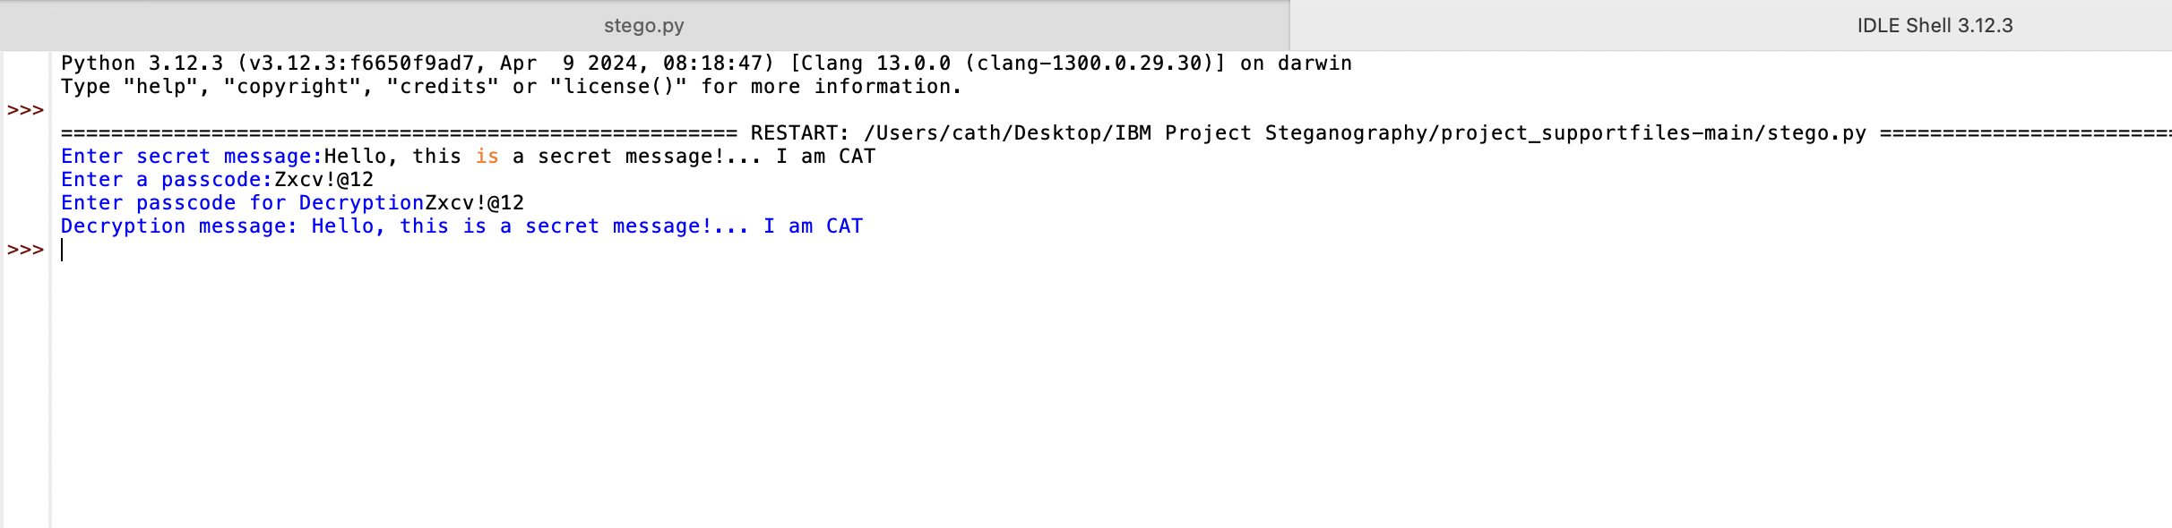
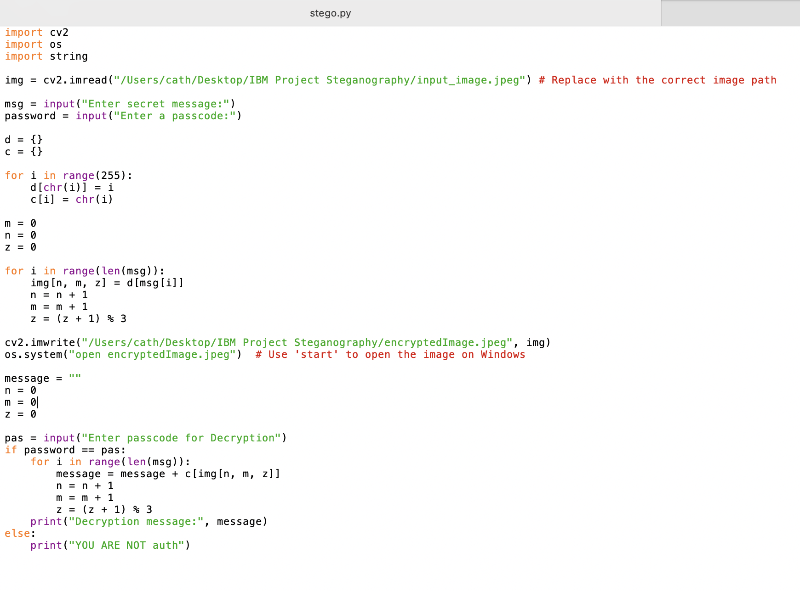


Results
INPUT IMAGE
OUTPUT IMAGE

Slide 8
Conclusion
The Project successfully implements a steganographic technique to securely hide sensitive data within digital images, ensuring that the embedded information remains imperceptible to the human eye and does not compromise the image's quality. By using advanced encryption algorithms and image processing methods, the system offers strong security and robustness against common attacks like compression or tampering. The approach effectively addresses the challenge of secure data transmission, providing a reliable solution for covert communication and privacy protection, with significant potential applications in fields such as cybersecurity, digital forensics, and secure messaging.

Slide 9
GitHub Link
https://github.com/Catherin-art/Steganography.git

Slide 10
THANK YOU

