Slide 1
SMART HOSPITAL RESOURCE CLUSTERING
Machine Learning Major Project
CATHERIN JESINTHA J
B.Sc. Computer Science | St. Anne's Arts and Science College

Slide 2

Project Overview
Uses Machine Learning to discover groups of similar hospital operational records.
Applies unsupervised learning because predefined target classes are not required.
Main algorithm: K-Means Clustering.
Main outputs: Elbow Method graph and cluster scatter plot.

Slide 3

Problem Statement
Hospital operational data contains multiple attributes that can be difficult to compare manually.
Similar records may have common patterns across age, severity, stay length, waiting time and cost.
The project groups records into clusters to support exploratory analysis.

Slide 4
Objectives
Clean and inspect the hospital dataset.
Select relevant features for clustering.
Encode Severity Level into numerical values.
Standardize features using StandardScaler.
Use the Elbow Method to examine suitable cluster counts.
Apply K-Means with three clusters and visualize the result.

Slide 5
Dataset Features
Age – numerical patient-related feature.
Severity_Level – Low, Medium, High; mapped to 0, 1, 2.
Length_of_Stay_Days – duration of stay.
Wait_Time_Minutes – waiting time.
Treatment_Cost_USD – treatment cost.

Slide 6
Technologies Used
Python
Pandas – data loading and manipulation
NumPy – numerical operations
Matplotlib – visualization
Scikit-learn – StandardScaler and KMeans
VS Code – development environment
CSV – dataset format

Slide 7
Load CSV dataset
Inspect rows, structure and missing values
Remove duplicate records
Select five features
Encode Severity Level
Remove missing values
Standardize features
Elbow Method → select/examine k
K-Means clustering
Add cluster labels
Visualize clusters
Project Workflow

Slide 8

Data Preprocessing
Duplicate rows are removed using drop_duplicates().
Severity levels are converted to numerical values: Low = 0, Medium = 1, High = 2.
Rows containing missing values in the selected features are removed.
StandardScaler is used so features are placed on comparable scales.

Slide 9
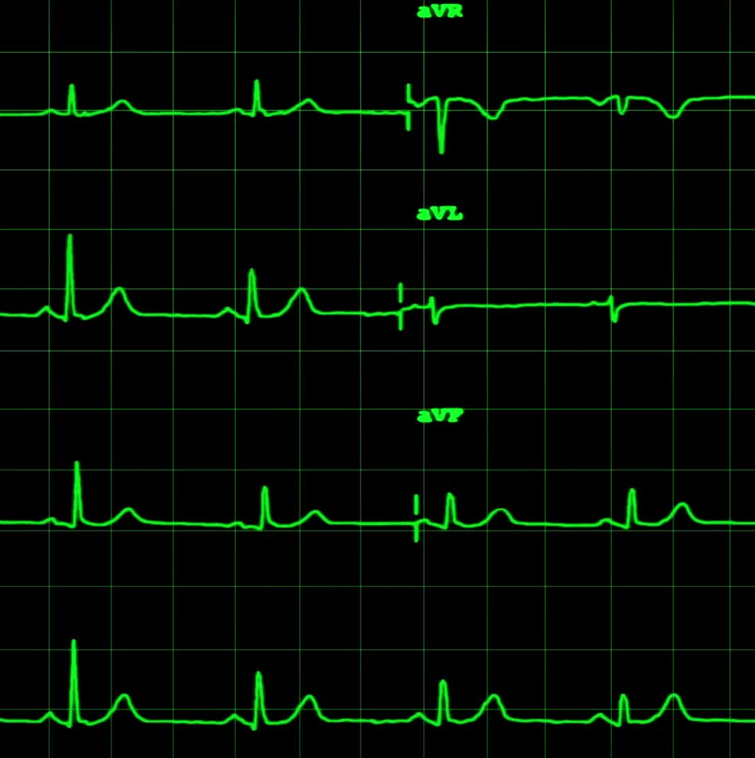
Elbow Method
WCSS (Within-Cluster Sum of Squares) is calculated for k = 1 to 10.
The values are plotted against the number of clusters.
The curve can be inspected for an elbow point indicating diminishing improvement.
The final implementation uses three clusters.

Slide 10

K-Means Algorithm
Choose the number of clusters, k.
Initialize centroids.
Assign each point to the nearest centroid.
Recalculate centroids.
Repeat until convergence/stopping condition.
Each processed record receives a cluster label.

Slide 11
Algorithm: K-Means Clustering
Number of clusters: 3
random_state: 42
n_init: 10
Input: five standardized features
Output: Cluster label for each processed record
Model Configuration

Slide 12
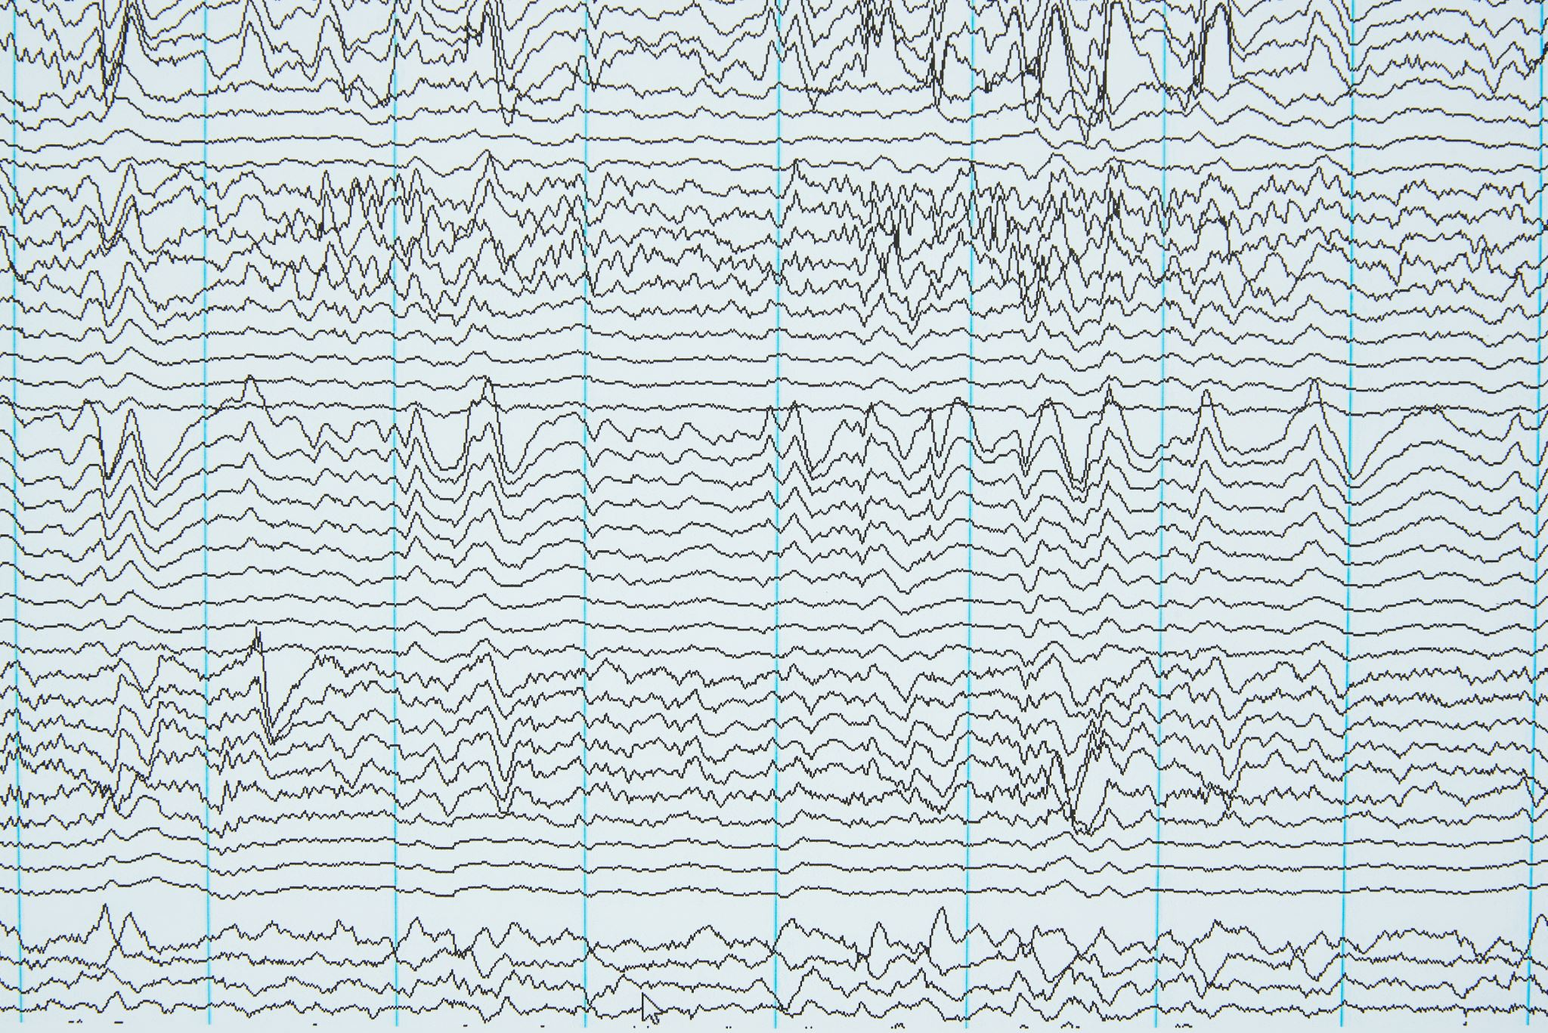
Visualization
Elbow Method graph: number of clusters vs WCSS.
Scatter plot: Age on X-axis and Treatment Cost on Y-axis.
Point color represents the assigned cluster.
Actual plots should be inserted from the program output for the final presentation.

Slide 13
Expected Output
Dataset preview and information
Missing-value summary
Standardized feature matrix shape/sample
Elbow graph
Clustered data with a Cluster column
Hospital Resource Clusters scatter plot

Slide 14
Advantages
Simple and practical Machine Learning workflow.
Uses multiple operational features together.
Supports automatic grouping of records.
Provides visual exploration of clusters.
Can be extended to additional hospital data.

Slide 15
K-Means requires a selected number of clusters.
Results depend on dataset quality and feature selection.
Cluster labels do not automatically have medical meaning.
Current visualization shows only two dimensions of the five-feature model.
The project is for analytical/educational use, not clinical diagnosis.
Limitations

Slide 16

Future Enhancements
Add more hospital operational features.
Compare K-Means with DBSCAN or hierarchical clustering.
Generate cluster profiles using summary statistics.
Add Silhouette Score for cluster evaluation.
Build an interactive Streamlit dashboard.
Support dataset upload and automated analysis.

Slide 17
Conclusion
The project demonstrates an end-to-end unsupervised Machine Learning workflow.
Hospital operational data is cleaned, transformed and standardized.
K-Means is used to discover three groups of similar records.
Visualizations make the clustering process easier to interpret.
The project provides a foundation for further hospital data analytics.

Slide 18
SMART HOSPITAL RESOURCE CLUSTERING
CATHERIN JESINTHA J
B.Sc. Computer Science
St. Anne's Arts and Science College
Thank You

