Slide 1
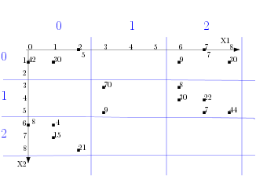
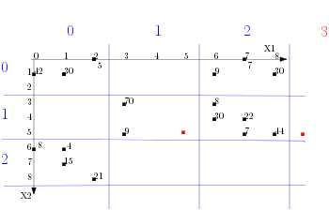
Store
Quantity =10
Greenside
18/05/2016
Date
Apples
Product

Slide 2
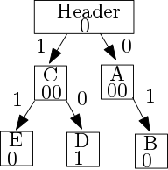

Slide 3
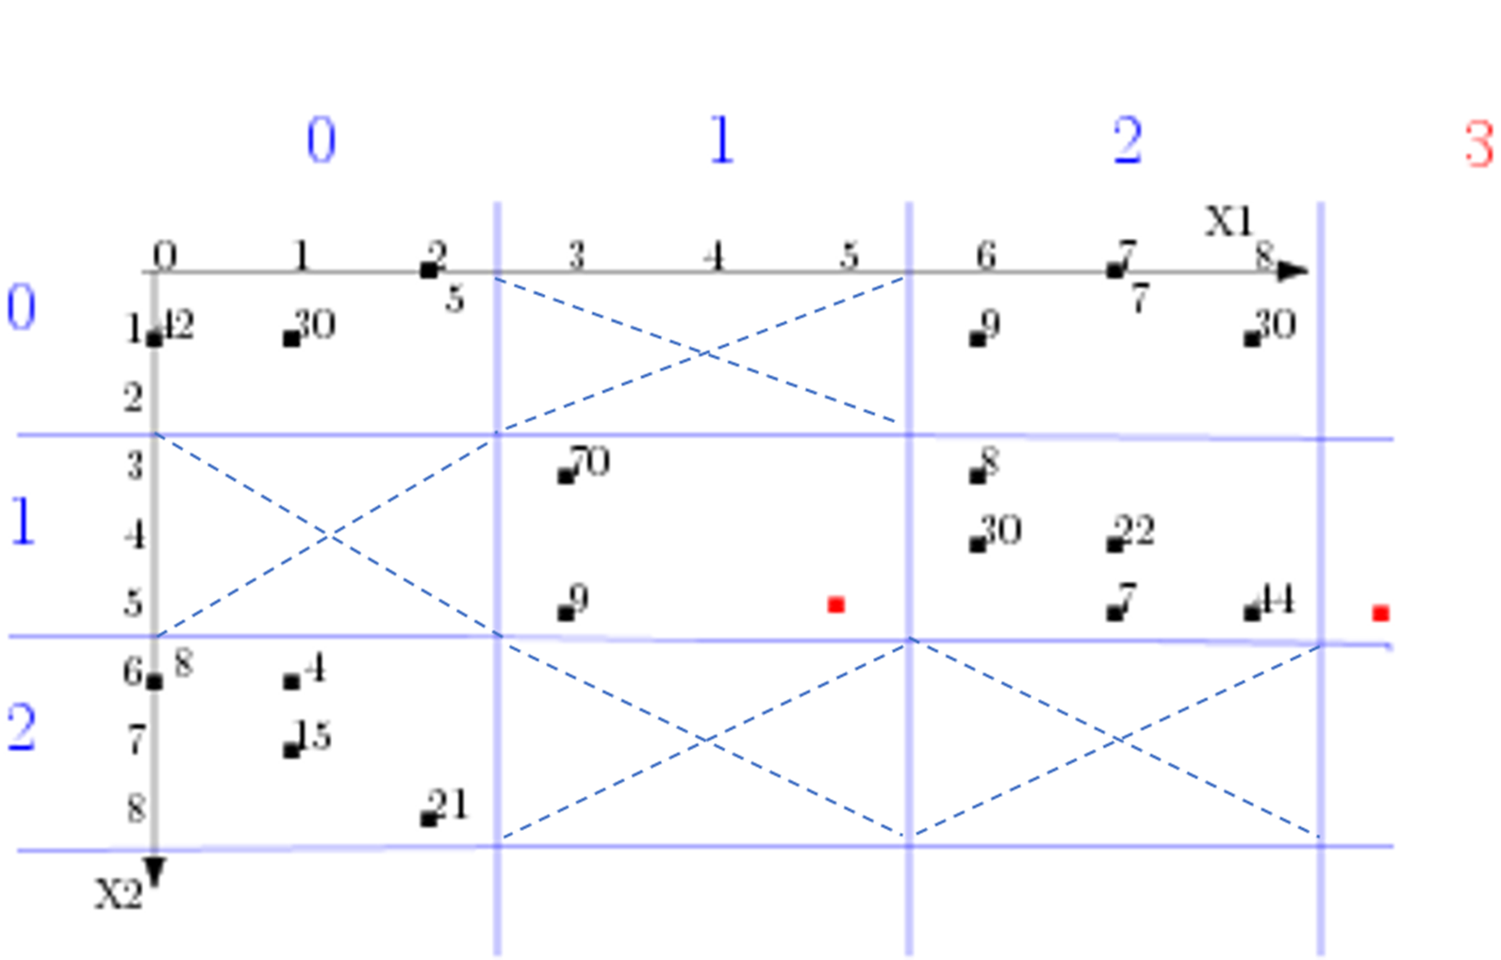
A
B
C
D
E

