Slide 1
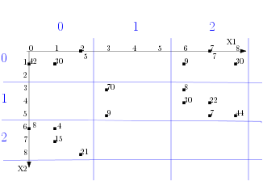
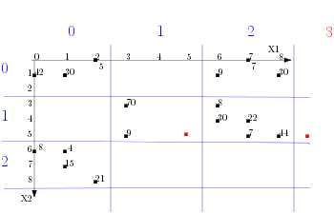
Store
Quantity =10
Greenside
18/05/2016
Date
Apples
Product

