Slide 1

Credit Card Customer Attrition
Business Analytics with R
Prof. Zhe Zhang
Group-8
Suma Harshini Samanthula
Catherine Christina Ganduri
Srija Mannam
Ramakrishna Chepuri
Dharmik Mahendra Bhanushali

Slide 2
Business Problem:
Attrition on credit cards has become a major concern for the banking industry in recent years as an alarming number of consumers are dropping the bank's credit card services, which worries the manager there.
Given that the expense of obtaining new consumers is greater than the expense of keeping existing customers, it has a substantial impact on profitability.
There will be many reasons for leaving the bank that are dissimilar from those given by other clients, however what if there is a pattern in the reasons clients chose to do so?
The manager would like it if someone could foresee who will leave their firm so that they may go to the client in advance to give them better services and sway their decisions.
Additionally, the business will benefit from preventing future client attrition.

Slide 3
Objective :
In order to reduce credit card attrition, it is important to determine what characteristics are driving customers away from the bank. In this case study, actions to take in order to arrive at a decision and conclusion.
Procedure:
Data Cleaning :
Removing a few unnecessary columns like Clientnum.
There were outliers in many attributes such as Credit limit, Customer Age, which were addressed by imputing values below the IQR to 5% of the data distribution and values above the IQR to 95%.
Explore the data :
Investigating the data will enable us to make conclusions and get a basic picture of what might be the primary factors driving credit card consumers away from banks. We will be able to identify the key characteristics in our model that influence attrition.
Predictive Analysis:
We then perform classification models like Decision tree, Logistic regression and Naïve Bayes models.

Slide 4
Data Description:
The data set consists of 10127 observations and 21 columns with credit card details, one for each customer in the bank.
Feature Attributes:
Attrition Flag: This is our target variable, which means whether our customer decided to leave the organization or that there is a high probability the customer will leave.
Gender: Male or Female
Customer age: Age of the customer
Income category: To which income category does the customer belongs to.
Card category: Which card category does the customer have?
Months Inactive: Amount of inactivity when using the credit card.
Credit Limit: Credit Limit the customer currently has.
Total Revolving Balance: The unpaid portion that carries over to the next month when a customer does not pay.

Slide 5
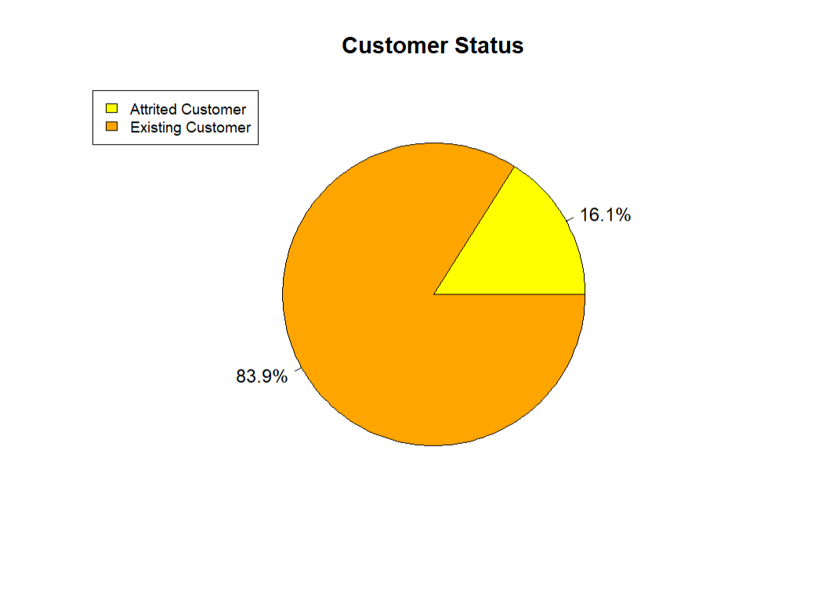
Exploratory Data Analysis:
The main challenge with this data set is that it has an unbalanced target variable, that is, Attrition_Flag, which only counts for about 16.1% of the desired output.

Slide 6
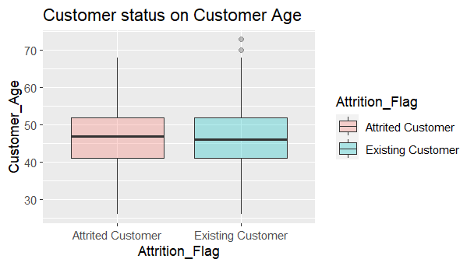
Customer Status on Customer Age
The attrition rate doesn’t depend on the Customer Age.

Slide 7
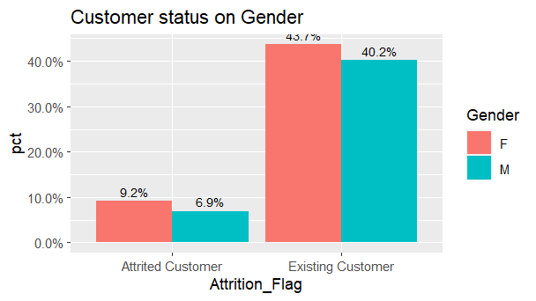
Female Male
5358 4769
The bar graph shows that 9.2% of customers attrited female customers and 6.9% of customers are male.
So, the bank should offer female customers more services in order to hold them back.

Slide 8
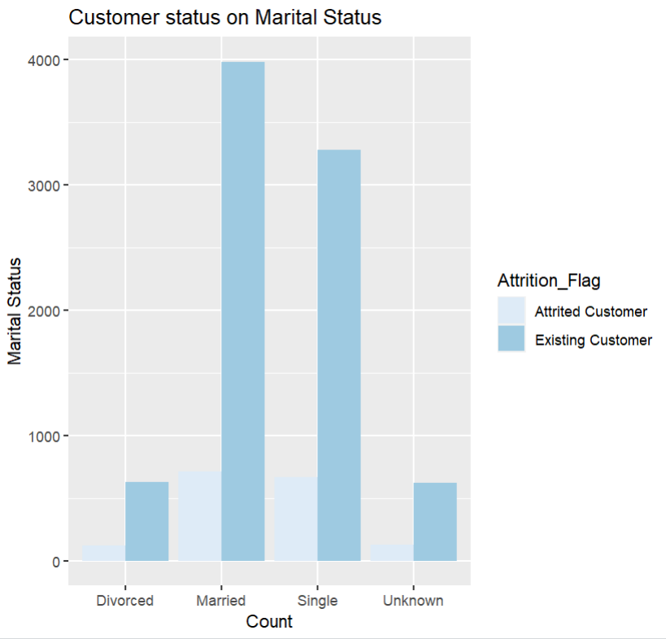
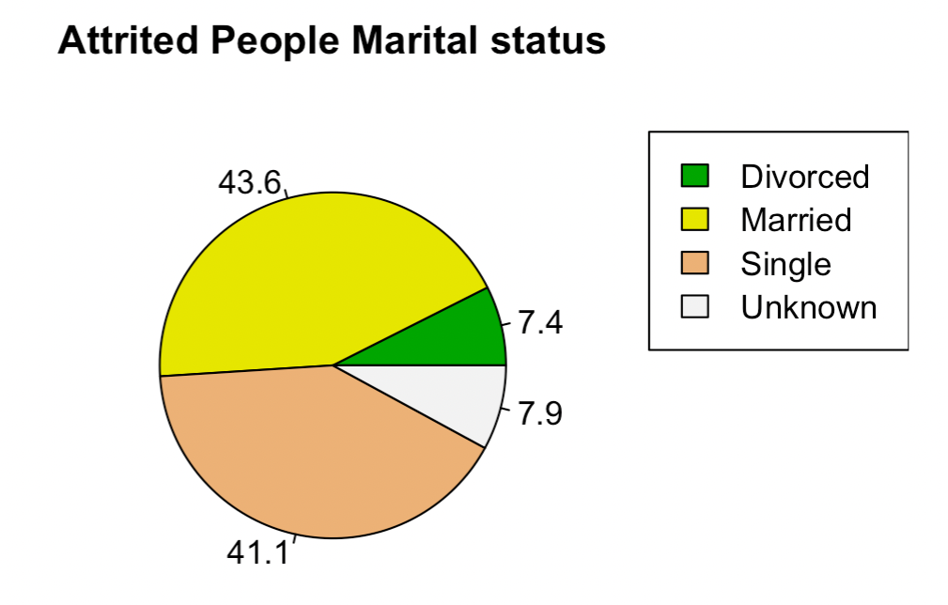
The graph shows that most of the customers are married. However, single customers have a large part in customers’ marital status.
We can also notice here that there is no significant difference between the ratios of the marital status between married and single customers.

Slide 9
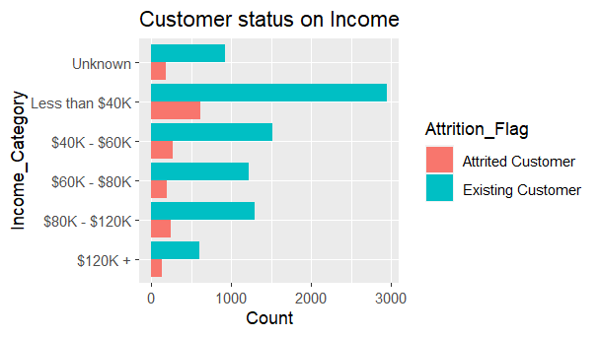
Customer Status on Income
The graph shows that customers with income less than $40k are more likely to attrite a credit card. Also, the same category of customers is more likely to use credit cards without attrition.
The customers with income greater than $120k use the credit card less compared to other category customers based on income.

Slide 10
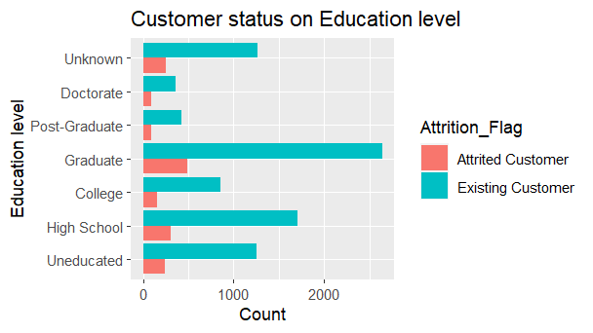
Customer Status on Education level
Main education level of the customers is graduated people, followed by high school.

Slide 11
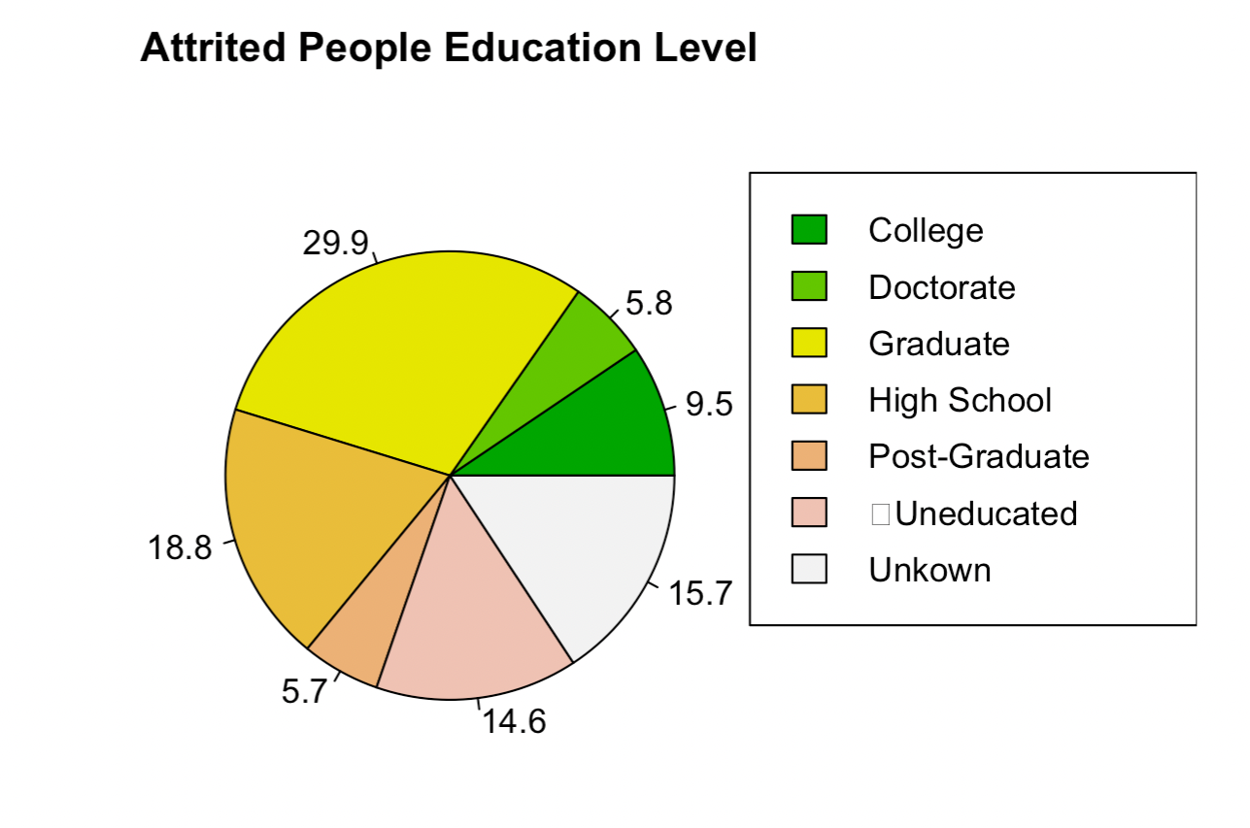
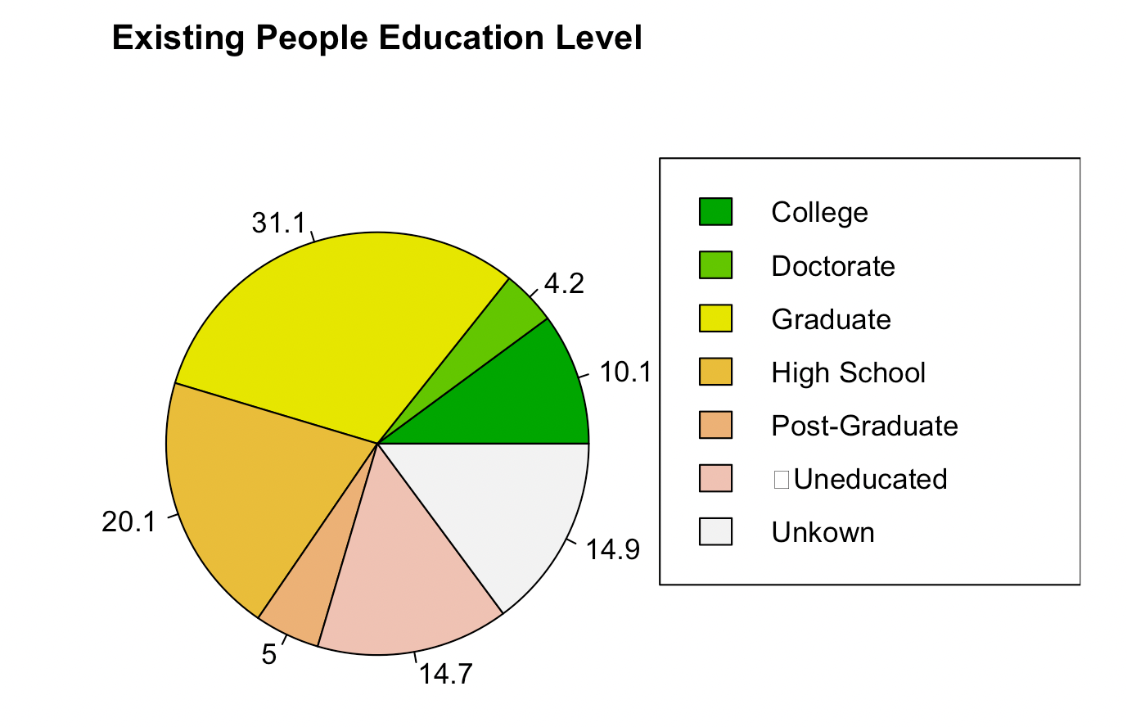
We can also notice here that there is no great difference between the ratios of the educational level between the existing and attired customers

Slide 12
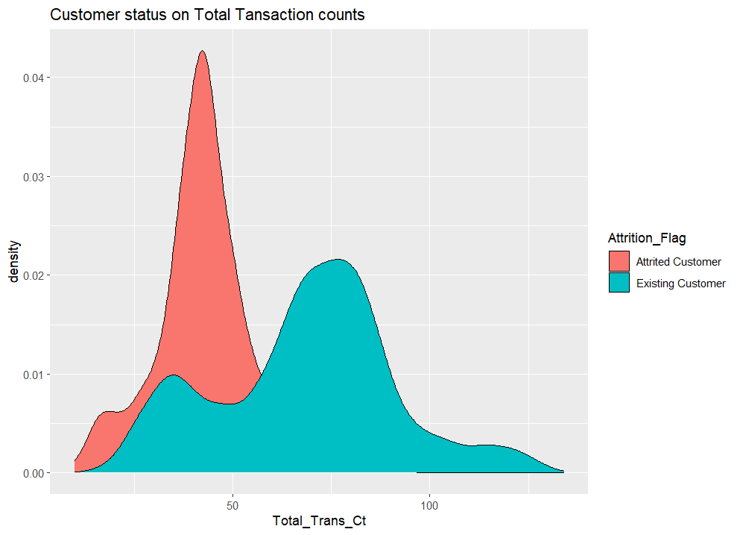
Customer status on Total Transaction counts
The density graph can be interpreted that the customers whose total transaction count is less than 75 have highly resulted in credit card attrition and the customers with a total transaction count greater than 75 are existing customers.

Slide 13
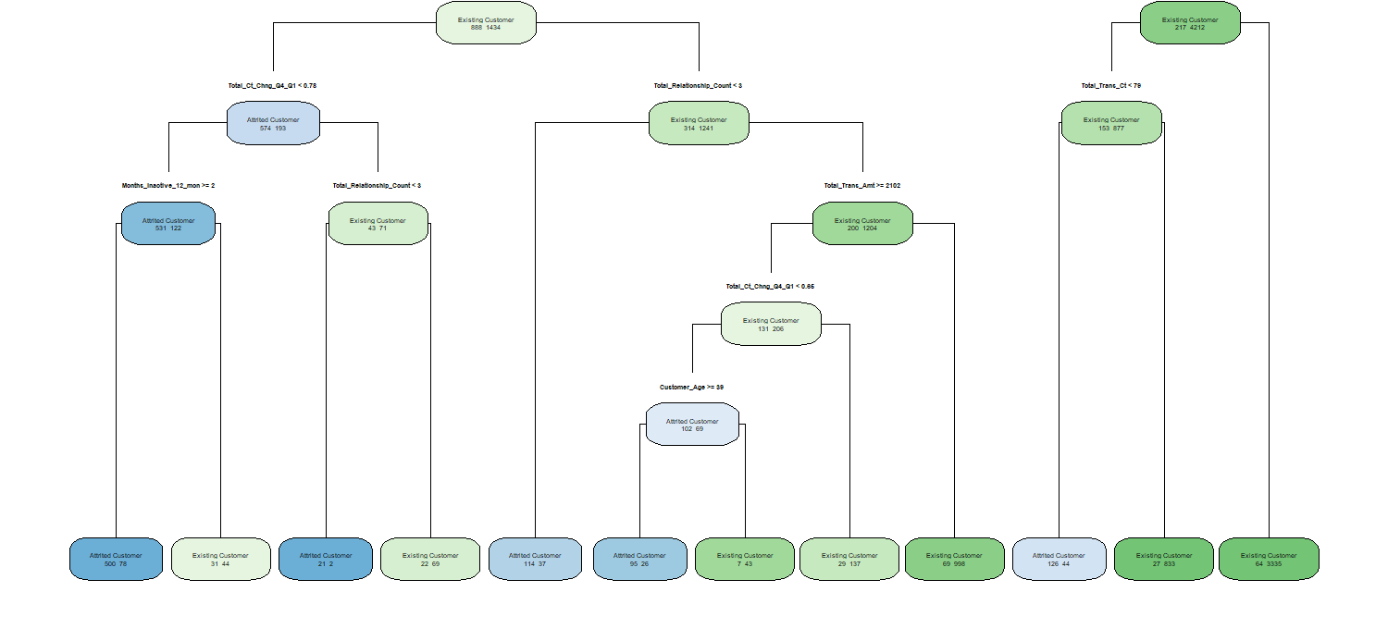
Decision Tree:

Slide 14
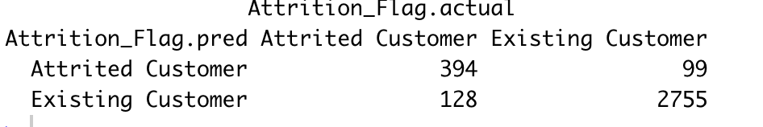
On the test data, model predicted the attrited customers with an accuracy of 93.3% and sensitivity of 96.5% When total transactions are less than 55 and revolving balance is less than 629 customers are more attrited.
When total transactions are greater than 55 and total transaction amount is less than or equal to 5365, customers are less attrited which is a true positive
True positives and True negatives are high.

Slide 15
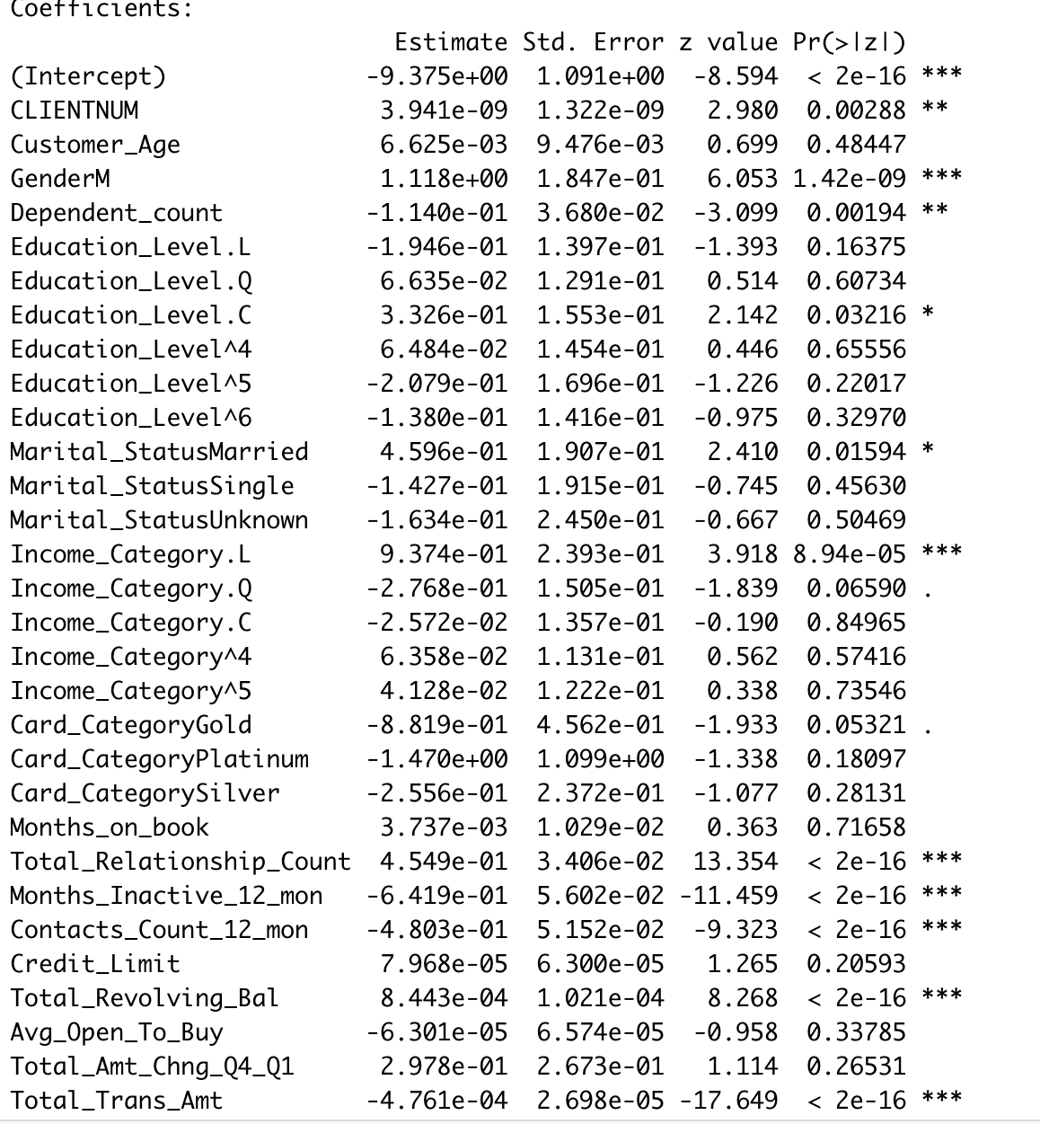
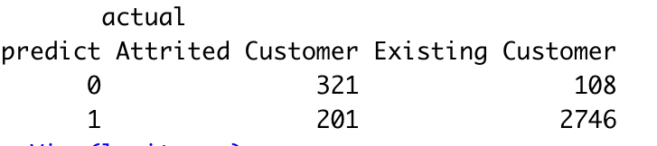
Logistic Regression:
These are the significant variables used for logistic regression.

Slide 16
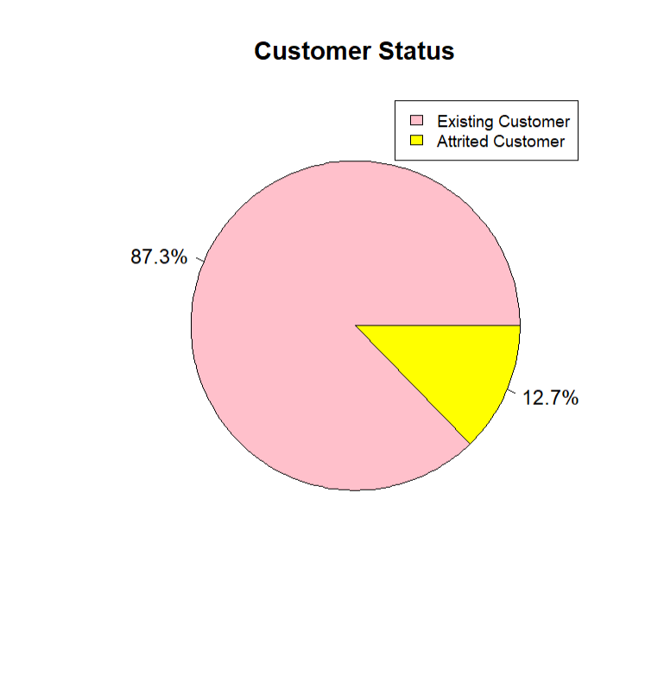
Customer Status
This model predicted the attrited customers with an accuracy of 90.8% and sensitivity of 96.2%.
Our prediction through test data from logistics regression model tells us that 12.7% are predicted to be attrited.

Slide 17
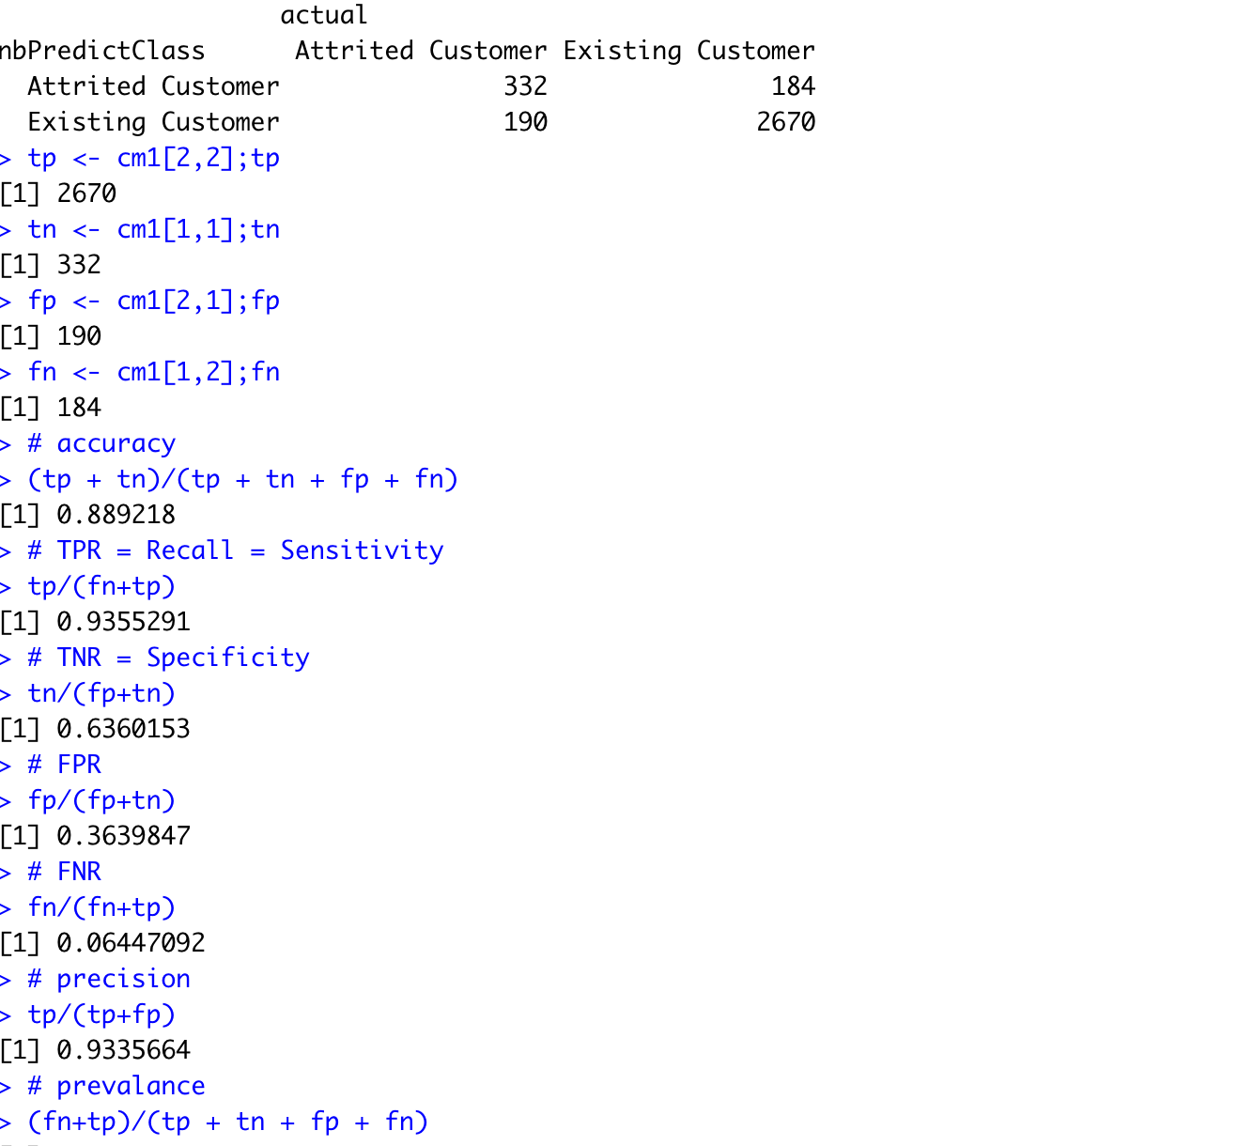
Naïves Bayes:
False negative is high in Naïve bayes when compared to other models.

Slide 18
Comparing Our Classification Models:

Slide 19

Conclusion:
Three prediction models have been built to predict whether a customer is attrited or not. Those models were Decision Tree, logistic regression model and Naïve Bayes method model.
To guarantee a high accuracy Decision Tree model will be a good model.
But since we want to capture a greater number of customers in the false negative region in Naïve Bayes model would give more better results compared to decision tree.

Slide 20
Thank You!

