Slide 1
Via Rating System
By Matt Christman, Catherine Etter, and Hoa To

Slide 2
About the Via Rating System
The Via Rating App functions as a way to reward users for riding VIA bussess and reviewing drivers.

Slide 3
Our Purpose for making this app
Solve the problems of VIA buss tardiness and any issues with driver behavior or responsivness
Reward the good drivers
Be notified of the bad drivers

Slide 4
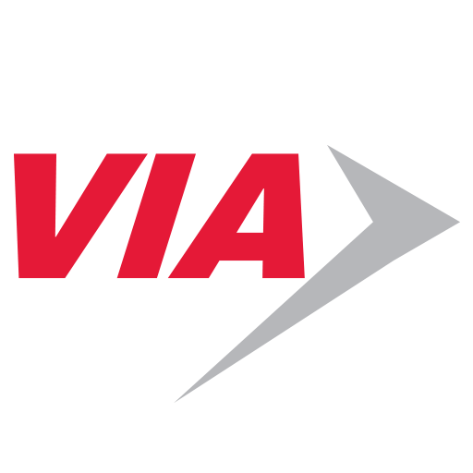
App Demo

Slide 5
Tools We Used
Firebase
Android Studio

Slide 6
Problems We Faced
Experience
Database building

Slide 7
Impact on Via
Good drivers can be recognized and bad driver can be notified they need to improve
Helps notifiy VIA of routes that may need to be improved

