Slide 1
Education/Qualification and Health Effects Summary
Jon Minton

Slide 2
Modelling the effect of health on labour market engagement
We use three types of approach:
Using reported long-term illness as a binary variable
Using scores on SF-12, mental and health sub-domain, as a continuous variable
Using reported presence or absence of specific clinically diagnosed medical conditions as a series of binary variables
We will now consider these three approaches in turn

Slide 3
General approach (as a reminder)
The general approach taken is:
We decide on the variables to consider including as exposures
We fit a series of models with and without exposures to see if including the exposures adds to the quality of the model (Using the AIC/BIC criteria)
If a model with the exposure is preferred we use this for running baseline-counterfactual scenarios
Even if a model with exposure does not outcompete the foundational (no-exposure) specification we may still run it if there are sound clinical/epidemiological reasons to do so
We decide on a representative dataset to pass to the best exposure model to estimate the effects on economic (in)activity composition in the next wave under a do-nothing (baseline) scenario
This has usually been wave J of UKHLS
We modify the baseline dataset to allow the estimated effects of the exposure on economic (in)activity to be estimated. This produces one or more counterfactual scenarios
We compare the baseline and counterfactual scenarios’ estimated economic (in)activity compositions in absolute and relative terms:
Absolute differences: how many more/fewer people are (say) unemployed in the counterfactual scenario than the baseline scenario?
Relative differences: how many % higher/lower are the numbers (say) unemployed in the counterfactual scenario than the baseline scenario?

Slide 4
Modelling based on reported long-term illness
Long-term illness is a binary variable: present/absent

Slide 5
Jointly modelling education changes and health changes
Let’s define this in PICO structure:
Population Representative adults aged 25-60 years
Intervention:
Education: Everyone up one level (up to degree)
Health: 1 SD unit change, equal through MH and PH path
Comparator: No change in health or qualifications
Outcome: Change in absolute and relative distribution of persons in EI/EA states, focusing on change in EI: LT sick

Slide 6
Step 1: Get data

Slide 7
Modelling
# weights: 238 (198 variable) initial value 399791.131945 iter 10 value 126639.517682 iter 20 value 103779.451831 iter 30 value 97088.637936 iter 40 value 91956.345766 iter 50 value 87944.976491 iter 60 value 85762.997646 iter 70 value 83126.138557 iter 80 value 81571.885958 iter 90 value 81262.495695 iter 100 value 81212.030099 final value 81212.030099 stopped after 100 iterations
# weights: 259 (216 variable) initial value 399791.131945 iter 10 value 215001.009243 iter 20 value 177848.963491 iter 30 value 156796.609415 iter 40 value 142652.781894 iter 50 value 123418.798186 iter 60 value 108871.149235 iter 70 value 96731.000821 iter 80 value 88936.643276 iter 90 value 84020.780544 iter 100 value 80793.162794 final value 80793.162794 stopped after 100 iterations
# weights: 252 (210 variable) initial value 399791.131945 iter 10 value 144032.727280 iter 20 value 124919.751476 iter 30 value 111976.041567 iter 40 value 101875.629993 iter 50 value 95450.092194 iter 60 value 89460.648702 iter 70 value 85223.775743 iter 80 value 82788.860638 iter 90 value 81265.601333 iter 100 value 80668.974336 final value 80668.974336 stopped after 100 iterations
# weights: 273 (228 variable) initial value 399791.131945 iter 10 value 212049.576681 iter 20 value 178239.604541 iter 30 value 160609.074880 iter 40 value 143240.736144 iter 50 value 124882.672065 iter 60 value 114415.699568 iter 70 value 103729.936738 iter 80 value 92907.844453 iter 90 value 86511.227083 iter 100 value 82471.169387 final value 82471.169387 stopped after 100 iterations

Slide 8
Model comparison
model_name | aic | bic | aic_rank | bic_rank
Qualifications | 161613.9 | 163026.1 | 1 | 1
Health | 161874.3 | 163347.9 | 2 | 2
Foundational | 162676.1 | 163965.4 | 3 | 3
Both | 165254.3 | 166850.7 | 4 | 4

Slide 9
Lower BIC and AIC scores are better. The models are arranged from lowest to highest, and ranks shown as aic_rank and bic_rank.
This shows that the Qualifications model is preferred to the other three model specifications, then the Health model. The Foundation model is third, and the model with both appears too complex and is not preferred to the Foundational model.
There is no difference in the rank ordering of models preferred by the AIC and BIC metrics.

Slide 10
Dilemma
The models with the best penalised fit are those considering Qualifications and Health separately
The model with the worst penalised fit is that with both Qualifications and Health.
But we are interested in something like ceteris paribus effects of intervening on one variable but not the other
We will present results from the Both model even though it has the poorest performance by these measures

Slide 11
Representative data
Select wave J from UKHLS as it’s comparatively recent (and/but pre-pandemic)
Now let’s calculate the scenarios

Slide 12
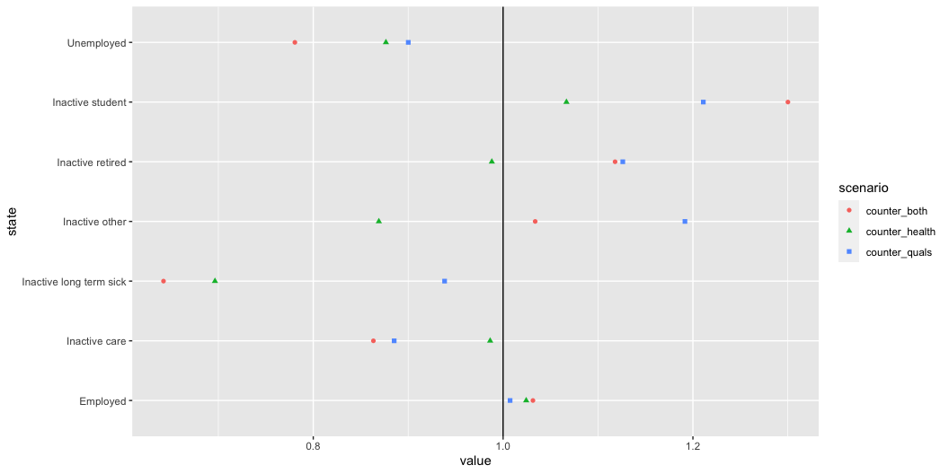
Relative change, plotted
Now let’s at least visualise this

Slide 13
Relative change, as a table
state | counter_health | counter_quals | counter_both
Employed | 102.4 | 100.7 | 103.1
Unemployed | 87.7 | 90.0 | 78.1
Inactive student | 106.7 | 121.1 | 130.0
Inactive care | 98.6 | 88.5 | 86.3
Inactive long term sick | 69.6 | 93.8 | 64.2
Inactive retired | 98.8 | 112.6 | 111.8
Inactive other | 86.9 | 119.2 | 103.4

Slide 14
Absolute changes, as a table
state | baseline | counter_health | counter_quals | counter_both
Employed | 12572.39686 | 12878.38916 | 12665.04858 | 12967.62307
Inactive care | 799.75053 | 788.84507 | 707.97660 | 690.47038
Inactive long term sick | 708.17263 | 493.19533 | 664.52715 | 454.79876
Inactive other | 66.90592 | 58.14845 | 79.72435 | 69.16837
Inactive retired | 527.51858 | 521.25689 | 594.04442 | 589.75623
Inactive student | 102.51298 | 109.35547 | 124.13801 | 133.27551
Unemployed | 582.74250 | 510.80963 | 524.54089 | 454.90767

Slide 15
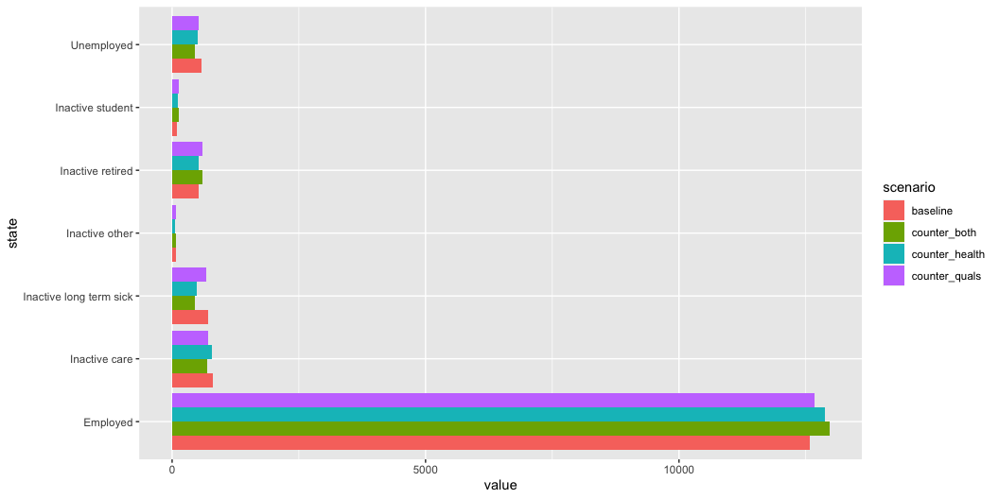
Absolute, as a graph

Slide 16
Table of changes in proportions under each scenario
state | baseline | counter_health | counter_quals | counter_both
Employed | 81.85 | 83.84 | 82.45 | 84.42
Inactive care | 5.21 | 5.14 | 4.61 | 4.50
Inactive long term sick | 4.61 | 3.21 | 4.33 | 2.96
Inactive other | 0.44 | 0.38 | 0.52 | 0.45
Inactive retired | 3.43 | 3.39 | 3.87 | 3.84
Inactive student | 0.67 | 0.71 | 0.81 | 0.87
Unemployed | 3.79 | 3.33 | 3.41 | 2.96
Let’s see how the distribution of persons in each state is estimated to change

Slide 17
Summary of tables
Improving general health estimated to reduce size of inactive long-term sick population by more than increasing qualifications
After health, the additional qualifications effect on inactive LT sick are estimated to be somewhat marginal
Both improved health and improved qualifications are associated with higher proportions of the population who are students, and thus economically inactive for this reason.
Improved health is expected to increase the size of the employed population by around 2.4%

Slide 18
Job quality
We will also look at including measures of job quality in the above. We need to note that as the job quality measure only applies to persons in employment, the PICO frame will need to be adjusted accordingly; i.e this will look only at those who start off in employment, rather than the whole dataset.

Slide 19
PICO of above
Population: Persons in employment at time T
Aged 25-60 years of age
Intervention:
Qualifications: up one level
Health: up one SD
Job quality:
Initially just the job satisfaction item
Both individually and in combination

Slide 20
Extracting the data
Now to model
# weights: 238 (198 variable) initial value 315040.907222 iter 10 value 45115.336913 iter 20 value 40198.173796 iter 30 value 37856.887750 iter 40 value 37298.333019 iter 50 value 36991.806405 iter 60 value 36651.119338 iter 70 value 36634.901503 iter 80 value 36530.982520 iter 90 value 36350.693139 iter 100 value 36345.604315 final value 36345.604315 stopped after 100 iterations
# weights: 259 (216 variable) initial value 315040.907222 iter 10 value 48532.315429 iter 20 value 44172.444734 iter 30 value 40911.457040 iter 40 value 38366.001802 iter 50 value 36953.077939 iter 60 value 36583.422297 iter 70 value 36071.038845 iter 80 value 35918.191376 iter 90 value 35905.281156 iter 100 value 35612.664050 final value 35612.664050 stopped after 100 iterations
# weights: 252 (210 variable) initial value 315040.907222 iter 10 value 46448.457469 iter 20 value 41647.238031 iter 30 value 39092.395254 iter 40 value 37561.262115 iter 50 value 37219.912693 iter 60 value 36772.305050 iter 70 value 36525.340770 iter 80 value 36514.588870 iter 90 value 36233.405516 iter 100 value 36165.793616 final value 36165.793616 stopped after 100 iterations
# weights: 280 (234 variable) initial value 315040.907222 iter 10 value 46003.357316 iter 20 value 42032.511103 iter 30 value 38922.620442 iter 40 value 37881.394941 iter 50 value 37219.518544 iter 60 value 36924.210083 iter 70 value 36717.076100 iter 80 value 36376.356505 iter 90 value 36303.088572 iter 100 value 36288.824344 final value 36288.824344 stopped after 100 iterations
# weights: 315 (264 variable) initial value 315040.907222 iter 10 value 56268.651396 iter 20 value 50312.065073 iter 30 value 45095.225293 iter 40 value 41702.346848 iter 50 value 38757.758106 iter 60 value 37588.225541 iter 70 value 37074.333685 iter 80 value 36697.395568 iter 90 value 36449.038730 iter 100 value 36137.385306 final value 36137.385306 stopped after 100 iterations

Slide 21
Model comparison with three exposure variables
 | df | AIC
mod_00 | 126 | 72943.21
mod_hlth | 144 | 71513.33
mod_qual | 138 | 72607.59
mod_jobsat | 162 | 72901.65
mod_full | 192 | 72658.77

Slide 22
 | df | BIC
mod_00 | 126 | 74202.54
mod_hlth | 144 | 72952.57
mod_qual | 138 | 73986.86
mod_jobsat | 162 | 74520.79
mod_full | 192 | 74577.76

Slide 23
model_name | aic | bic | aic_rank | bic_rank
Health | 71513.33 | 72952.57 | 1 | 1
Qualifications | 72607.59 | 73986.86 | 2 | 2
Foundational | 72943.21 | 74202.54 | 5 | 3
Jobsat | 72901.65 | 74520.79 | 4 | 4
All | 72658.77 | 74577.76 | 3 | 5

Slide 24
Discussion
As before, we recognise that the full model does not have the best fit (and according to BIC has the worst fit adjusted for complexity), but at the same time we are interested in something like SAFs, so will use it below

Slide 25
Scenario creation

Slide 26
Comparison of scenarios: change in distributions
state | baseline | counter_health | counter_quals | counter_jobsat | counter_health_qual | counter_health_jobsat | counter_jobsat_qual | counter_all
Employed | 95.67 | 96.53 | 95.72 | 96.04 | 96.45 | 96.86 | 96.12 | 96.82
Inactive care | 0.75 | 0.63 | 0.63 | 0.79 | 0.53 | 0.67 | 0.67 | 0.56
Inactive long term sick | 0.41 | 0.13 | 0.30 | 0.43 | 0.10 | 0.14 | 0.32 | 0.10
Inactive other | 0.18 | 0.14 | 0.21 | 0.20 | 0.17 | 0.15 | 0.23 | 0.18
Inactive retired | 1.05 | 1.04 | 1.34 | 0.87 | 1.33 | 0.87 | 1.12 | 1.11
Inactive student | 0.27 | 0.28 | 0.32 | 0.24 | 0.33 | 0.25 | 0.28 | 0.29
Unemployed | 1.67 | 1.24 | 1.47 | 1.43 | 1.09 | 1.06 | 1.26 | 0.94

