Slide 1
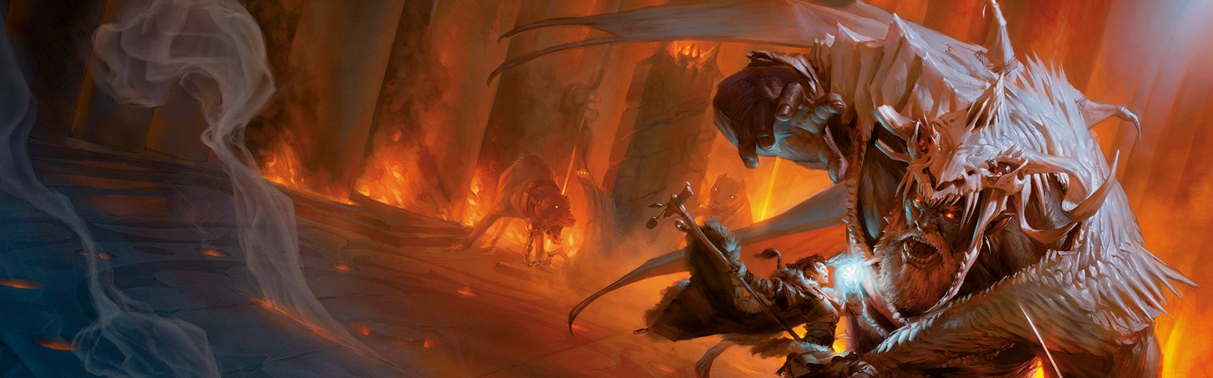
Dungeons & Dragons Character Sheet
Christopher Sousa, John Canducci, Catherine Gallaher, Dylan Bryant

Slide 2
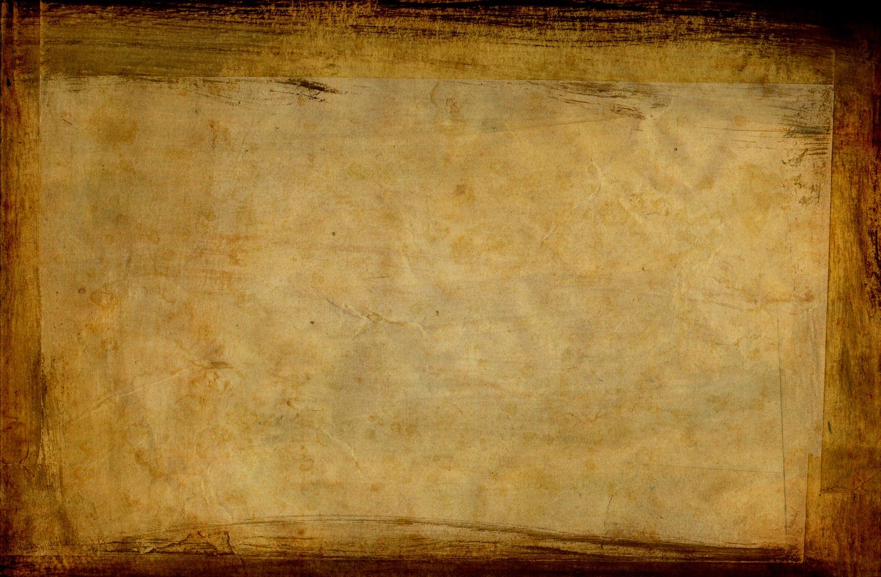
Project summary
DnD: Character Generator
Character sheet at the beginning of the game, updated intermittently
Character creation can be time-consuming; why not speed it up?

Slide 3
Division of labor
Chris did the Class portion, the overall Character class, and leveling up
Dylan did the Race portion and languages
Catherine did the Equipment portion, design, and validation
Jack did the Background portion, Skills, PDF filling, and loading from PDF

Slide 4
Technology
C#, using Windows Forms
Visual Studio
GitHub

Slide 5
Plot (challenges, time frame, etc.)
Filling a PDF form(Thank you, Jack)
Ensuring a large codebase interacted cleanly
Reached a good place for minimum product, expanded well to the end.

Slide 6
Demo
https://www.youtube.com/watch?v=4uOccVnYD7Y

Slide 7
Moving Forward
Attack Roll function
Extra skills for background
Make forms more cohesive in size
Clean up old code/comments
Implement spellcasting
Auto generate character background details
Make race more interactive with attacks
Database it

