Slide 1
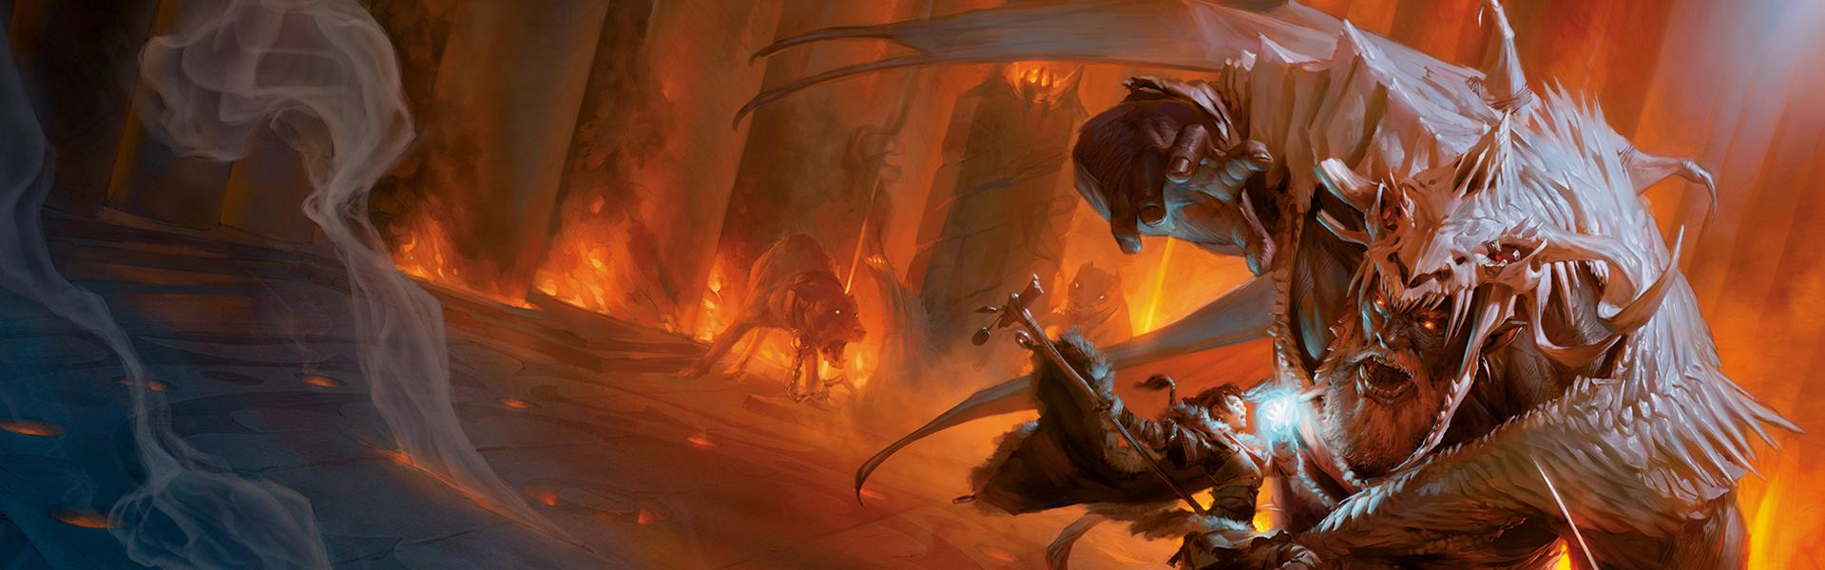
Dungeons & Dragons Character Sheet
Christopher Sousa, John Canducci, Catherine Gallaher, Dylan Bryant

Slide 2
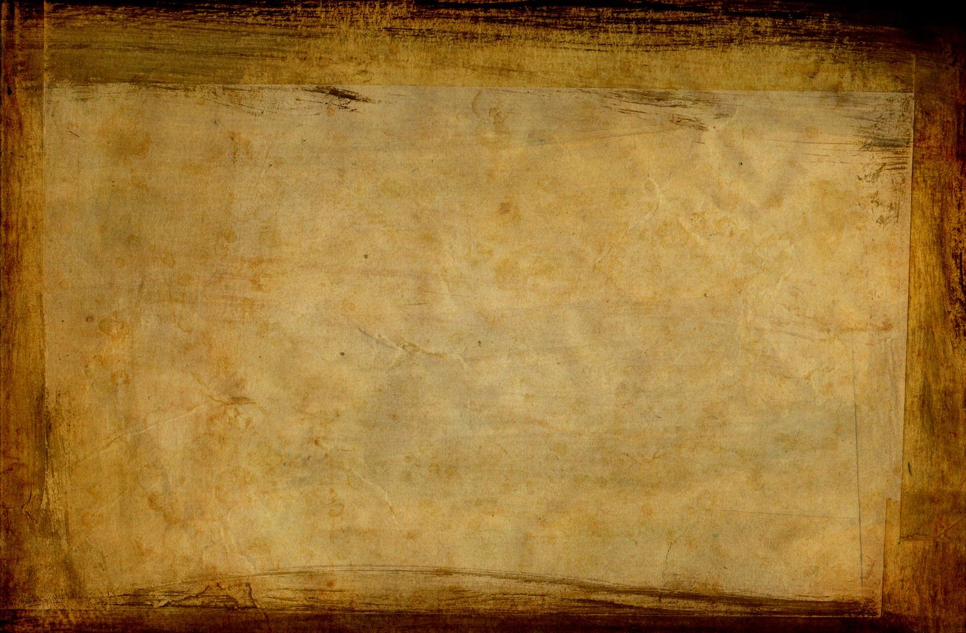
Project summary I guess
DnD: A game. It exists.
Character sheet at the beginning of the game, updated intermittently
Basically, you make a character to play in the game because it’s a role playing game. I’m sure literally everyone in the room knows this, but we’ll say it anyway.

Slide 3
Division of labor
Chris did the Class portion, the overall Character class, and leveling up
Dylan did the Race portion and languages
Catherine did the Equipment portion, design, and validation
Jack did the Background portion, Skills, PDF filling, and loading from PDF

Slide 4
Plot (challenges, time frame, etc.)
We did work
Jack did a lot of work
We all did a lot of work

Slide 5
Finished Product

Slide 6
Examples?

Slide 7
Moving Forward
Attack Roll function
Extra skills for background
Make forms more cohesive in size
Clean up old code/comments

