Slide 1


TimeTuner: Diagnosing Time Representations for Time-Series Forecasting with Counterfactual Explanations
Jianing Hao¹, Qing Shi¹, Yilin Ye^{1, 2}, Wei Zeng^{1, 2}

Slide 2
Part 1: Background

Slide 3
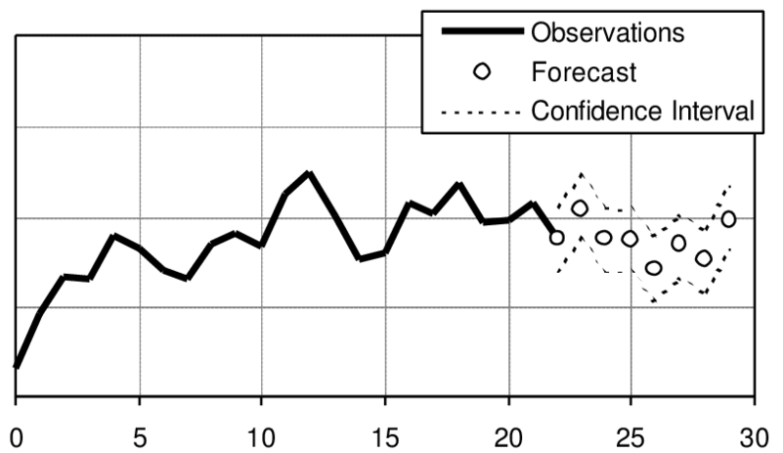
Background
Time-series forecasting with Deep Learning Techniques.
Explore the impact of different transformation methods on predictions.
Consider a large number of possible data representations and a massive volume of time-series data.
Notes:
Time-series forecasting is a critical research problem, with an increasing emphasis on leveraging deep learning techniques in recent years.
The lack of interpretability and sensitivity to deep learning models and data representations grow the need for interactive solutions to increase user engagement in exploring the impact of different transformation methods on predictions, analyzing outliers, gaining more intuitive explanations, and subsequently selecting appropriate transformation methods.
The evaluation of time-series forecasting is currently limited to single numeric metrics, and applying DL models requires considering a large number of possible data representations and a massive volume of time-series data.

Slide 4
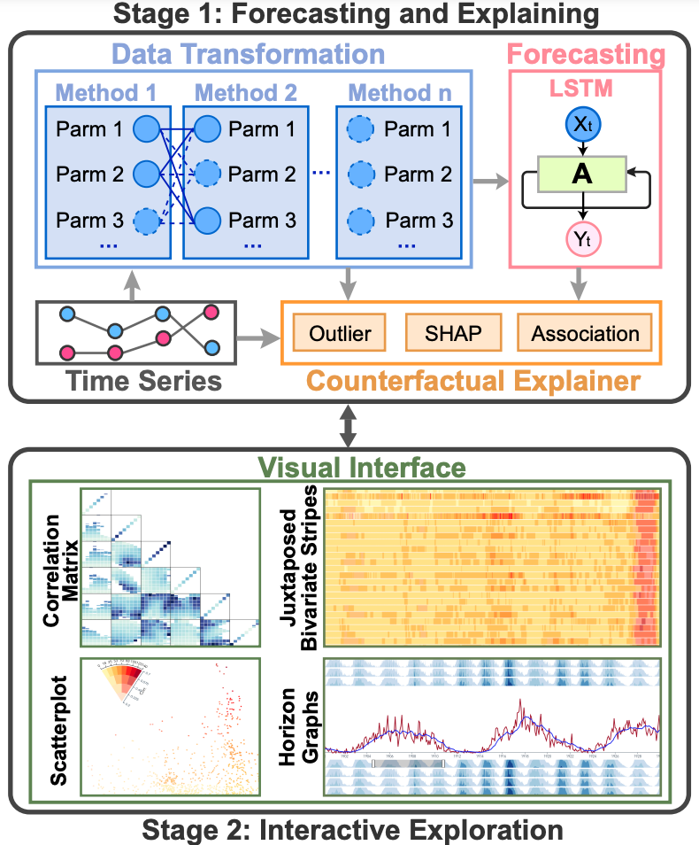
Workflow
Notes:
In our work, we propose a general visual analytics framework , TimeTuner, which mainly consists of four modules in two stages. 1) data transformation, 2) forecasting and 3) counterfactual explaining in the Forecasting and Explaining stage, and 4) visualization system in the Interactive Exploration stage.

Slide 5
Analytical Tasks
Examine the details of variables.
Variable Level
Identify associations among variables.
Compare different representations.
Analyze the association between representations and variables.
Representation Level
Analyze the association between representations and predictions.
Detect the overall patterns of predictions.
Prediction Level
Detect the prediction outliers.
Notes:
We summarized a set of analytical tasks and categorized them into three levels: Variable Level, representation level and prediction level.

Slide 6
Part 2: Visual Interface

Slide 7
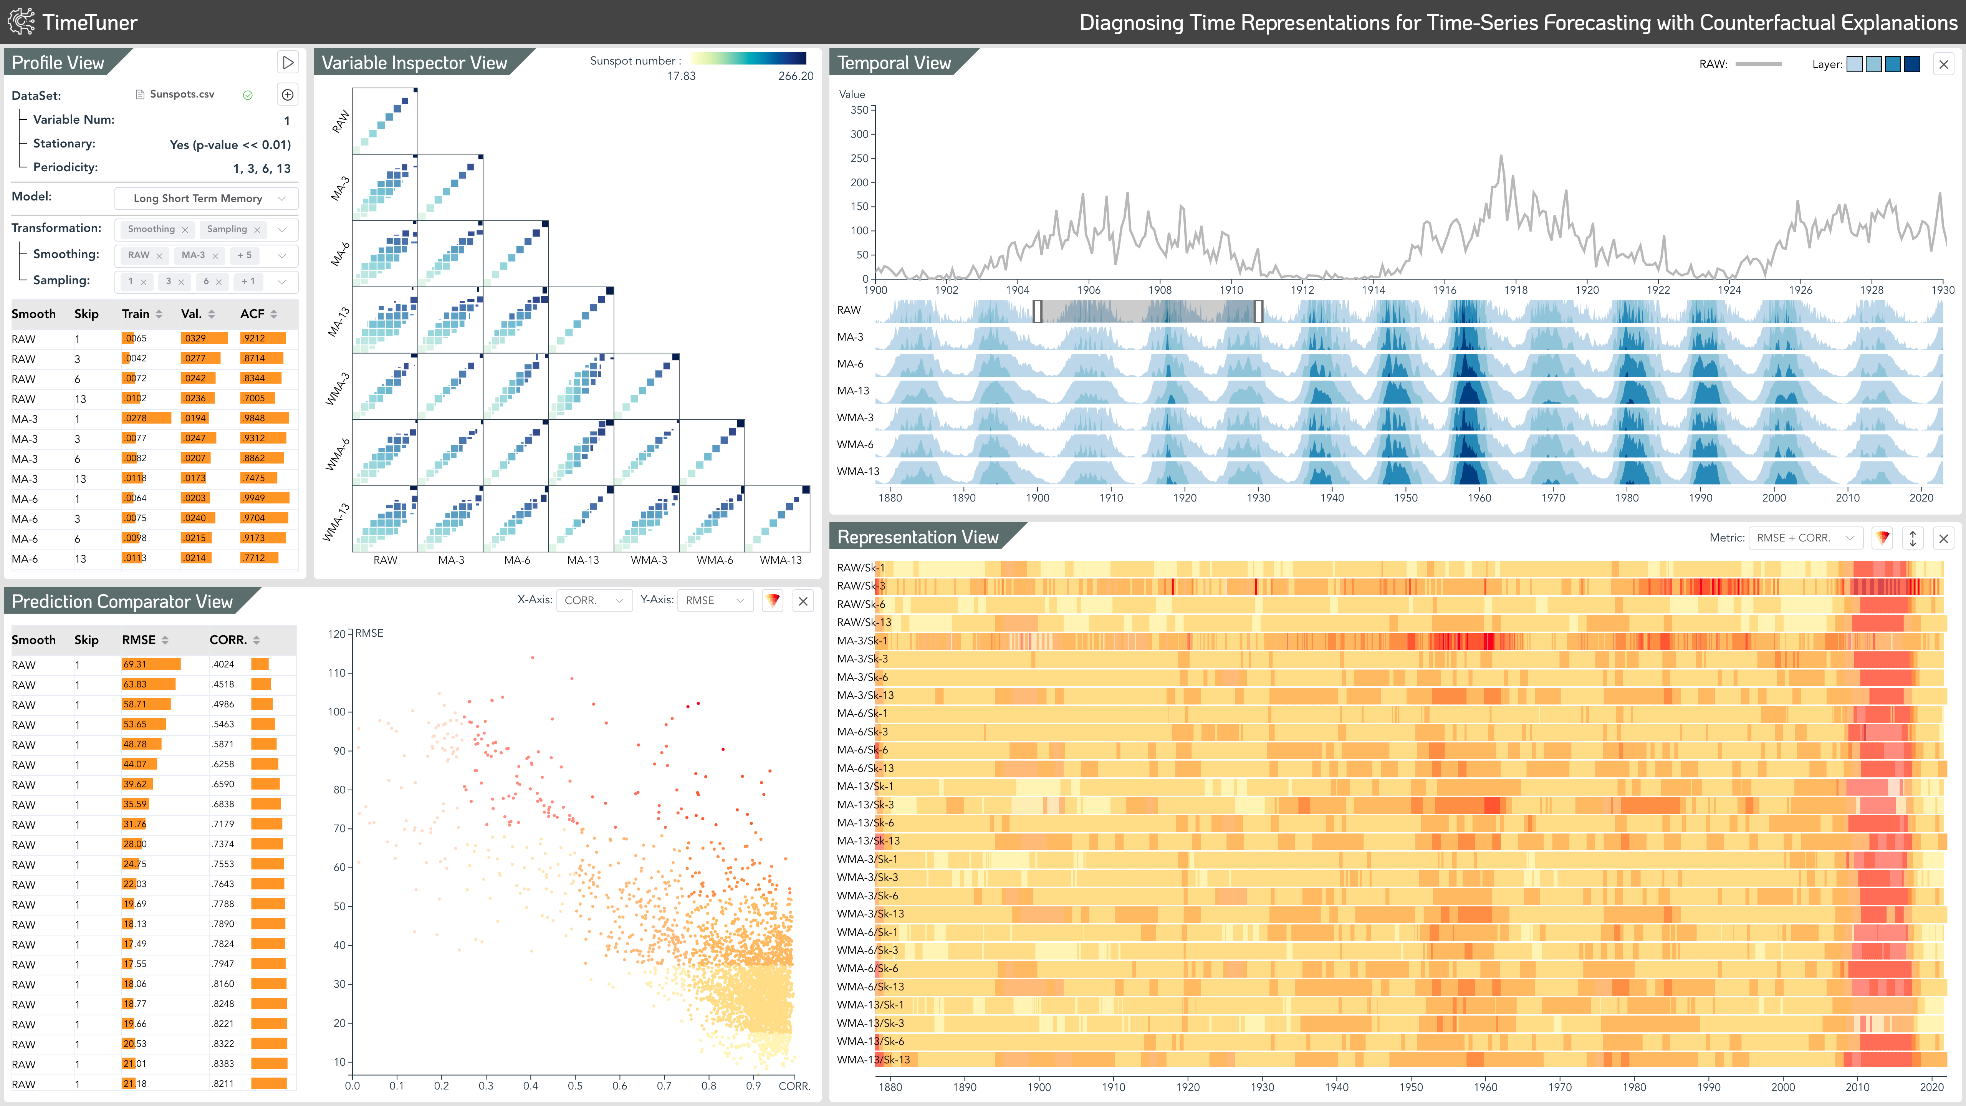
Visual Interface

Slide 8
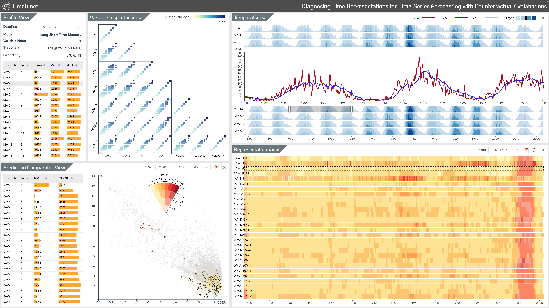
System

Slide 9
Part 3: Case Study

Slide 10
Univariate sunspots forecasting
Case 1

Slide 11
Multivariate PM2.5 forecasting
Case 2

Slide 12
Thank you!

