Slide 1
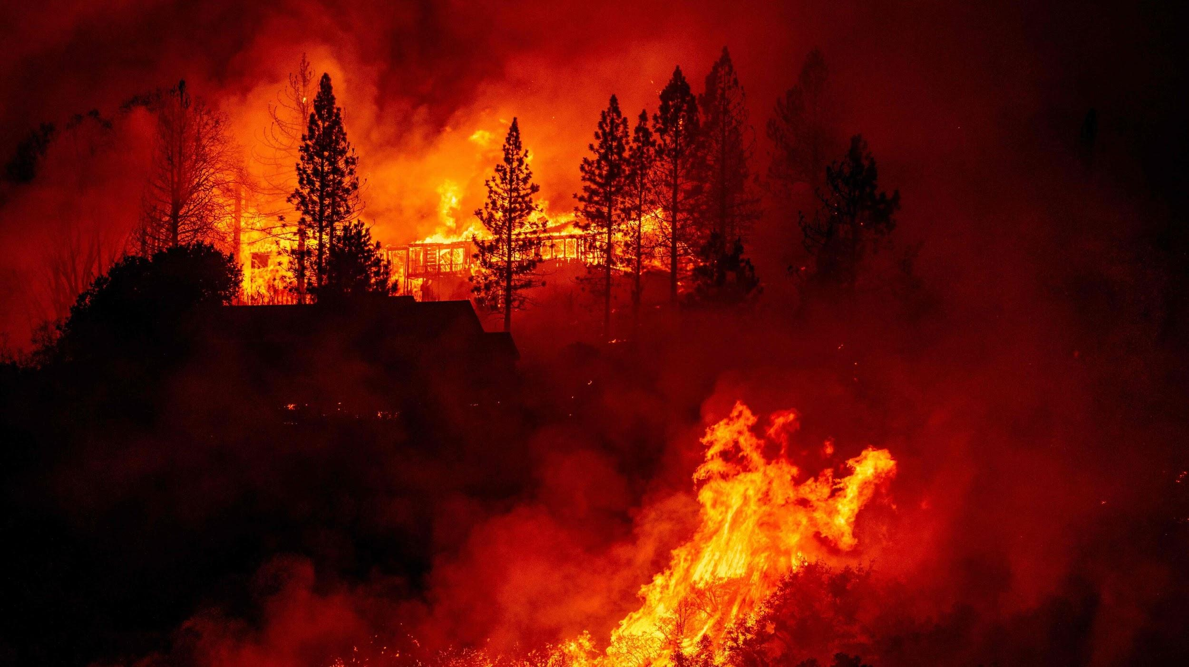
A Burning Wallet:
The Economic Impact of Wildfires in America
Team:
Yukie Kajita
John Falcone
Katy Luquire

Slide 2
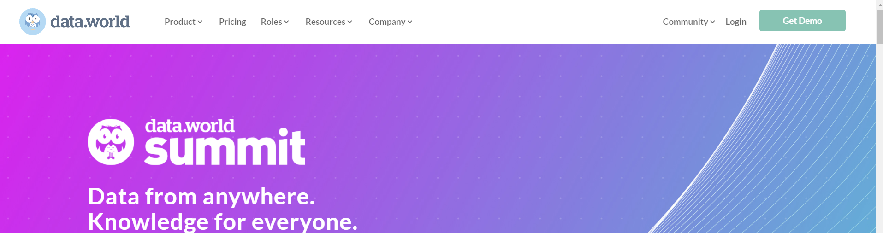
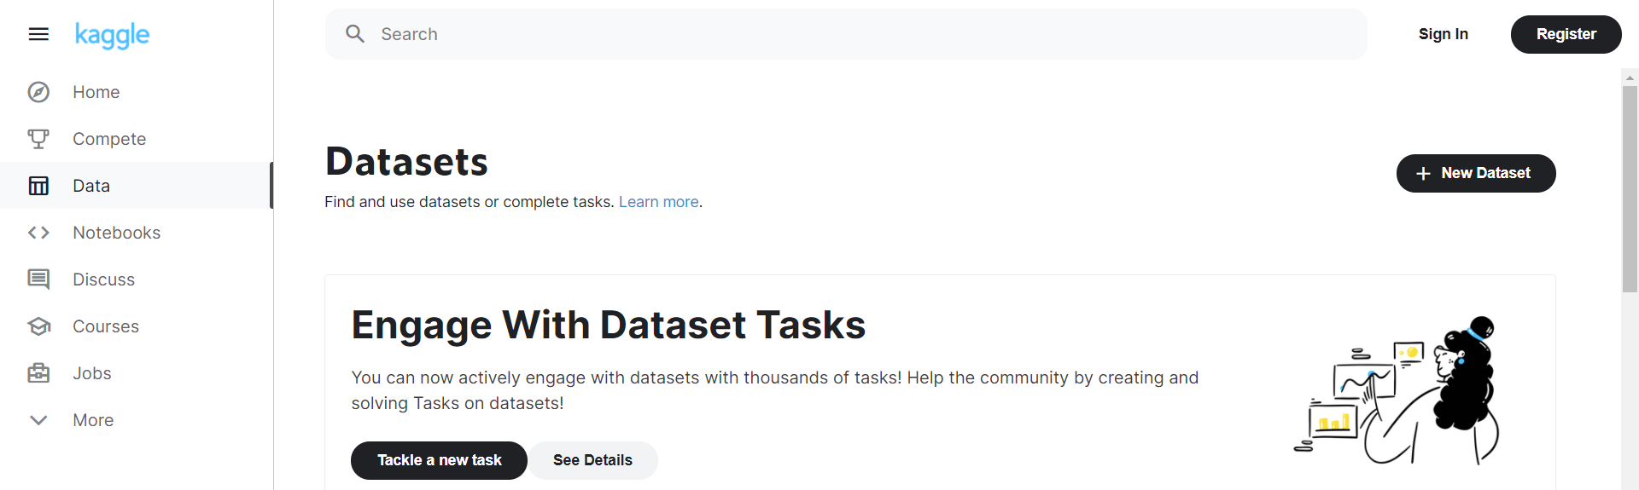
Sources: Options
The team initially wanted to figure out where we would be getting our data from before creating our question. Between the two we felt that data.world fell short in a few ways.
Kaggle was a more intuitive site to use, making it easier for us to peruse for datasets we might find interesting. After this we began thinking about what we wanted to ask with this project...

Slide 3
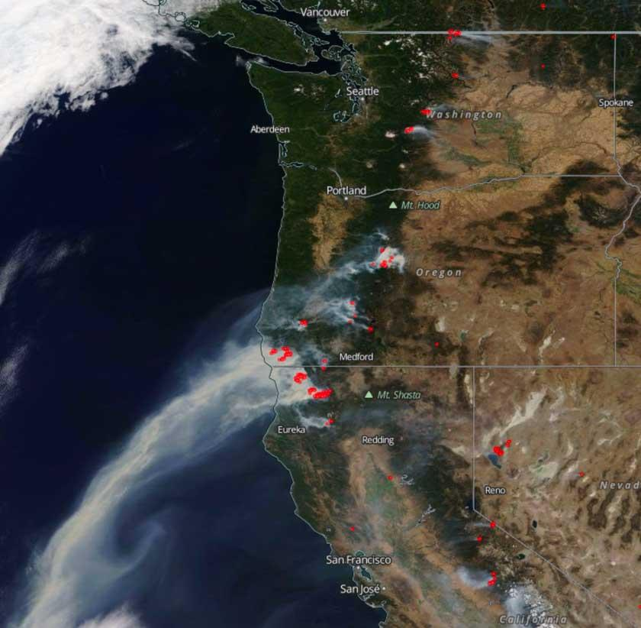
The Ask
While looking through the websites Katy noted that she was on vacation in Northern California and they were in the middle of wildfire season. With a few big fires currently raging in different places all over the United states, we wanted to see what type of economic impact they have had over the years.
Smoke dispersion and fire locations 9/8/2020

Slide 4
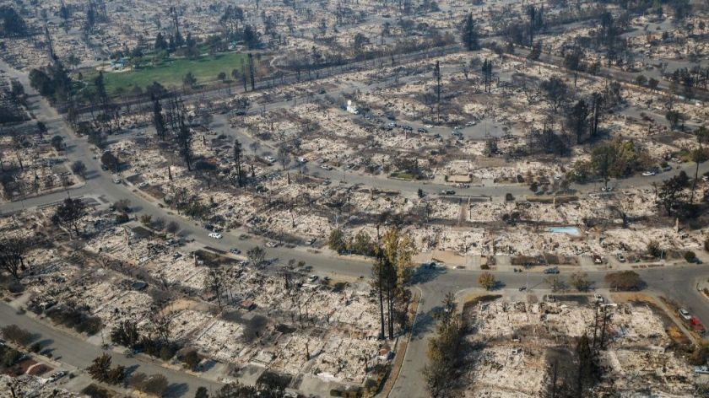
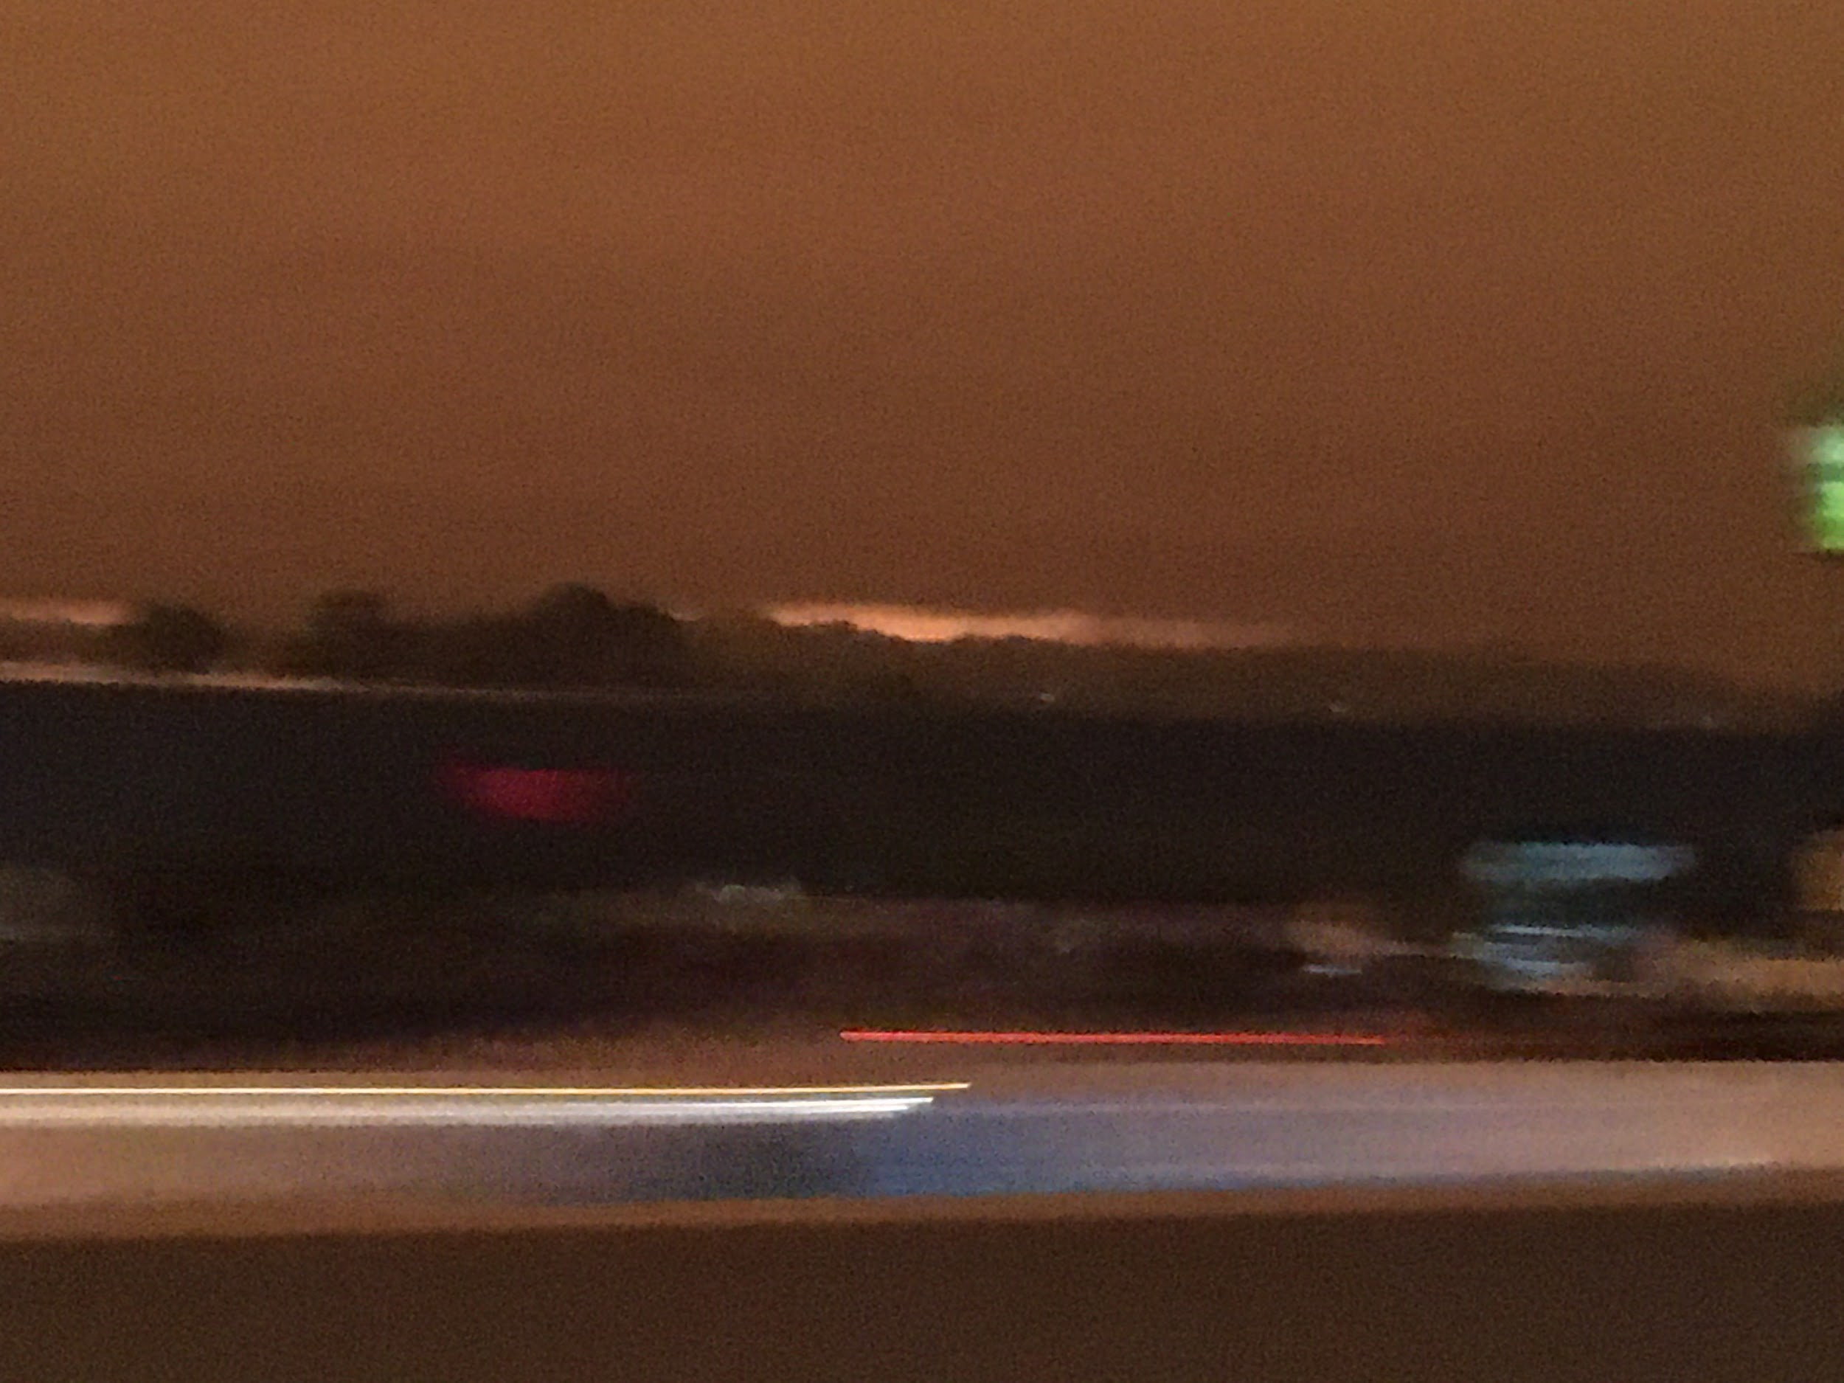
The Questions
How many wildfires have happened in North Carolina compared to California?
What is the economic impact from fires on a specific year? (Ex. 2012)
Noon on wednesday September, 8th Northern California

Slide 5
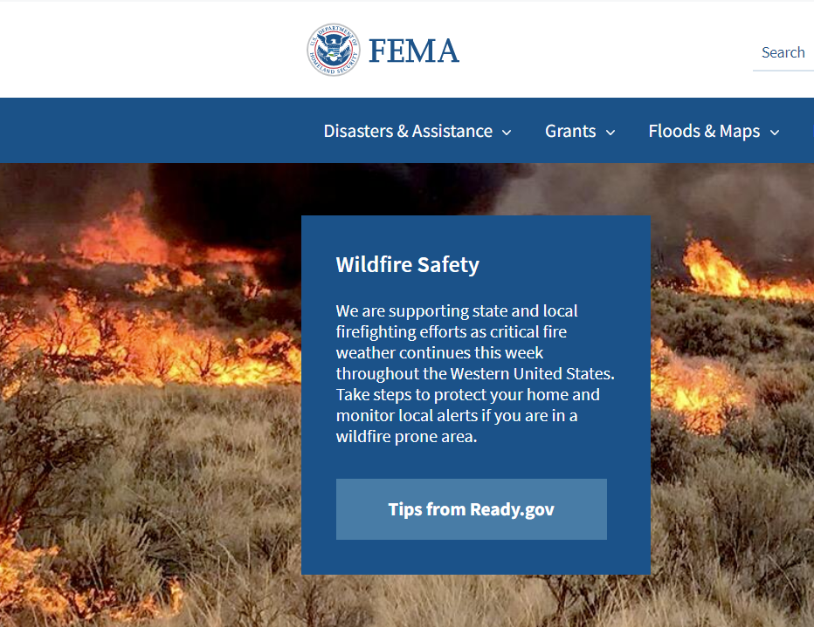
Extract: searching for data
Federal Emergencies and Disasters, 1953-Present
https://www.kaggle.com/dataenergy/natural-disaster-data?select=number-of-natural-disaster-events.csv
The Team began searching for some data sets that met our criteria, either a full disaster database able to be filtered for wildfires or a wildfire specific database. More so finding the former we choose two that were able to be cleaned and searched through for our specified outcomes. The FEMA data being for 1953 and above while the presidential declaration of a natural disaster data set begins in 1911. Both coincide well enough to be manipulated in Pandas and PostgreSQL without much extraneous cleaning.

Slide 6
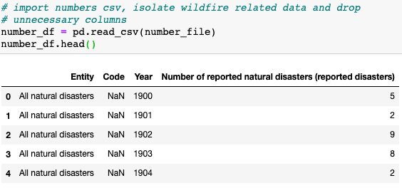
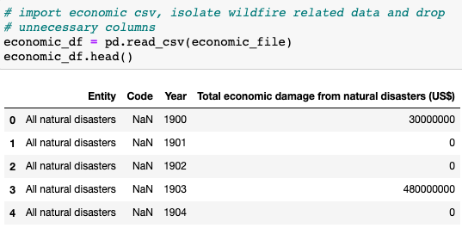
Transform
We utilized the following methods to get our CSV files ready to be imported into a relational database:
Cleaning
Filtering
Merging

Slide 7
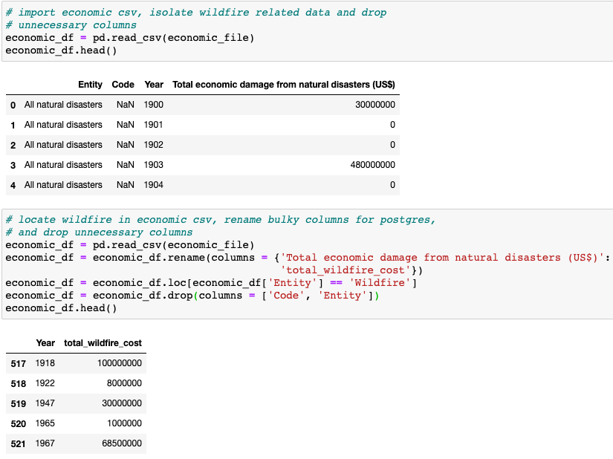
Transform
Data Filtering:
Filtered by ‘Wildfire’ to get relevant disaster data
Data Cleaning:
Renamed columns for ease of use
Dropped columns no longer needed

Slide 8
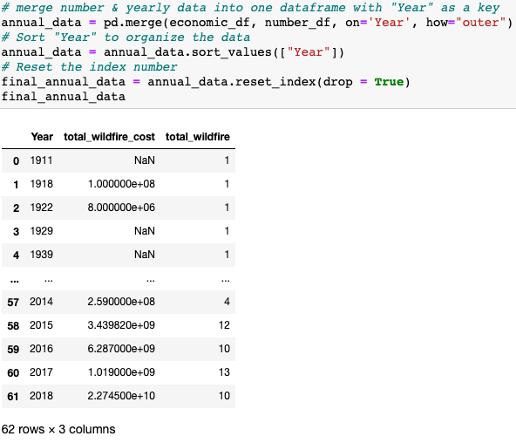
Transform
Merged economic data with number of wildfires to create and annual data frame containing the economic cost and total number of wildfires.

Slide 9
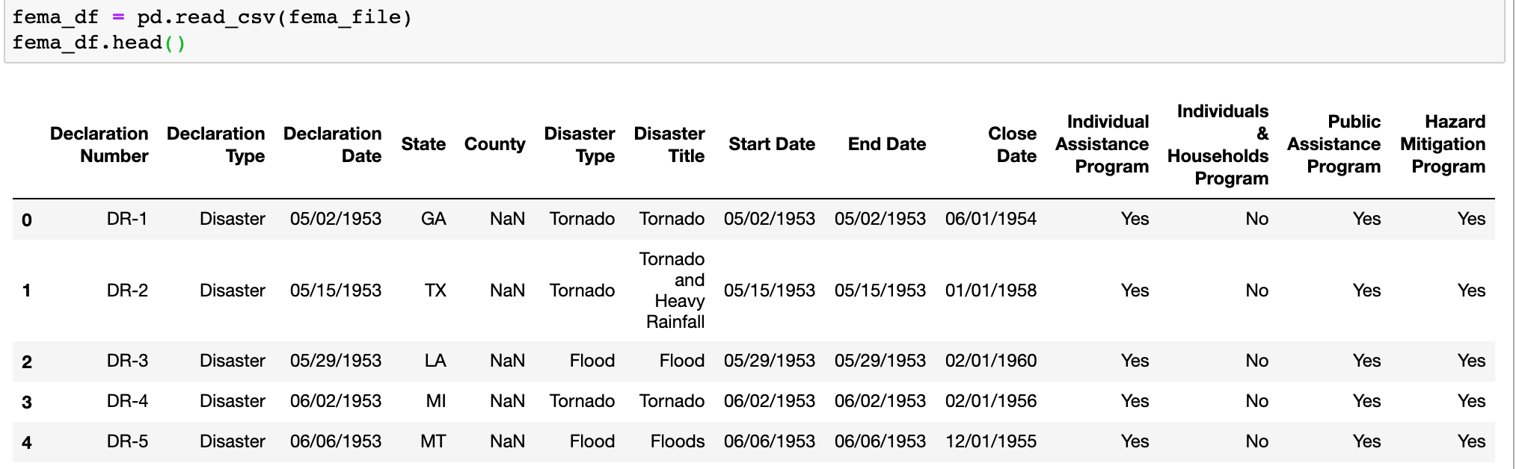
Transform: filtering and cleaning
This database is a collection of all FEMA disasters since 1953. We needed to narrow down to just wildfires and isolate the year in order to relate it in Postgres to our annual dataframe.

Slide 10
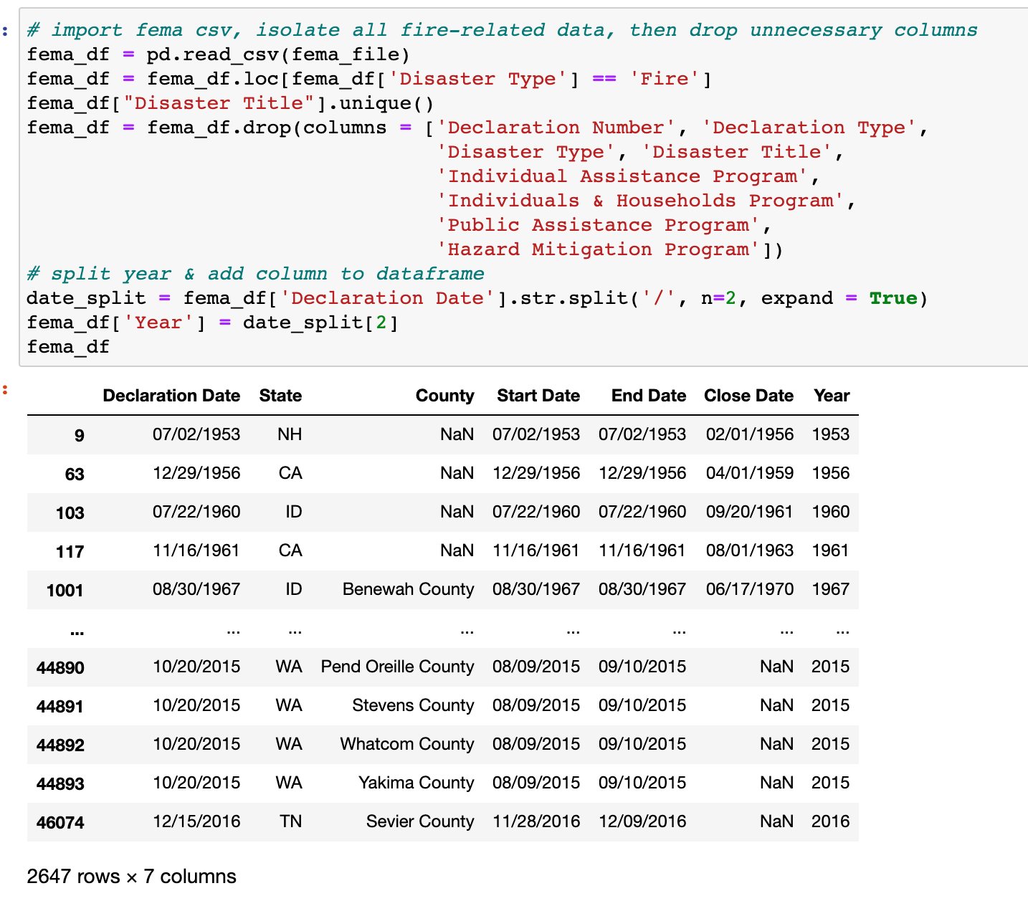
Transform
Filtered by Disaster Type (‘fire’ instead of ‘wildfire’ in this dataframe)
Dropped unnecessary columns.
Split ‘Year’ from ‘Declaration Date’ and put into a new column to relate to back to the annual dataframe.

Slide 11

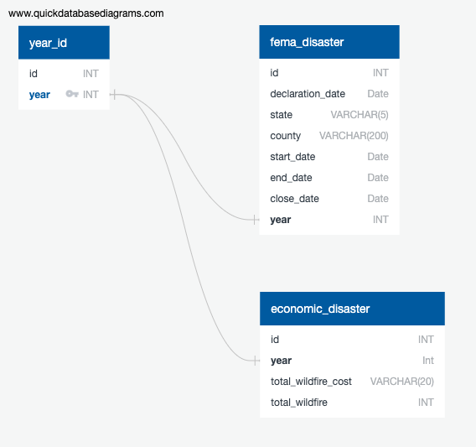
Load: DB in PostgreSQL
Relational & Structured DB
Year is a Primary Key
Created Entity-Relationship Diagram (ERD) with QuickDBDiagrams.com

Slide 12
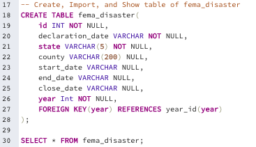
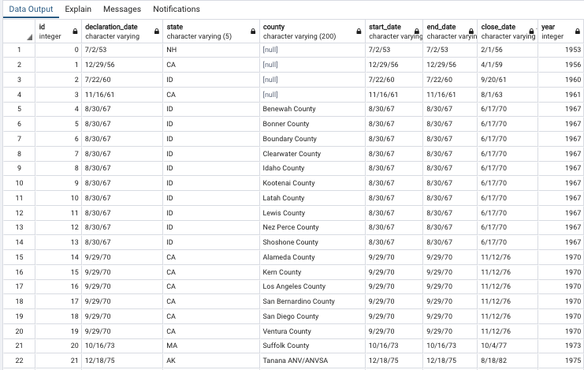
Load: Created Table Schema
- FEMA Disaster

Slide 13
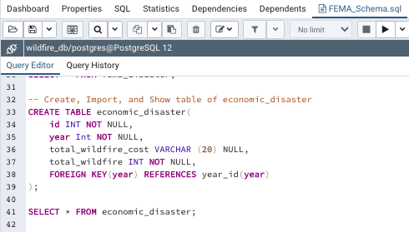
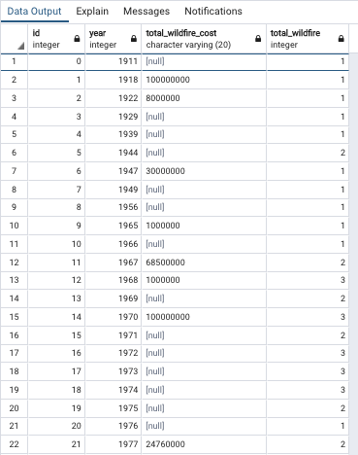
Load: Created Table Schema
- Economic Disaster

Slide 14


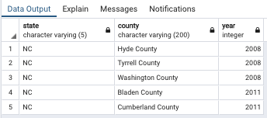
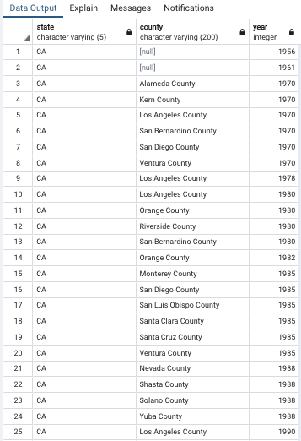
Quick data query examples with our database
n=5
n=224

Slide 15

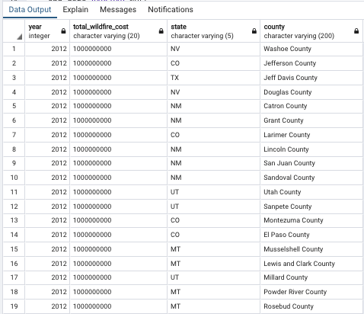
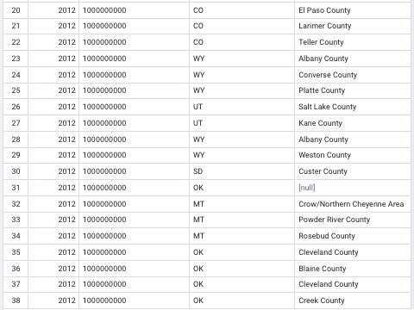
Quick data query example with our database

Slide 16
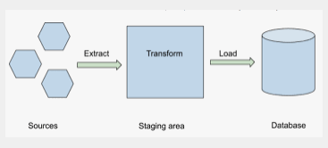
Conclusions
We successfully completed our ETL project!
Extracted: Our original data sources from kaggle.com
Transformed: Data were cleaned and transformed with Python
Loaded: Final database in PostgreSQL
Image from keboola.com

