Slide 1
Online video service strategic PLANNING ROCKBUSTER STEALTH, LLC
Catherine Mikelson 02.07.23

Slide 2
PROJECT OVERVIEW
OBJECTIVE: Determine the best strategy for launching the new online video service.
KEY QUESTIONS:
● Which movies contributed the most/least to revenue gain?
● What was the average rental duration for all videos?
● Which countries are Rockbuster customers based in?
● Where are customers with a high lifetime value based?
● Do sales figures vary between geographic regions?

Slide 3
DATA OVERVIEW
What is the average
rental duration?
Number of Films: 1000
Number of Genres: 20
RENTAL LENGTH
Avg. : 5 days
Min. : 3 days
Max.: 7 days
RENTAL RATE
Avg. : $2.98
Min. : $0.99
Max.: $4.99
CUSTOMERS
Number of Customers: 599
Number of Countries: 109
Avg : $4.20
Min : $0.00
Max: $11.99
FILM
PAYMENT
COUNTRY REVENUE
Most Revenue: India: $6,034.78
Least Revenue: American Samoa: $47.85

Slide 4
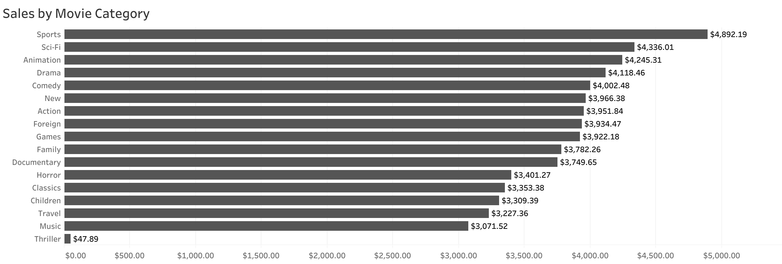
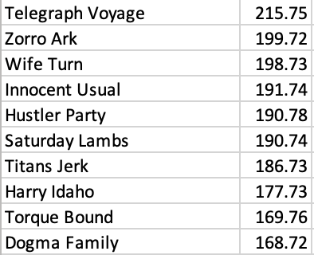
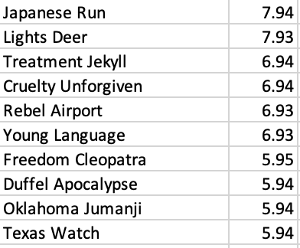
Which movies contributed the most/least to revenue gain?
Top 10 Films
Bottom 10 Films

Slide 5
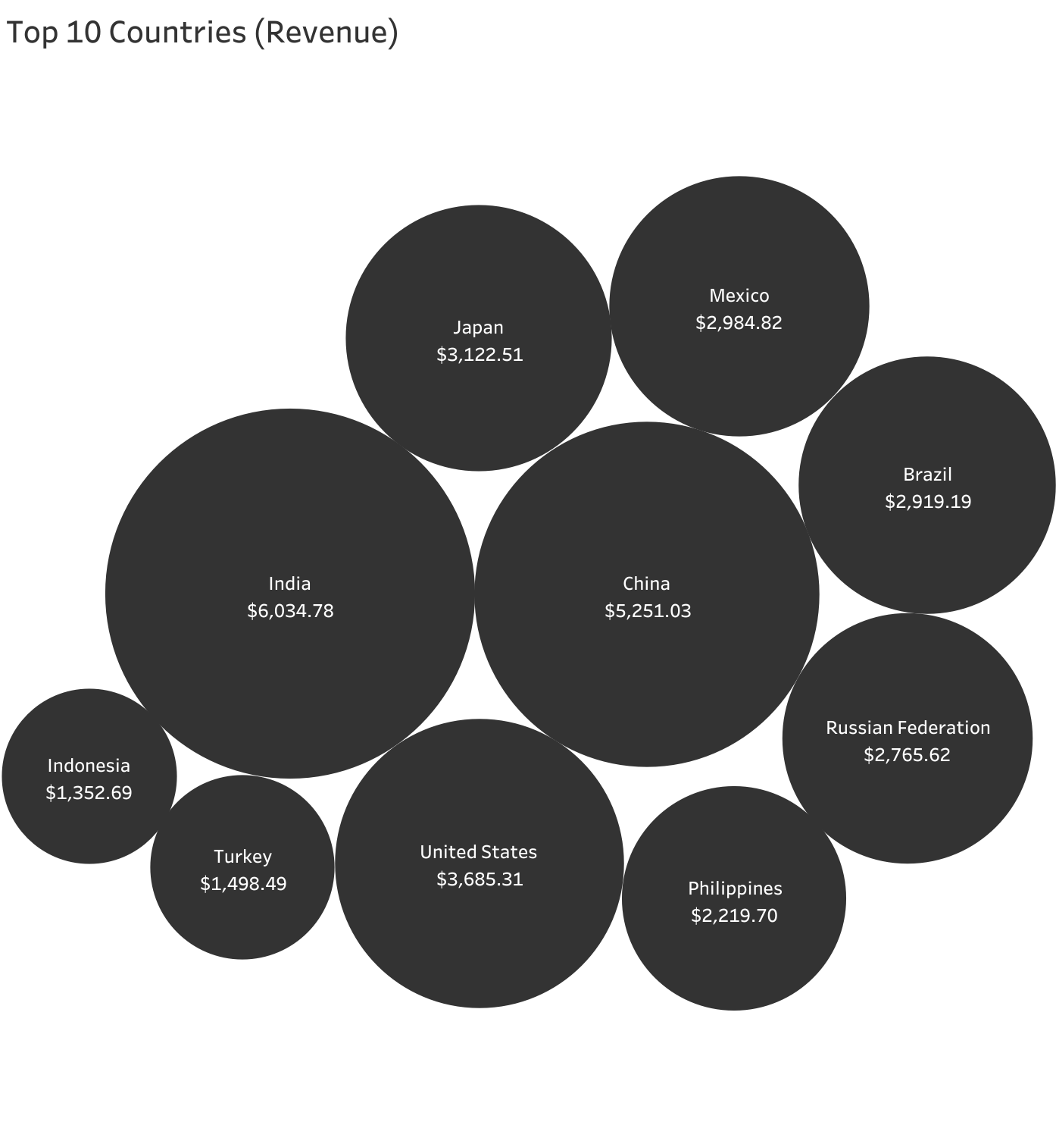
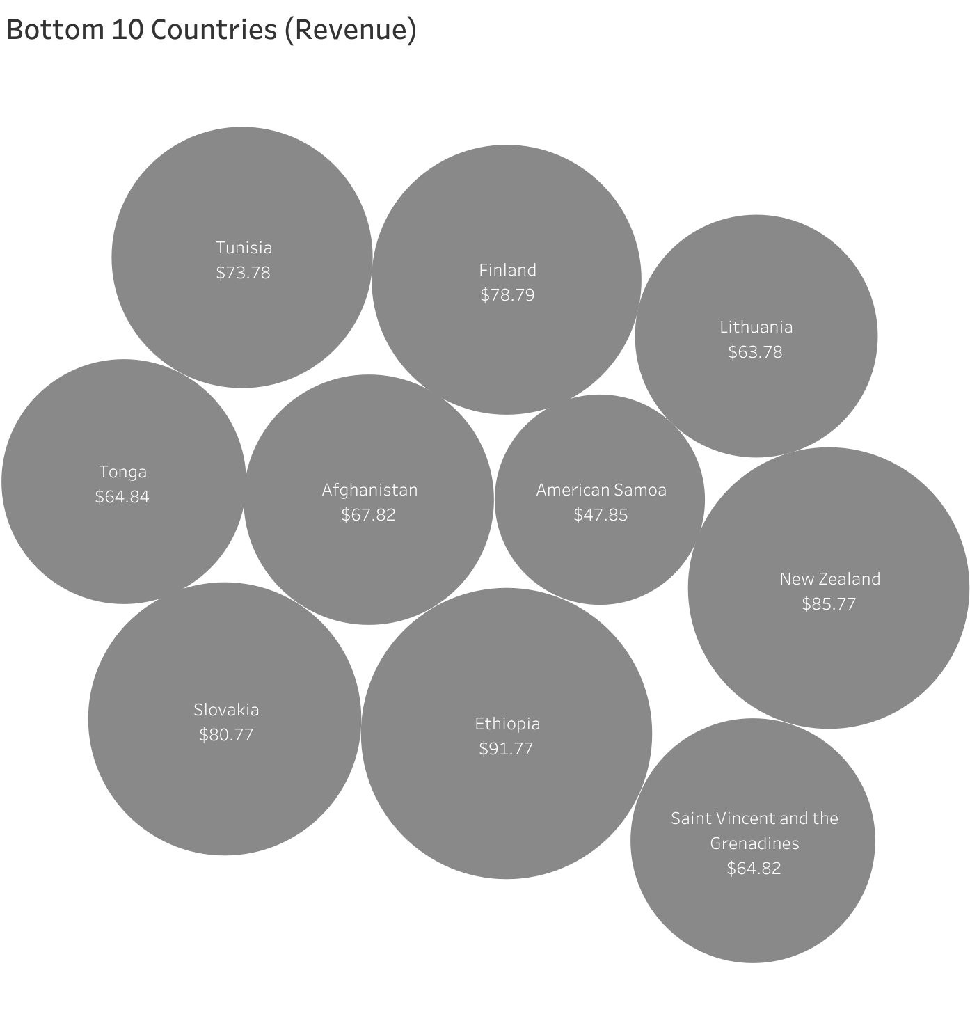
Top and bottom countries for revenue
How do sales figures vary between regions?

Slide 6
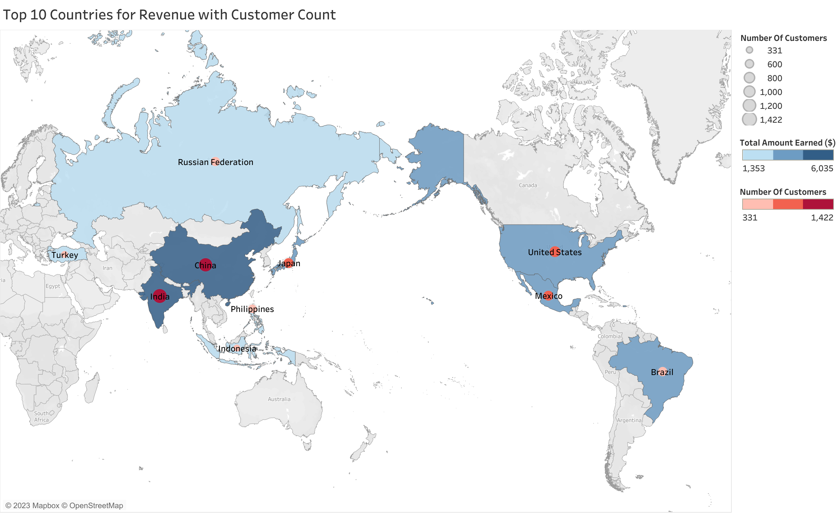
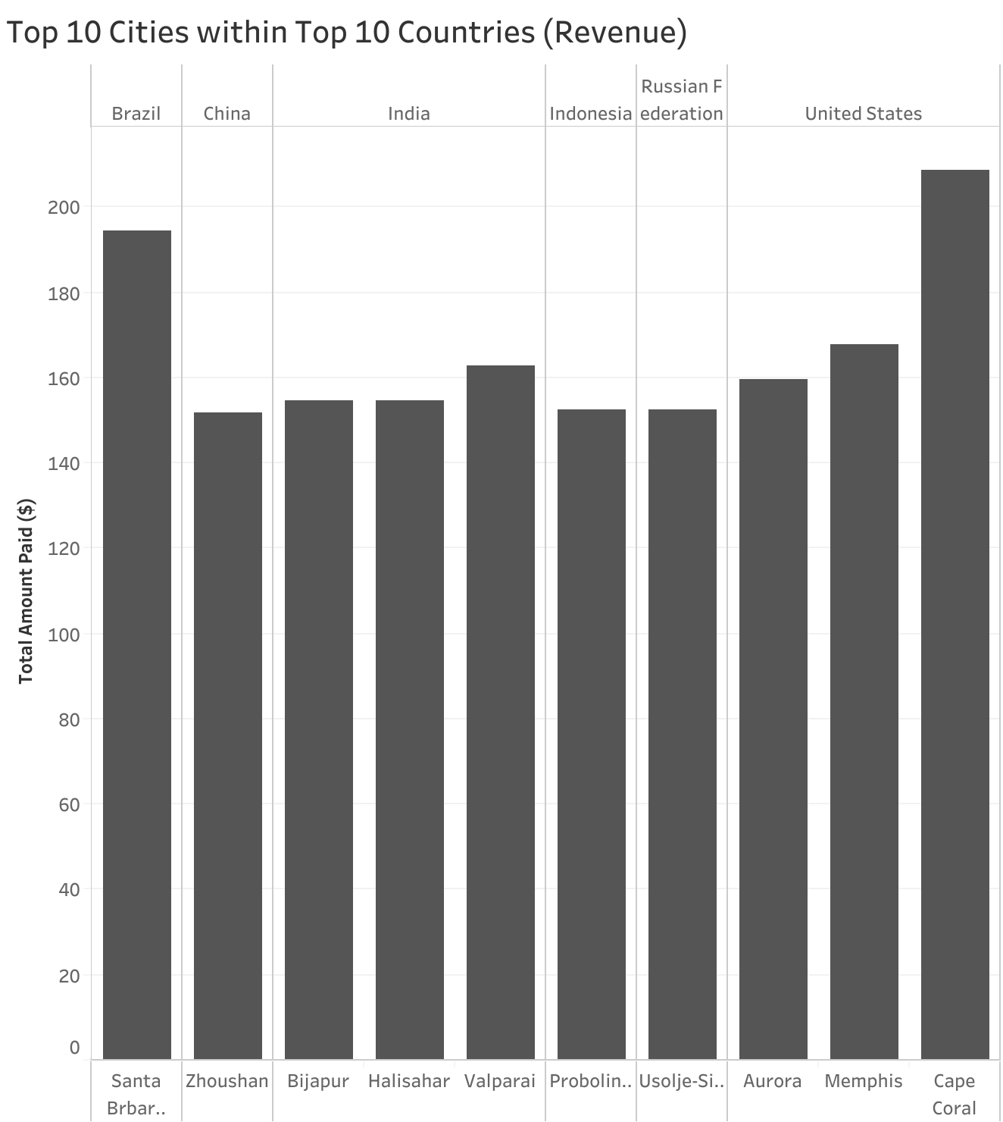
CUSTOMER LOCATION
Where are customers with a high lifetime value based?
Is there a relationship between revenue and number of customers?

Slide 7
RECOMMENDATIONS
1
Prioritize the highest selling countries such as India, China and the US.
2
Stock inventory with your highest selling categories including Sports, Sci-Fi and Animation. Remove Thriller as a category as it is not a valuable revenue source.
3
Consider advertising using content from the most popular films such as Telegraph Voyage, Zorro Ark and Wife Turn.
4
Send a survey to top customers to see what they value in Rockbuster Stealth, LCC. Use the results to further determine design and marketing strategy.

Slide 8
THANK YOU
Catherine Mikelson
catherinewmikelson@gmail.com

