Slide 1

Будильник

Slide 2
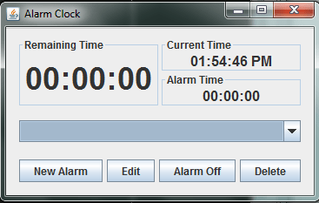
Java-будильник
Среда разработки: JDK 8u162
Технологии: JavaFX or JavaSwing, JTAnalogClock
Features:
поставить таймер на определенное время,
выбрать формат времени,
определить сигнал или мелодию,
активировать таймер

Slide 3
Life cycle
Planning features to include in the project considering technologies to be implemented
10/04/18 – 12/04/18
Planning tasks and dividing them among team members
13/04/18 – 15/04/18
Every Sprint Backlog:
Defining tasks for the current sprint, dividing them among team members
1 weeks
Every test & review phase:
Q & A
1 week
Sprint Backlog
Sprint
Test & review
Sprint Backlog
Sprint
Test & review
Sprint Backlog
Sprint
Test & review
Every Sprint:
Development
2 weeks
Pre final release
18th of June
Final release – 27th of June

