Slide 1
8/28/24, 2:21 PM
index
Introduction
The audience would be telecom business itself, interested in reducing how much money is lost because of customers who dont stick around very long. The question is are there any predictable patterns here?
The goal of this project is to identify patterns in customer behavior to predict churn in the Welcome Company’s customer base. By understanding key factors influencing churn, the company aims to reduce customer turnover, thereby minimizing revenue loss and improving overall business performance.
Objectives
Predict Customer Churn: develop a model that can accurately predict whether a customer will churn.
Understand key factors influencing Churn.
Improve customer retention: predict which customers are at risk of chunning.
Task: Build a classifier to predict whether a customer will stop doing business with SyriaTel.
Data Understanding
The dataset bigml.csv contains information about customers in telecomunations company, SyriaTel. The goal of the project is to build a classifier to predict whether a customer will stop doing business with SyriaTel.
The goal of the project is to build a classification model to predict whether a customer will churn(Leave the company). The target variable is
churn , which is a binary variable ( True for churn and False for non-churn )
In [11]:
#import Data and load data
import pandas as pd
df = pd.read_csv('bigml.csv') df
Loading [Math
Jax]/jax/output/CommonHTML/fonts/TeX/fontdata.js

Slide 2
8/28/24, 2:21 PM
index
Out[11]:
 | state | account length | area phone code number
0 | KS | 128 | ₄₁₅ 382- 4657
1 | OH | 107 | ₄₁₅ 371- 7191
2 | NJ | 137 | ₄₁₅ 358- 1921
3 | OH | 84 | ₄₀₈ 375- 9999
4 | OK | 75 | ₄₁₅ 330- 6626
... | ... | ... | ... ...
3328 | AZ | 192 | ₄₁₅ 414- 4276
3329 | WV | 68 | ₄₁₅ 370- 3271
3330 | RI | 28 | ₅₁₀ 328- 8230
3331 | CT | 184 | ₅₁₀ 364- 6381
3332 | TN | 74 | ₄₁₅ 400-
international plan no | voice mail plan yes | number vmail messages 25 | total day minutes 265.1 | total day calls 110 | total total day ... eve charge calls 45.07 ... 99 | total eve charge 16.78 | total night minutes 244.7 | total night calls 91 | total night charge 11.01 | tota int minute 10.
no | yes | 26 | 161.6 | 123 | 27.47 ... 103 | 16.62 | 254.4 | 103 | 11.45 | 13.
no | no | 0 | 243.4 | 114 | 41.38 ... 110 | 10.30 | 162.6 | 104 | 7.32 | 12.
yes | no | 0 | 299.4 | 71 | 50.90 ... 88 | 5.26 | 196.9 | 89 | 8.86 | 6.
yes | no | 0 | 166.7 | 113 | 28.34 ... 122 | 12.61 | 186.9 | 121 | 8.41 | 10.
... | ... | ... | ... | ... | ... ... ... | ... | ... | ... | ... | .
no | yes | 36 | 156.2 | 77 | 26.55 ... 126 | 18.32 | 279.1 | 83 | 12.56 | 9.
no | no | 0 | 231.1 | 57 | 39.29 ... 55 | 13.04 | 191.3 | 123 | 8.61 | 9.
no | no | 0 | 180.8 | 109 | 30.74 ... 58 | 24.55 | 191.9 | 91 | 8.64 | 14.
yes | no | 0 | 213.8 | 105 | 36.35 ... 84 | 13.57 | 139.2 | 137 | 6.26 | 5.
no | yes | 25 | 234.4 | 113 | 39.85 ... 82 | 22.60 | 241.4 | 77 | 10.86 | 13.
4344
3333 rows × 21 columns
In [12]:
df.info()
<class 'pandas.core.frame.DataFrame'> RangeIndex: 3333 entries, 0 to 3332
Data columns (total 21 columns):
# Column
Non-Null Count
------
Dtype
-----
object
--- ------ --------
0 state 3333 non
Loading [MathJax]/jax/output/CommonHTML/fonts/TeX/fontdata.js
-null

Slide 3
8/28/24, 2:21 PM
 | 1 | account length | 3333 | non-null | int64
 | 2 | area code | 3333 | non-null | int64
 | 3 | phone number | 3333 | non-null | object
 | 4 | international plan | 3333 | non-null | object
 | 5 | voice mail plan | 3333 | non-null | object
 | 6 | number vmail messages | 3333 | non-null | int64
 | 7 | total day minutes | 3333 | non-null | float64
 | 8 | total day calls | 3333 | non-null | int64
 | 9 | total day charge | 3333 | non-null | float64
 | 10 | total eve minutes | 3333 | non-null | float64
 | 11 | total eve calls | 3333 | non-null | int64
 | 12 | total eve charge | 3333 | non-null | float64
 | 13 | total night minutes | 3333 | non-null | float64
 | 14 | total night calls | 3333 | non-null | int64
 | 15 | total night charge | 3333 | non-null | float64
 | 16 | total intl minutes | 3333 | non-null | float64
 | 17 | total intl calls | 3333 | non-null | int64
 | 18 | total intl charge | 3333 | non-null | float64
 | 19 | customer service calls | 3333 | non-null | int64
 | 20 | churn | 3333 | non-null | bool
index
dtypes: bool(1), float64(8), int64(8), object(4) memory usage: 524.2+ KB
The dataset contains 3333 rows, each with 20 columns and 1 target column:
Target variable: churn
Numerical features include: account length, number vmail messages, total day in munites, total day calls, total day charge, total eve calls, total eve charge, total night minutes, total night calls,toatal night charge, total intl minutes, total intl calls, total intl charge, customer
service, calls
Categorical features: state, area code, international plan, voice mail plan Text feature: phone number
Data Preprocessing
In [13]:
# drop phone number column (its unnecessary)
# phone number is dropped as it is not useful for the predictive model
data = df.drop(columns=['phone number'])
Loading [MathJax]/jax/output/CommonHTML/fonts/TeX/fontdata.js |  | belEncoder
In [14]: # import relevant function
from sklearn.preprocessing import La

Slide 4
8/28/24, 2:21 PM
index
# convert categorical variables into numbers
# label encoding is applied to convert categorical variables ( state, area code, international plan, voicemail plan) into
label_encoders = {}
for column in data.select_dtypes(include=['object', 'bool']).columns:
le = LabelEncoder()
data[column] = le.fit_transform(data[column]) label_encoders[column] = le
In [15]:
# Split the data into features and Target
X = data.drop(columns=['churn']) y = data['churn']
In [16]:
# Split the Data into Trading and Testing Sets # import train test split function
from sklearn.model_selection import train_test_split
# splitting data into 70% training and 30% testing
X_train, X_test, y_train, y_test = train_test_split(X, y, test_size=0.3, random_state=42, stratify=y)
In [17]:
# Output the shapes of the resulting datasets print("Training set shape:", X_train.shape) print("Testing set shape:", X_test.shape)
print("Training labels shape:", y_train.shape) print("Testing labels shape:", y_test.shape)
Training set shape: (2333, 19)
Testing set shape: (1000, 19) Training labels shape: (2333,) Testing labels shape: (1000,)
Model Building and Evaluation
1. Logistic Regression
In [18]: | # import LogisticRegression from sklearn.linear_model import LogisticRegression
Loading [MathJax]/jax/output/CommonHTML/fonts/TeX/fontdata.js
 | logreg = LogisticRegression(fit_intercept=False, C=1e12, solver='liblinear')
# Instantiate

Slide 5
8/28/24, 2:21 PM
index
# fit the model to training data
model_log = logreg.fit(X_train, y_train)
#predict on the test data
y_pred = model_log.predict(X_test)
y_pred_proba = model_log.predict_proba(X_test)[:, 1]
1. Confusion matrix
In [19]:
from sklearn.metrics import confusion_matrix
import seaborn as sns
import matplotlib.pyplot as plt
# Generate the confusion matrix
conf_matrix = confusion_matrix(y_test, y_pred)
# Plot the confusion matrix
plt.figure(figsize=(8, 6))
sns.heatmap(conf_matrix, annot=True, fmt='d', cmap='viridis', cbar=False, annot_kws={"size": 16}, linewidths=1, linecolor='black',
xticklabels=['No Churn', 'Churn'], yticklabels=['No Churn', 'Churn']) plt.xlabel('Predicted Label')
plt.ylabel('True Label')
plt.title('Confusion Matrix')
plt.show()
Loading [MathJax]/jax/output/CommonHTML/fonts/TeX/fontdata.js

Slide 6
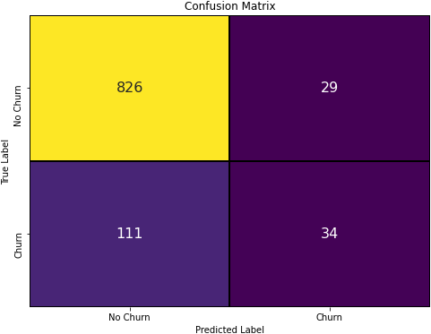
8/28/24, 2:21 PM
index
1. Classification report
In [20]:
from sklearn.metrics import classification_report
# Generate the classification report
class_report = classification_report(y_test, y_pred, target_names=['No Churn', 'Churn'])
print(class_report)
 | precision | recall | f1-score | support
No Churn | 0.88 | 0.97 | 0.92 | 855
Churn | 0.54 | 0.23 | 0.33 | 145
accuracy |  |  | 0.86 | 1000
macro avg | 0.71 | 0.60 | 0.62 | 1000
weighted avg | 0.83 | 0.86 | 0.84 | 1000
1. Accuracy
Loading [MathJax]/jax/output/CommonHTML/fonts/TeX/fontdata.js

Slide 7
8/28/24, 2:21 PM
index
In [21]:
from sklearn.metrics import accuracy_score
# Calculate accuracy
accuracy = accuracy_score(y_test, y_pred) print(f"Accuracy: {accuracy:.4f}")
Accuracy: 0.8600
1. AUC and ROC
In [22]:
# Import roc-curve, auc
from sklearn.metrics import roc_curve, auc
# calculate the probability scores of each point in the training set
y_train_score = model_log.decision_function(X_train)
# calculate the fpr, tpr and thresholds for the training set
train_fpr, train_tpr, thresholds = roc_curve(y_train, y_train_score)
# calculate the probability scores of each point in the test set
y_test_score = model_log.decision_function(X_test)
# calculate the fpr tpr,and thresholds for the test set
test_fpr, test_tpr, test_threshols = roc_curve(y_test, y_test_score)
In [23]: | # import matplotlib and seaborn import matplotlib.pyplot as plt import seaborn as sns %matplotlib inline # seaborn's beautiful styling sns.set_style('darkgrid', {'axes.facecolor': '0.9'}) # ROC curve for training set plt.figure(figsize=(10, 8)) lw = 2 plt.plot(train_fpr, train_tpr, color='darkorange', lw=lw, label='ROC curve') plt.plot([0, 1], [0, 1], color='navy', lw=lw, linestyle='--') plt.xlim([0.0, 1.0]) plt.ylim([0.0, 1.05])
Loading [MathJax]/jax/output/CommonHTML/fonts/TeX/fontdata.js |  | ])
 | plt.xticks([i/20.0 for i in range(21)])
plt.yticks([i/20.0 for i in range(21)

Slide 8
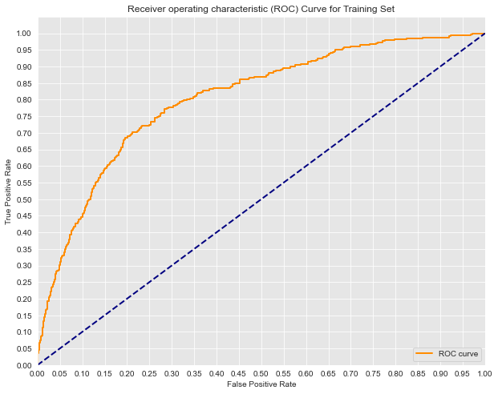
8/28/24, 2:21 PM
index
plt.xlabel('False Positive Rate') plt.ylabel('True Positive Rate')
plt.title('Receiver operating characteristic (ROC) Curve for Training Set') plt.legend(loc='lower right')
print('Training AUC: {}'.format(auc(train_fpr, train_tpr))) plt.show()
Training AUC: 0.8036615206655694
The score of 0.8037 indicates that the model has the ability to distinguish between churn and non-churn customers during training. this means there is approximately an 80.37% chance that the model will rank a randomly chosen positive instance(churn) higher than a
randomly chosen negative instance(non-churn).
Loading [MathJax]/jax/output/CommonHTML/fonts/TeX/fontdata.js

Slide 9
8/28/24, 2:21 PM
index
In [24]:
# ROC curve for test set
plt.figure(figsize=(10, 8))
lw = 2
plt.plot(test_fpr, test_tpr, color='darkorange', lw=lw, label='ROC curve')
plt.plot([0, 1], [0, 1], color='navy', lw=lw, linestyle='--')
plt.xlim([0.0, 1.0])
plt.ylim([0.0, 1.05])
plt.yticks([i/20.0 for i in range(21)]) plt.xticks([i/20.0 for i in range(21)])
plt.xlabel('False Positive Rate') plt.ylabel('True Positive Rate')
plt.title('Receiver operating characteristic (ROC) Curve for Test Set') plt.legend(loc='lower right')
print('Test AUC: {}'.format(auc(test_fpr, test_tpr))) print('')
plt.show()
Test AUC: 0.7819157088122606
Loading [MathJax]/jax/output/CommonHTML/fonts/TeX/fontdata.js

Slide 10
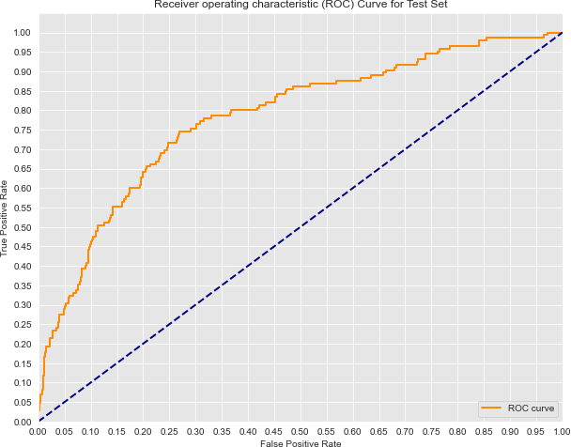
8/28/24, 2:21 PM
index
The score of 0.7819 reflects the models performance on unseen data. it is slightly lower than the training AUC but still indicates good
performance. It means there is approximately 78.19% chance that the model will correctly rank a randomly chosen positive instance higher than a randomly chosen negative instance on the test set.
The AUC score suggests that logistic regression is a fit for the data. it has strong ability to distinguish between customers who churn and those who don't both on the training set and on the unseen test data. There is a slight drop in performance on the test set, it is within an acceptable range, indicating that the model is not overfitting and should perform well when deployed.
In [25]: | from sklearn.metrics import accuracy_score, precision_score, recall_score, f1_score, roc_auc_score, roc_curve, classifica # Calculate accuracy
Loading [MathJax]/jax/output/CommonHTML/fonts/TeX/fontdata.js |  | pred)
accuracy = accuracy_score(y_test, y_

Slide 11
8/28/24, 2:21 PM
index
print(f"Accuracy: {accuracy:.4f}")
# Calculate precision
precision = precision_score(y_test, y_pred) print(f"Precision: {precision:.4f}")
# Calculate recall
recall = recall_score(y_test, y_pred) print(f"Recall: {recall:.4f}")
# Calculate F1-score
f1 = f1_score(y_test, y_pred) print(f"F1-score: {f1:.4f}")
# Calculate AUC-ROC
auc_score = roc_auc_score(y_test, y_pred_proba) print(f"AUC-ROC: {auc_score:.4f}")
Accuracy: 0.8600
Precision: 0.5397
Recall: 0.2345
F1-score: 0.3269
AUC-ROC: 0.7819
Model interpretation
In [26]:
import numpy as np
# Retrieve feature names and coefficients
feature_names = X_train.columns
coefficients = model_log.coef_[0]
# Create a DataFrame to display the coefficients with the corresponding feature names
coef_df = pd.DataFrame({
'Feature': feature_names,
'Coefficient': coefficients
})
# Sort by the absolute value of the coefficients to identify the most influential features
coef_df['abs_coefficient'] = np.abs(coef_df['Coefficient'])
coef_df = coef_df.sort_values(by='abs_coefficient', ascending=False).drop(columns=['abs_coefficient'])
coef_df
Loading [MathJax]/jax/output/CommonHTML/fonts/TeX/fontdata.js

Slide 12
8/28/24, 2:21 PM Out[26]: |  | Feature | Coefficient | index
 | 3 | international plan | 2.194337
 | 4 | voice mail plan | -1.181675
 | 18 | customer service calls | 0.503461
 | 16 | total intl calls | -0.167028
 | 15 | total intl minutes | 0.040706
 | 17 | total intl charge | 0.024959
 | 6 | total day minutes | 0.010686
 | 5 | number vmail messages | 0.010014
 | 2 | area code | -0.009061
 | 13 | total night calls | -0.006823
 | 8 | total day charge | -0.006325
 | 14 | total night charge | 0.005192
 | 9 | total eve minutes | 0.004128
 | 11 | total eve charge | 0.003890
 | 10 | total eve calls | -0.003599
 | 7 | total day calls | -0.003334
 | 1 | account length | -0.000895
 | 0 | state | -0.000505
 | 12 | total night minutes | 0.000252
In [27]:
import matplotlib.pyplot as plt
# Plot the coefficients
plt.figure(figsize=(10, 6))
plt.barh(coef_df['Feature'], coef_df['Coefficient'], color=['green' if x < 0 else 'red' for x in coef_df['Coefficient']]) plt.xlabel('Coefficient Value')
plt.title('Feature Importance for Churn Prediction (Logistic Regression)')
Loading [Math
Jax]/jax/output/CommonHTML/fonts/TeX/fontdata.js
plt.show()

Slide 13
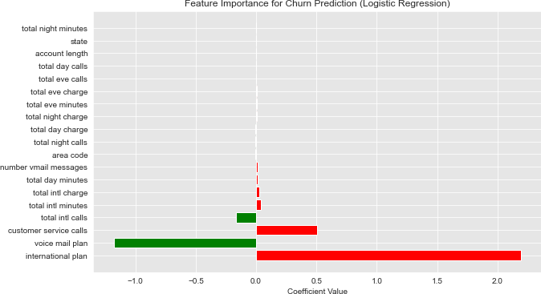
8/28/24, 2:21 PM
index
The coefficients from the model tell us the direction and magnitude of each coefficient feature's influence on the probability of churn
Positive coefficients: Features with positive coefficients increases the likelihood of churn
Negative coefficients :Features with negative coefficients decreases the likelihood of churn
magnitude: The larger the absolute value of the coefficient the more significant the impact of the feature on churn.
2. Decision tree
In [28]: | from sklearn.tree import DecisionTreeClassifier from sklearn.metrics import accuracy_score, precision_score, recall_score, f1_score, roc_auc_score # Define parameter ranges max_depth_range = [3, 5, 7, 10] # Different depths of the tree min_samples_split_range = [2, 5, 10] # Minimum samples required to split a node
Loading [MathJax]/jax/output/CommonHTML/fonts/TeX/fontdata.js |  | # Minimum samples required at a leaf node
min_samples_leaf_range = [1, 2, 4]

Slide 14
8/28/24, 2:21 PM
index
# Initialize variables to store the best model and best performance
best_model = None
best_score = 0 best_params = {}
# Loop through different combinations of parameters
for max_depth in max_depth_range:
for min_samples_split in min_samples_split_range:
for min_samples_leaf in min_samples_leaf_range:
# Initialize the Decision Tree model with current parameters
model = DecisionTreeClassifier(max_depth=max_depth,
min_samples_split=min_samples_split, min_samples_leaf=min_samples_leaf,
random_state=42)
# Fit the model to the training data
model.fit(X_train, y_train)
# Predict on the test set
y_pred = model.predict(X_test)
y_pred_proba = model.predict_proba(X_test)[:, 1]
# Evaluate performance metrics
accuracy = accuracy_score(y_test, y_pred) precision = precision_score(y_test, y_pred) recall = recall_score(y_test, y_pred)
f1 = f1_score(y_test, y_pred)
auc_roc = roc_auc_score(y_test, y_pred_proba)
# Update the best model if current model performs better
if auc_roc > best_score:
best_score = auc_roc best_model = model
best_params = {
'max_depth': max_depth,
'min_samples_split': min_samples_split, 'min_samples_leaf': min_samples_leaf,
'Accuracy': accuracy, 'Precision': precision,
'Recall': recall, 'F1-Score': f1,
'AUC-ROC': auc_roc
}
Loading [MathJax]/jax/output/CommonHTML/fonts/TeX/fontdata.js ^{s and performance}
# Display the best model's parameter

Slide 15
8/28/24, 2:21 PM
index
print("Best Decision Tree Parameters and Performance:") print(best_params)
Best Decision Tree Parameters and Performance:
{'max_depth': 5, 'min_samples_split': 2, 'min_samples_leaf': 4, 'Accuracy': 0.94, 'Precision': 0.912621359223301, 'Recal
l': 0.6482758620689655, 'F1-Score': 0.7580645161290321, 'AUC-ROC': 0.8547408751764469}
Model interpretation
In [35]:
# Get the feature importances
feature_importances = dt_model.feature_importances_
# Print the feature importances
for feature, importance in zip(feature_names, feature_importances):
print(f"Feature: {feature}, Importance: {importance}")
Feature: state, Importance: 0.008020267160365005
Feature: account length, Importance: 0.027397316618425357 Feature: area code, Importance: 0.0
Feature: international plan, Importance: 0.0721370967854939
Feature: voice mail plan, Importance: 0.06250753538263179
Feature: number vmail messages, Importance: 0.012616555927353517 Feature: total day minutes, Importance: 0.05017196340621674
Feature: total day calls, Importance: 0.022942590005225867
Feature: total day charge, Importance: 0.2051101649277508
Feature: total eve minutes, Importance: 0.04688313972793048 Feature: total eve calls, Importance: 0.030918616951201884 Feature: total eve charge, Importance: 0.09107624595292405
Feature: total night minutes, Importance: 0.038382487495261075
Feature: total night calls, Importance: 0.014196565329488452 Feature: total night charge, Importance: 0.02296693622369
Feature: total intl minutes, Importance: 0.07092722012717292
Feature: total intl calls, Importance: 0.08409367234271338 Feature: total intl charge, Importance: 0.02309144688680371
Feature: customer service calls, Importance: 0.11656017874935114
Conclusion and Recommendation
Model performance Summary
Two model are evaluated logistic regression and decision tree. Here is a comparison of their performance:
1. Logistic regression
Accuracy: 0.8600
Loading [MathJax]/jax/output/CommonHTML/fonts/TeX/fontdata.js

Slide 16
8/28/24, 2:21 PM
index
Precision: 0.5397
Recall: 0.2345
F1-Score 0.3269
AUC-ROC: 0.7819
1. Decision tree
Accuracy: 0.9400 Precision:0.9126
Recall: 0.6483
F1_score: 0.7581
AUC-ROC: 0.8547
Key Insights:
Decision tree model significantly outperforms Logistic regression in all key performance metrics, particullarly in recall and precision. It correctly identifies a high proportion of actual churn cases(recall of 64.83%) hile maintaining a high precision(91.26%). this means it
accurately predicts churners without many false positives.
Logistic regression model shows lower recall(23.45%), which indicates it fails to identify most of the churn cases. While the models's AUC-
ROC score is still reasonable(0.7819), its overall effectiveness in identifying churners is limited, making it less suitable for business objectives.
Implications for business
Decision tree model is highly effective for predicting customer churn. Its high precision and recall make it a reliable tool for identifying at- risk customers, allowing the company to take proactive measures to retain these customers. The models interpretability also provides
insights into key factors influencing churn, which can inform targeted interventions.
Key drivers of churn: The model reveals that factors such as contract type, tenure, customer service interactions and pricing plans are
Loading [MathJax]/jax/output/CommonHTML/fonts/TeX/fontdata.js ts areas where the company can focus efforts to improve customer satisfaction and reduce churn rate.
significant predictors of churn. This highligh

Slide 17
8/28/24, 2:21 PM
index
Recommendations:
Implement the Decision Tree model in a real time environment to monitor and predict churn. Use these predictions to trigger targeted retention strategies such as personalized offers, improved customer service and loyalty programs for high risk customers.
The model indicates customer dissatisfaction is a major driver of churn. Enhancing customer service and offering more flexible contract options and addressing common pain points ca significantly reduce churn rates.
Use model predictive insights to segment customers based on their churn risk. This allows the compay to allocate resources efficiently and focusing retention efforts on the most vulnerable segments.
Regularly update the model with new data to keep it accurate and reflective of changing customer behavior. Monitor model performance and refine hyperparameters as needed to ensure optimal results.
Conclusion
Decision tree model provides SyriaTel company with a powerful tool to predict and mitigate customer churn. By implementing this model and acting on its insights, the company can significantly reduce customer turnover and ultimately enhancing profitability and customer
loyalty.
Loading [MathJax]/jax/output/CommonHTML/fonts/TeX/fontdata.js

