Slide 1
About these slides
Please contact Tim Slice or Wendi Schultz if you have questions
The is the Med Comm EV development deck for SGEN-ATLAS
This is a working document and is not intended for use outside of Med Comm
Links to publications, clinical protocols, or clinicatrials.gov are not active in this deck
Organization of this deck
Studies are generally organized alphabetically
For studies with limited (or without) data, safety and efficacy results are grouped into a single side to save space
General do’s and don’ts
Do keep content limited to one slide per category i.e. safety or efficacy when data is reported
Do provide NCT#; Do not provide hyperlink to clinicaltrials.gov
Use letters or symbols for footnotes in tables/figures
Use numbers to indicate more than one publication source
Do provide numbered publication reference(s) at the bottom of each slide; Do not provide hyperlink to PubHub
In ECMS Atlas, publication references are listed at the very end, please use a running list for entire study set
Do provide study title: Do not provide hyperlink to clinical protocol
This will be done in ECMS Atlas
Do not provide link to expanded PubHub study-specific view
This will be done in ECMS Atlas

Slide 2
EV-101 (ASG-22CE-13-2)
NCT02091999
Study Design
Study Design
Treatment (each 4-week cycle)
Part A (dose-escalation): EV at assigned dose; D1, q1wkx3; until PD, intolerability, or consent withdrawal
Part B (disease-specific expansion cohorts): EV (1.25 mg/kg): Days 1,8, and 15 of each 28-day cycle; until PD, intolerability, or consent withdrawal
Cohort 1: mUC with severe renal insufficiency; cohort 2: metastatic non-small cell lung cancer; cohort 3: platinum-resistance metastatic ovarian cancer
Part C: mUC who have received prior CPI
Follow-Up
Every 2 months
Registration
EOT Assessments
Screening/Baseline
Title | A phase 1 study of the safety and pharmacokinetics of escalating doses of ASG-22CE given as monotherapy in subjects with metastatic urothelial cancer and other malignant solid tumors that express Nectin-4
Design | Phase 1, open-label, multicenter; [N=215]
Status | Enrolling mUC and renal insufficiency expansion cohort only
Disease Area | Advanced solid malignancies and metastatic urothelial cancer
Key Outcomes | Safety and PK of EV Antitumor activity Immunogenicity

Slide 3
EV-101 (ASG-22CE-13-2)
NCT02091999
Results: Safety
Consistent with previous reports, EV was generally well tolerated
The majority of adverse events considered related to EV were mild-to-moderate in severity
Fatigue was the most commonly reported adverse event considered related to EV; anemia, hyponatremia, UTI, and hyperglycemia were the most common grade ≥3 AEs regardless of attribution
Grade ≥3 AEs | TRAEs occurring ≥25% in patients included: fatigue (1%), decreased appetite (1%), diarrhea (1%), decreased appetite (1%), nausea (1%), pruritus (1%), maculopapular rash (2%)
SAEs and Grade 5 AEs | As of April 9 2018, SAEs occurring in ≥5% patients (out of 112 patients), regardless of attribution were Anemia (8%), hyponatremia (7%), urinary tract infection (7%), and hyperglycemia (6%; total of 3.6% were considered serious and related) Grade 5 AEs considered possibly related to treatment were diabetic ketoacidosis, multiple organ dysfunction syndrome, respiratory failure, and urinary tract obstruction; Grade 5 AEs considered not related to EV were dyspnea, sepsis*, and small intestinal perforation*
*Sepsis and small intestinal perforation occurred in the same patient.
Reference
Data presented by J. Rosenberg, ASCO, 2018

Slide 4
EV-101 (ASG-22CE-13-2)
NCT02091999
Results: Safety
Start
Consistent with previous reports, EV was generally well tolerated
The majority of adverse events considered related to EV were mild-to-moderate in severity
Fatigue was the most commonly reported adverse event considered related to EV; anemia, hyponatremia, UTI, and hyperglycemia were the most common grade ≥3 AEs regardless of attribution
Grade ≥3 AEs | TRAEs occurring ≥25% in patients included: fatigue (1%), decreased appetite (1%), diarrhea (1%), decreased appetite (1%), nausea (1%), pruritus (1%), maculopapular rash (2%)
SAEs and Grade 5 AEs | As of April 9 2018, SAEs occurring in ≥5% patients (out of 112 patients), regardless of attribution were Anemia (8%), hyponatremia (7%), urinary tract infection (7%), and hyperglycemia (6%; total of 3.6% were considered serious and related) Grade 5 AEs considered possibly related to treatment were diabetic ketoacidosis, multiple organ dysfunction syndrome, respiratory failure, and urinary tract obstruction; Grade 5 AEs considered not related to EV were dyspnea, sepsis*, and small intestinal perforation*
End
*Sepsis and small intestinal perforation occurred in the same patient.
Reference
Data presented by J. Rosenberg, ASCO, 2018

Slide 5
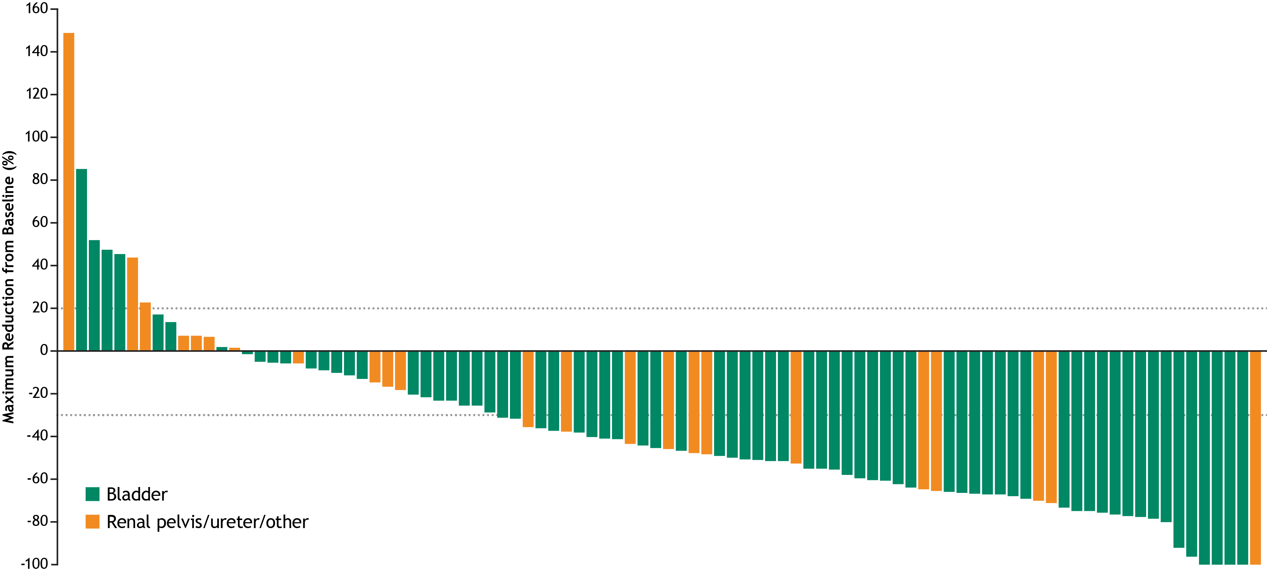
EV-101 (ASG-22CE-13-2)
NCT02091999
Results: Efficacy
Change in Tumor Burden from Baseline in Patients with mUC Treated with EV 1.25 mg/kg (n=112)
Change in Tumor Burden from Baseline in Patients with mUC Treated with EV 1.25 mg/kg (n=112)
Response, % | 1.25 mg/kg (n=112)
Confirmed CR | 4
Confirmed PR, n (%) | 37
SD | 30
Confirmed ORR (95% CI) | 41 (31.9 – 50.8)
DCR (95% CI) | 71 (62.1 – 79.6)
Reference
Data presented by D. Petrylak, ASCO, 2018

