Slide 1
Wildfire Effects on AQI: What We Learned and How to Use It
Catherine Yao, Binghong Chen, Xiwen Sun, Zitong Shu, Liyan Wang

Slide 2
Case Study 1 Recap
Analyzed traffic, meteorology, and temporal patterns.
Key finding: AQI variation largely explained by traffic and weather.
Linear models performed best for forecasting.

Slide 3
Case Study 1 Limitations
The Baseline Gap: Case 1 models performed well on average but failed to capture episodic “extreme AQI” spikes.
The Risk: The days where our baselines fail are the exact days our users rely on us most for health advisories.
The Hypothesis: These aligned error spikes are driven by unobserved exogenous factors—specifically, wildfire smoke transport—rather than a lack of model complexity.

Slide 4
Business Question
The key business question is: How can we make next-day AQI forecasts more reliable during high-risk pollution events, particularly during wildfire smoke episodes?
More specifically:
Can wildfire activity explain extreme AQI spikes that current models fail to capture?
Can wildfire signals be integrated into the forecasting pipeline to improve advisory reliability?

Slide 5
Data
Data Source: Canadian Wildland Fire Information System (CWFIS) Fire M3 Daily Hotspots archive for 2022–2024.
Filtered strictly to Ontario borders and stripped out records with missing coordinates or timestamps to guarantee accurate downstream spatial joins.
Identified and removed physically impossible sensor errors, such as surface temperatures recorded above 100°C. Deliberately retained records where the Head Fire Intensity (HFI) was exactly 0.

Slide 6
Model Assumptions
We fit a Bayesian hierarchical regression model with a Gaussian likelihood to estimate the effect of wildfire exposure on next-day AQI.
Predictors:
Wildfire exposure lags (0–3 days)
Meteorology (temperature, precipitation, wind)
Traffic intensity
Weekday effects (day-of-week indicators)

Slide 7
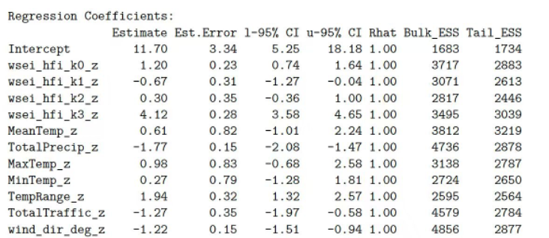
Model Assumptions
Hierarchical structure
Station-level random intercepts
Cyclic seasonal spline for day-of-year

Slide 8
Bayesian Estimation
Fitting
Posterior inference via MCMC (NUTS sampler)
4 chains × 2,000 iterations (per chain)
Posterior evidence
The posterior probability that the cumulative 0–3 day wildfire effect is positive is > 99.9%
MCMC diagnostics
R-hat ≈ 1.00 across parameters (good mixing / convergence)
High effective sample sizes (ESS), suggesting estimates are stable and not driven by sampling noise

Slide 9
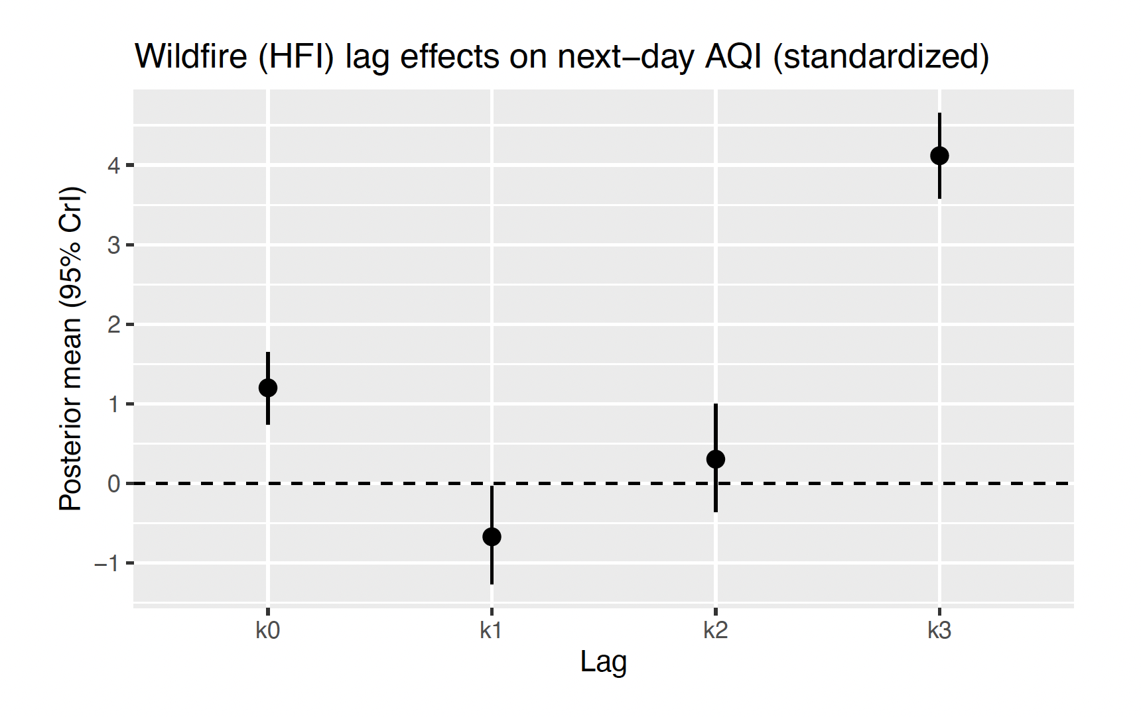
Wildfire Lag Effect
Key takeaway: wildfire exposure is associated with higher next-day AQI, with effects concentrated in short lags (0–3 days).

Slide 10
Cumulative Wildfire Effect
Cumulative effect over lags 0–3 days:
Mean ≈ 4.95 AQI increase
95% credible interval ≈ [4.63, 5.27]
Probability positive ≈ 1.

Slide 11
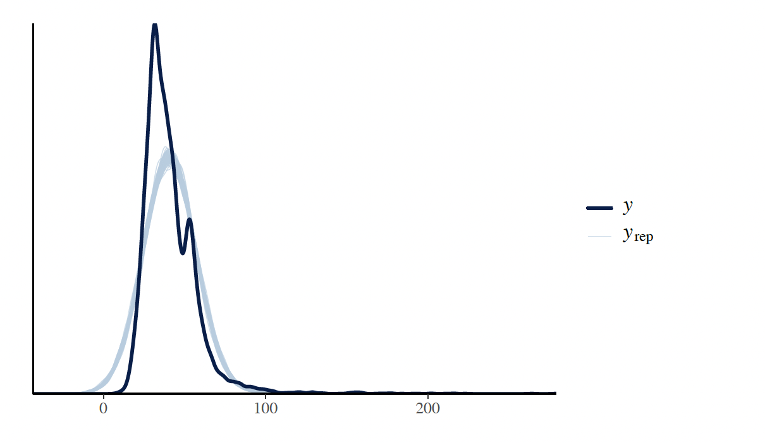
Posterior Predictive Check
Model reproduces the main AQI distribution.
Some mismatch in extreme right tail.
Indicates difficulty modeling extreme events.

Slide 12
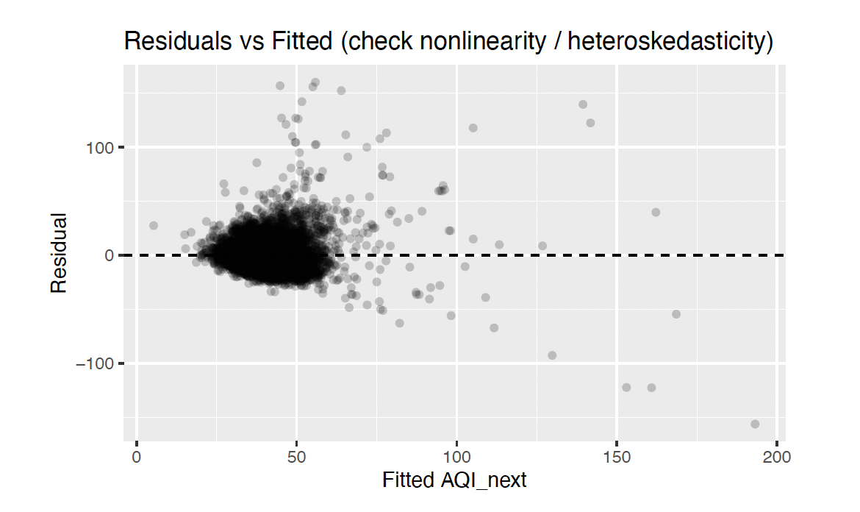
Residual Diagnostics
Residual variance increases at higher AQI levels.
Suggests heteroskedasticity during severe pollution days.

Slide 13
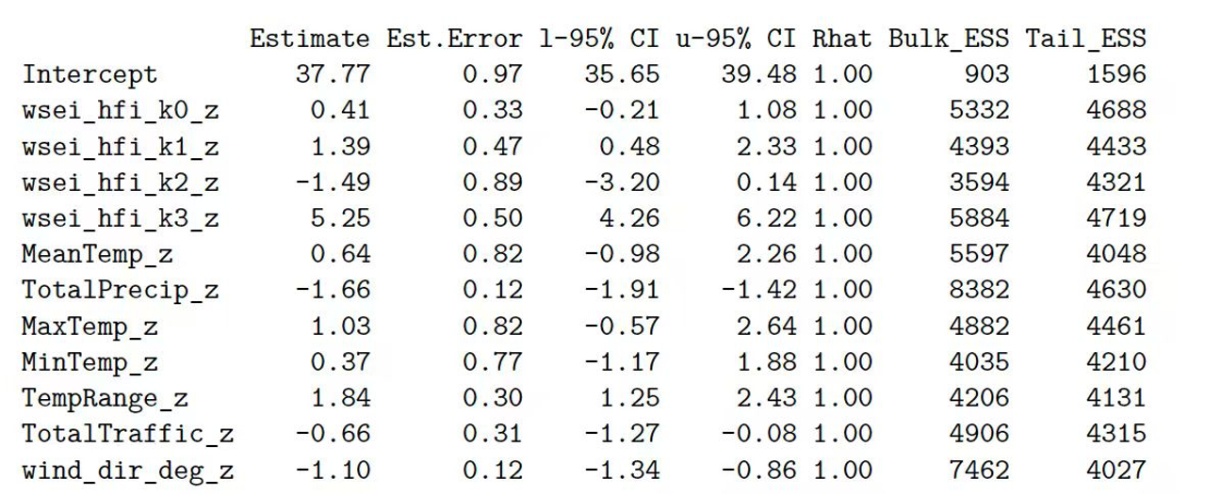
Heavy-Tail Modeling
Student-t likelihood used to capture extreme pollution spikes.
Estimated degrees of freedom ≈ 3.9.
Indicates heavy-tailed AQI distribution.
Key takeaway:
Strongest wildfire association occurs at lag 3, with a clearly positive 95% credible interval.

Slide 14
Gaussian vs Student-t
Gaussian: thin tails → extremes inflate σ and can distort uncertainty.
Student-t: heavy tails (small ν) → handles spikes without over-inflating σ.
Robustness: wildfire lag effects (esp. lag 3) stay positive in both models; Student-t is often cleaner/stronger because outliers have less leverage.

Slide 15
Remaining Limitations
wildfire hotspots are only proxies for smoke transport
wind direction treated linearly
lag coefficients may trade off due to correlation
extreme AQI days remain hard to predict

Slide 16
Research Question 2
RQ2 (Forecast lift): Does adding wildfire exposure features improve next-day AQI point-forecast accuracy,
with emphasis on extreme days (e.g., top decile AQI) where Case 1 failed?

Slide 17
RQ2 Goal & Setup
Question: Does adding wildfire exposure features improve next-day AQI point forecasts?
Emphasis: extreme days (top-decile next-day AQI) where Case Study 1 failed
We compare Baseline vs +Wildfire across three model families:
OLS
Neural Network (MLP)
LSTM

Slide 18
Handling Missing Values
Data sources include station outages and missing predictors.
Strategy:
Drop rows with missing target AQI(t+1)
For missing predictors:
simple imputation (e.g., forward fill / median by station) OR
complete-case filtering for model-ready rows
Report final sample size:
Remaining observations: N = 18523 (original: 33496)
Remaining stations: S = 21
Avoiding Data Leakage
We fit the imputer only on the training data and then transform both training and testing data.

Slide 19
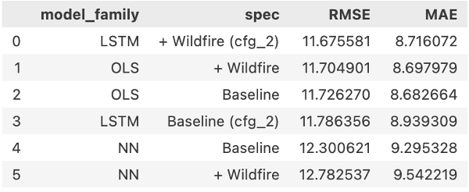
Result
overall performance comparison

Slide 20
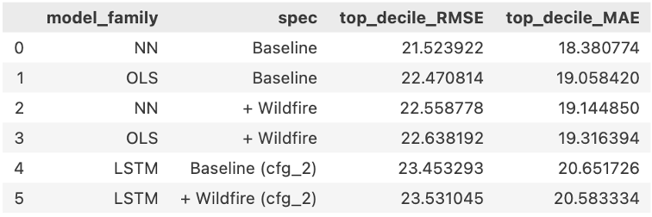
Result
extreme days performance comparison

Slide 21
Interpretation
Overall: OLS ≈ LSTM; NN worse
Extreme days: NN baseline best; +Wildfire slightly worse (all models)
Business: no strong smoke-day lift; avoid over-claim
Action: deploy OLS baseline; wildfire for monitoring/explanation
Next: transport-aware features; extreme-focused training

Slide 22
Research Question 3
RQ3 (Operational signal):
Can we produce a stable, interpretable wildfire-risk signal (feature + diagnostics) that supports stakeholder-facing explanations and monitoring?

Slide 23
Define the Operational Signal
Operational target: “High AQI tomorrow” event
Definition: next-day AQI in the top 10% (binary outcome)
Why this helps stakeholders: a single number for alerts + dashboards

Slide 24
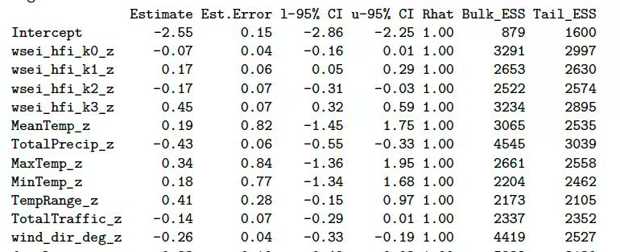
Procedures
Step 1: Define the Monitored Outcome
Create a binary “high-AQI tomorrow” event (e.g., top 10% of next-day AQI).
Step 2: Fit an Interpretable Risk Model
Train a Bayesian hierarchical logistic regression.
The model’s wildfire exposure features, especially the 3-day lag, meaningfully increase the probability of a high-AQI day tomorrow.

Slide 25
Result: Wildfire Increases High-AQI Risk
Focus on the most actionable term: lag-3 wildfire exposure (k3)
Coefficient (log-odds): ≈ 0.45
Odds ratio: exp(0.45) ≈ 1.57
→ ~57% higher odds of a high-AQI day per +1 SD wildfire exposure
Interpretation: strongest risk signal appears with ~3-day delay

Slide 26
Diagnostic A: Calibration of the Risk Score
Bin predictions into deciles of probability of high AQI next day
Near-diagonal points → probabilities are reasonably calibrated

Slide 27
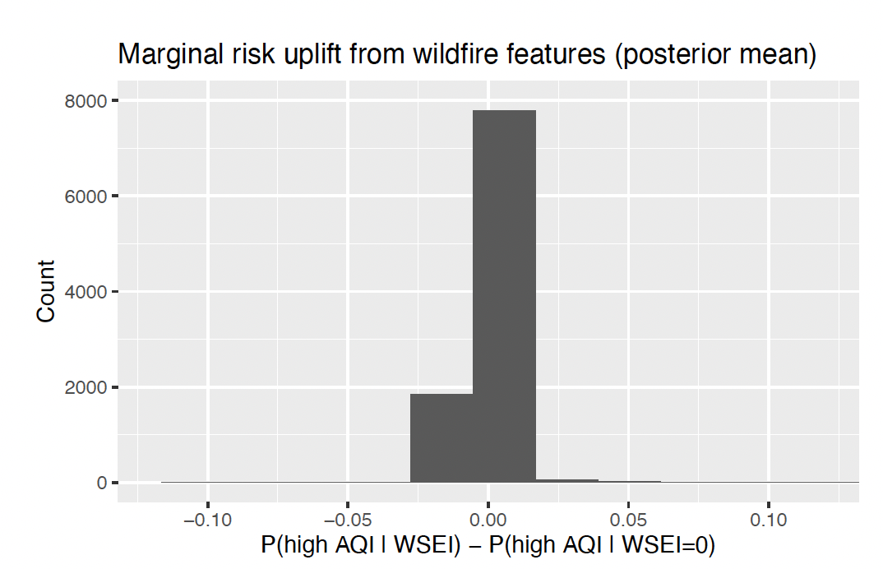
Diagnostic B: Wildfire-driven Risk Uplift
Δ = P(High AQI | WSEI) − P(High AQI | WSEI = 0)
Compute wildfire uplift:
Interpretation: mass near 0 → wildfire has little effect on most days (good: fewer false alarms) positive tail → wildfire meaningfully increases risk on smoke-impacted days

Slide 28
Conclusion
Wildfire exposure shows a clear positive association with next-day AQI, with the strongest and most consistent effect around a ~3-day lag; results are robust under Gaussian and Student-t errors (Student-t better reflects spike-prone AQI).
Adding WSEI features improves performance where CS1 struggled most—high-AQI periods—by providing an additional driver that helps explain and anticipate spike days. The wildfire-aware model reduces “missing-driver” behavior relative to baselines that rely mainly on seasonality/meteorology.
Using a top-decile next-day AQI event, the Bayesian risk model produces a probability score that is interpretable and calibratable. Wildfire features (especially lag-3) increase predicted risk, and the uplift diagnostic shows the wildfire signal activates primarily on a subset of days (good: less noise on normal days). Value to decision-making
We can deploy a wildfire-aware early-warning indicator for Ontario: a daily risk probability + a clear explanation of why risk is elevated.

