Slide 1



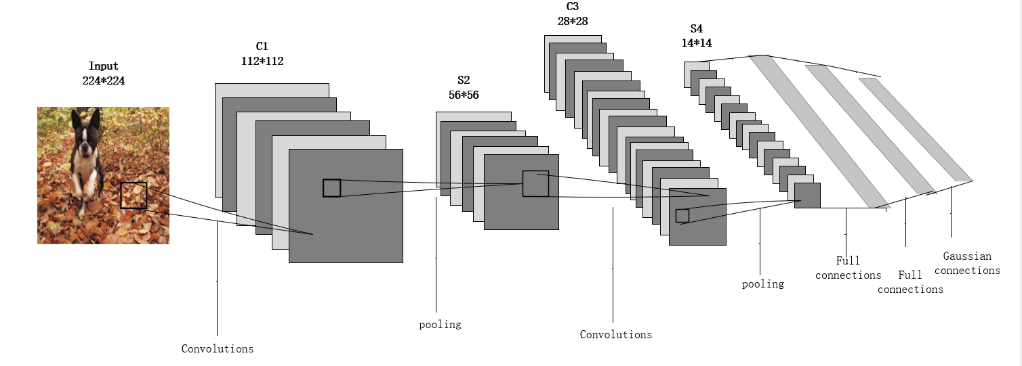
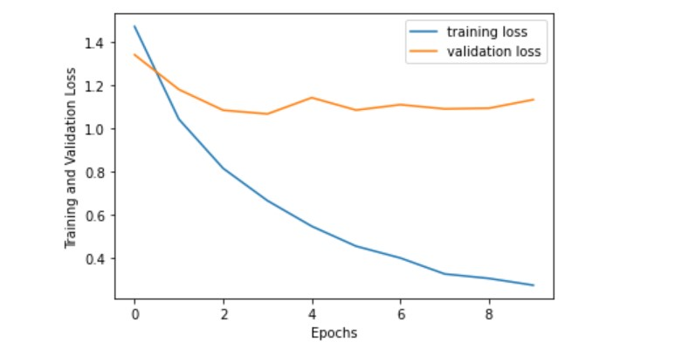
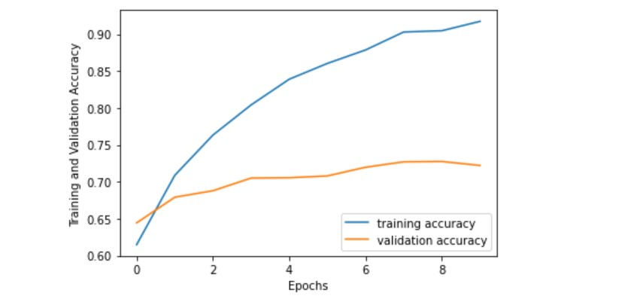
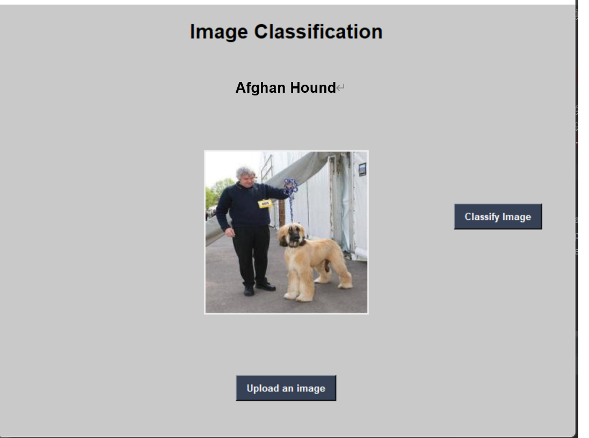
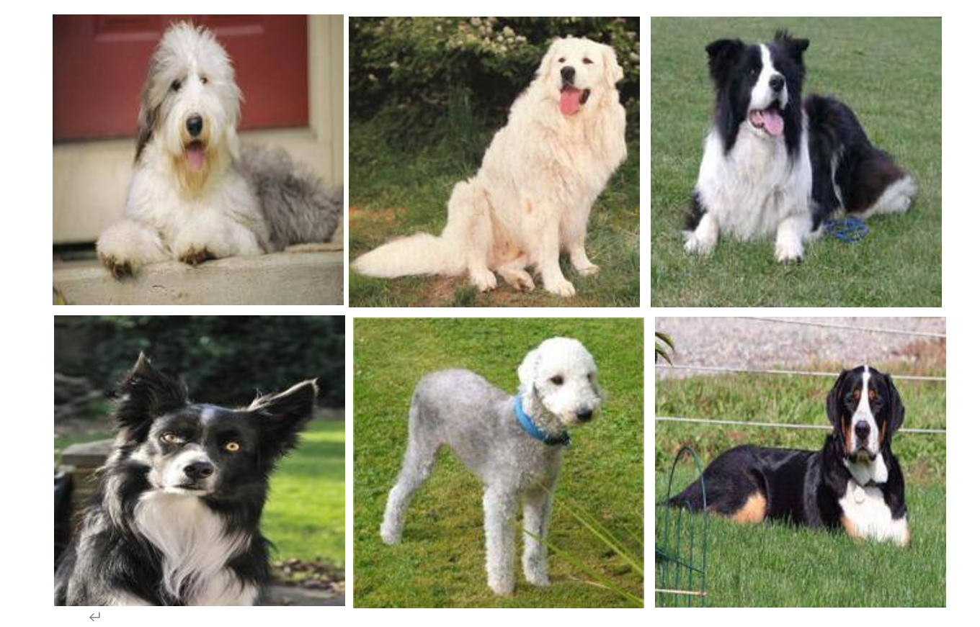
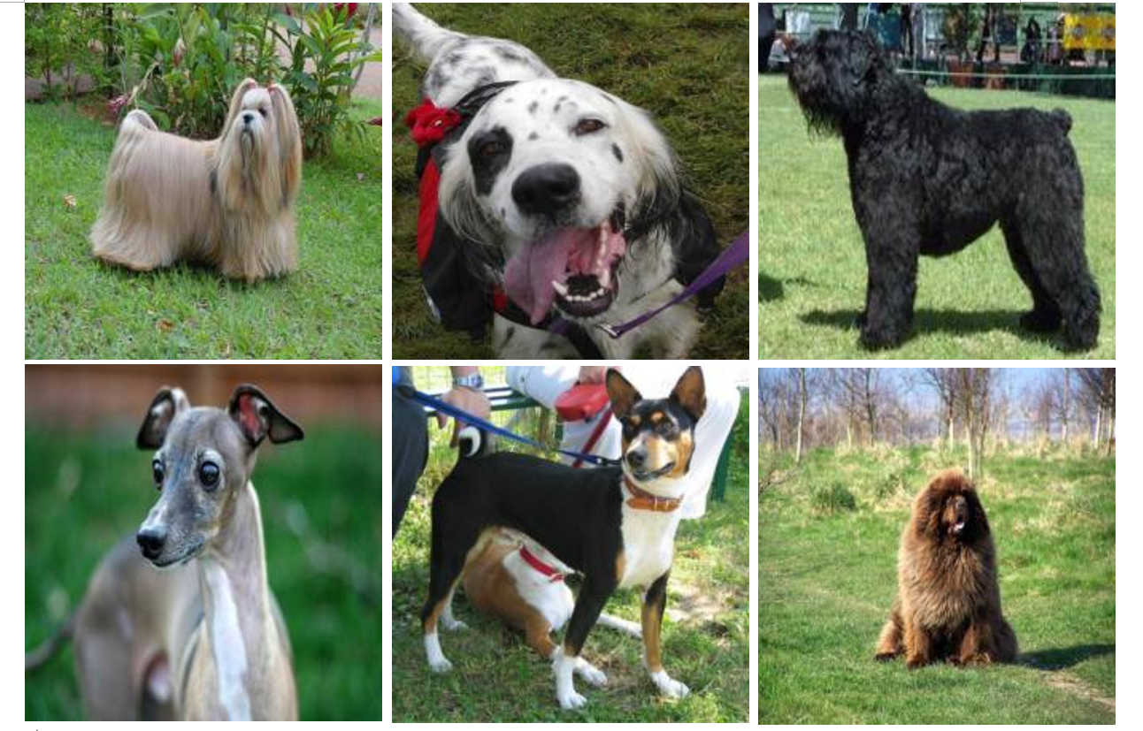
Dog Breed Classification using Convolutional Neural Network
Zhou Fanlin
Oxford Brookes University- CDUT, Supervised by Dr. Grace Ugochi Nneji
Abstract
Currently, there are about 340 recognized dog breeds worldwide. They are classified by body type, hair, purpose and many other characteristics. To better understand breed characteristics, health problems and develop effective care strategies. In this study, a breed classification system based on deep learning technology was proposed to classify 120 breeds of dogs. The system has demonstrated the effectiveness and feasibility of deep learning in accurately identifying and classifying dog breeds.
ResNet50 performed better than vgg-16 in the variety classification task. Xception outperformed VGG-16 and ResNet50 in the breed classification task. Its performance is usually more accurate and efficient.
Fig 2: Convolutional Neural Network
Introduction
Unified Perceptual Parsing Network
Dogs have been our constant companions for centuries, and their ubiquitous presence in our daily lives has become an integral part of our society. [1] In order to better understand the characteristics and types of dogs. This project uses the canine image data set on Kaggle (Fig.1) for deep learning training. A deep learning-based method was used to classify 120 different dog breeds with high precision. It also proves that transfer learning technology is effective in improving the classification performance of deep learning models.
Dataset details:
The data set is the Stanford Dog data set. Each image has a unique file name. The data set included 120 dog breeds. There are 10,357 testing images and 10,222 training images. The size of the picture is 224*244 by using resizing method.
Researchers have explored various approaches to improve the accuracy of classification models. Raduly et al. used fine-tuning of Convolutional Neural Networks (CNNs) to achieve high accuracy in classifying dog breeds from the Stanford dog dataset. Similarly, Lai et al. used transfer learning on CNNs to achieve an accuracy rate of 86.63% on the same dataset.
Liu et al. combined SIFT descriptors, color histograms, and landmark data with an SVM classifier to achieve an accuracy rate of 67% for 133 dog breeds from the Columbia Dogs Dataset.
Fig 4: Accuracy and loss function of VGG16
Interface GUI
Researchers | Model | Performance(Accuracy)
Kumar et al. | ResNet+PCA | 90%.
Jain et al. | Res Net | 84.56%
Borwarnginn et al. | Pretrained | 88.92%
lDbrowski and Michalik | Pretrained | 70%
Vrbani et al. | Pretarined | 94.76%
Fig 5: The GUI of model
References
[1] P. Borwarnginn, K. Thongkanchorn, S. Kanchanapreechakorn, and W. Kusakunniran, “Breakthrough conventional based approach for dog breed classification using CNN with transfer learning,” 2019 11th International Conference on Information Technology and Electrical Engineering (ICITEE), 2019.
[2] Z. Raduly, C. Sulyok, Z. Vadaszi, and A. Zolde, “Dog breed identification using Deep Learning,” 2018 IEEE 16th International Symposium on Intelligent Systems and Informatics (SISY), Sep. 2018.
[3] J. X. Liu, A. Kanazawa, D. Jacobs, P. Belhumeur. Dog breed classification using part localization. In Proceedings of the 12th European Conference on Computer Vision, Springer, Florence, Italy, pp.172–185, 2002. DOI: 10.1007/ 978-3-642-33718-5_13.
Fig 3: The model that was done before
Result & Discussion
Fig 1: Stanford Dogs Dataset
When epochs was set to 50, the final training accuracy of VGG-16 reached 48.5%, ResNet50 achieved 95% and Xception 91.7%.
What the CNN is looking
What:
For a standard classification CNN, the input is an image and the output is a class probability.
In this work, we propose to use CNN's implicit attention and locate the discriminant region for the prediction class.
model | epochs | accuracy
VGG-16 | 50 | 48.5%
ResNet50 | 50 | 95%
Xception | 50 | 91.7%

