Slide 1

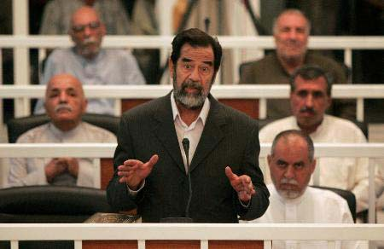
commit
1. Do you remember when he was captured
and thrown into prison?
2. Do you think it fair to sentence him to death
because he killed 5000 people in 1988?
3. Do you think he should be responsible for
the killing he did?
4. Do you believe he is likely to kill himself before
he is hanged, as
some news media
have suggested?
commit sb. to prison
committed murder
the crime he committed
commit suicide

