Slide 1


ability, unable,
enable, disabled, disability
The ___________ are those who need love and
care most. As they are ___________ to take care
of themselves in one way or another, and many
of them lack the _________ to work, we should
offer more help to __________ them to live a
better life. Those who have the wrong attitude
towards people with ______________ should
be more considerate and put themselves
in others’ shoes.
disabled
unable
ability
enable
disabilities

Slide 2



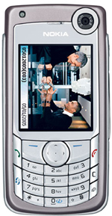

enable
Your cousin Amy has just been admitted to a university. She is going to buy an electronic product before she starts her college education.
She now has four choices:
laptop
play
station
cell phone
digital
camera
A: I would like to buy a … first,
as it enables me to …
B: But I think it’s better to buy a …,
as it enables you to …

