Slide 1
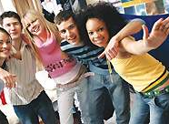
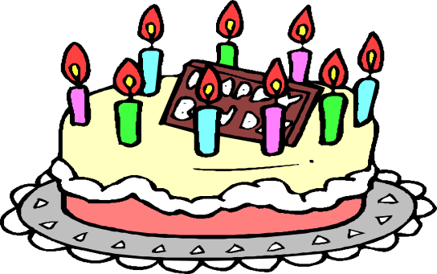


The 18th birthday is the date when you stop being a child and become a legal adult faced society, so turning 18 means much more than a sweet birth-day cake. It means facing to the problems by yourself. It means you will be faced to more challenges. It also means you should no longer be a cry baby to the face of difficulties.
face
面向 facing
vt. 面对 facing
vt. 面临 be faced with
n. 面对 in the face of

Slide 2
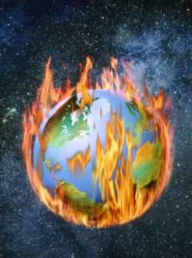
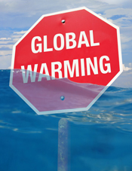
face
1. global warming / serious
problem / face / mankind
other creatures
Global warming is a serious
problem facing mankind
as well as other creatures.

Slide 3
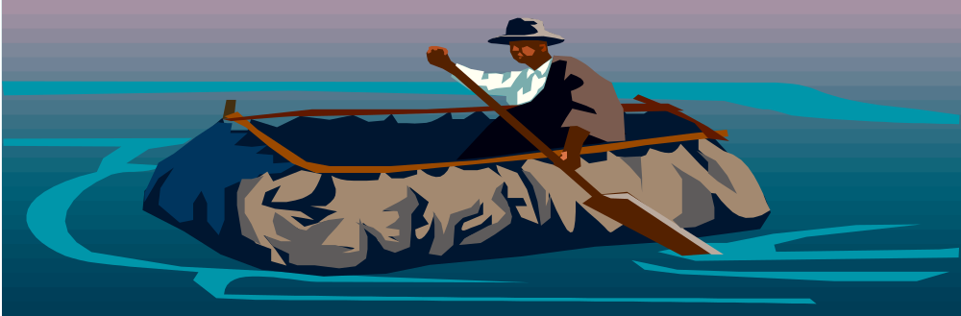
face
2. Some Pacific islanders /
face / fate / leave home
permanently
Some Pacific islanders
are faced with the fate of leaving their home permanently.

Slide 4
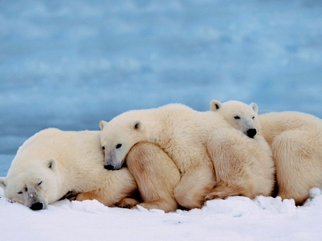
face
3. polar bear / face / survival
problem, die out from the
earth /high temperature
Polar bears will be faced
with survival problems,
for they can die out from
the earth as a result of
the high temperature.

Slide 5
face
4. We / face / reality / great
courage / determination
We should face the reality
with great courage and
determination.

Slide 6
face
5. Global warming / not the
only fatal problem / face
mankind
Global warming is not the
only fatal problem facing
mankind.

