Slide 1
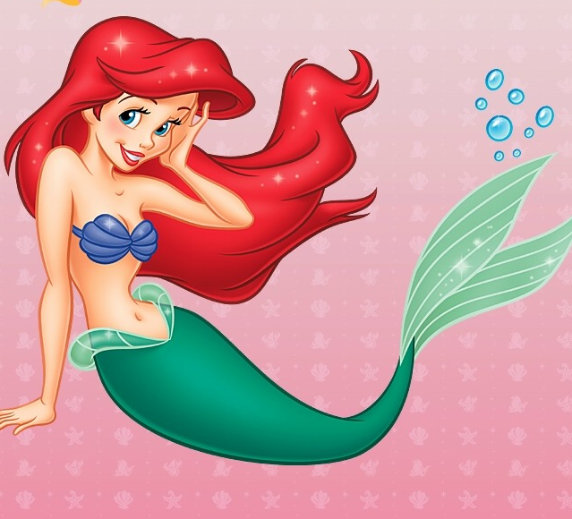
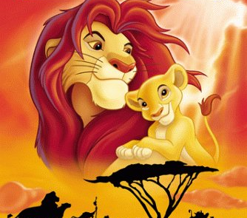
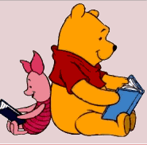
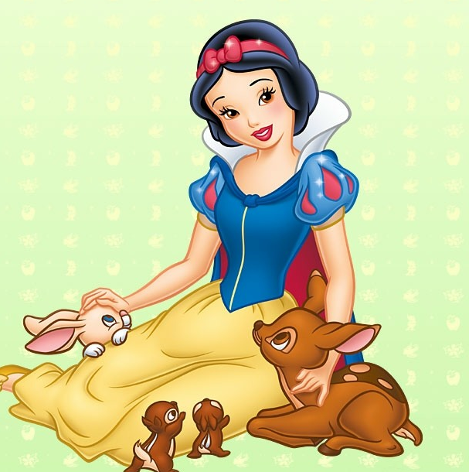
Can you _________ living in a black and white world? Many of you actually do when you are enjoying those colorful Disney _________ such as Lion King, Little Mermaid and Winnie the Pooh.
Disney always describes itself as an creative and __________ dream factory, using all __________ means to entertain kids. Disney characters, though __________, do have great influence on kids world wide.
But recently many people have been criticizing Disney cartoons for its role as a great danger to cultural diversity, saying that Disney has tried to limit kids’ _____________.
imagine
images
imaginative
imaginable
imaginary
imagine, image, imagination
imaginary, imaginative, imaginable
imagination

