Slide 1

observe
1) It is required that students ______________ keenly
when the teacher is doing an chemistry experiment.
observe
watch attentively

Slide 2

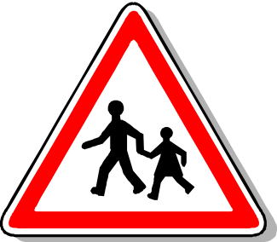
observe
2) It is essential that everyone
_____________ traffic rules.
observe
obey, keep to

Slide 3
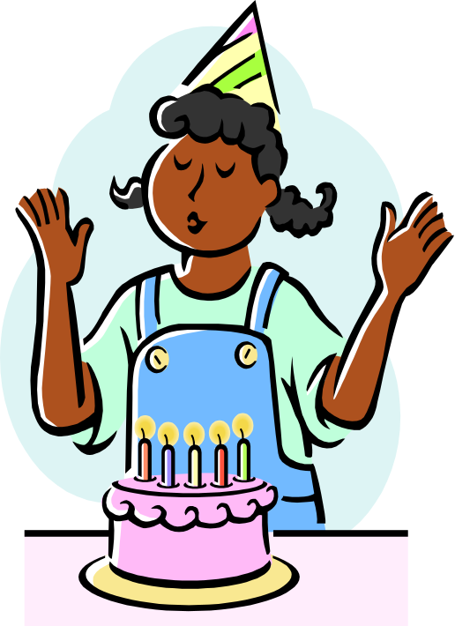
observe
3) Which way do you prefer
_____________ your
coming birthday?
to observe
celebrate

