Slide 1

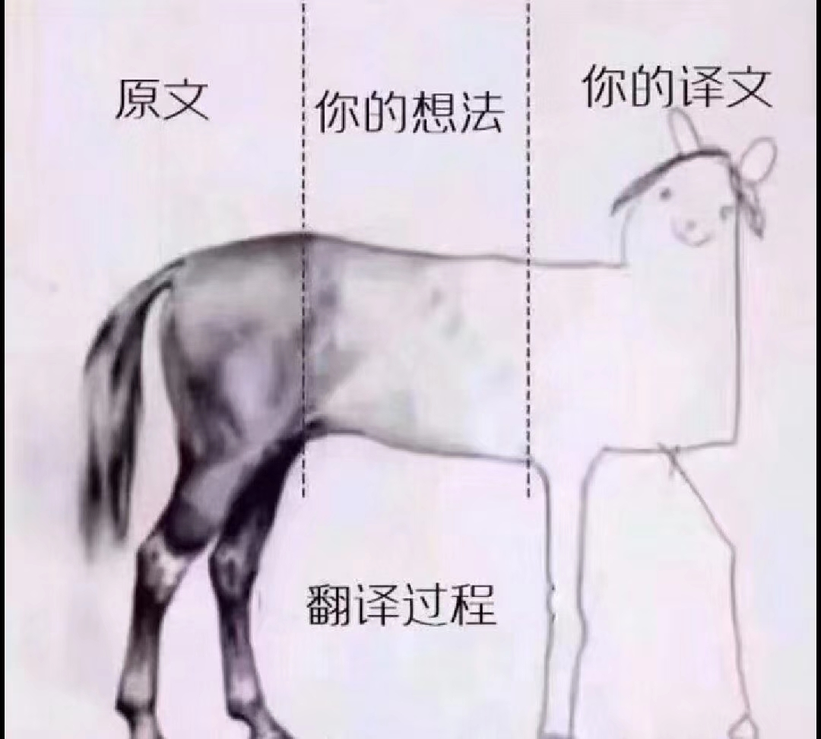
Translation
Learn through the constant comparison between your translation and other better translations.

