Slide 1

Forecasting:
Monthly Gold Price
STAT 443 Project
Group 2:
Catherine Zhou 20813562
Xinjie Qiao 20823462
Zoe Zou 20846974
Notes:
Hi, everyone. Today, we are going to present our forecasting project of modeling monthly gold price. My name is xxx, with my teammate, xxx and xxx.

Slide 2


1
Introduction
Contents
2
Data Analysis
3
Discussion
Notes:
This is our agenda for today.
We will first introduce you to our data set and background of our project. Than, we will move on to the data analysis and the models we use to make the prediction. Finally, we will draw some statistical conclusions from our analysis and discuss our discovery from the data.

Slide 3


Why choose the topic?
The historical status of gold
Benefits of constructing Arbitrage portfolio
Notes:
So why we choose this topic? Because the gold price means a lot to the financial market and we also want to have some native attempt of predicting its price and chance of constructing arbitrage portfolio.

Slide 4
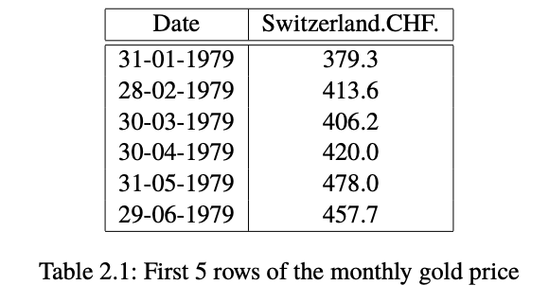
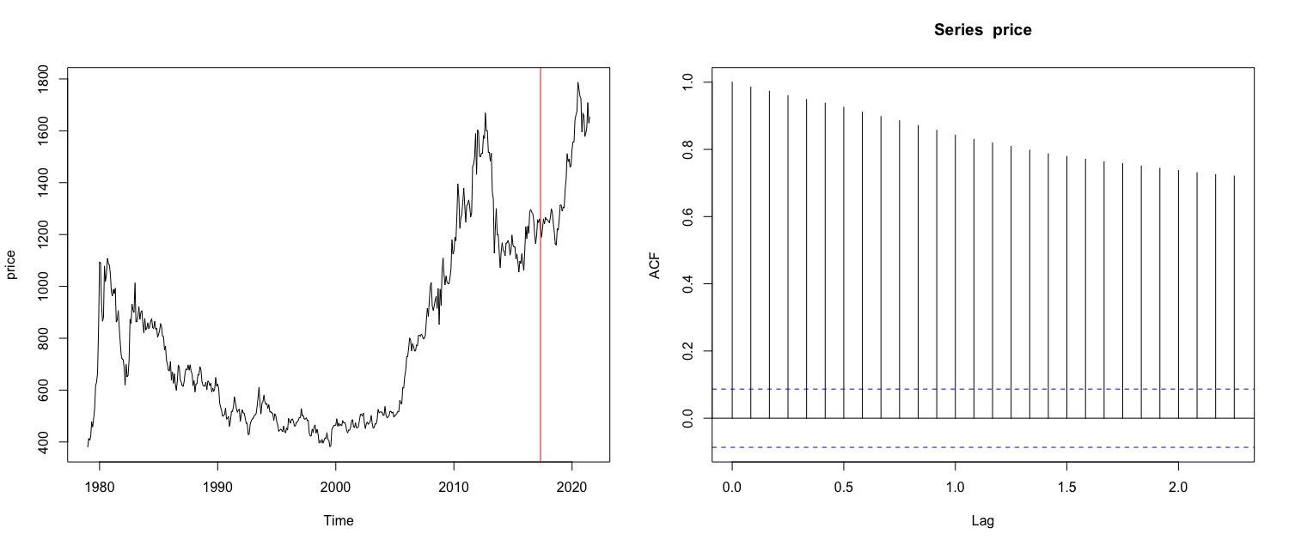
Monthly Gold Price (per gram)
Notes:
We choose the monthly gold price data from January 1979 to July 2021 in Switzerland currency, we are going to predict the next two years’ monthly gold price. By looking at the acf of original data, there is a slow decay which means the data has a trend. However, our dataset failed the fliger-killeen test which means we have non-constant variance. We tried to use power transformation to fix it, but it is not really helpful, so we move forward and try to fit with different models.

Slide 5
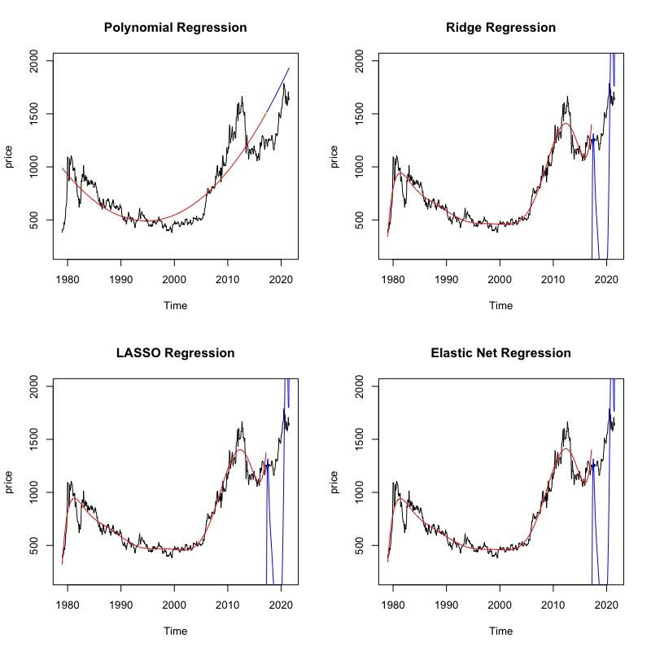
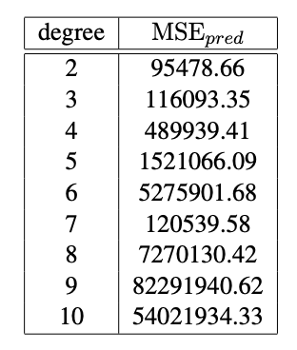
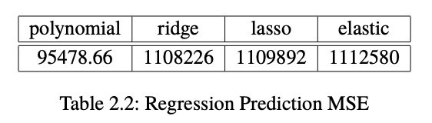
Regression Models - Polynomial, Ridge, LASSO, Elastic Net
Degree 9 with 𝜆 = 1.0000
Degree 2
Degree 10 with 𝜆 = 0.2231
Degree 9 with 𝜆 = 0.0302
Notes:
Catherine: We want to fit unregularized and regularized regression on the data and make predictions. Here, we applied polynomial regressions and the shrinkage methods we discussed in class.
From degree 2 to 10, we find that degree 2 has the smallest prediction MSE with the test data. This is probably because of the bias variance trade off, since a polynomial regression with higher degree result in lower bias and higher variance. Degree 2 polynomial might not be a good fit for the data but apparently have a higher prediction power than the rest models.
Among the unregularized regressions, we choose the best ridge, lasso, and elastic net (with alpha = 0.5) by applying 10-fold cross validation over degree 2 to 10 and a range of potential lambda values. We select the optimal degree and lambda values based on the cross validation error.
Putting the regressions all together, we select the best regression model based on the prediction MSE, and we can see that the polynomial regression has the smallest prediction MSE. Going back to the plots, we can see that ridge, lasso, and elastic net did poorly on predicting future values as they have too much variance. We think this is probably because shrinkage methods work better with models that have more parameters and features instead of on time-series data with only one explanatory variable.

Slide 6
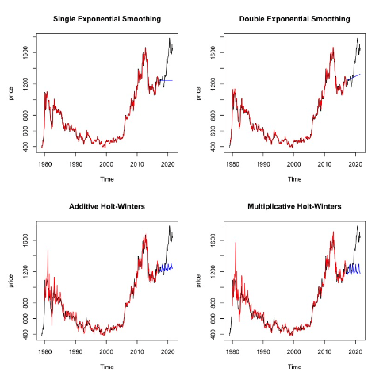
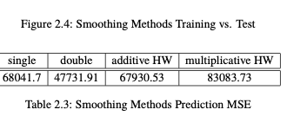
Smoothing
Method
Models:
Simple Exponential;
Double Exponential;
Additive HW;
Multiplicative HW
Prediction MSE chooses Double Exponential
Bad bias-variance tradeoff
Non-constant variance
Notes:
Zoe:
We perform four models in this section: single exponential, double exponential, additive and multiplicative Holt-Winters algorithm.
And by the minimum prediction MSE, the double exponential is the best among them.
By the ploy, we can see that even the model is almost perfect fit, the prediction for the test set is quite terrible. it is an extreme example of bad bias-variance trade-off.
Also, after checking the non-stationarity, the only source is non-constant variance.

Slide 7
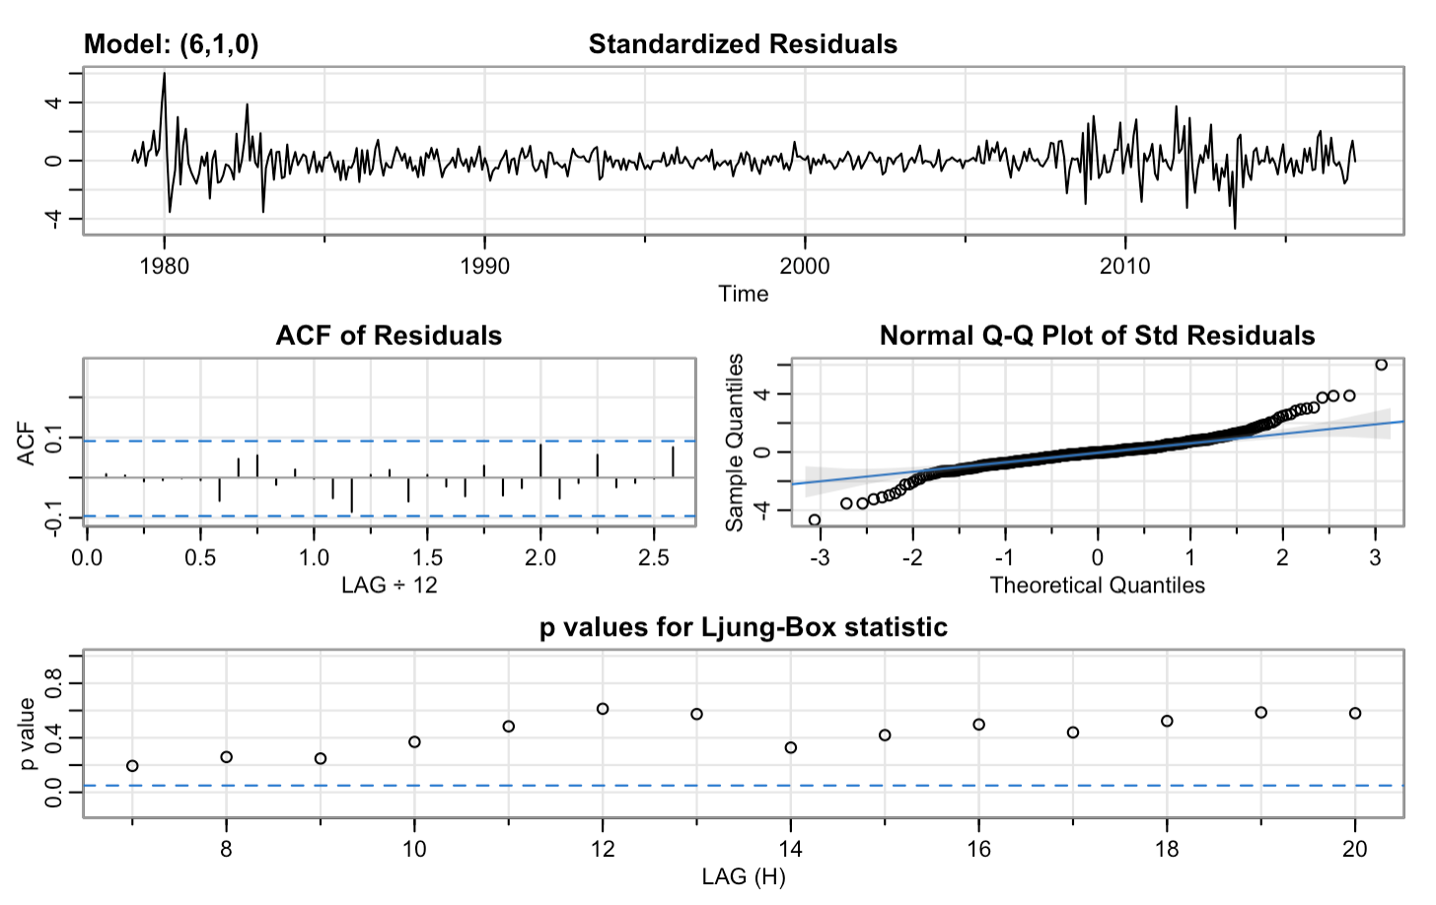
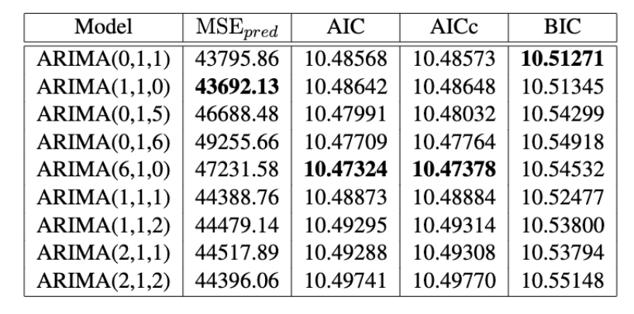
Box-Jenkins
Proposed Models:
ARIMA(0,1,1)
ARIMA(1,1,0)
ARIMA(0,1,5)
ARIMA(0,1,6)
ARIMA(6,1,0)
ARIMA(1,1,1)
ARIMA( p,1,q ) with larger p and q
Compare their prediction power
Choose ARIMA(6,1,0) by residual diagnostics
Notes:
Lana: For this part, we do one regular differencing to remove the trend and also proposed the following ARIMA models by looking at the acf and pacf of differencing data.
In order to choose the best models, we calculate their prediction MSE, AIC, bias-corrected AIC and BIC, then we find three models have better prediction power which shown in the table.
Then we do residual diagnostics to check which models satisfy assumptions. From the plot, we can see that residuals of ARIMA with order (6,1,0) have constant mean, no seasonality and good p-values, so we choose this one as the best one.

Slide 8
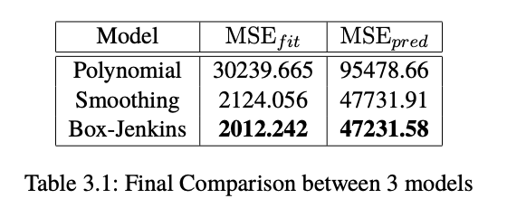
Final Model
Fit MSE with the entire dataset
Prediction MSE on the test set
Residual Analysis
Notes:
Catherine: We choose our final model with three criterias: … The first analyzes the prediction power of the model; the second analyzes the fit of the model, and the third shows the validity of the model.
The comparison result shows that the box-jenkins model, which is ARIMA(6,1,0), has the lowest fit MSE as well as prediction MSE. And as we presented before, the polynomial regression has the worst residual analysis that it failed every single model assumption. The double exponential smoothing and the box-jenkins model has fairly similar issues with the residuals that they are not normal and have non-constant variance. We will next discuss the variance issue, but for now ARIMA(6,1,0) is our best model based on the criterias and we perform a prediction of 30 month into the future with this model.

Slide 9
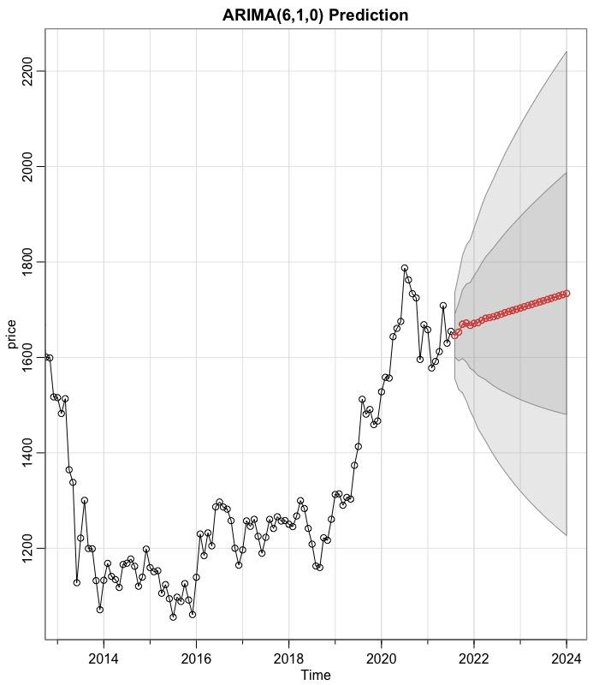
Prediction
Notes:
Catherine: Our predictions above are the monthly gold prices from 2021 August to 2023 December. We observe that the monthly gold price will have a steady and slowly increasing trend, but the variation in our results exists and is pretty huge. Since the model assumptions are not met, the validity of the prediction interval remain questionable.

Slide 10
Further Discussion on our Data-set
Gold price is hard to predict using just a time-series model.
Change points in the dataset, e.g. 1980s, 2010s, 2020s.
Non-constant variance.
Notes:
Catherine: In this project, we find that the gold price is very hard to predict using a time-series model due to the complexity and variation existing within this topic. The price is not only tied to time but also many other factors. A lot of research has already put effort in this kind of prediction and include many other factors in their prediction.
There are also several change points in the data-set, e.g. around the 1980s, 2010s, and 2020s. We can guess that the first is due to the stock market recession in 1980-1981, the second is due to the financial crisis in 2007-1008, and the last is due to the COVID-19 pandemic. All these global incidents cause the high variance in the data-set.
Recall the time series plot of the entire dataset we saw at the beginning, we didn't observe any non-constant variance, but to double check, we performed the Fligner-Killeen test, which returned a very small p-value. Hence, we do have non-constant variance in our data-set. However, when we try to use power transformation and boxcox transformation to remove the non-constant variance, neither method is helpful.
Hence, we decide to move forward and try to fit models with non-constant variance in the data, which caused all the models to have pretty bad residual analysis results.

Slide 11
Thank you
THE END

