Slide 1

Routing multiple vehicles in road networks with constrained communication capability
組員：郭蕙綺、趙仰生

Slide 2

Outline
Problem description
Reinforcement Learning theory
Implementation
Demo
Experiment

Slide 3
Outline
Problem description
Reinforcement Learning theory
Implementation
Demo
Experiment

Slide 4
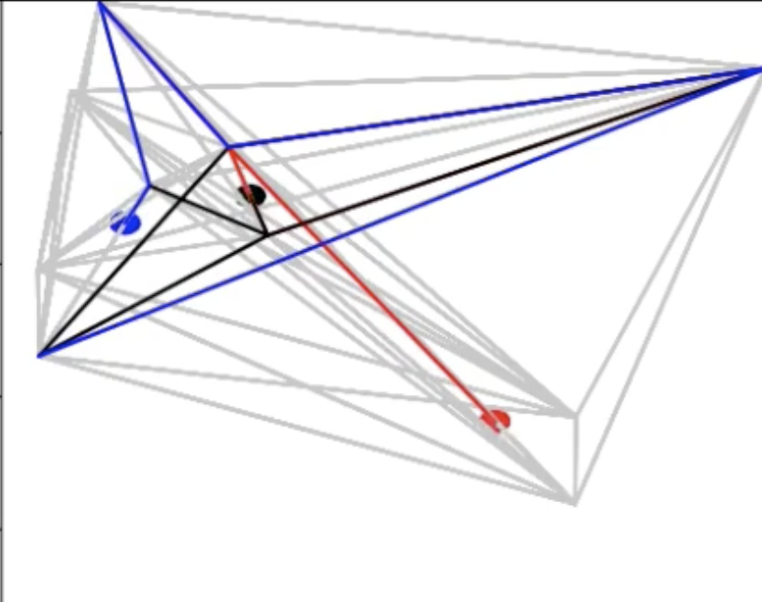
Definition
Multiple agents cooperate to traverse all the edges in a graph.

Slide 5
Input and Output
Input :
A graph without isolated node.
Starting points and speed for agents.
Output :
Routing path.
Cost.

Slide 6
Constraints
Agents can communicate with each other only when they are within a certain distance.
Agents have their own speeds and different starting points.
The length of the edges are not calculated by the coordinates but given by the user.

Slide 7

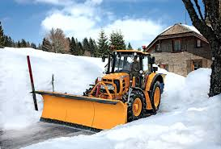
Application
Patrol mission
Snow shovel mission

Slide 8
Outline
Problem description
Reinforcement Learning theory
Implementation
Demo
Experiment

Slide 9
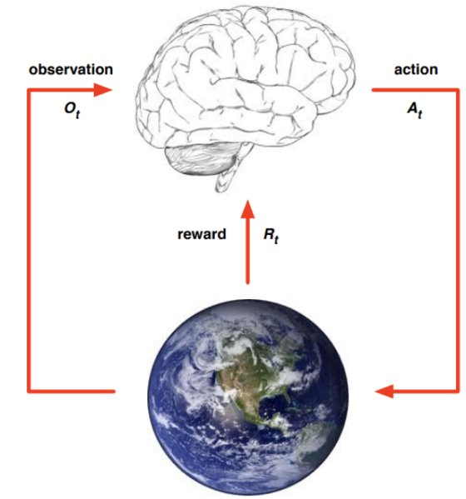
Theory
At each time step the agent
Receives observation
Take action
Receives reward
The environment
Receives action
Emits observation
Emits reward

Slide 10
Outline
Problem description
Reinforcement Learning theory
Implementation
Demo
Experiment

Slide 11
Environment
States :
Indicate whether the connected edges have been visited in binary.
Each agent has its own state.
Reward :
Traverse a non-visited edge -> +1
If done -> +10
If cost less than greedy algo when done -> +25
Each step -> (-0.001) * edge length

Slide 12
Model
Network : Tower type
Active function : ReLu
Optimizer : AdamW (learning rate:0.00002)
Algorithm : Double DQN

Slide 13
Outline
Problem description
Reinforcement Learning theory
Implementation
Demo
Experiment

Slide 14
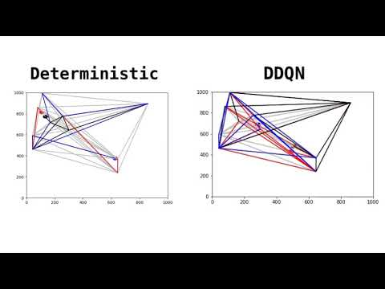

Slide 15
Outline
Problem description
Reinforcement Learning theory
Implementation
Demo
Experiment

Slide 16
Parameter tuning
Algorithm:
DQN -> DDQN
Learning rate :
0.001 -> 0.00002
State:
Complex -> Binary
Reward:
Complex -> simple

Slide 17
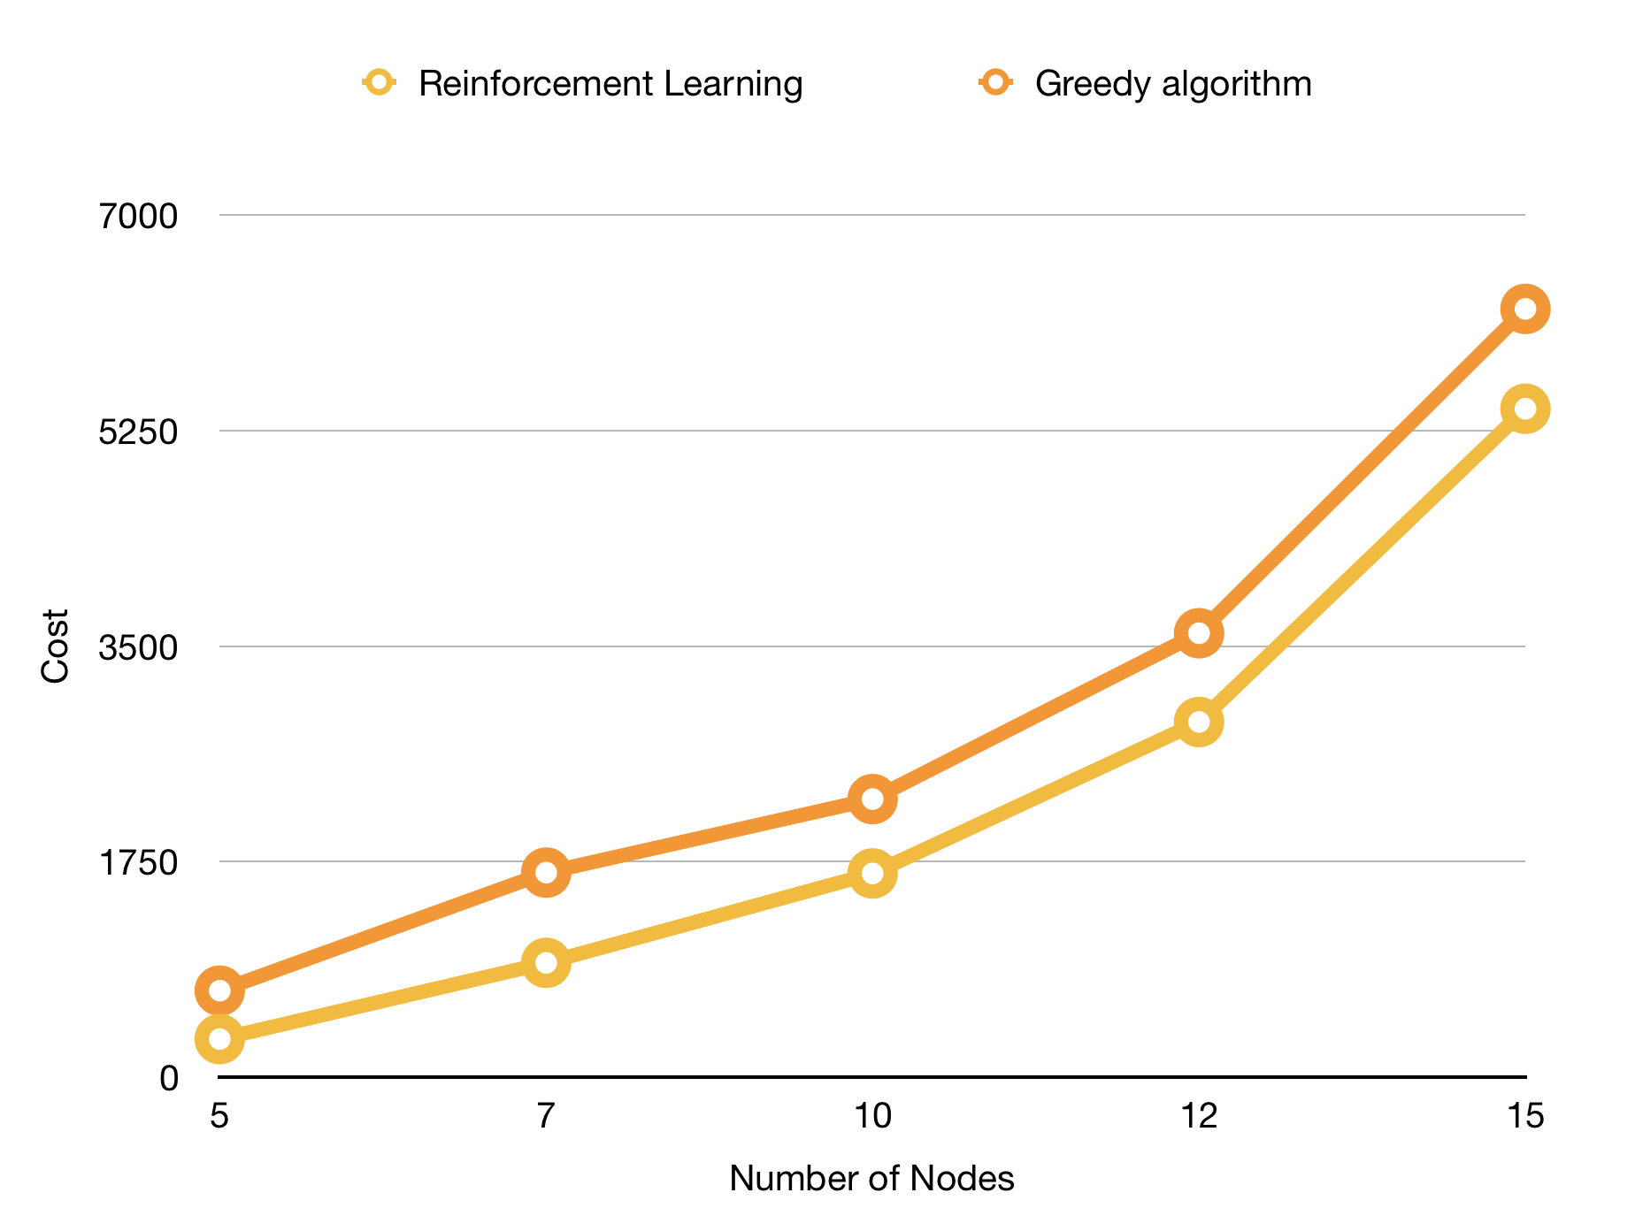
Result

Slide 18
Thank you!

