Slide 1
R50,1333*800
GA-RPN 29.3
GridRCNN 27.0
ATSS 25.8
RepPoints 25.4
FoveaBox 23.9
FCOS 21.5
Free Anchor18.8
FSAF 18.4

Slide 2
Anchor based和anchor free
Bridging the Gap Between Anchor-based and Anchor-free Detection via Adaptive Training Sample Selection
这篇文章说anchor based 和 anchor free的区别在于如何界定正负样本，提出ATSS用来消除gap（AP 50.7）
但在kitti上分不高

Slide 3
Anchor free（Keypoint-based)
CornerNet
CornerNet-Lite
CenterNet
Grid RCNN 27.0
ExtremeNet
RepPoints 25.4

Slide 4
Anchor free（Center-based)
DenseBox
FCOS 21.5
CSP
FoveaBox 23.9

Slide 5
Guided Anchor
FSAF 18.4
Free Anchor 18.8
Guided Anchor(Faster RCNN) 29.3 同配置的 Faster RCNN 26.1
SAPD
ATSS 25.8

Slide 6
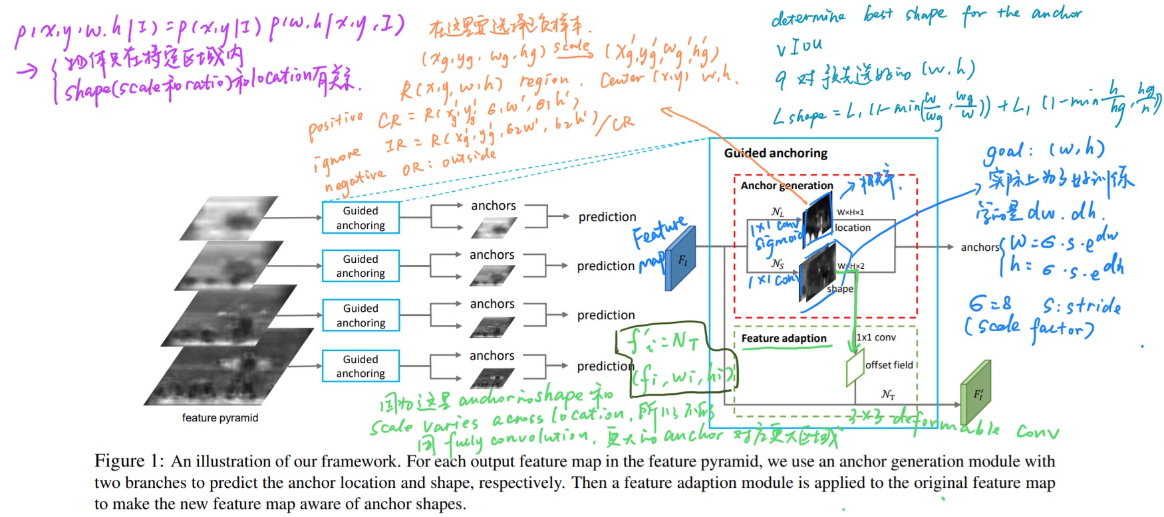
Guided Anchoring（GA-RPN)
Notes:
https://arxiv.org/pdf/1901.03278.pdf

Slide 7
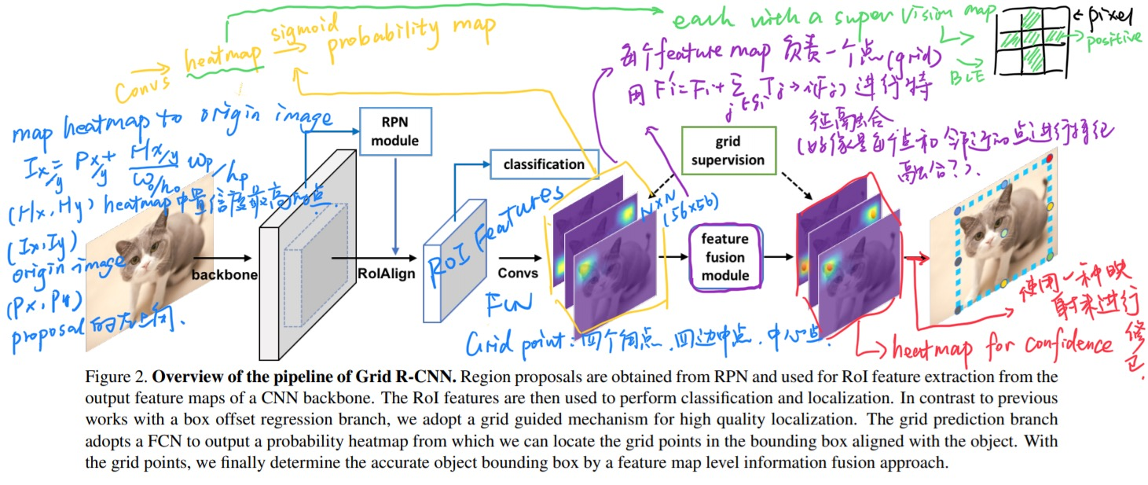
Grid RCNN
最后的那步映射变换是不是相当于某种意义上的anchor？
Notes:
https://arxiv.org/pdf/1811.12030.pdf

Slide 8
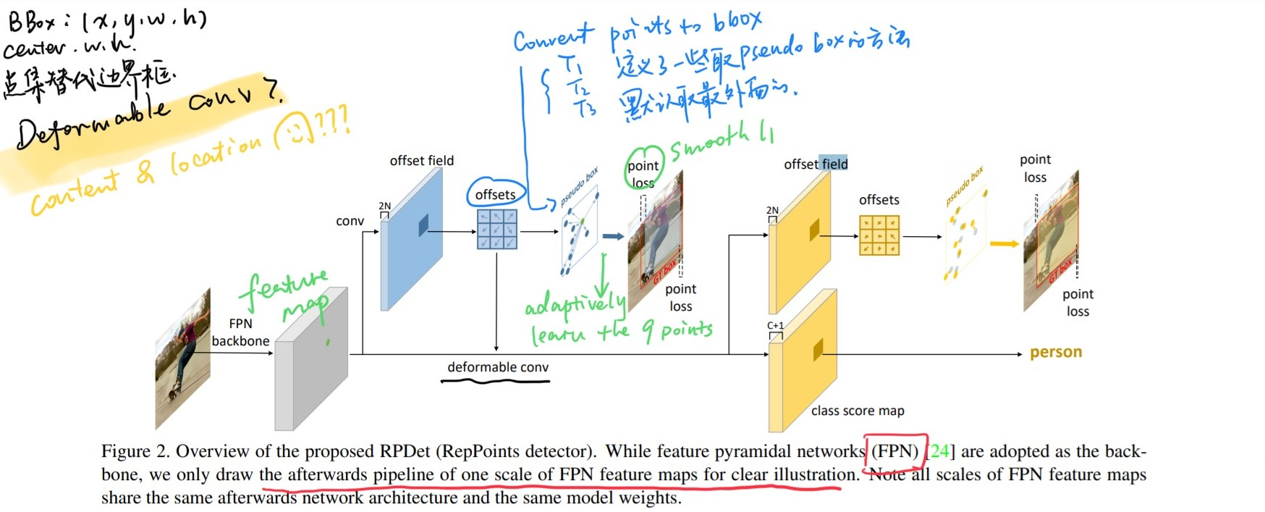
RepPoints
有点类似FCOS的那种感觉，或许可以用来做ins seg（像polarmask那样）
Notes:
https://arxiv.org/pdf/1904.11490.pdf

Slide 9
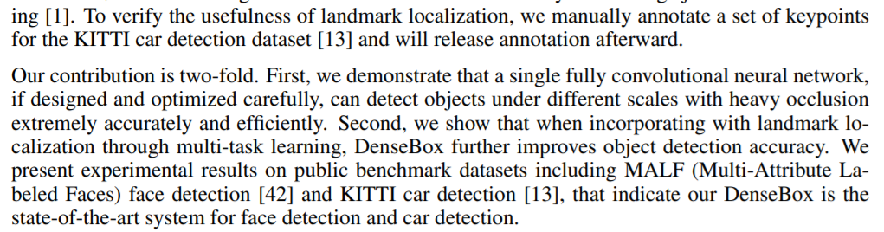
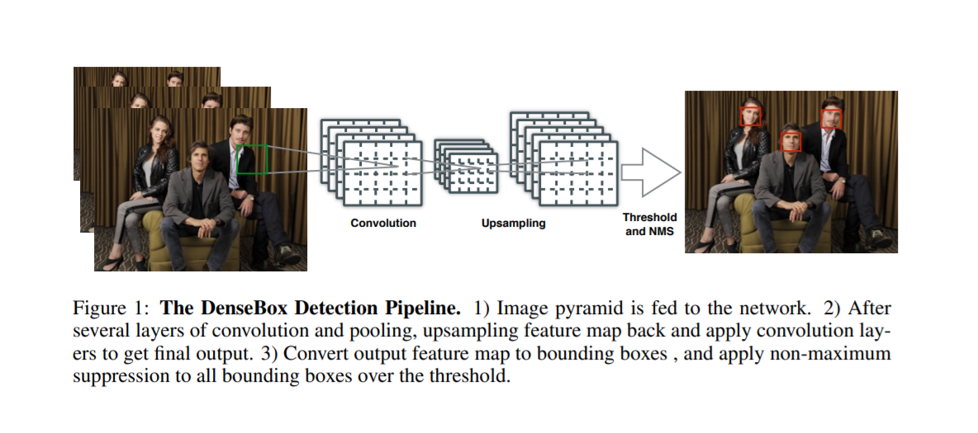
Dense Box
这篇似乎是最先开始FPN的
Notes:
https://arxiv.org/pdf/1509.04874.pdf

Slide 10
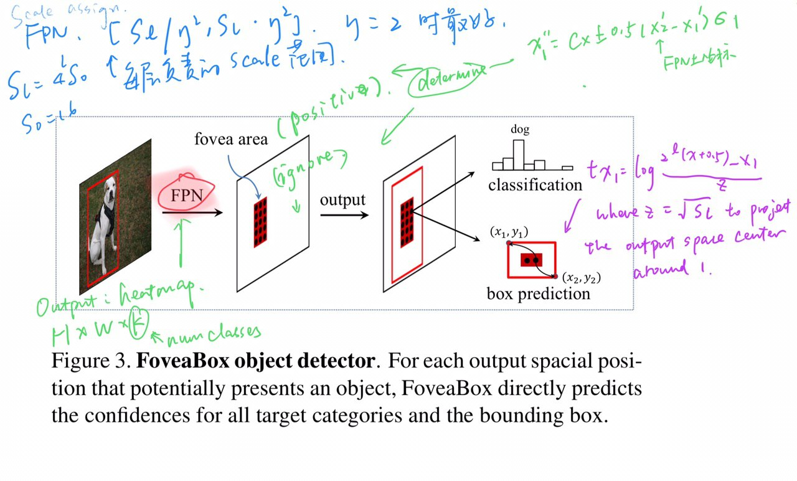
FoveaBox
Notes:
https://arxiv.org/pdf/1904.03797.pdf

Slide 11
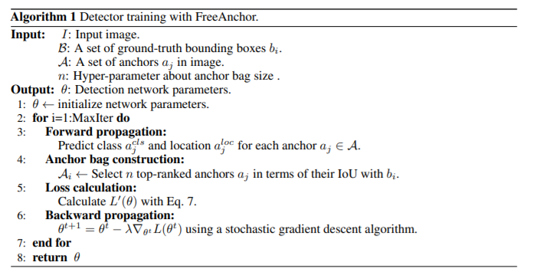
Free Anchor
Notes:
https://arxiv.org/pdf/1909.02466v1.pdf

Slide 12
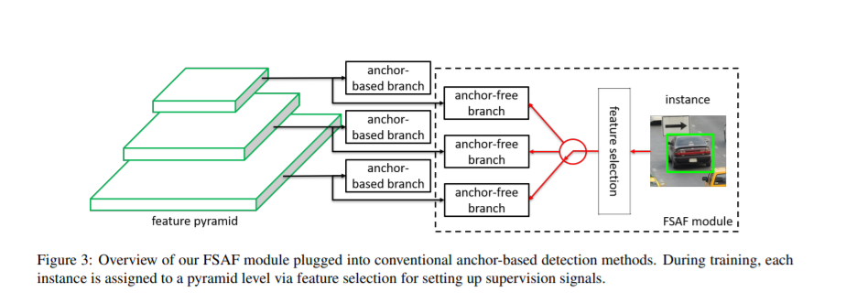
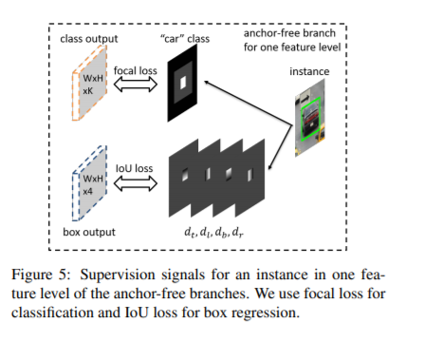
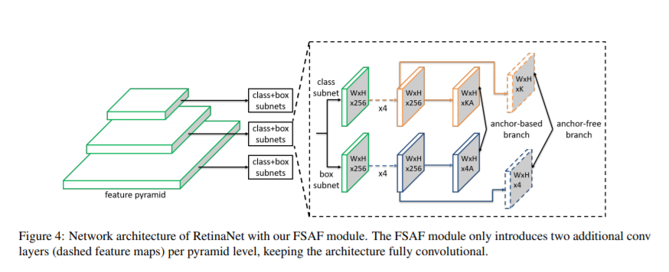
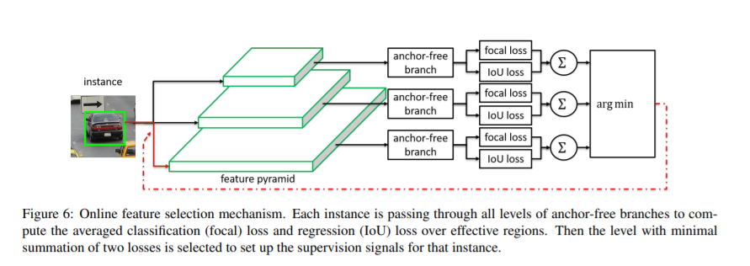
FSAF
Notes:
https://arxiv.org/pdf/1903.00621.pdf

