Slide 1
Music Genre Classification
Katrina Li, Cathy Guang

Slide 2
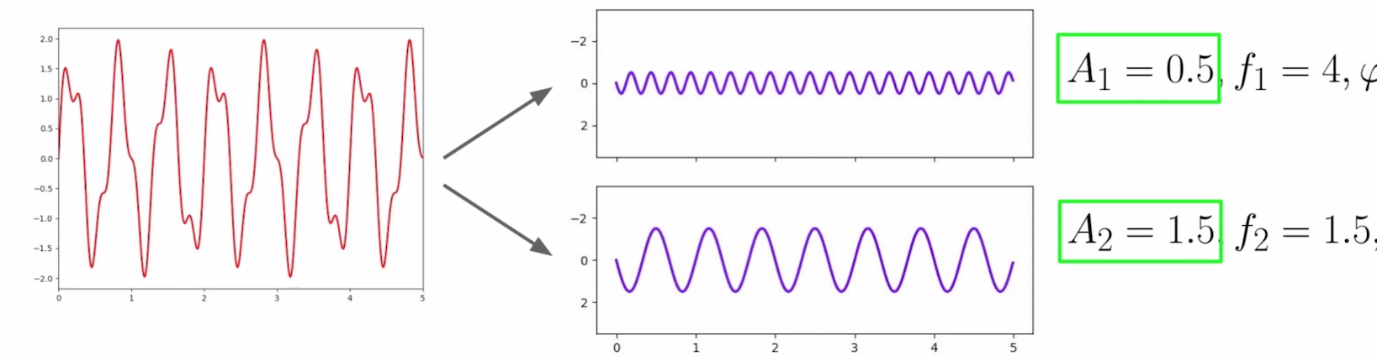
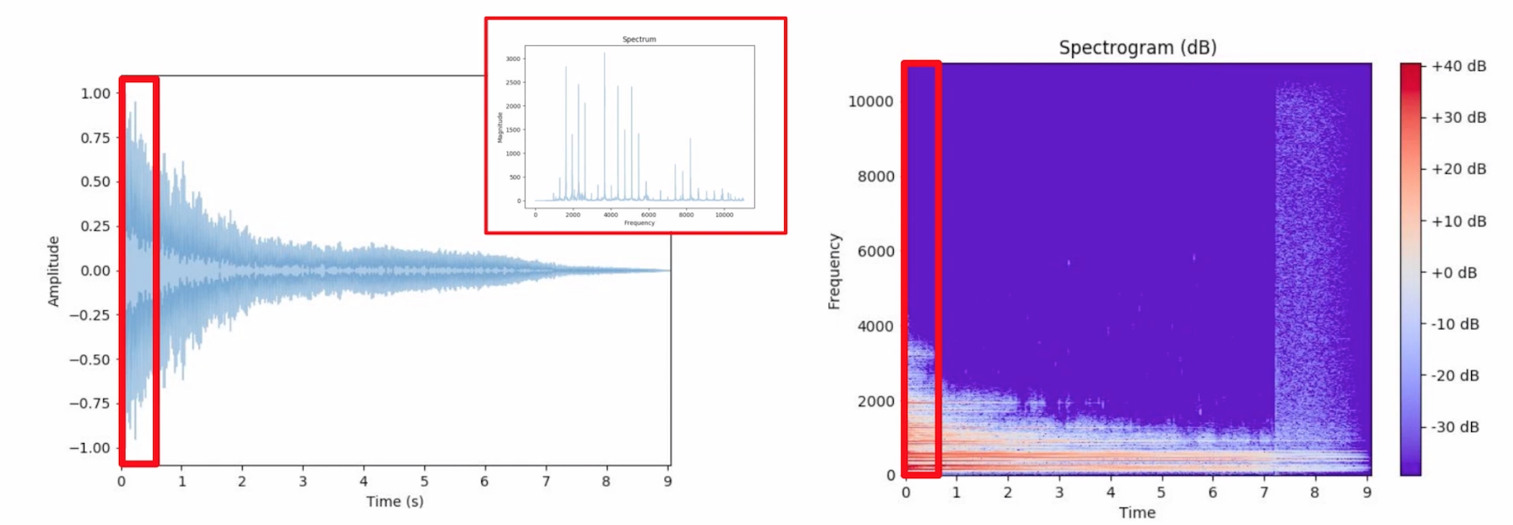
Audio Processing
Fourier transform
Short time Fourier transform

Slide 3
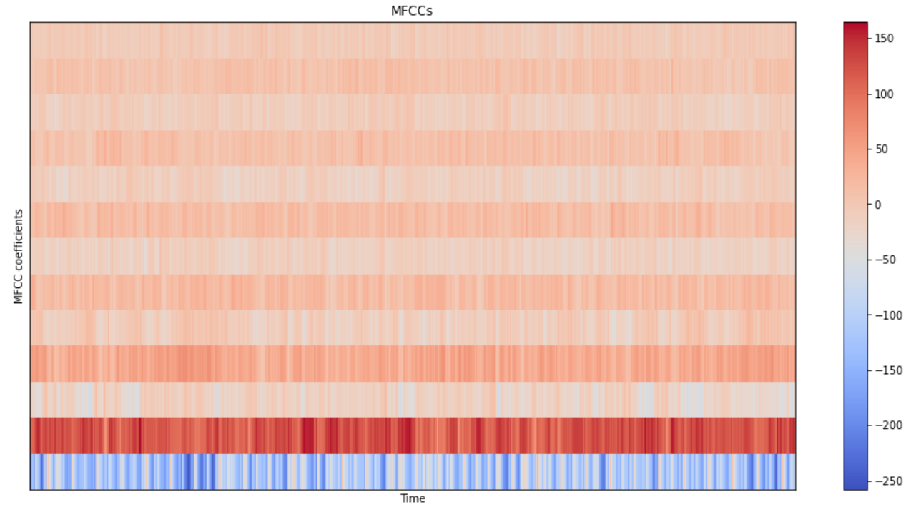
Mel Frequency Cepstral Coefficients (MFCCs)
Capture timbral/textural aspects of sound
Approximate human auditory system
13 to 40 coefficients
Calculated at each frame

Slide 4
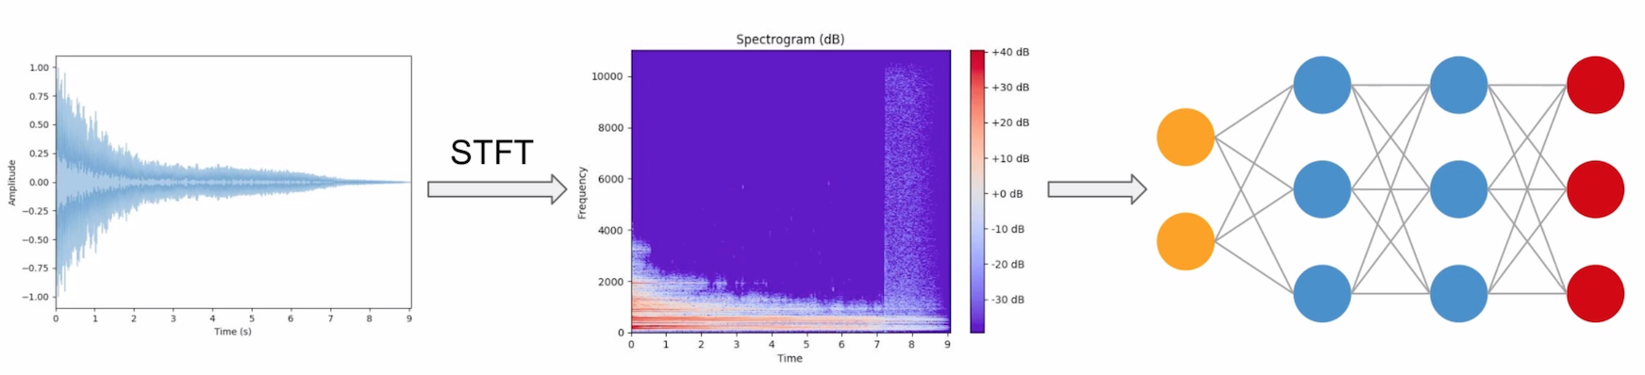
Why we chose CNN?

Slide 5
Preprocessing Data
For each audio file
Create 10 segments (there are overlaps between each segment)
For each segment
Label their genre
Extract 13 MFCCs
Store only MFCC for segment if it has expected number of vectors
X.shape = (10000, 130, 13) Y.shape = (10000,)

Slide 6
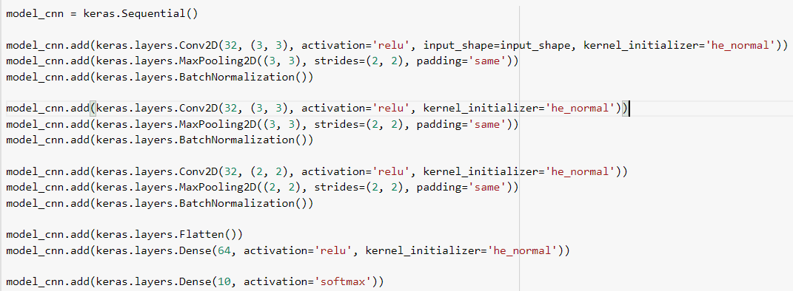
Model Structures
Hidden Layers: ReLU, he_normal
Output Layer: Softmax

Slide 7
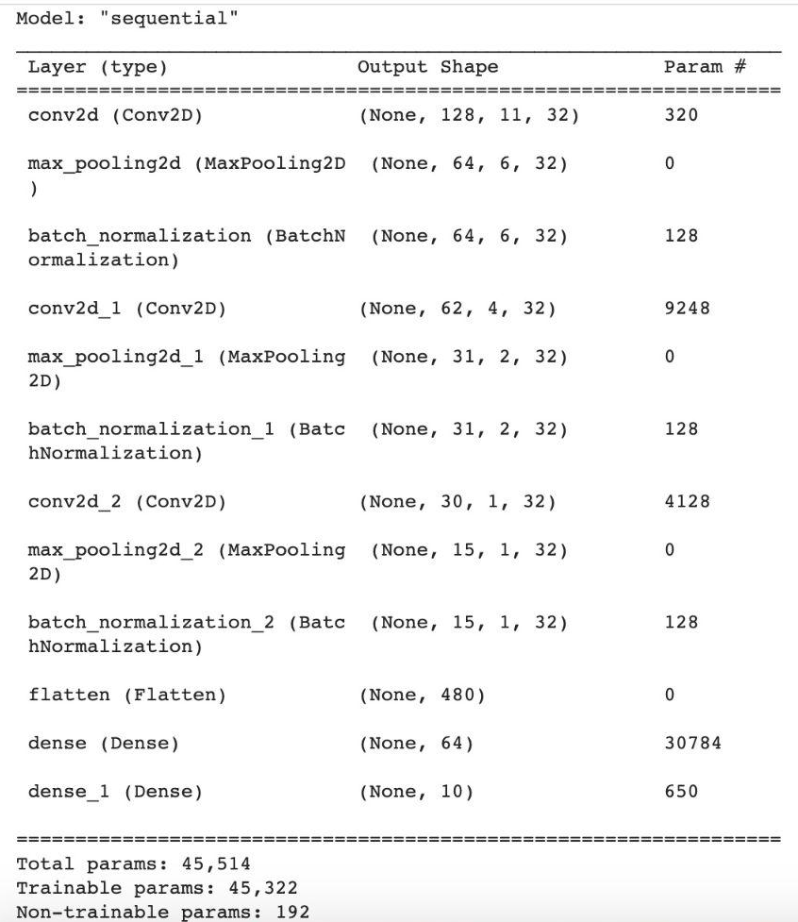
Model Structures

Slide 8
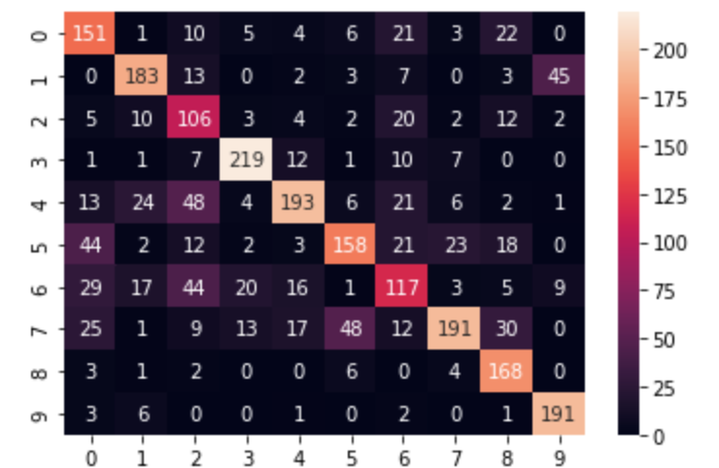
Results
Accuracy for the test data: 0.66

Slide 9
Acknowledgement
Youtube channel-Valerio Velardo - The Sound of AI: https://www.youtube.com/channel/UCZPFjMe1uRSirmSpznqvJfQ
Why we choose ReLU for hidden layers: https://machinelearningmastery.com/choose-an-activation-function-for-deep-learning/
Why use he_normal for ReLU: https://machinelearningmastery.com/weight-initialization-for-deep-learning-neural-networks/

